Slide 1
Engineering Health: Introduction to Yoga and Physiology
Rakshit Singh Tomar-12013985 | CDP (GEN231)

Slide 2
1.
OVERVIEW
A brief overview of what yoga and physiology is

Slide 3
Yoga can be defined as psycho-somatic-spiritual discipline.
While physiology is the study about functioning of human body systems.
Yoga + Physiology:
This deals with the effects of yoga
on physiological level concerning
with major human body systems.

Slide 4
2. Yoga and Its Physiological Effects
In this section, I’ll be discussing about the physiological effects of yoga on major human body systems

Slide 5
2.1
CELLULAR HOMEOSTASIS
Improves cell signaling
Contributes to cell development
Healthy cell production
Reduces oxidative cell stress
Hence, aids in cell-homeostasis.

Slide 6
2.2
THE NERVOUS SYSTEM
Improves neuroplasticity
Improves cognitive abilities
Calms the sympathetic nervous system
Activates the parasympathetic nervous system
Boosts levels of feel-good neurotransmitters like dopamine and serotonin

Slide 7
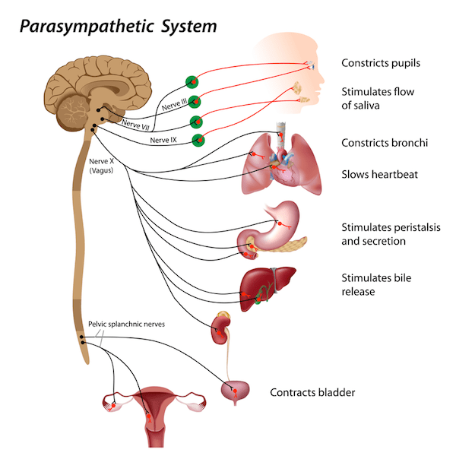
The vagus nerve and the activation of parasympathetic nerve system

Slide 8
2.3
THE RESPIRATORY AND CARDIOVASCULAR SYSTEMS
Nadi Shodhana (Alternate Nostril Breathing) can improve oxygen intake
It also increases lung capacity
It can help in management of asthma
Improves blood circulation
Helps in management of hypertension and other cardiovascular diseases

Slide 9
Insights from Research Paper
Study conducted by Kumar et al. (2020)
On a group of 60 subjects aged between 20-40 years divided in two groups
It showed that can aid in better resting heart rate and improved blood pressure

Slide 10
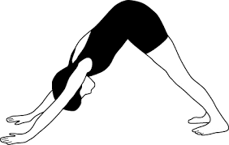
2.4
THE LYMPHATIC AND IMMUNE SYSTEMS
Depiction of Adho Mukha Svanasana (Downaward Facing Dog)
Adho Mukha Svanasana (Downward Facing Dog) can improve flow and lymph drainage
Yoga can boost immunity by reducing stress as stress can compromise the immune system

Slide 11
2.5
THE MUSCULOSKELETAL SYSTEM
It improves musculoskeletal strength and coordination.
Improves body posture and flexibilty
It releases muscle tension and also lubricates joints
Helps in management of conditions like osteoporosis

Slide 12
2.6
THE RENAL AND DIGESTIVE SYSTEMS
It helps in maintaining blood pressure optimized for the healthy functioning of the kidneys
Twisting and stretching involved in yoga can help in the activation of the digestive system
It boosts metabolism and overall functionality
Helps in management of lifestyle disorders like type II diabetes

Slide 13
Insights from Research Paper
Study conducted by Chimkode et al. (2015)
On 30 male patients aged between 36-55 with type II diabetes and 30 male non-diabetic volunteers both subjected to yoga practice for over six months
It showed that the blood-sugar levels of the diabetic group decreased significantly

Slide 14
2.7
THE ENDOCRINE AND REPRODUCTIVE SYSTEMS
Stimulates hormone production that plays a vital role
It stimulates glands of the endocrine system, which can regulate secretions
Helps balancing of cortisol levels
It strengthens core muscles around the reproductive organs and stimulates them thereby, improves their functionality

Slide 15
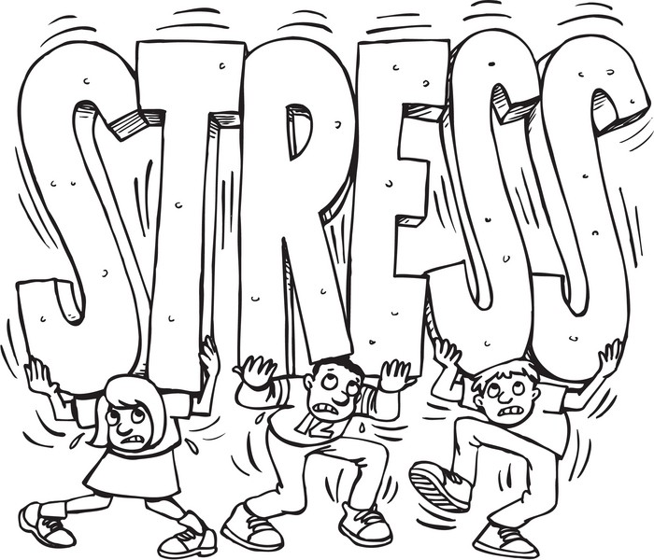
“
It’s not stress that kills us, it is
our reaction to it.
- Hans Selye, Endocrinologist
& founder of stress theory

Slide 16
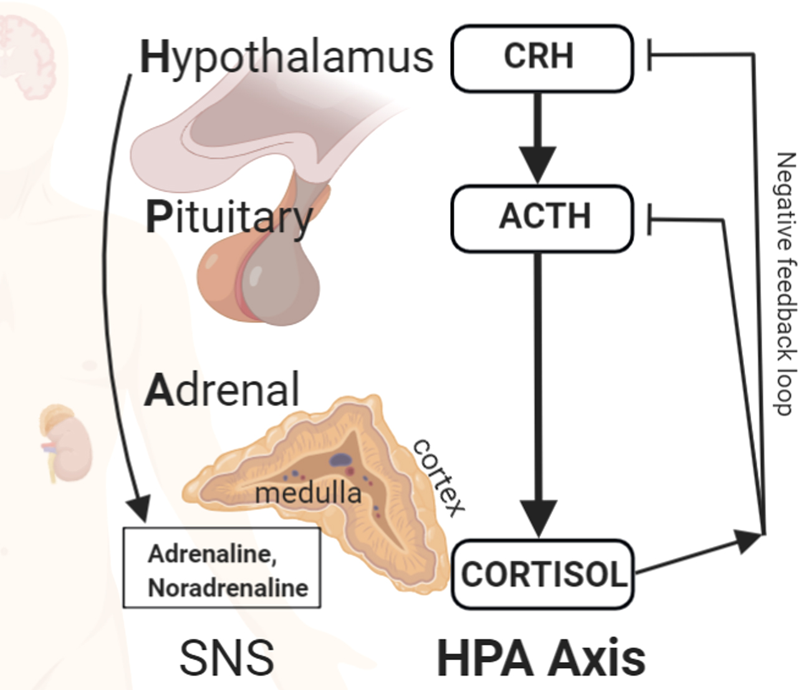
HPA Axis - Stress and Negative Feedback Loops

Slide 17
3.
MY EXPERIENCE WITH YOGA
In this section, I’ll be discussing the positive impact of yoga on me

Slide 18
I have incorporated yoga in my daily life. I start my day by practicing Surya Namaskar (Sun Salutations). It has almost been 5 months now.
Positive change
Weight loss
Stress Management

Slide 19
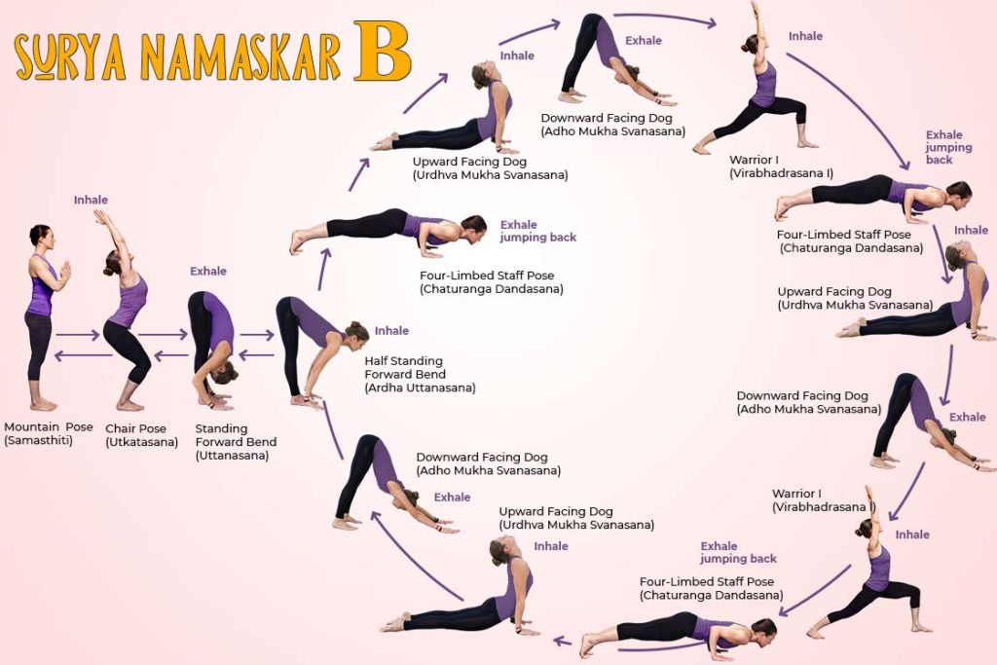
SURYA NAMASKAR
*Avoid in case of serious back and knee injuries.
*Preferably practice on an empty stomach.

Slide 20
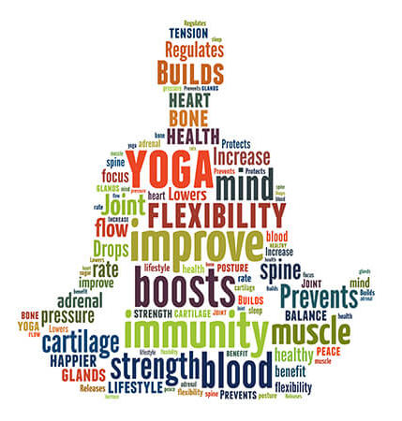
CONCLUSION
Dedicating a few minutes to yoga practice daily can have a positive impact on overall health and well-being. Yoga has innumerable benefits and can help in management of lifestyle induced disorders like obesity, hypertension, cardiovascular diseases, asthma, and diabetes.

Slide 21
The best way to understand Yoga is:
TRY IT OUT YOURSELF!

Slide 22
THANK YOU!

