Slide 1
Uber Ride Analysis
By Ryan, Fidel, and Caleb

Slide 2
INTRO
Data looks at Uber pickups in NYC from January - June 2015
How does weather factor into the number of pickups
Does the day of the week impact number of pickups?
Do Holidays impact the number of pickups?

Slide 3
PRECIPITATION AND PICKUPS
The data set gives 3 different measures of rain and tracked snowfall as well
Organized the data by each measurement
Totaled the pickups and days per each measurement
Found the average number of pickups per day per weather type

Slide 4
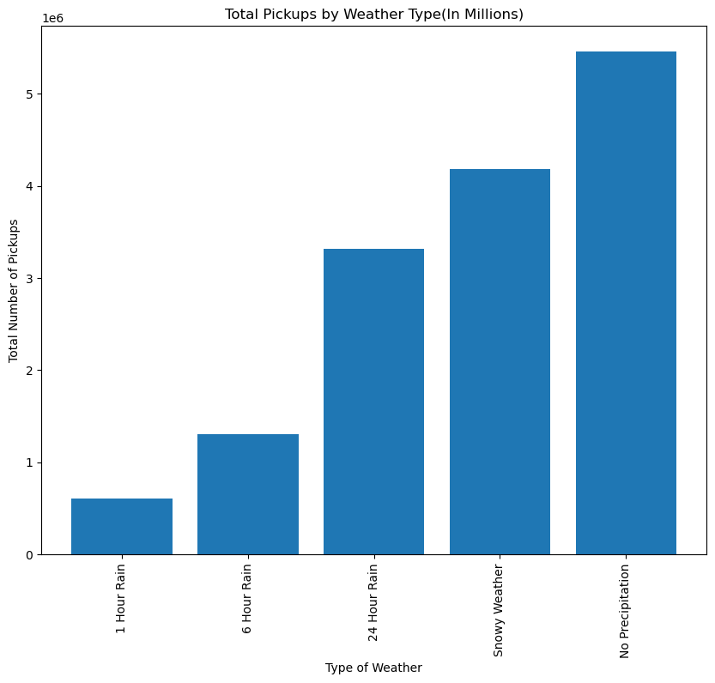
PRECIPITATION TOTAL PICKUPS

Slide 5
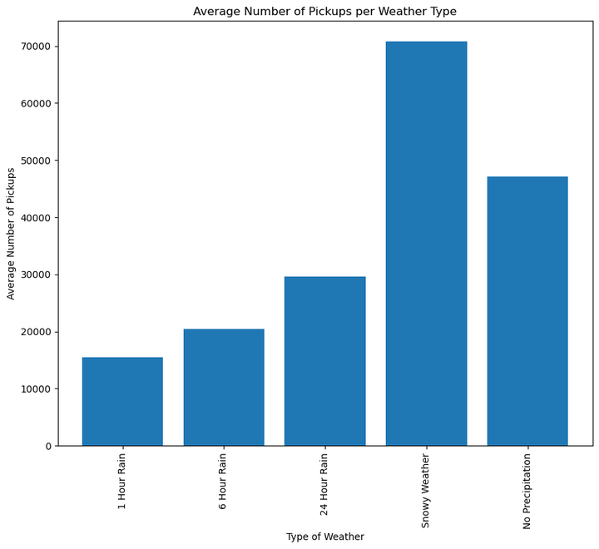

Slide 6
PRECIPITATION RESULTS
There was a steady increase in average number of pickups as days have more rain
Days with no precipitation still had a greater number of pickups than days with
Snowy days had the greatest number of pickups

Slide 7
ADDITIONAL QUESTIONS
Those results lead to additional questions such as :
What factors lead to an increase in pickups on days that have no precipitation vs precipitation?
Are riders taking more frequent, shorter rides during times of inclement weather?
Do wind speed and the temperature play more of a role rather than the actual precipitation?
Does the day of week impact these numbers?
The days of bad weather could be on days that have less pickups normally

Slide 8
Daily Pickups and Average Wind Speed
- While looking at the dataset we wanted to know if there would be more pickups on days with a higher average wind speed.
- Organized the dataset into 3 columns and aggregated the hourly data into daily for easier analysis.
- Took the daily average wind speed for each day and created a scatter plot to show any correlation.

Slide 9
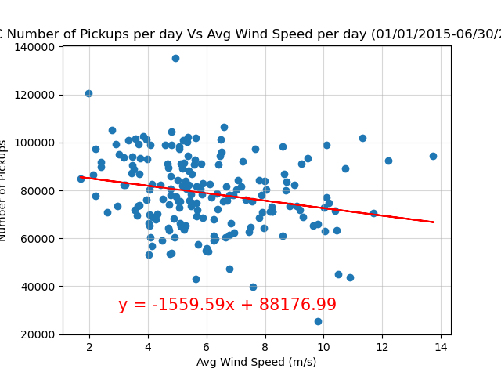
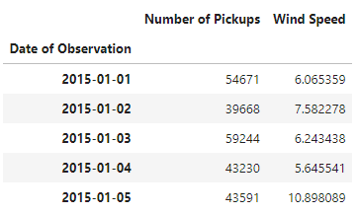
Example of Dataset

Slide 10
Average Wind Speed Results & Questions
- With an r-value of -0.2257… showing a weak correlation between average wind speed and the number of daily pickups.
- With this dataset, you can conclude that there is no strong correlation between wind speed and the number of pickups.
- It could also be that data set only covers 6 months and there can be other stronger variables leading to the number of pickups.

Slide 11
Limits to our Dataset: Feels like Temperature
- While looking at our original dataset, we noticed there were not enough factors to determine the relative temperature, or what temperature the riders would be experiencing that could push them to call an Uber.
- We decided to pull an API for Virtual Crossing to look at a more expansive weather dataset in New York City covering the same time period, 01/01/2015-06/30/2015.
- By merging the two datasets by focusing on the number of pickups each day, and the feels like temperature each day we are able to then analyze the data.

Slide 12
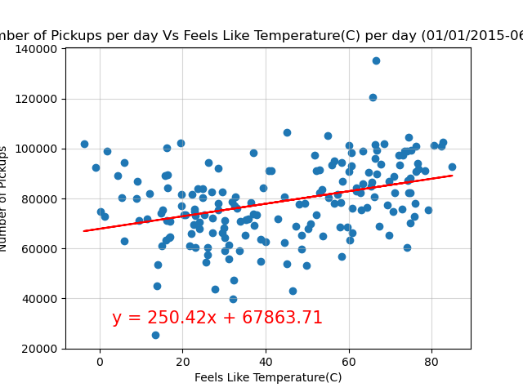
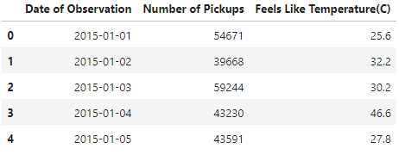
Example of Dataset

Slide 13
Feels Like Temperature Results & Questions
- The r-value this time is 0.3642… which is weak positive correlation between the Feels Like Temperature and the Number of Pickups.
- Looking at the scatter plot there are a handful of outliers, especially with the cold temperatures. To look into that data more and get a better understanding we should do a statistical test.
- A dataset comparing cold days and precipitation could help us to better understand those outliers as well.

Slide 14
Number of Pickups per Borough
- We also wanted to look at just the boroughs themselves and see their popularity and frequency of pickups.
- For this we created a bar chart with the total number of pickups for each borough over the time span.

Slide 15
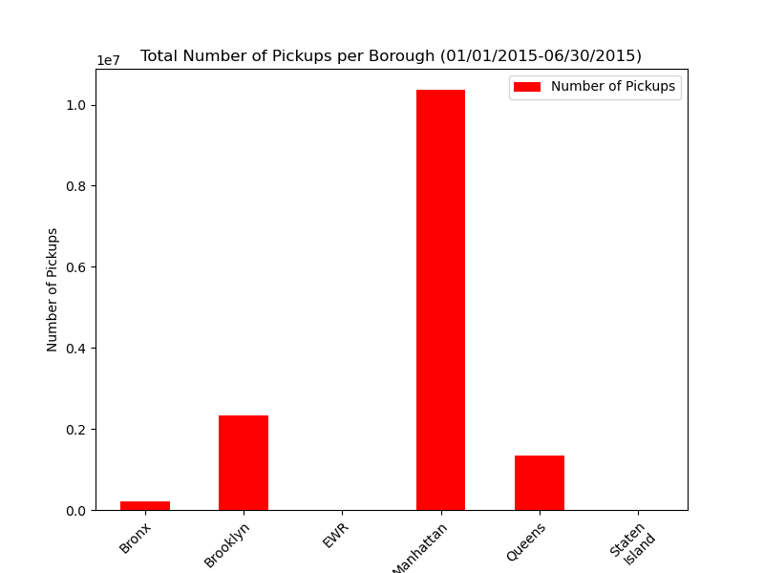
Pickups by Borough
Bronx: 220,047
Brooklyn: 2,321,035
EWR(Newark Airport): 105
Manhattan: 10,367,841
Queens: 1,343,528
Staten Island: 6,957

Slide 16
Pickups by Borough Results & Questions
Manhattan had an overwhelming 7 million more pickups than the next highest borough of Brooklyn.
It was not surprising to see that the 3 majors boroughs of NYC were where the highest number of pickups occurred.
Using this data, we can look at which locations we could charge surge pricing for pickups.

Slide 17
Day of the week effect on pickups
While looking at the dataset we wanted to look at if the day of the week effects the number of pickups
We organized the data set and used the timestamp to create a new column to show the day of the week
The data was then broken down and filtered to create groups by day.
An Anova test was ran to view if there was any significance

Slide 18
Takeaways and results
After running the Anova test the P-value returned 1.880511996714594e-14
This indicated that there was a significance between the days of the week and total pickups.
We also graphed the total pickups per day and the average pickups per day to see if there would be a difference in mean vs total
What we found that there was no difference and Saturday has the highest amount of pickups and Monday has the lowest

Slide 19
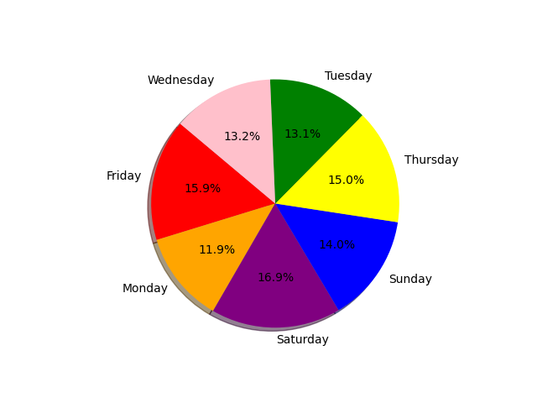
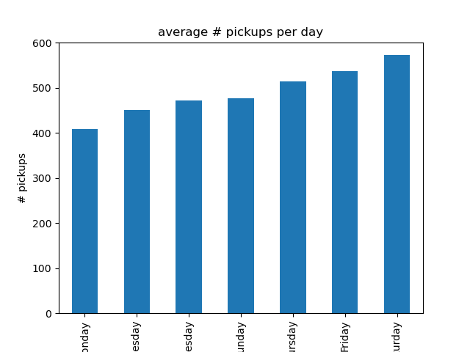
Visuals
Total Pickups Average pickups

Slide 20
Weekday vs Weekend
Another aspect we were curious was if weekday vs weekend matters on the pickups
The data was organized and used the pickup timestamp to create a new column displaying the day and then created a filter to display either “weekday or weekend” .
We ran another Anova test to see if there is any significance

Slide 21
Testing and results
The results from the Anova showed there was a great significance with the pvalue=0.00018175457982768056.
With the pvalue being low we believe that this would benefit further research.
We also wanted to view the difference between the total and average for differences.
We found that the weekend has higher pickups but the weekday has a higher total. Which was expected.

Slide 22
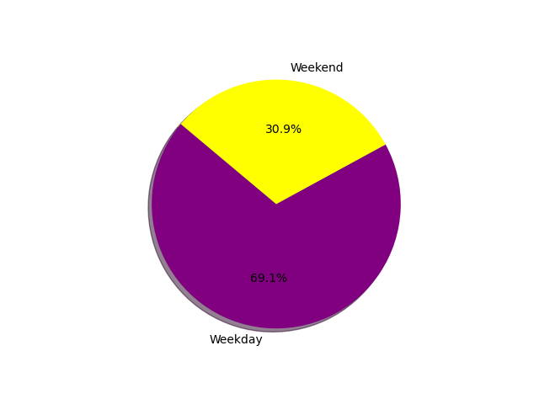
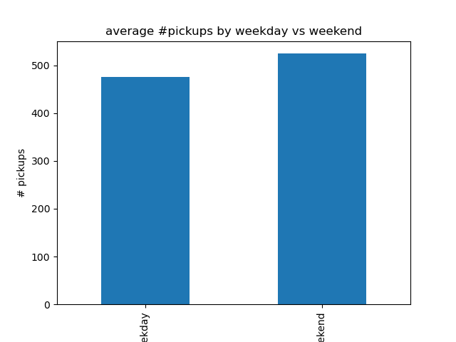
Visuals
Total Average

Slide 23
The holiday effect
While going through the data we wanted to see the effect of the holiday on pickups
The data was parsed to show pickups and holiday and then grouping them by either holiday vs non holiday
The data was then graphed to show the averages to compare them and the total pickups.

Slide 24
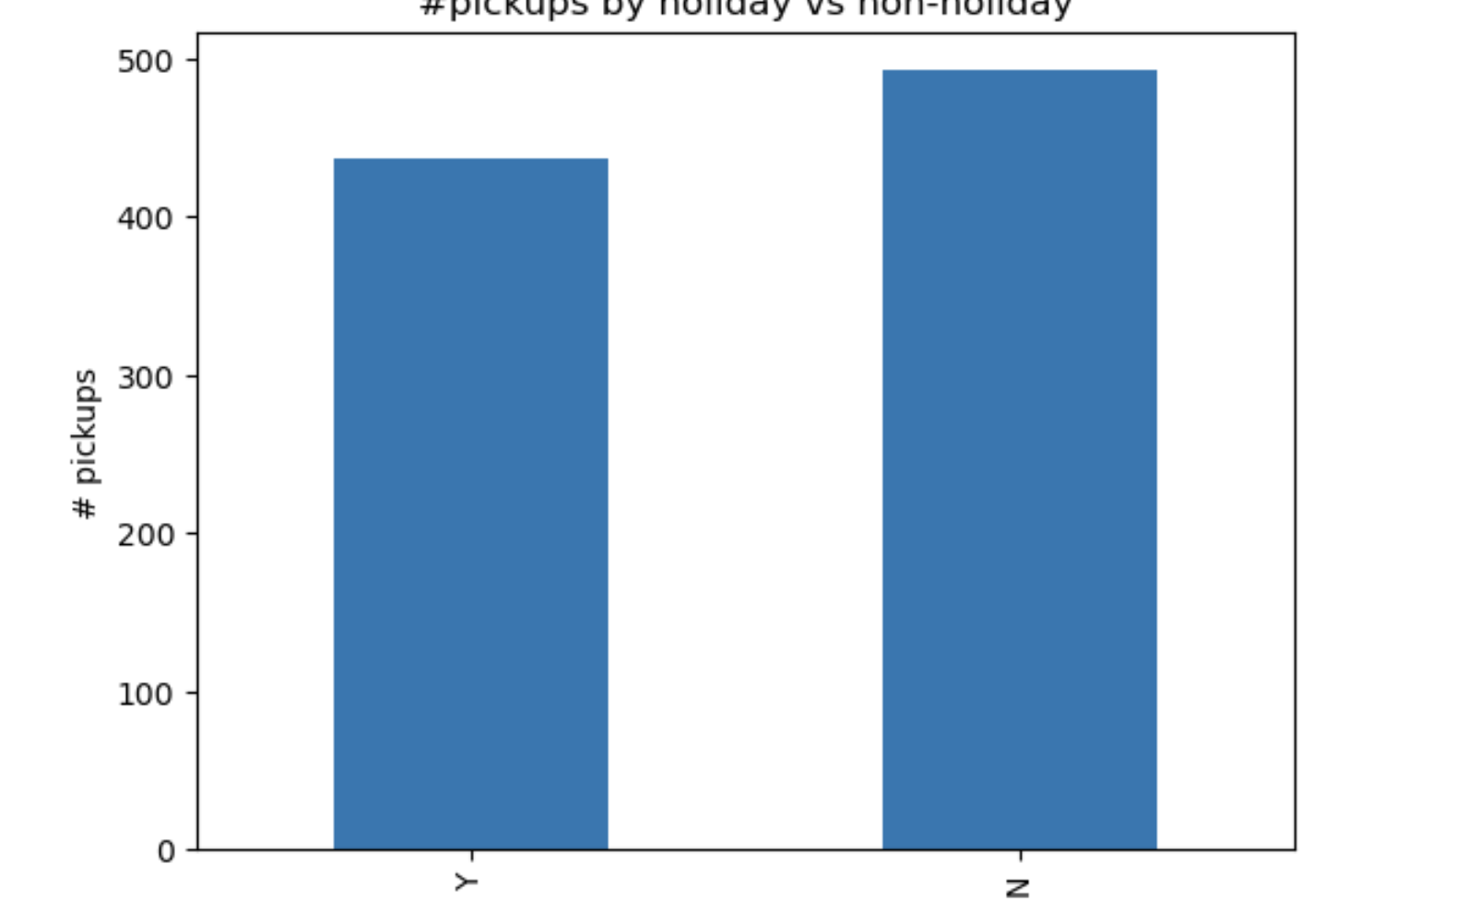
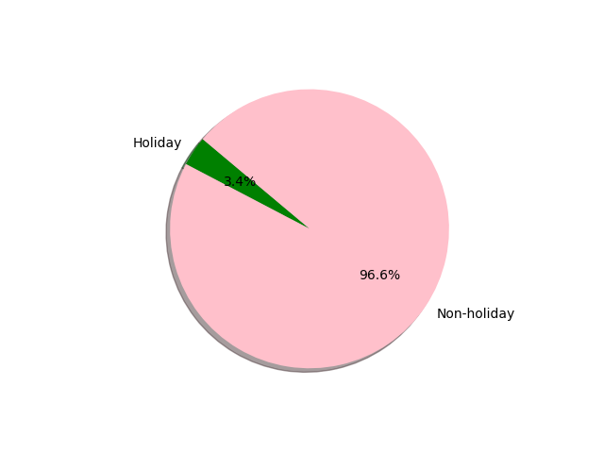
Visuals
Average Total

Slide 25
Limits to dataset
Not enough holidays in the beginning of the year
There is only 6 months worth of data so unable to see the accuracy of the data

