Slide 1
DSM: A Case for Hardware-Assisted Merging of DRAM Rows with Same Content
Seyed Armin Vakil Ghahani
Mahmut Taylan Kandemir
Jagadish B. Kotra
ACM SIGMETRICS’20
Notes:
Hello everyone,
I am Armin Vakil from Penn State University and in this video I am going to present our paper in SIGMETRICS 2020, DSM: a case for hardware-assisted merging of DRAM rows with the same content.

Slide 2
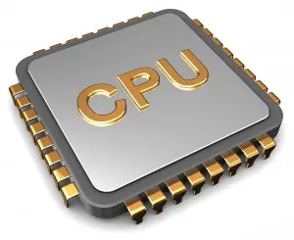
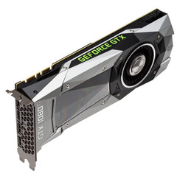
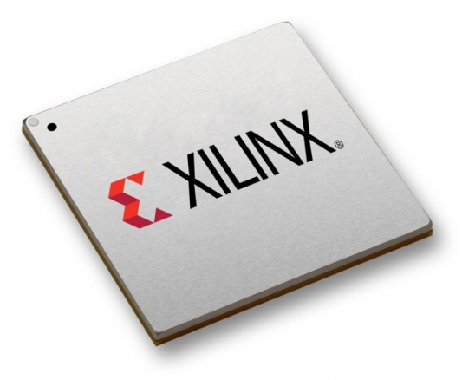

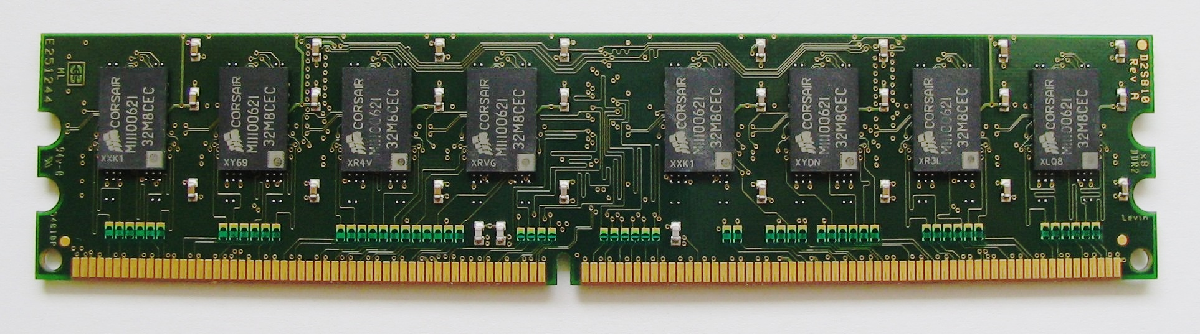
Cloud Servers
Notes:
Cloud servers architecture today consist of several computing elements such as CPUs, GPUs, FPGAs and TPUs which all operate on memory. Consequently, the demand for DRAM memory has increased to keep up with the need of these computing elements. However, DRAM memory capacity do not scale with the same pace as these computing elements are scaling and DRAM scaling introduces both power and performance issues that are now more important than anytime.

Slide 3
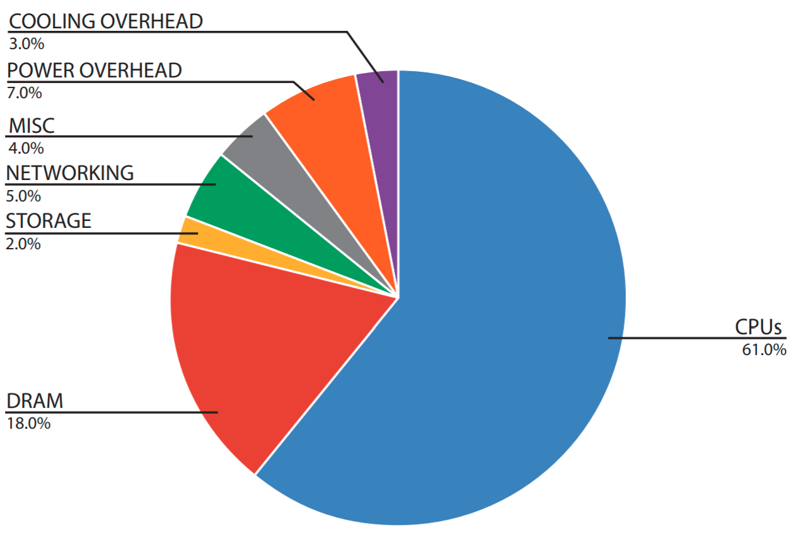
Datacenter Power Usage Distribution
7-50% in 4-64Gb
Refresh
[1] Luiz André Barroso, Urs Hölzle, and Parthasarathy Ranganathan. 2018.
The Datacenter as a Computer: Designing Warehouse-Scale Machines, Third Edition
Notes:
To elaborate on the importance of this problem, lets look at how DRAM contributes to the total power usage in datacenters. This figure shows that DRAM memory accounts for roughly 20% of consumed power in datacenters. And one of the main contributing factors in this energy consumption is memory refresh. Our evaluation shows that memory refresh energy consumption accounts for about 7 to 50% of the consumed energy in 4GB to 64GB DRAM memories. So an impoertant question is how can we reduce this overhead?

Slide 4
Cloud Applications
Host virtualized systems
Uses similar or identical kernel, libraries, etc.
How to leverage this opportunity to reduce the memory refresh overhead?
Notes:
And for answering this, let’s look at the environment that we are targeting and kind of applications that execute on these systems.
Usually cloud servers host multiple virtual machines to service multiple users at the same time. These virtual machines typically use similar or even identical kernels and libraries. In this work, we are going to answer the question of how can we leverage this opportunity to reduce the memory refresh overhead.

Slide 5
Contributions
DSM: Hardware extension to detect rows with same content in memory and refresh only one of them
Skipping 47.1% of memory refresh commands
8.5% memory energy saving
8.2% improvement of 99th percentile latency
Notes:
In this work, we have the following contributions. First, we propose DSM, a lightweight hardware-extension that detect different rows in DRAM that have the same content and refresh only one of them.
And by this, DSM can skip 47% of memory refresh commands and reduce the memory energy consumption by 8.5%.
Also, with reducing the time in which DRAM is refreshing the memory and not servicing the memory requests, DSM improves the 99th percentile latency by 8.2%.

Slide 6
Outline
Background
Motivation
DSM
Evaluation
Conclusion
Notes:
In the rest of this talk, I first go over some background on DRAM and Cloud systems and then provide some motivational results that shows the opportunity that DSM can leverage. Then, I will talk about the design of DSM and some evaluation results and finally, I will conclude my talk.

Slide 7
Increasing memory size
More Frequent Refreshes
Longer Refresh Time
DIMM
Row Decoder
Bank
Bank
Rank-0
Rank-1
Row Buffer
Notes:
DRAM chips are composed of multiple ranks and each rank has multiple banks. Each of these banks, then, has multiple rows and each bit in memory is stored with one transistor and capacitor that is shown by a circle in this figure. These capacitors are volatile and lose their charge over time and need to be refreshed every 64ms.
DRAM vendors for increasing the size of memory in their newer technologies, first, reduce the size of each cell that means each capacitor can store lower amount of charge and lose their data faster that means memory cells should be refreshed more frequently.
Second, for increasing the size of memory, DRAM vendors increase the number of rows in each bank that means during refreshing a bank, higher number of rows should be refreshed that results into longer refresh time and unavailability. That adversely affect both energy consumption and performance of the system.

Slide 8
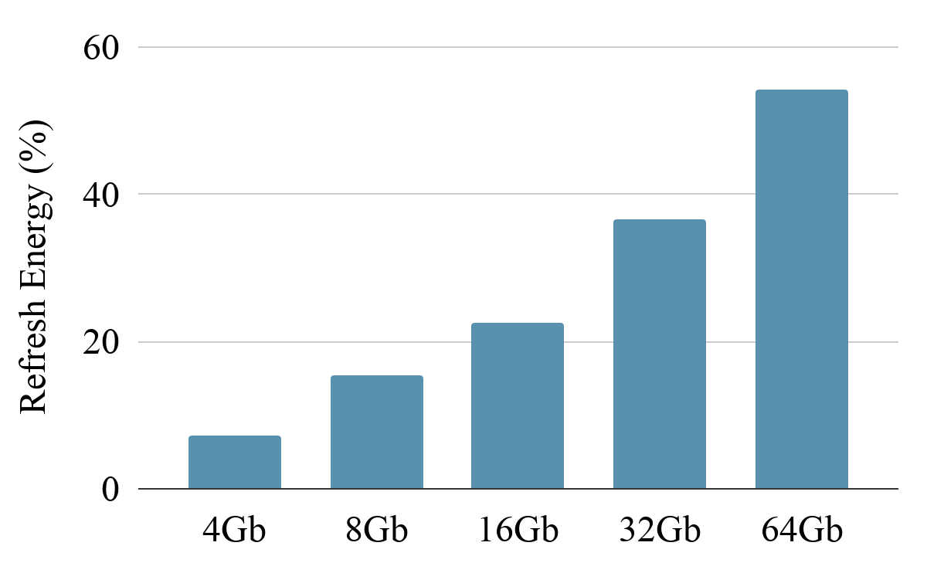
Memory Refresh Overhead - Energy
Notes:
We first look at the energy overheads of memory refresh.
If we follow the trend of memory refresh energy consumption for different DRAM device capacities, the wasted energy that should be consumed because of DRAM refresh that don’t result to any computation increases by the size of memory and it can be up to 54% in 64GB DRAM memories.

Slide 9
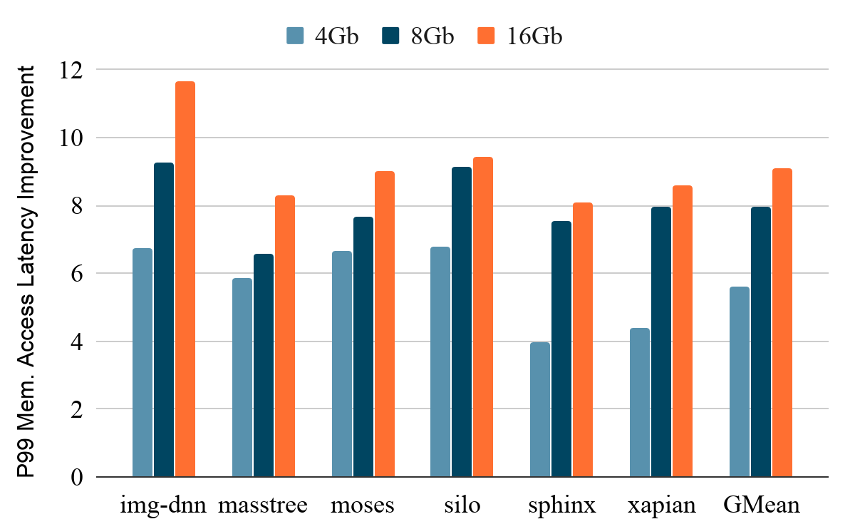
Memory Refresh Overhead - Latency
Notes:
We secondly look at the implication of memory refresh on the performance. Memory refresh can result into hiccups in memory access latency as certain sections of DRAM (whether one-bank or all-banks, based on the refreshing policy) are not accessible during refresh. In this experiment, we show that removing all memory refresh overhead can improve the 99th percentile memory access latency by 6-9x.

Slide 10



Cloud Systems
Apps
Apps
Apps
Libs
Libs
Libs
OS
OS
OS
Hypervisor
Hardware
Notes:
By closely looking at the cloud systems hardware-software stack, we have the hardware on the bottom of the stack. Then, a hypervisor or host operating system is responsible for sharing this hardware between multiple virtual machines, and each of these virtual machines have their own operating system that has different libraries and on top of these libraries, the applications are running.
Then hypervisors consolidate multiple virtual machine instances on top of this hardware to increase the utilization. Different virtual machines usually use same or even identical operating systems such as different kernels of Linux. Moreover, all of them uses identical libraries such as C++ or Python. And finally, these applications may use similar frameworks such as tensorflow.
This type of consolidation results into having same value rows in memory.

Slide 11
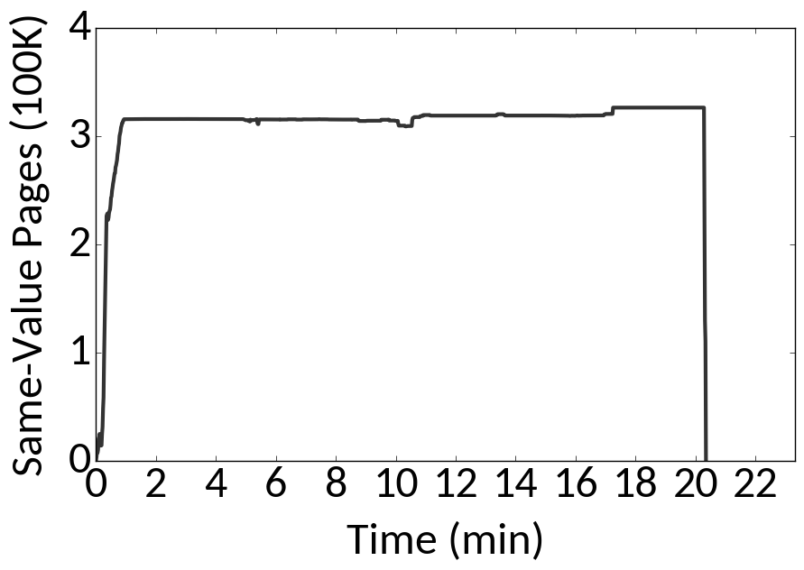
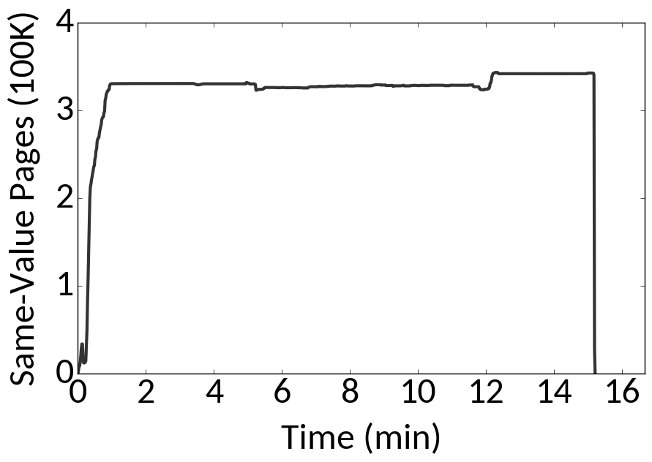
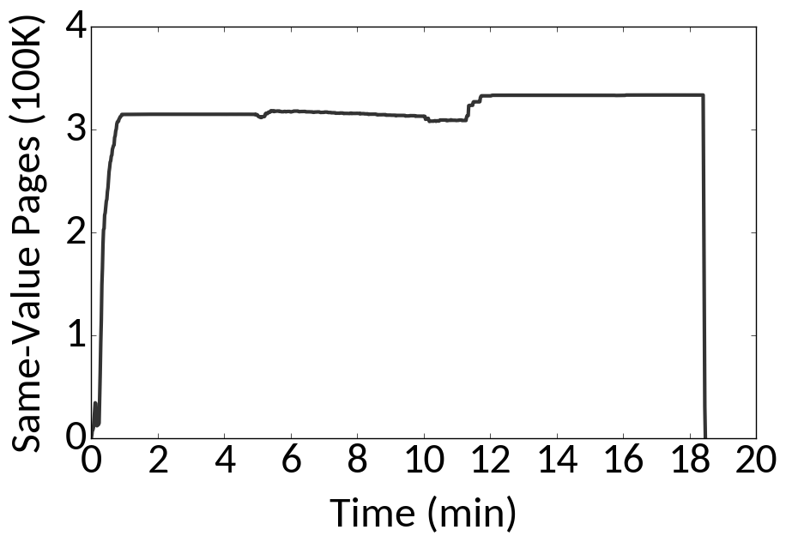
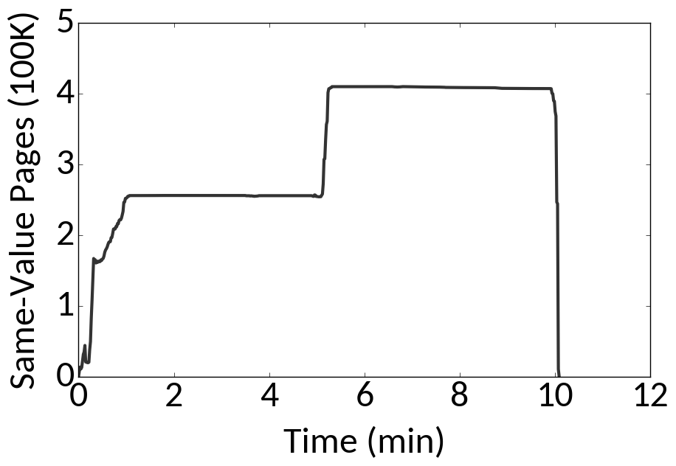
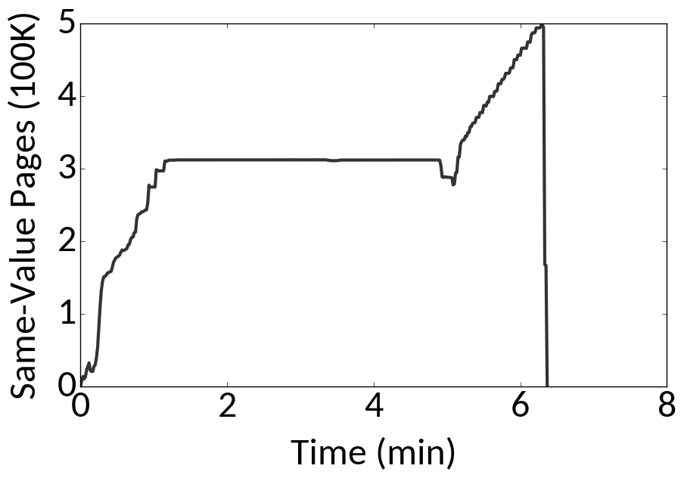
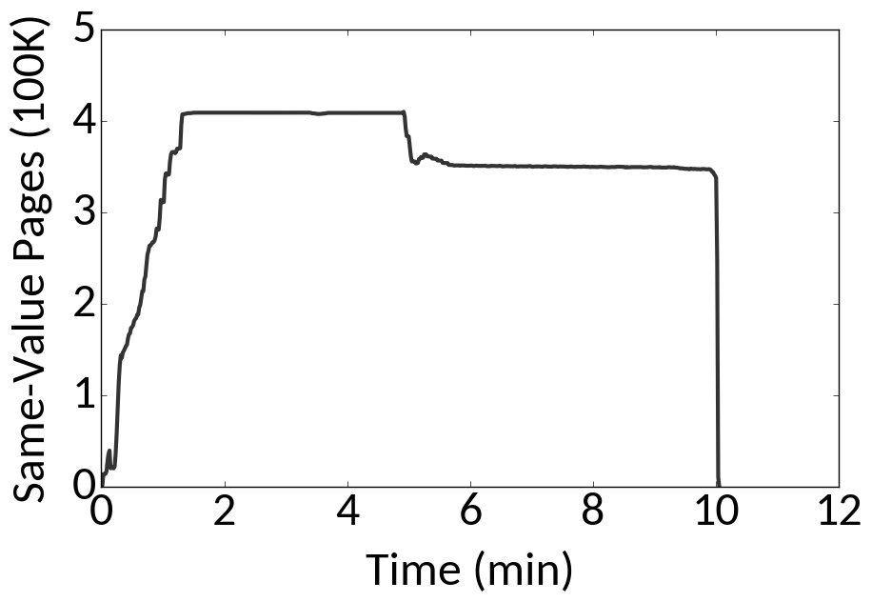
Same-Content Opportunity
Mix 1
Mix 2
Mix 3
Bootup
Apps
img-dnn
masstree
silo
Notes:
To illustrate the amount of memory that is same in these virtualized systems, we ran four virtual machines on a real system with 16GB memory and let KSM that is a kernel module for merging same pages in the operating system, to merge as many pages as it can for 5 minutes and as it is shown even before running the applications there is 300K pages that have the same value. And this number can increase by another 100K pages during the runtime of applications in some cases.

Slide 12


Challenges
Goal: Refresh Representative instead of all rows
Representative
A
A
A
A
B
A
A
How to keep the integrity of data?
How to service read/write memory accesses?
Notes:
Now lets look at how we can leverage this opportunity to reduce the memory refresh overhead and what are the challenges. Assume we have 4 rows in memory that 3 of them have the same value A. Since these rows have the same value, the goal is to merge these rows into one representative row and only refresh this row and skip refreshing other ones.
Now the question is how we should keep the integrity of data as the read requests to memory should return the correct data and also write requests to a row should only change the written row and not affect other rows that are merged with this row prior to write.

Slide 13
DSM
Exploit same-content opportunity for reducing overhead of memory refresh
Design Goals
Track rows with the same content and refresh only one
Keep mapping information
Redirect memory accesses if required
Notes:
To exploit the same-content opportunity for reducing the overhead of memory refresh, we propose DSM. The main design goals for designing DSM are (1) tracking rows with the same content and refresh only one of them. (2) Keeping the mapping information of all DRAM rows and (3) redirect the memory accesses if the accessing rows are mapped to another row.

Slide 14
Mapping Information
Row 0
Is it mapped to a representative?
Row 1
Which representative?
PFN
...
Is the content of the row zero?
Row N-2
Row N-1
Mapping Table
Notes:
One of the important informations that we have to keep track of is the mapping status of each row in memory.
For each row in our design, we should know whether it is mapped to a representative row? If yes, which representative row. In addition to this, we store the information that whether a row is zero or not and if it is zero, we can just send the data without even accessing DRAM.

Slide 15
Representative Row
A
A
A
B
A
Write to
Need the reverse of Mapping Table
Notes:
However, simply Mapping any row to any representative row can have high overheads. Lets look at this example again that three rows have the same value and two of them are mapped to the representative row. Upon a write request to this representative row, we should know which rows are mapped to it and copy the value of A to them so the rows that are not refreshed don’t lose their data. To collect this information, we will need the reverse of mapping table that has high overhead for both keeping and maintaining.

Slide 16
Representative Row in Practice: R-Rows
Bank
Row Decoder
R-Rows
2K ≈ 3%
Row Buffer
Notes:
Instead, we reserve 2K rows or 3% of rows in each bank in memory that are not accessible by OS and DSM uses them as representative rows and we call them R-Rows. Since these rows are not accessible by OS, there will not be any write to these rows and DSM does not require the reverse of mapping table.

Slide 17
Mapping Table Entry Content
Bank
R-Row index
PFN
R-Row index
Row Decoder
Mapping Table
...
R-Rows
R-Row index
R-Row index
Row Buffer
Notes:
Consequently, each Mapping Table entry only requires the index of the R-Row that the corresponding row is mapped to, in case of a merge. We put this mapping table inside memory and cache it inside memory controller. This table also stores whether a row is zero or not.

Slide 18
Counter/Checksum Value
Bank
Cnt CV
Counter/
Checksum
R-Row Id
Cnt CV
Row Decoder
Mapping Table
...
R-Rows
Row Buffer
Notes:
Moreover, we store the checksum value of each R-Row as R-Rows are the best candidates for merging and DSM uses this checksum for checking the potential of same-value in different rows. DSM also has a counter for each R-Row that shows the number of rows that are mapped to it. This counter is necessary for replacement of R-Rows. And we cache both counter and checksum value of R-Rows inside memory controller. Please also note that these data structures are not shown to scale and they are roughly 3% of each bank and memory. For more details on this, please look at our paper.

Slide 19
DSM in action
Mapping Table Cache
Read Queue
Controller
Refresh Bitmap
Write Queue
R-Rows Counter/ Checksum Cache
Memory Controller
Notes:
Now, lets look how DSM works in action.

Slide 20
DSM in action - Read X
Mapping Table Cache
Read Queue
X/X’
X
X’
Lookup X
Change
Controller
Add X
Refresh Bitmap
Write Queue
R-Rows Counter/ Checksum Cache
Memory Controller
Notes:
Upon a read request to memory controller, we put this request in the read Q and lookup mapping table cache in parallel. If row X is mapped to another row, like X’, then we simply change the address in the read Q and redirect the memory request to the correct row. On the other hand, if X is not merged, no further action is required.

Slide 21
DSM in action - Write X
Mapping Table Cache
Read Queue
X’
Lookup X
RowClone X’->X
Controller
Add X
Refresh Bitmap
X
RC
X
Write Queue
R-Rows Counter/ Checksum Cache
Memory Controller
[2] Vivek Seshadri et al. 2013.
RowClone: fast and energy-efficient in-DRAM bulk data copy and initialization. MICRO-46
Notes:
Upon a write request to memory, we simultaneously put the request in the write Q and lookup mapping table cache. If the row is not mapped to any R-Row, there will not be any change. On the other hand, if the row is mapped to another row, like X’, we should copy the content of X’ to X and then issue the write request to X. For efficiently doing this copy operation, we use RowClone that simply copy one row to another inside DRAM.

Slide 22
DSM in action - Content Checking
Mapping Table Cache
Read Queue
Fetch One Row
Controller
Read Two Rows
Refresh Bitmap
Calculate and Compare Checksums
Remap if Same Content
Write Queue
R-Rows Counter/ Checksum Cache
Memory Controller
Notes:
For calculating whether different rows in memory have the same value with R-Rows or not, DSM periodically lookup different rows in memory and compare them with R-Rows. More specifically, DSM fetches one row from memory and computes its checksum and compare this calculated checksum with the checksum of R-Rows. Then, in case of a match, it will fetch both rows and check if their content really match or not and if they have equal content, it will update the mapping table cache and counter of the corresponding R-Row.

Slide 23
DSM in action - Refresh
Mapping Table Cache
Read Queue
Lookup
Controller
Refresh Bitmap
Write Queue
R-Rows Counter/ Checksum Cache
Memory Controller
Notes:
For refreshing banks in memory, as the refresh schedule of each bank is predictable, DSM will populate the refresh bitmap over time before the refresh interval of each bank by reading the mapping from either mapping table cache or mapping table in case of a miss. During refresh, DSM will perform the refresh operations based on this calculated refresh bitmap. Please see the paper for more details on this.

Slide 24
Methodology
Gem5 cycle-accurate simulator
4 VMs
Workloads
Tailbench Suite
SPEC2006
Evaluated Configurations
Baseline
DSM
No Refresh
Notes:
To evaluate DSM, we used gem5 simulator that is a cycle-accurate architectural simulator. We ran 4 VMs inside gem5 and on each of these virtual machines run a mix of benchmarks from tailbench suite and memory-intensive applications of SPEC2006.
To see the effectiveness of DSM, we compared it with Baseline that is refreshing all rows of each bank. Moreover, we compare DSM with No Refresh configuration that assumes DRAM cells do not need refreshing and is the ideal case.
For more details on the evaluation methodology of DSM, please look at our paper.

Slide 25
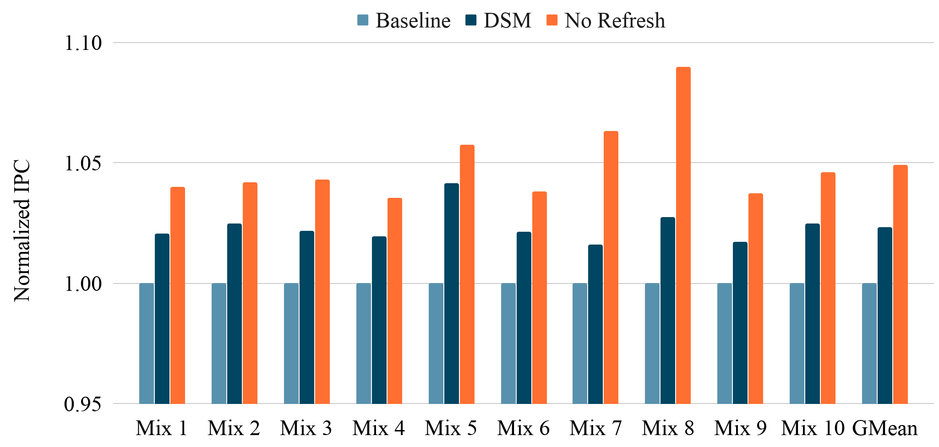
Performance Improvement
Better
4.2%
2.4%
Notes:
In this experiment, we evaluate the IPC improvement of DSM that shows by reducing the time in which a bank is not accessible because of memory refreshes, DSM can achieve up to 4.2% IPC improvement. It also improves IPC by 2.4%

Slide 26
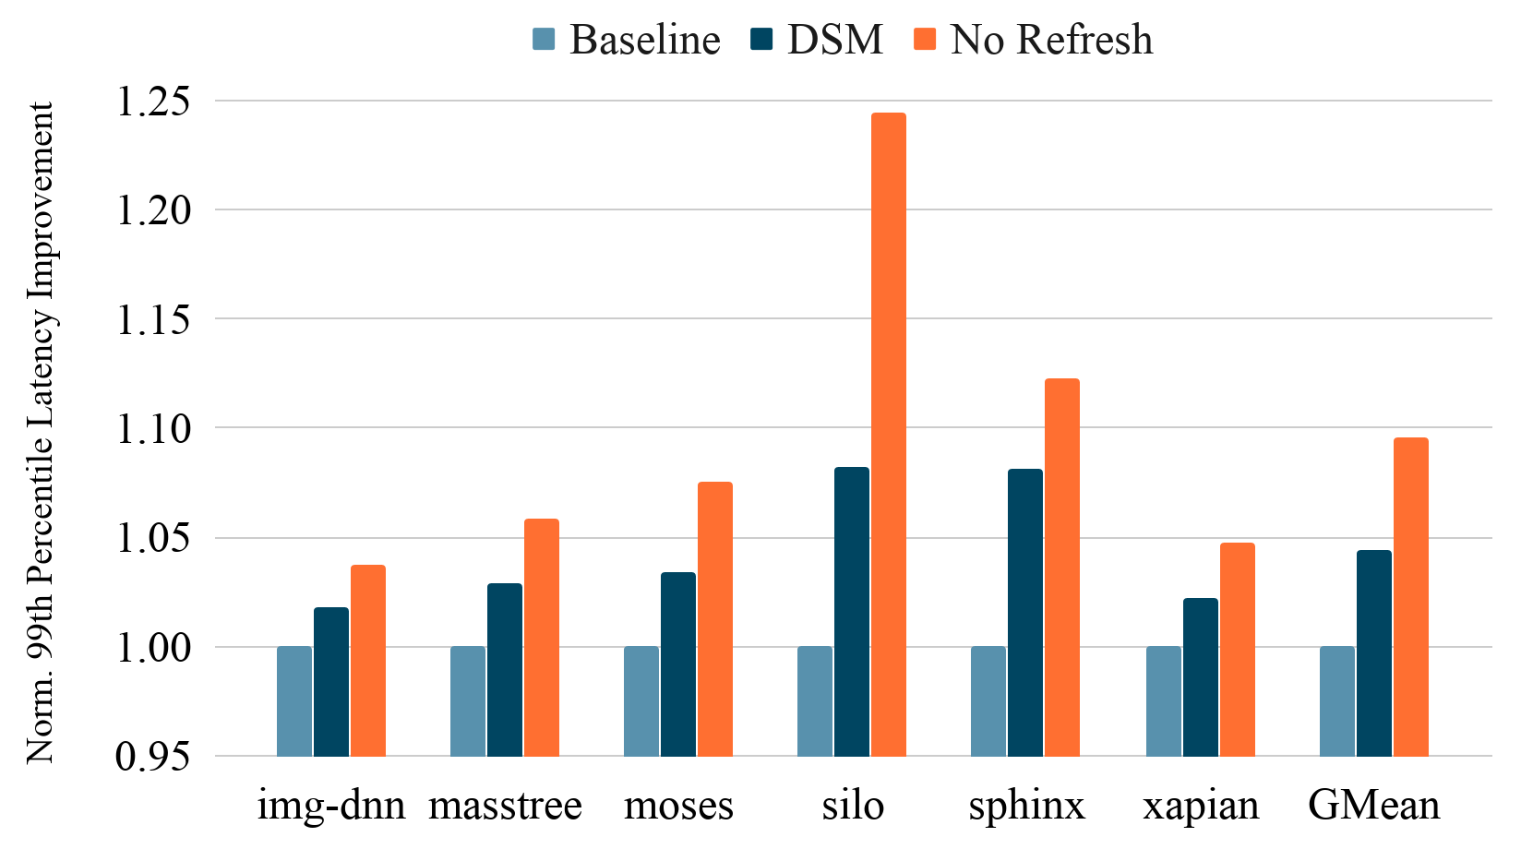
Tail Latency Improvement
Better
8.2%
4.4%
Notes:
We also estimated the impact of DSM on tail latency as it plays an important role in cloud servers total-cost-of-ownership.
DSM can improves the 99th percentile latency of tail-latency sensitive applications in Tailbench suite by up to 8.2%, and 4.4%, on average.

Slide 27
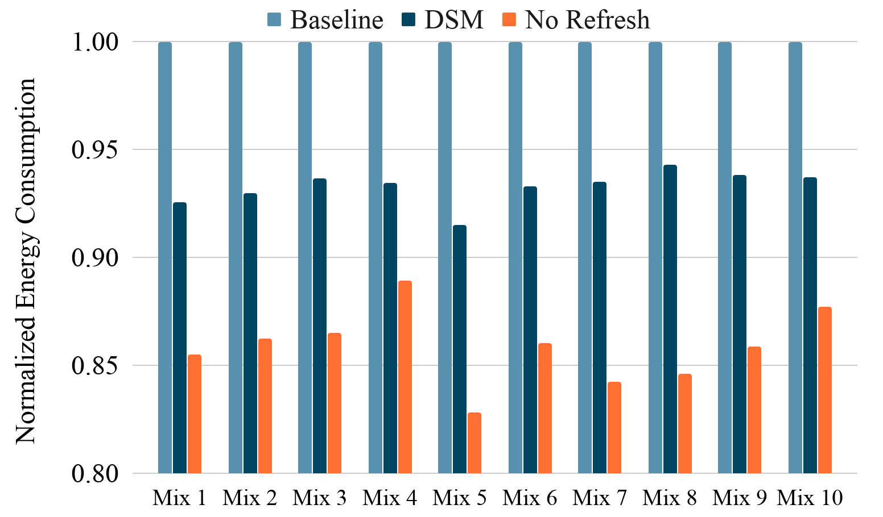
Energy Optimization
Better
6.7%
8.5%
Notes:
Finally, we evaluate the effectiveness of DSM on optimizing the energy consumption of memory. DSM reduces the memory energy consumption by up to 8.5% and 6.7% on average with skipping the unnecessary refresh commands in DRAM.

Slide 28
Conclusion
Address scaling problem of DRAM memory
Performance and Energy overheads
DSM: Hardware extension to detect rows with same content in memory and refresh only one of them
8.5% memory energy saving
8.2% improvement of 99th percentile latency
Notes:
To conclude my talk, in this paper, we addressed the scaling problem of DRAM memory and reducing the performance and energy overheads of DRAM refresh.
We proposed DSM: A Hardware extension to detect rows with same content in memory and refresh only one of them
We reduced the energy consumption of memory up to 8.5% and also improved the 99th percentile latency of tail-latency sensitive applications up to 8.2%.

Slide 29
Thank you!
Notes:
Thanks for joining my talk

