Slide 1
Nordic Test

Slide 2
目錄
Burn
GPIO
BT(RX/TX)

Slide 3
Burn
Step 1：安裝nRF Command Line Tools(參考1)
Step 2：安裝j-link
Step 3 ：nrfjprog -e(清除)
Step 4 ：nrfjprog -f NRF52(依據IC) --program <FW路徑/XXX.hex> --verify
Step 5 ：nrfjprog -r(重啟)

Slide 4
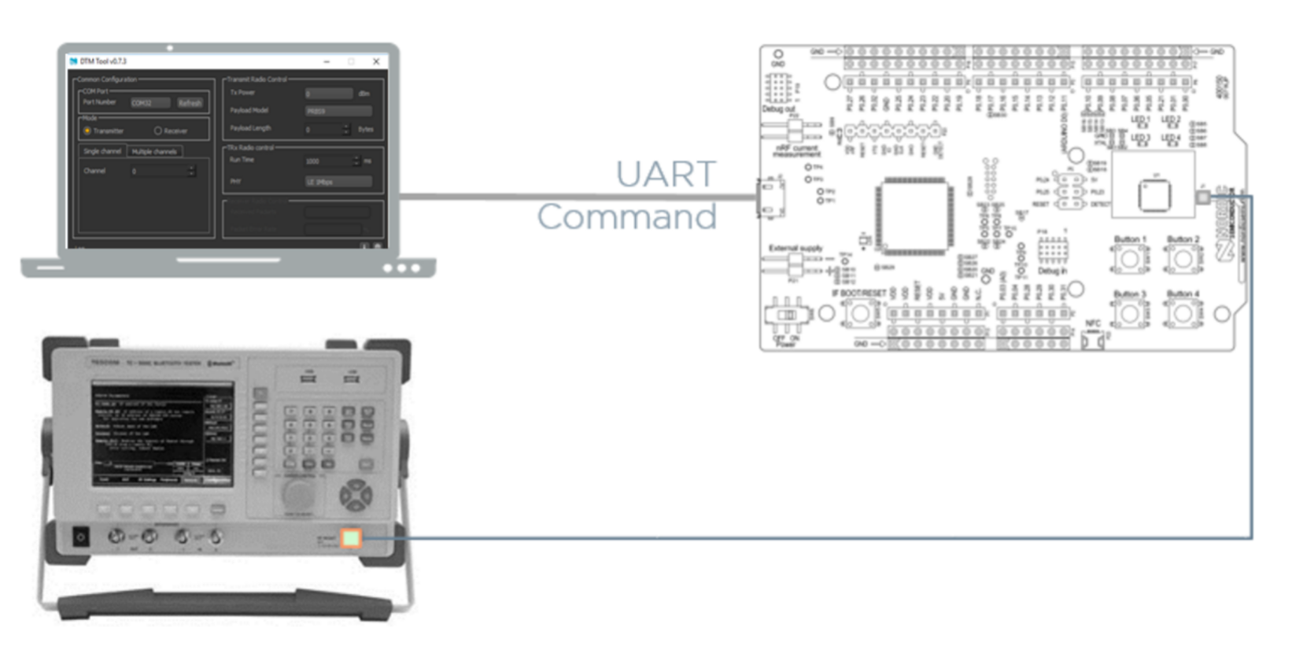

Slide 5
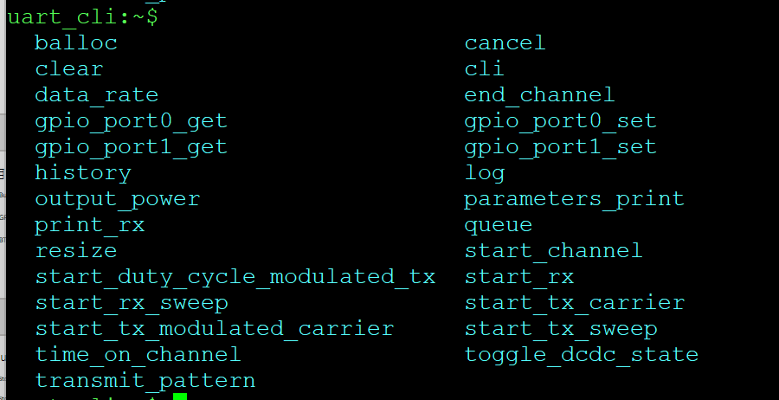
GPIO
Tab *2可看到 cmd

Slide 6
GPIO
 | P0.00 |  | P1.00 | O
 | P0.01 |  | P1.01 | O
 | P0.02 | O | P1.02 | O
 | P0.03 | O | P1.03 | O
 | P0.04 | O | P1.04 | O
 | P0.05 | O | P1.05 | O
 | P0.06 | O | P1.06 | O
 | P0.07 | O | P1.07 | O
 | P0.08 | 2.973V | P1.08 | O
 | P0.09 |  | P1.09 | O
 | P0.10 |  | P1.10 | O
 | P0.11 | O | P1.11 | O
 | P0.12 | O | P1.12 | O
LED | P0.13 | O | P1.13 | O
LED | P0.14 | O | P1.14 | O
LED | P0.15 | O | P1.15 | O
 | P0.16 | O | P1.16 | O
 | P0.17
 | P0.18 | O
 | P0.19
 | P0.20
 | P0.21
 | P0.22
 | P0.23
 | P0.24
 | P0.25
 | P0.26
 | P0.27
 | P0.28
 | P0.29
 | P0.30
 | P0.31
 | P0.32

Slide 7
BT(RX/TX)
FW： direct_test_mode_pca10056e.hex
Mod：DTM

Slide 8
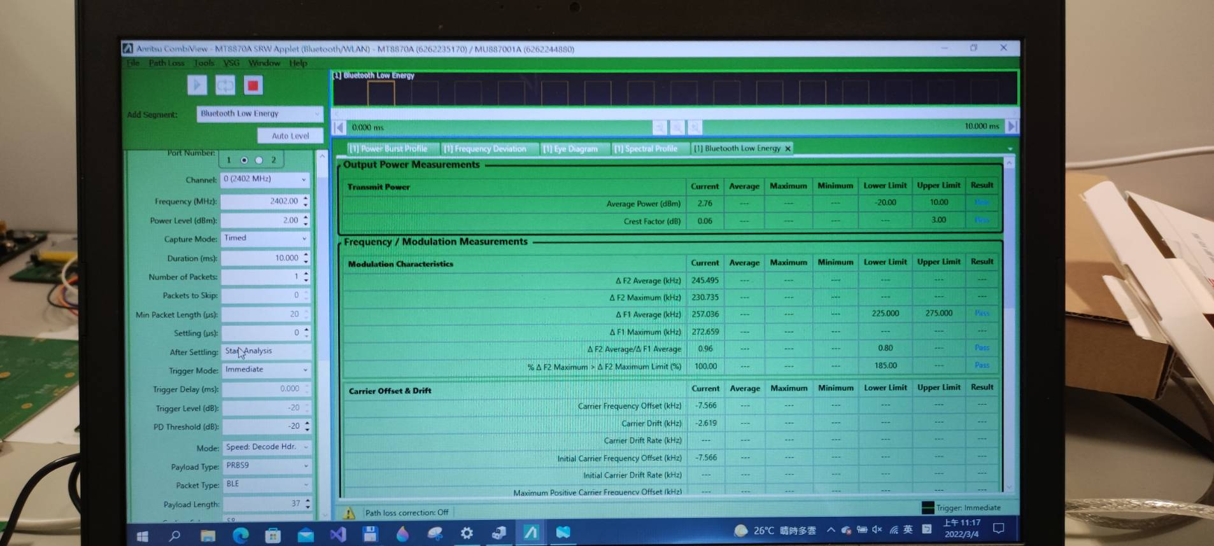

Slide 9
參考
https://www.nordicsemi.com/Products/Development-tools/nRF-Command-Line-Tools

