Slide 1
FARMO
Presented By:
Rabin Dangaura (21075077)
Raman Chaudhary (21075079)
Rohit Chaudhary (21075080)
Sushil Chaudhary (21075088)

Slide 2
Outline
Introduction
Aim and Scope
Objective
Methodology
Architectural Diagram
E-R Diagram
Use case Diagram
Data Flow Diagram
Cost Estimation
Project Time Schedule
Conclusion

Slide 3
1. Introduction
Agriculture is vital for developing countries like Nepal, but farmers often earn less due to middlemen, while customers struggle to get fresh produce at fair prices. Farmo is a mobile app designed to directly connect farmers and customers. It lets farmers list their crops and vegetables, and allows customers to compare prices and place orders, eliminating middlemen and ensuring better income for farmers and affordable produce for buyers.

Slide 4
2. Aim and scope
Aim: To build a digital platform that connects Nepali farmers and consumers directly, ensuring fair pricing and fresh agricultural products by removing middlemen.
Scope: Farmers can list and sell products; consumers can browse, order, and rate; admins oversee verification, transactions, and reporting.

Slide 5
3. Objective
To enable direct ordering between farmers and consumers.
To build a mobile marketplace ensuring transparent and fair agricultural transactions.
To provide efficient order tracking and communication.

Slide 6
PREVIOUS AND PROPOSED SYSTEM
Previous System:
Farmers sold their products through middlemen or local market often receive low price.
Website of business house to selling crops are only available in market that’s why we building direct interactive system between Farmer and consumer.
Proposed Solution:
Farmers can upload and sell the product directly through a simple mobile app by this they can eliminate middlemen.

Slide 7
4. Methodology

Slide 8
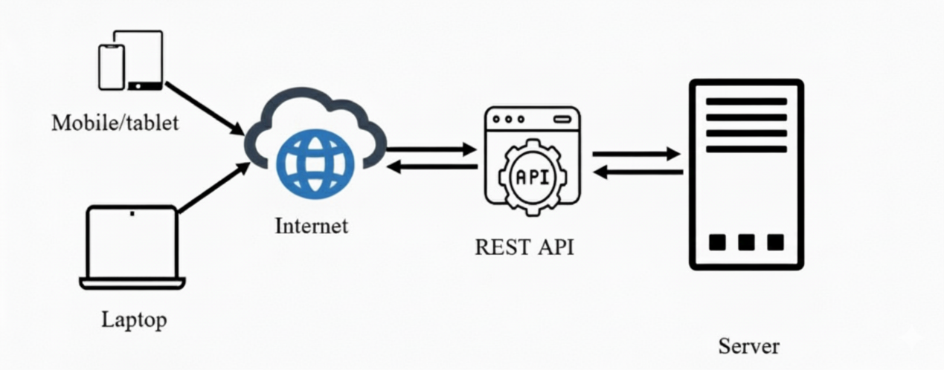
5. Architectural Diagram

Slide 9
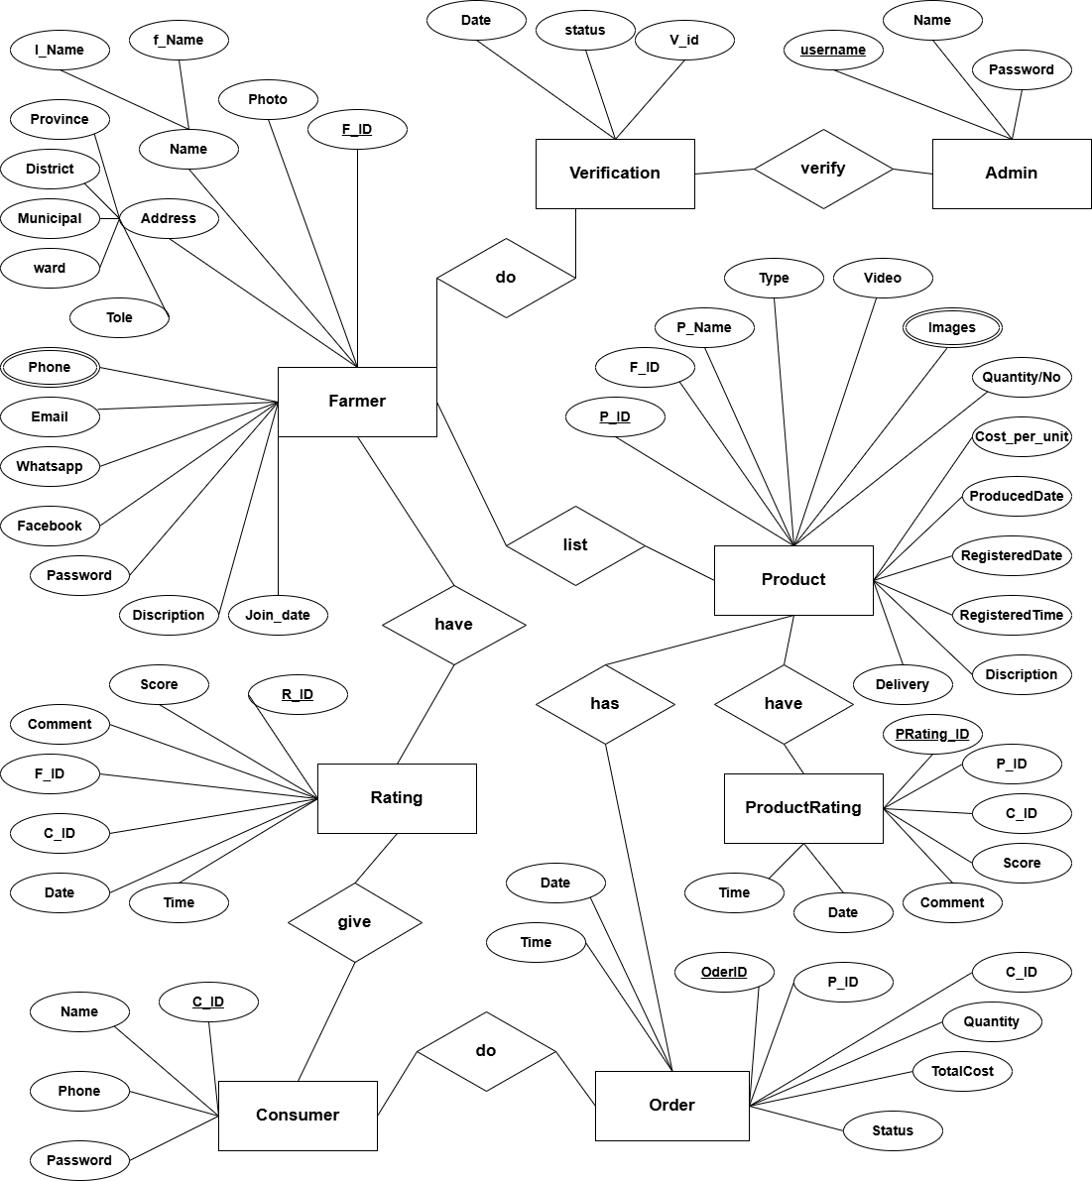
6. E-R Diagram

Slide 10
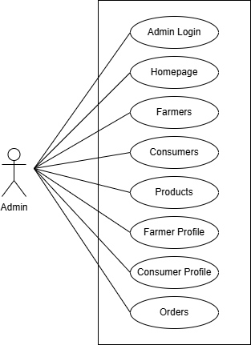
7. Use case diagram
7.1 For Admin

Slide 11
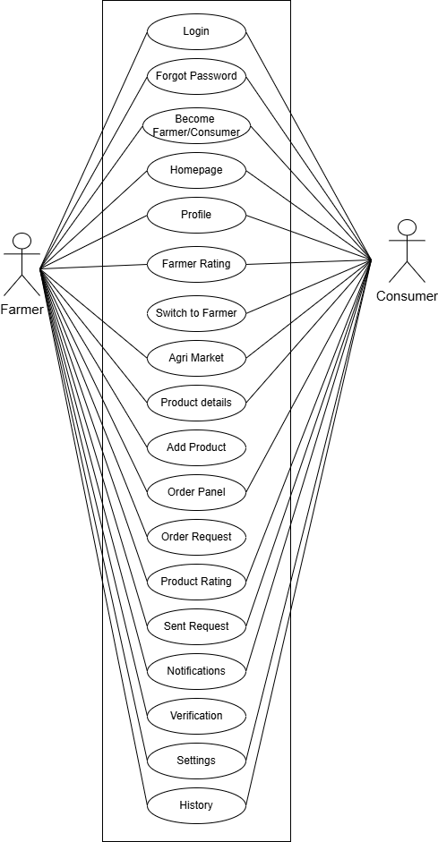
7. Use Case Diagram
7.2 For Farmer/Consumer

Slide 12
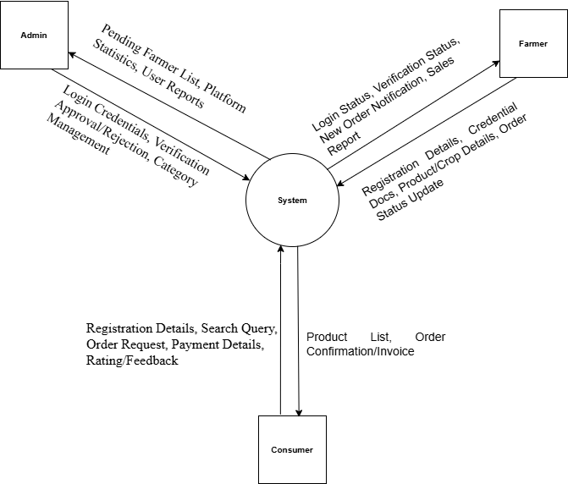
8. Data Flow Diagram
8.1 Level-0 DFD

Slide 13
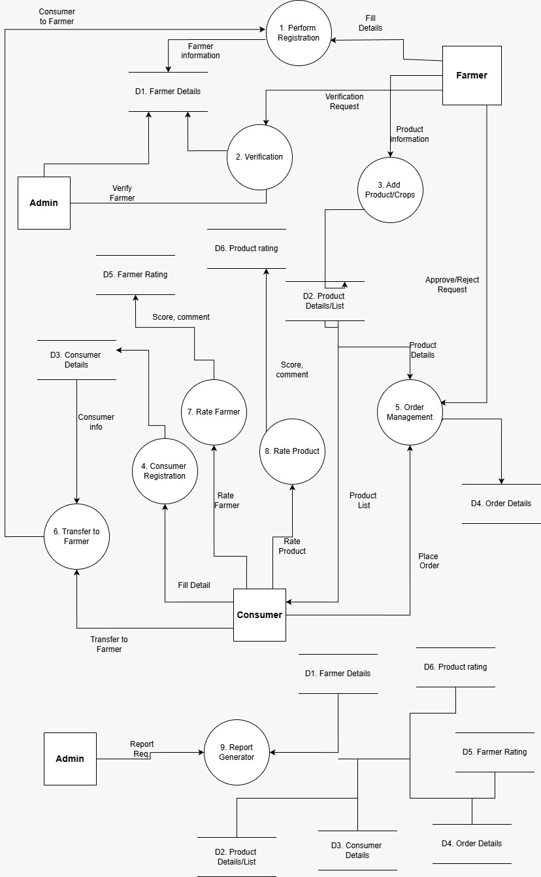
8.2 Level-1 DFD

Slide 14
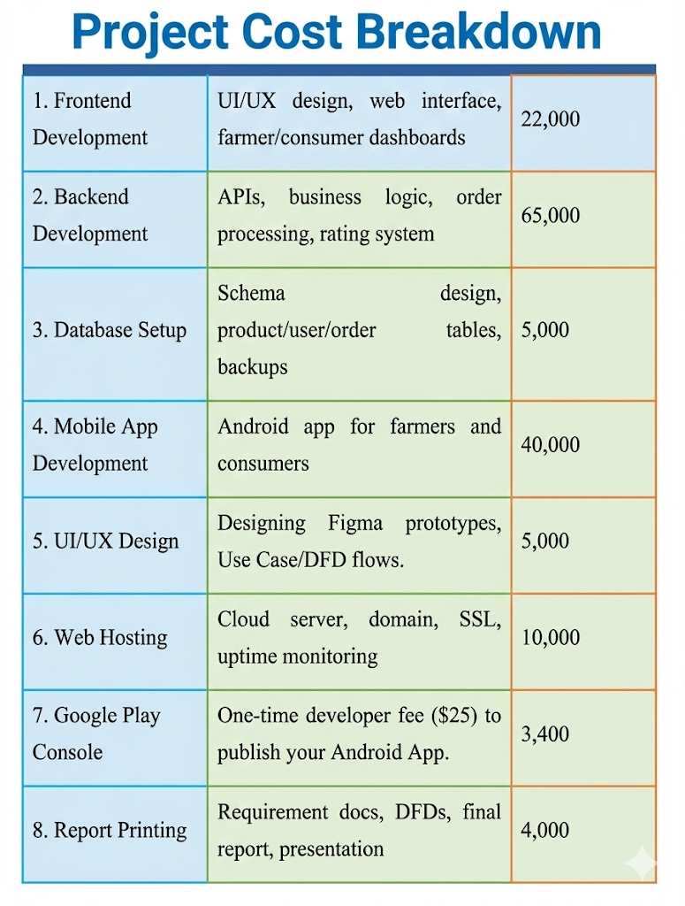
9. Cost estimation

Slide 15
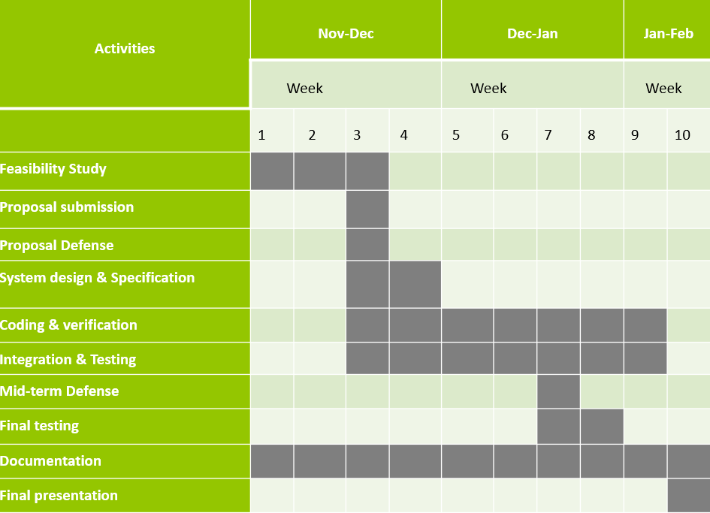
10. Project time schedule

Slide 16
11. Conclusion
The Farmo system bridges the gap between farmers and consumers by eliminating middlemen, ensuring fair prices for producers and fresh, affordable goods for buyers. Through intuitive tools for product listing, order management, and direct communication, the platform empowers farmers to increase their income and build trust with consumers. By promoting transparency, accessibility, and efficiency, Farmo contributes to a more equitable and sustainable agricultural supply chain.

Slide 17
Thank you!!

