Slide 1
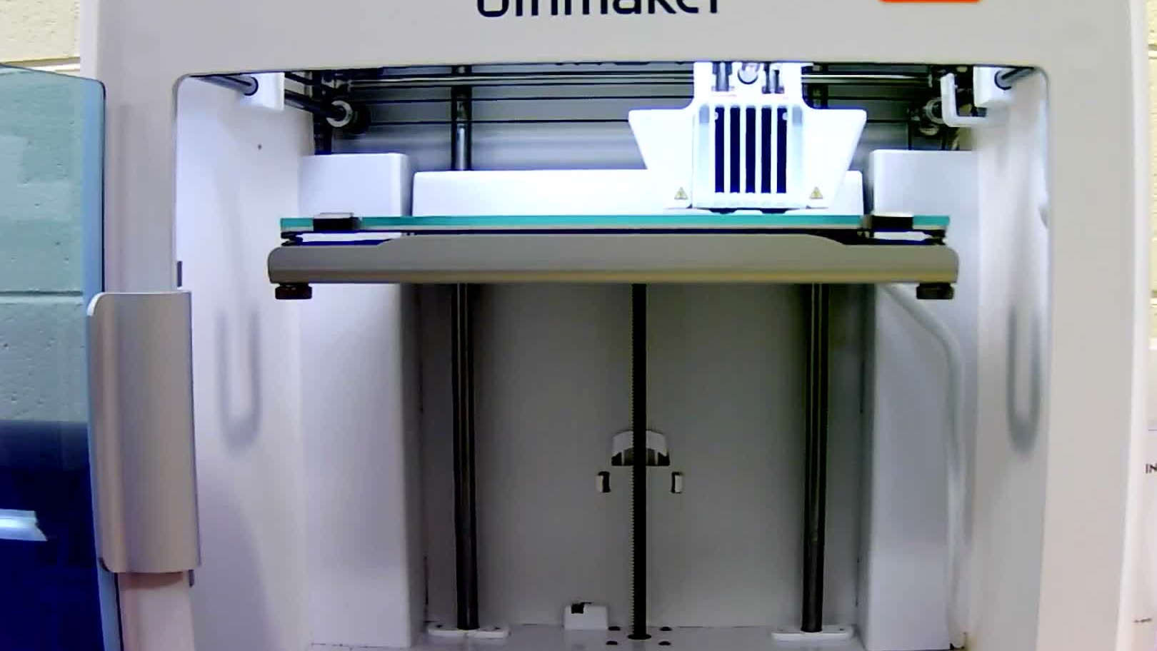
VSU THESIS
One side camera can check a 3D print against its G-code
Camera-based integrity verification of the first printed layer
Raven Mott, Virginia State University
November 2026

Slide 2
PROBLEM
Tampered G-code can change a part without the printer reporting it
01
02
03
The file is the attack surface
The printer trusts its input
A camera is independent
Additive-manufacturing attacks often alter the toolpath, speed or timing in the G-code before or during printing.
Firmware executes whatever moves it receives, so a modified path looks normal from the machine side.
A side-view camera watches what the head actually did and can be compared with what the approved G-code commanded.
02
Source: Rais et al., USENIX WOOT 2024

Slide 3
METHOD
Five layered stages turn video into printer millimeters and a verdict
 | 1 Timeline | 2 Track | 3 Map | 4 Align | 5 Compare
What it does | Time each G-code move | YOLO finds the head | Pixels to bed mm | Find start and speed | Score path error
Module | gcode_timeline | track | mapping | align | compare
03
Source: Thesis integrity runs, vsu-thesis-gcode-integrity repo

Slide 4
CALIBRATION
One known rectangle print calibrates the camera to 4.1 mm held-out error
Held-out position error by camera model (RMSE, mm)
Image horizontal maps to printer X; head size and height encode depth Y
Population: 5:21 PM rectangle calibration print; Geography: N/A (Lab printer); Period: Calibration run; Baseline: N/A (Model comparison); Status: actual
Fit error is 3.4 mm on 535 frames of the calibration print
No checkerboard is needed: the G-code itself is the ground truth
Note: Fit on the 5:21 PM rectangle video; held-out error uses alternate 1 s blocks: fit on even blocks, test on odd blocks.
Source: Thesis integrity runs, vsu-thesis-gcode-integrity repo
04

Slide 5
TIMING MODEL
Modeling corner slowdowns makes G-code time match the circle video
Modeled circle duration
1.04
Constant-speed moves | 11.2 s
Acceleration + jerk planner | 8.9 s
Observed in 6:38 PM video | 9.2 s
Other prints, time scale | 0.99 to 1.03
circle time scale with the jerk model
Was 0.83 with constant-speed moves
Note: Time scale = observed print duration / modeled duration; 1.00 is a perfect match.
Source: Thesis integrity runs, vsu-thesis-gcode-integrity repo
05

Slide 6
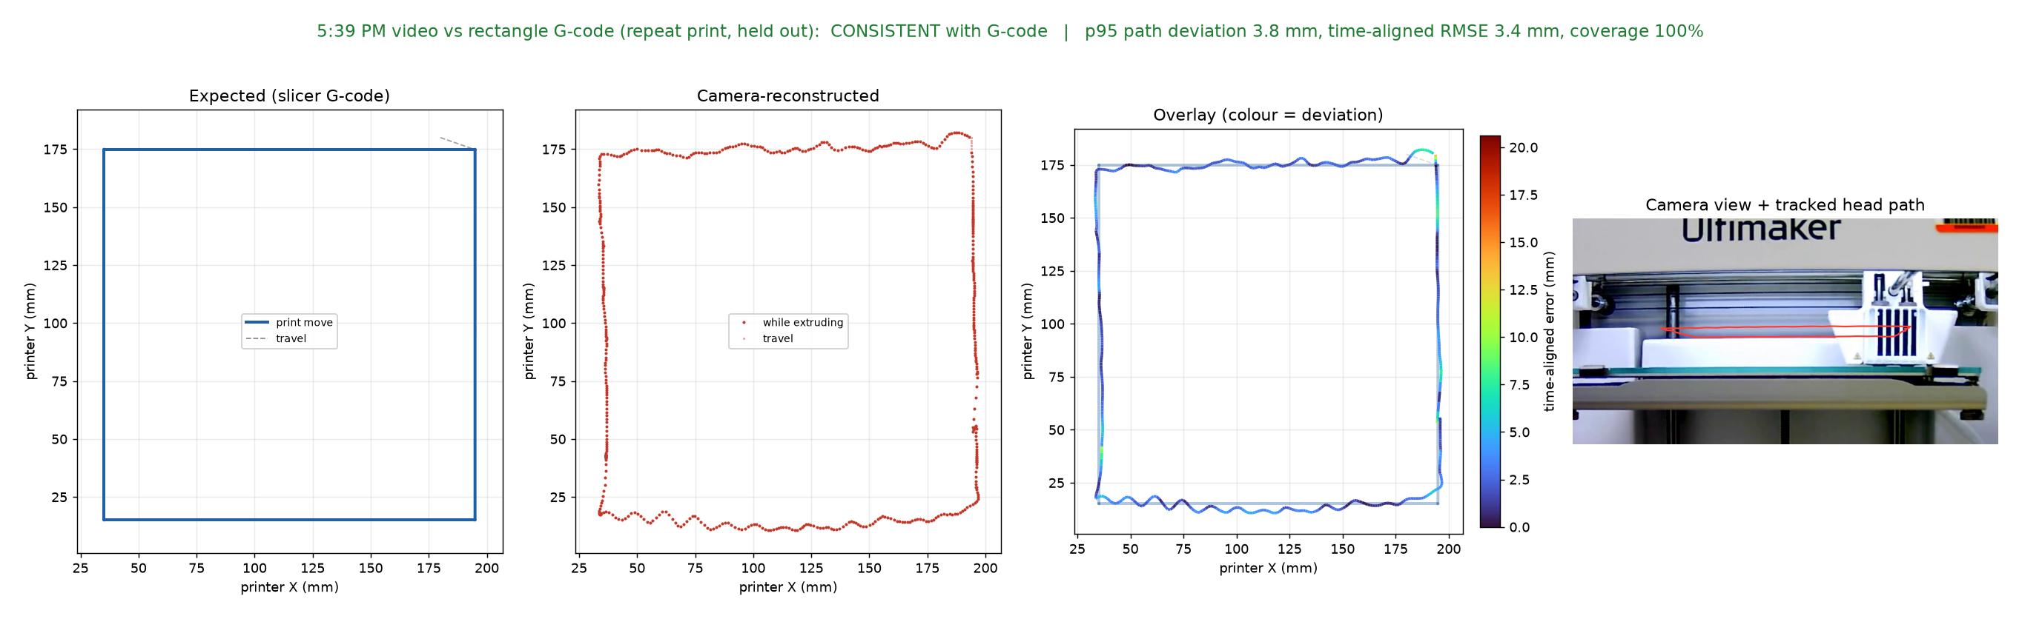
RESULT / HELD-OUT PRINT
A repeat rectangle print matches its G-code within 3.8 mm
Note: Panels: commanded G-code path, camera path in bed mm, overlay colored by error, camera view. p95 = 95th-percentile path deviation.
Source: Thesis integrity runs, vsu-thesis-gcode-integrity repo
06

Slide 7
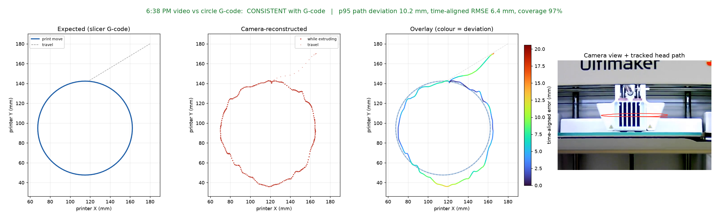
RESULT / CURVED PATH
The circle print passes at 10.2 mm p95 with 97% path coverage
Note: Same four panels as the rectangle. Tolerance is 10.3 mm. Curves are the hardest case because the head box is large relative to the circle.
Source: Thesis integrity runs, vsu-thesis-gcode-integrity repo
07

Slide 8
RESULTS
Every correct G-code passes and the wrong file fails by a wide margin
Video | G-code compared | Verdict | p95 deviation | Path coverage
5:21 PM | Rectangle (calibration) | Pass | 4.2 mm | 100%
5:39 PM | Rectangle (held out) | Pass | 3.8 mm | 100%
6:22 PM | Zig1 | Pass | 7.7 mm | 100%
6:38 PM | Circle | Pass | 10.2 mm | 97%
circle.mov | Zig | Pass | 6.7 mm | 100%
5:39 PM | Circle (wrong file) | Fail | 60.6 mm | 0%
Note: Pass rule: p95 path deviation at most 10.3 mm (2.5 x held-out error) and at least 90% of the commanded path observed.
Source: Thesis integrity runs, vsu-thesis-gcode-integrity repo
08

Slide 9
SWAP TEST
Each video passes only against its own G-code, so swapped files are caught
 | 5:21 PM | 5:39 PM | 6:22 PM | 6:38 PM | circle.mov | 5:49 PM
Rectangle | 4.2 pass | 3.8 pass | 61.8 | 43.4 | 63.3 | 19.2
Square | 44.7 | 68.0 | 36.2 | 42.1 | 43.7 | 54.9
Circle | 60.0 | 60.6 | 30.7 | 10.2 pass | 40.1 | 35.8
Zig | 38.7 | 39.6 | 22.0 | 24.0 | 6.7 pass | 21.1
Zig1 | 50.3 | 50.7 | 7.7 pass | 32.5 | 34.6 | 27.8
Note: Cells show p95 path deviation in mm for every video and G-code pair. The 5:49 PM video matched none of the five files.
Source: Thesis integrity runs, vsu-thesis-gcode-integrity repo
09

Slide 10
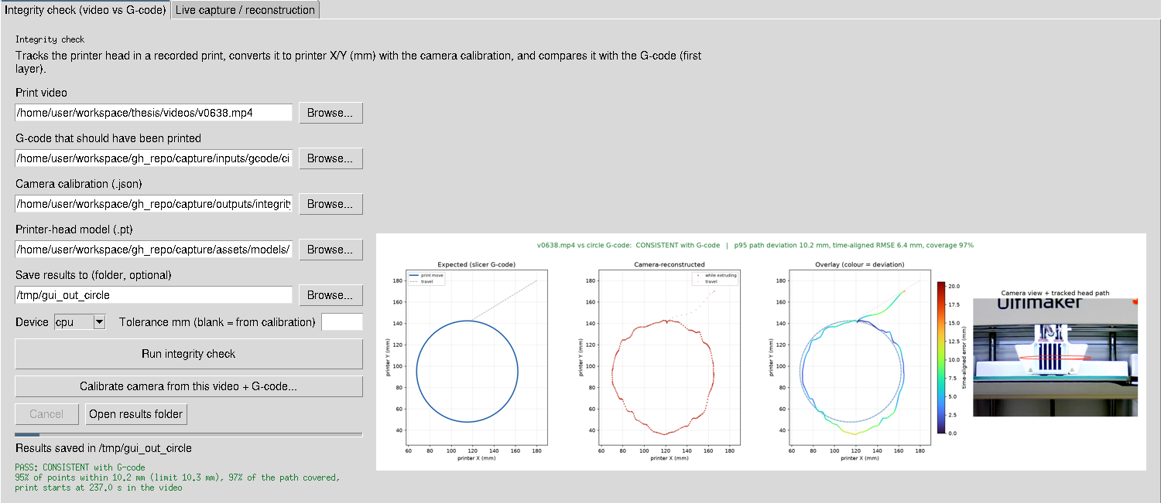
SOFTWARE
The desktop app runs the full check and shows the verdict in one window
Note: Integrity tab of capture/application/gui.py; it can also calibrate the camera from a new video and G-code pair.
Source: Thesis integrity runs, vsu-thesis-gcode-integrity repo
10

Slide 11
LIMITATIONS
The check shows where the head moved, not whether plastic was deposited
01
02
03
First layer only
Head box, not nozzle
No extrusion sensing
Z is fixed in the current runs, so later layers and height changes are not yet verified.
YOLO tracks the whole print-head box, which adds a few millimeters of noise on small curves.
An attack that changes flow or retraction but keeps the path would still pass today.
11
Source: Thesis integrity runs, vsu-thesis-gcode-integrity repo

Slide 12
NEXT IDEAS
Timing, extrusion and multi-layer checks are the next defenses to add
Idea | Builds on | What it adds
Per-segment timing check | Sophos timing detection | Flags speed or dwell changes even when the path shape is correct
Extrusion width from side view | WOOT 2024 attack classes | Covers flow and retraction attacks the path check misses
Multi-layer Z tracking | One Video to Steal Them All | Rebuilds the full toolpath from video, layer by layer
Short 7-stop calibration G‑code | Current calibration stage | Faster, repeatable camera setup before every job
12
Source: Sophos timing-attack detection (ACM); One Video to Steal Them All (ACM); Rais et al., USENIX WOOT 2024

Slide 13
CONCLUSION
A calibrated side camera verifies first-layer paths and catches swapped G‑code
NEXT STEPS
01
Add per-segment timing comparison
Raven Mott
Next sprint
02
Record multi-layer prints for Z tracking
Raven Mott
Next prints
03
Prototype extrusion-width measurement
Raven Mott
Pre-defense
github.com/Rmot1202/vsu-thesis-gcode-integrity

