Slide 1

Keshav Memorial Engineering College
CHEMORA – Chemical Exploration
A.Y:2025 - 2026
Batch ID: CSM2025B12
Team Members:
Guide:
      G.Harinivas (245522748079)
      J.Mahathi (245522748086)
      Rishwanth Aryan Sripathi (245522748128)
Mrs.Padmaja UshaRani
M.Tech(Ph.D)
Assistant Professor ,CSE(AI&ML)
Dept: CSE (AI&ML)
Notes:
Keshav Memorial Engineering College

Slide 2
Keshav Memorial Engineering College
Abstract
Chemora is an intelligent agent-based AI system designed to streamline and accelerate chemical research. It integrates natural language processing, cheminformatics tools, and chemical databases to interpret user queries and automate key research operations. The system can retrieve relevant literature, analyze reaction data, suggest synthesis routes, evaluate safety considerations, and generate structured experimental protocols. By handling these routine tasks, Chemora significantly reduces manual effort and supports more efficient chemical investigation.
The platform functions through a set of specialized agents, each responsible for tasks such as information retrieval, synthesis planning, or hazard assessment. These agents operate under a central orchestrator that coordinates their outputs to ensure clarity, accuracy, and ease of use for researchers. With built-in provenance tracking and safety checks, Chemora promotes reliability and responsible usage. Overall, it acts as a powerful decision-support tool, enabling chemists to explore synthetic possibilities more confidently and focus on deeper scientific innovation.
11-11-2025
Dept. of CSE(AI & ML)
2
Notes:
Keshav Memorial Engineering College

Slide 3
Keshav Memorial Engineering College
Introduction:
Advancements in chemistry increasingly depend on quick access to reliable information, efficient synthesis planning, and accurate interpretation of complex data. However, chemists often spend a significant amount of time searching through research papers, comparing reaction pathways, and performing repetitive analysis before beginning practical work. This slows down the overall research cycle and makes experimentation more demanding.
Chemora is being developed to address these challenges by providing an intelligent AI companion that assists throughout the research workflow. Instead of manually navigating multiple sources, researchers can rely on Chemora to understand queries, analyze chemical information, and support informed decision-making. With its agent-based design and ability to handle tasks like literature search, synthesis exploration, and safety evaluation, Chemora aims to create a smoother, faster, and more organized research experience for chemists. It also helps reduce human errors by standardizing data interpretation and ensures greater reproducibility through structured protocol generation. In addition, Chemora provides a user-friendly interface that makes complex chemical insights accessible even to early-stage researchers, improving overall usability and learning.
11-11-2025
Dept. of CSE(AI & ML)
3

Slide 4
Keshav Memorial Engineering College
Objective:
      To design an AI-driven system that automates routine chemical research tasks, reducing repetitive manual work and enabling faster information processing.
      To retrieve accurate literature and reaction data according to user queries, ensuring access to reliable, verified, and relevant chemical information.
      To generate feasible and efficient synthesis routes through intelligent agent collaboration, analyzing known reaction patterns and chemical relationships.
      To evaluate safety risks and promote responsible chemical planning, identifying hazardous reagents, unsafe conditions, and potential regulatory issues.
      To provide structured and easy-to-follow experimental protocols, converting synthesis plans into clear step-by-step procedures.
      To improve overall research efficiency by delivering fast, data-driven insights, reducing the manual workload and speeding up the research cycle.
11-11-2025
Dept. of CSE(AI & ML)
4

Slide 5
Keshav Memorial Engineering College
Problem Statement:
Chemical research involves extensive manual effort, requiring chemists to search literature, verify reaction data, compare synthesis options, and assess safety risks across multiple disconnected sources. This process is slow, repetitive, and often leads to inconsistencies or human errors. Existing tools for chemical analysis are fragmented, forcing researchers to rely on multiple platforms and time-consuming cross-referencing. As a result, valuable research time is spent on information gathering rather than experimental innovation. The lack of an integrated, intelligent system limits efficiency, reproducibility, and decision-making accuracy. There is a clear need for a unified solution that can automate routine tasks and deliver reliable chemical insights. Chemora aims to address this challenge by offering an AI-powered platform that streamlines and enhances the entire research workflow.
11-11-2025
Dept. of CSE(AI & ML)
5

Slide 6
Keshav Memorial Engineering College
Existing system & drawbacks:
      Existing tools like ChemAIRS and SYNTHIA focus mainly on retrosynthesis, leaving other research steps unsupported. This forces chemists to depend on multiple disconnected platforms.
      AI–robotic systems such as IBM RoboRXN still require human supervision for safety and validation. This limits true automation and reduces researcher confidence.
      LLM-based frameworks like LLM-RDF demand high compute and expert knowledge. Their complexity makes them difficult for beginners or small laboratories to use.
      Many systems perform poorly with novel molecules due to limited training data. Their predictions weaken when exploring new or unfamiliar chemical spaces.
      Most existing tools lack transparency and provenance tracking, giving results without clear justification. This leads to manual double-checking and slows workflow efficiency.
      Platforms are often fragmented, requiring chemists to switch between various tools and databases. This disjointed process increases effort, time, and chances of human error.
11-11-2025
Dept. of CSE(AI & ML)
6

Slide 7
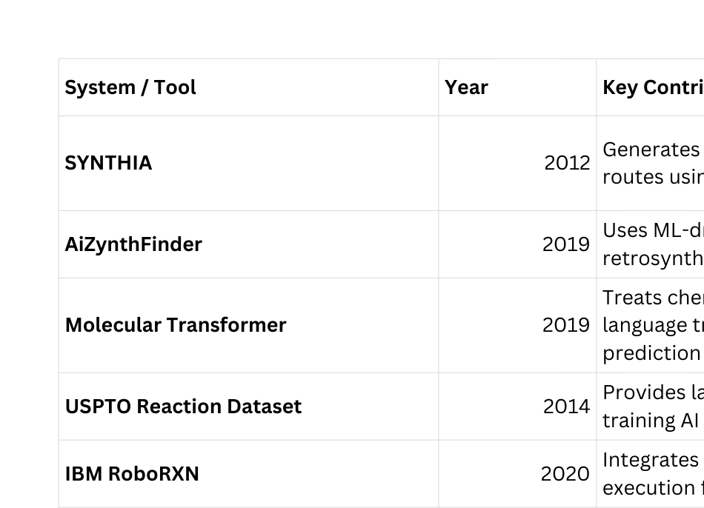
Keshav Memorial Engineering College
Literature Review:
11-11-2025
Dept. of CSE(AI & ML)
8

Slide 8
Keshav Memorial Engineering College
Proposed Solution:
      To develop a unified AI platform that integrates literature search, synthesis planning, safety checks, and protocol generation. This eliminates the need to switch between multiple disconnected tools.
      To use intelligent agents that collaborate to analyze data, interpret queries, and produce reliable outputs. This structured approach improves accuracy and workflow clarity.
      To implement a central orchestrator that manages agent communication and ensures consistent, interpretable results. This enhances system transparency and user trust.
      To incorporate cheminformatics and chemical databases for precise reaction analysis and synthesis prediction. This supports faster and more informed experimental planning.
      To generate clear, step-by-step experimental protocols based on selected synthesis routes. This improves reproducibility and reduces manual documentation effort.
      To provide a single, integrated environment that reduces researcher workload and accelerates the overall research cycle. This makes chemical investigation more efficient and accessible.
11-11-2025
Dept. of CSE(AI & ML)
9

Slide 9
Keshav Memorial Engineering College
System Requirements:
Software Requirements:
      Python 3.10+
      FastAPI (backend)
      RDKit (cheminformatics)
      PostgreSQL (database)
      Vector DB: Qdrant or Pinecone
      PyTorch (ML/AI models)
      Docker (deployment)
      Git (version control)
      Hardware Requirements:
      4–8 Core CPU
      16–32 GB RAM
      256+ GB SSD Storage
      Stable Internet Connection
      Optional GPU (NVIDIA T4/A10 for model inference)
11-11-2025
Dept. of CSE(AI & ML)
10
Notes:
Keshav Memorial Engineering College

Slide 10
Keshav Memorial Engineering College
Functional Requirements:
      Query Intake & Parsing
      Chemical Structure Canonicalization
      Literature and Reaction Retrieval
      Retrosynthesis Planning
      Safety and Feasibility Analysis
      Route Scoring and Selection
      Protocol Generation
      Data Storage and Provenance Logging
      User Interface for Result Visualization
11-11-2025
Dept. of CSE(AI & ML)
11

Slide 11

Keshav Memorial Engineering College
System Design
11-11-2025
Dept. of CSE(AI & ML)
12

Slide 12
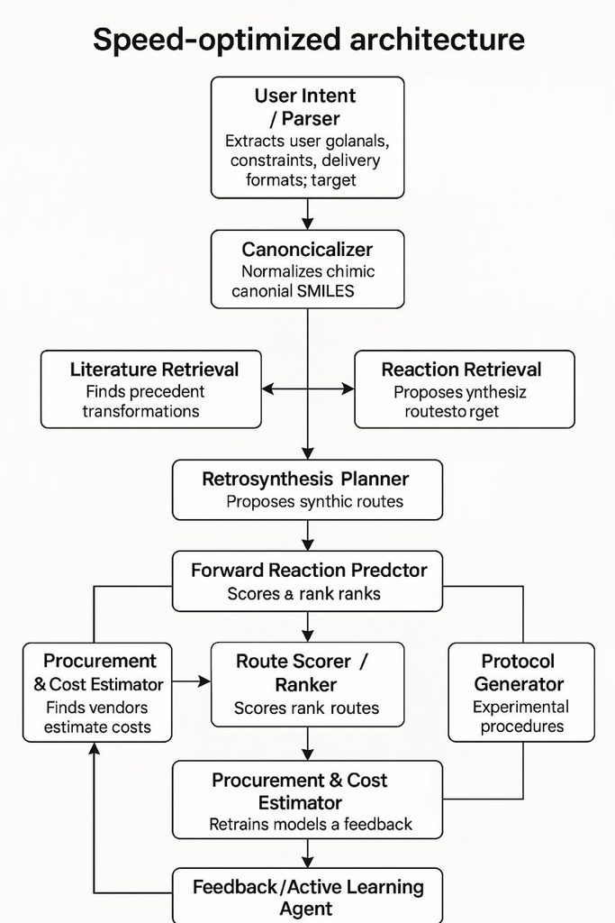
Keshav Memorial Engineering College
Overall Block Diagram:
11-11-2025
Dept. of CSE(AI & ML)
13

Slide 13
Keshav Memorial Engineering College
Modules & Modular Design:
1. User Intent Parsing Module
Understands the user’s natural language query and determines the task type such as synthesis, safety analysis, or procurement.
Extracts the target molecule along with constraints like cost, safety, and priority for further processing.
2. Canonicalization Module
Converts chemical names into standardized molecular representations such as canonical SMILES.
Ensures uniform and unambiguous chemical data for all downstream agents.
3. Literature Retrieval Module
Searches scientific literature to find validated synthesis methods and reaction precedents.
Provides experimentally proven knowledge to support reliable route generation.
4. Reaction Retrieval Module
Identifies chemically similar reactions using structure-based similarity.
Supplies transformation patterns that assist retrosynthesis planning.
5. Retrosynthesis Planning Module
Generates multiple possible synthetic pathways to produce the target molecule.
Breaks down complex molecules into simpler, commercially available precursors.
6. Forward Reaction Prediction Module
Evaluates the feasibility and success probability of each reaction step.
Filters out low-confidence or impractical reaction pathways.
11-11-2025
Dept. of CSE(AI & ML)
14

Slide 14
Keshav Memorial Engineering College
7. Safety & Compliance Module
Analyzes hazards related to reagents, solvents, and reaction conditions.
Ensures that suggested routes comply with safe laboratory practices.
8. Procurement & Cost Estimation Module
Estimates reagent availability, suppliers, and overall synthesis cost.
Helps prioritize routes that are economically practical and accessible.
9. Route Scoring & Ranking Module
Scores synthesis routes using multiple criteria such as safety, cost, and efficiency.
Ranks routes to identify the most optimal and reliable pathway.
10. Protocol Generation Module
Converts the selected synthesis route into a detailed experimental procedure.
Generates clear, step-by-step laboratory instructions for execution.
11. Data Curation & Provenance Module
Records all decisions, sources, and intermediate results during planning.
Supports reproducibility, traceability, and auditing of workflows.
12. Feedback & Active Learning Module
Collects user feedback and execution outcomes for continuous improvement.
Updates internal models to enhance future predictions and recommendations.
Dept. of CSE(AI & ML)
12

Slide 15
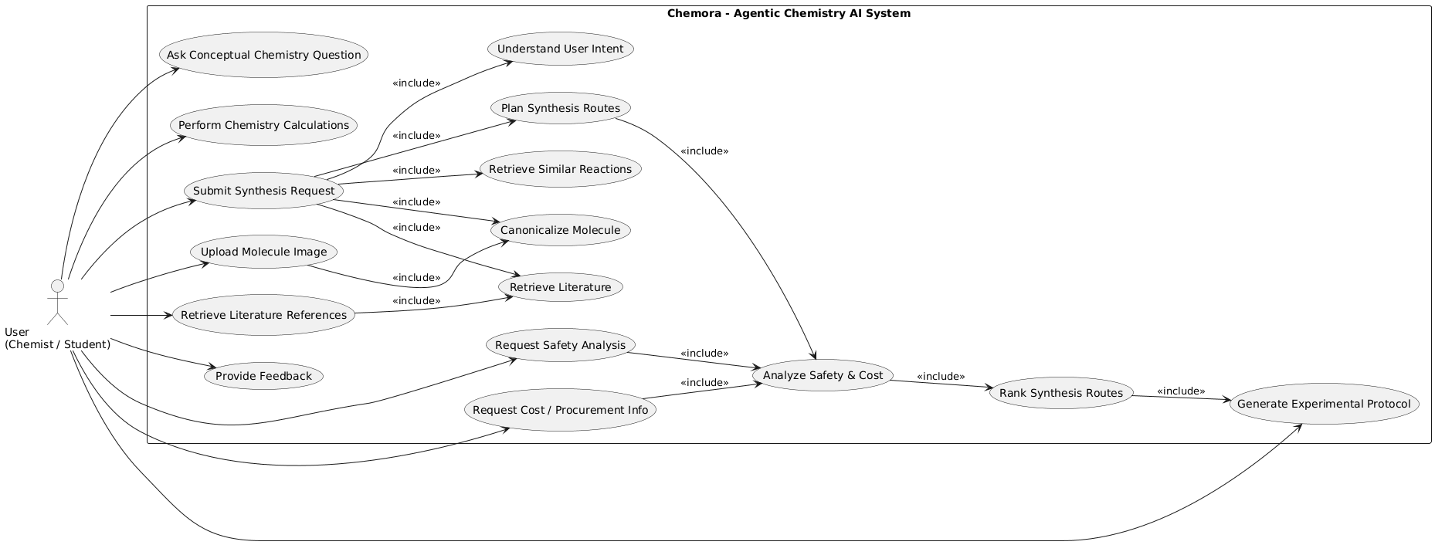
Keshav Memorial Engineering College
UML Diagram:
11-11-2025
Dept. of CSE(AI & ML)
15

Slide 16
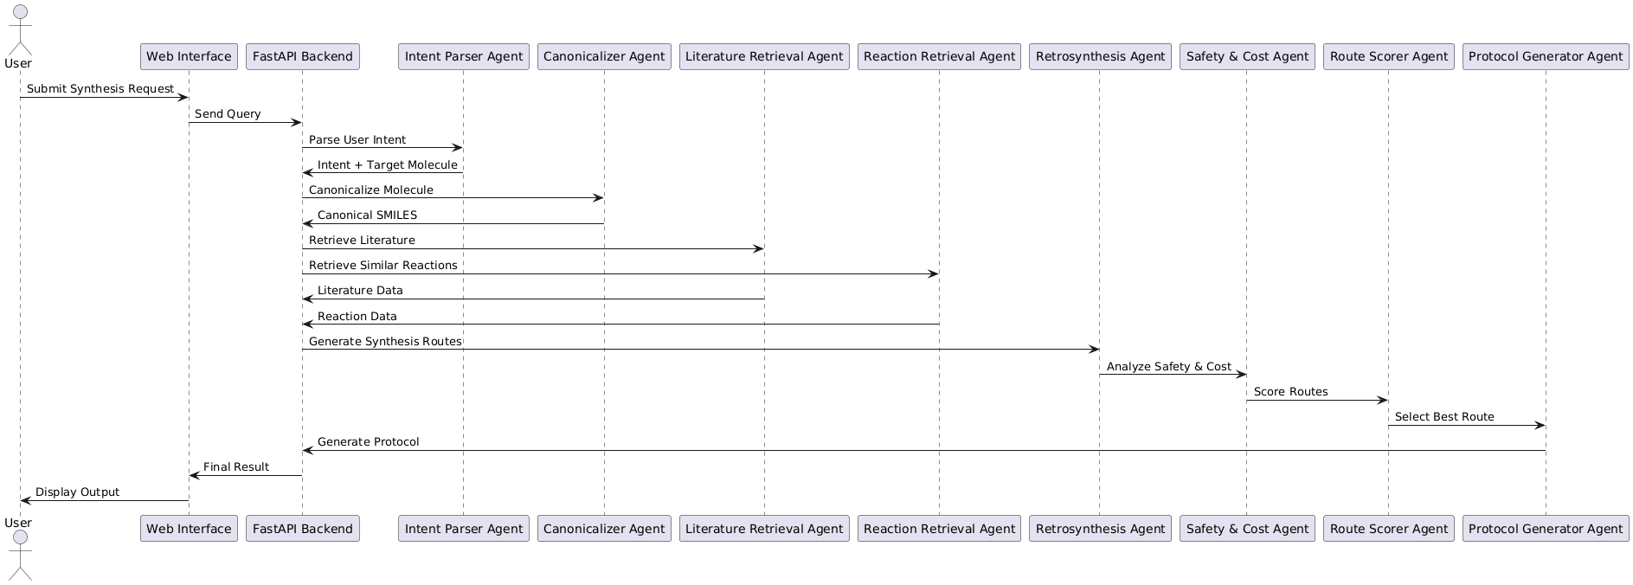
Keshav Memorial Engineering College
Sequence Diagram:
11-11-2025
Dept. of CSE(AI & ML)
15

Slide 17
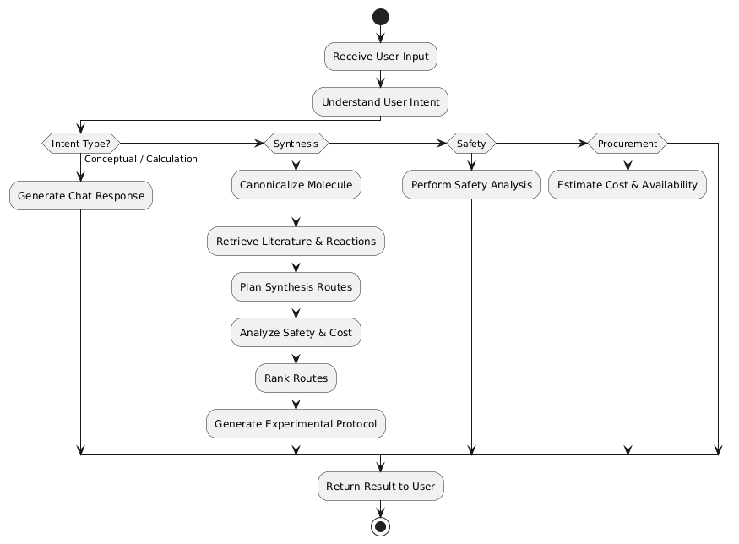
Keshav Memorial Engineering College
Activity Diagram:
11-11-2025
Dept. of CSE(AI & ML)
15

Slide 18
Keshav Memorial Engineering College
Implementation & Testing
11-11-2025
Dept. of CSE(AI & ML)
16

Slide 19
Keshav Memorial Engineering College
Usage of Platforms, Languages, tools, Components and Modules wise implementation info:
  Programming Language: Python
  Backend Framework: FastAPI
  Agent Orchestration: LangGraph
  NLP Tools: spaCy, Transformers
  Cheminformatics: RDKit, PubChemPy
  Machine Learning: PyTorch, Sentence-Transformers
  Database (Optional): MongoDB
  Image Processing: Tesseract OCR, Pillow
  Deployment: Uvicorn
  Version Control: Git
11-11-2025
Dept. of CSE(AI & ML)
17

Slide 20
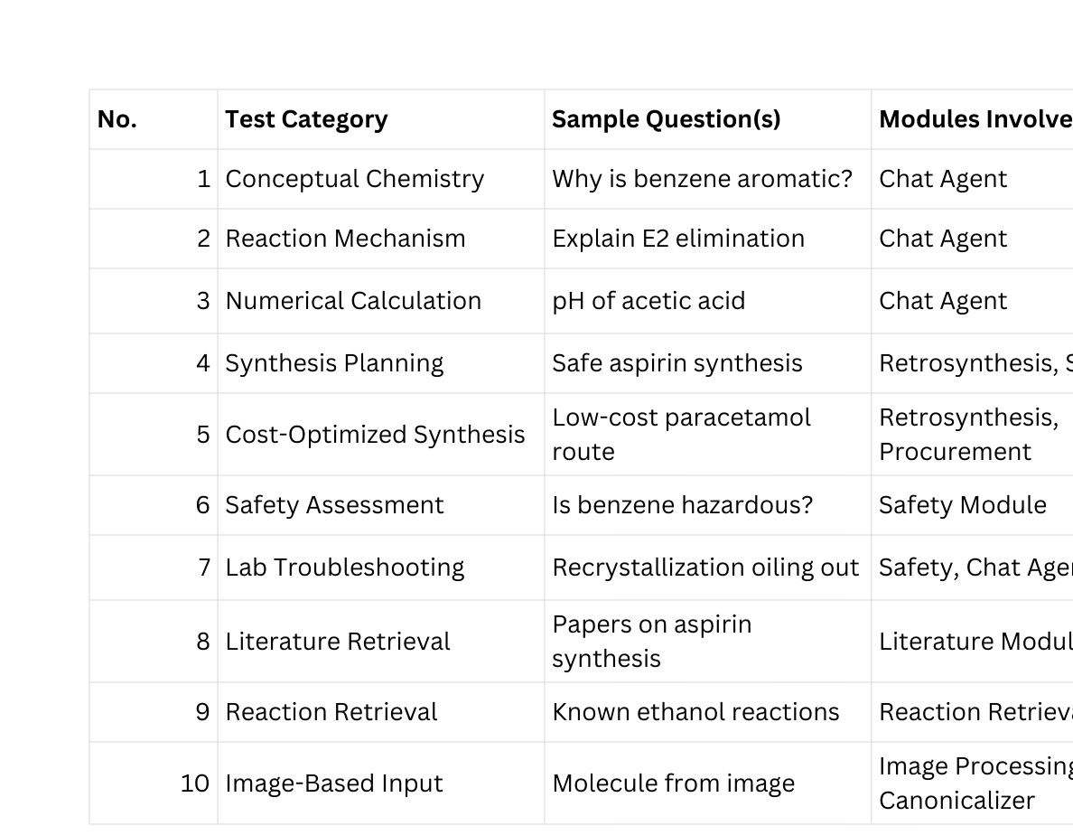
Keshav Memorial Engineering College
About Testing & Test Cases (Scenarios)
11-11-2025
Dept. of CSE(AI & ML)
18

Slide 21
Keshav Memorial Engineering College
Thank You
11-11-2025
Dept. of CSE(AI & ML)
26

