Slide 1
TRACK B · CONTRACT REDLINING
Reading a vendor's contract
against your own rules
Northwind's draft breaches the Zycus playbook in seven places across six clauses. The agent finds every one, drafts the replacement wording, and says plainly which findings it cannot stand behind.
Liability cap
Termination notice
Auto-renewal notice
Payment terms
at least 12 months of fees
at least 30 days
30 days, no penalty
Net 30 or longer
Data ownership
Indemnification
Governing law
stays with Zycus
mutual, not one-sided
neutral jurisdiction
Four of these rules turn on a number, so they can be settled by arithmetic. Three turn on what the words mean, and only those need a model. The system is built around that split, and it survives swapping the playbook: rules load as structured data carrying their own thresholds and anchor phrases, so a customer's own rules still reach the verified tier.

Slide 2
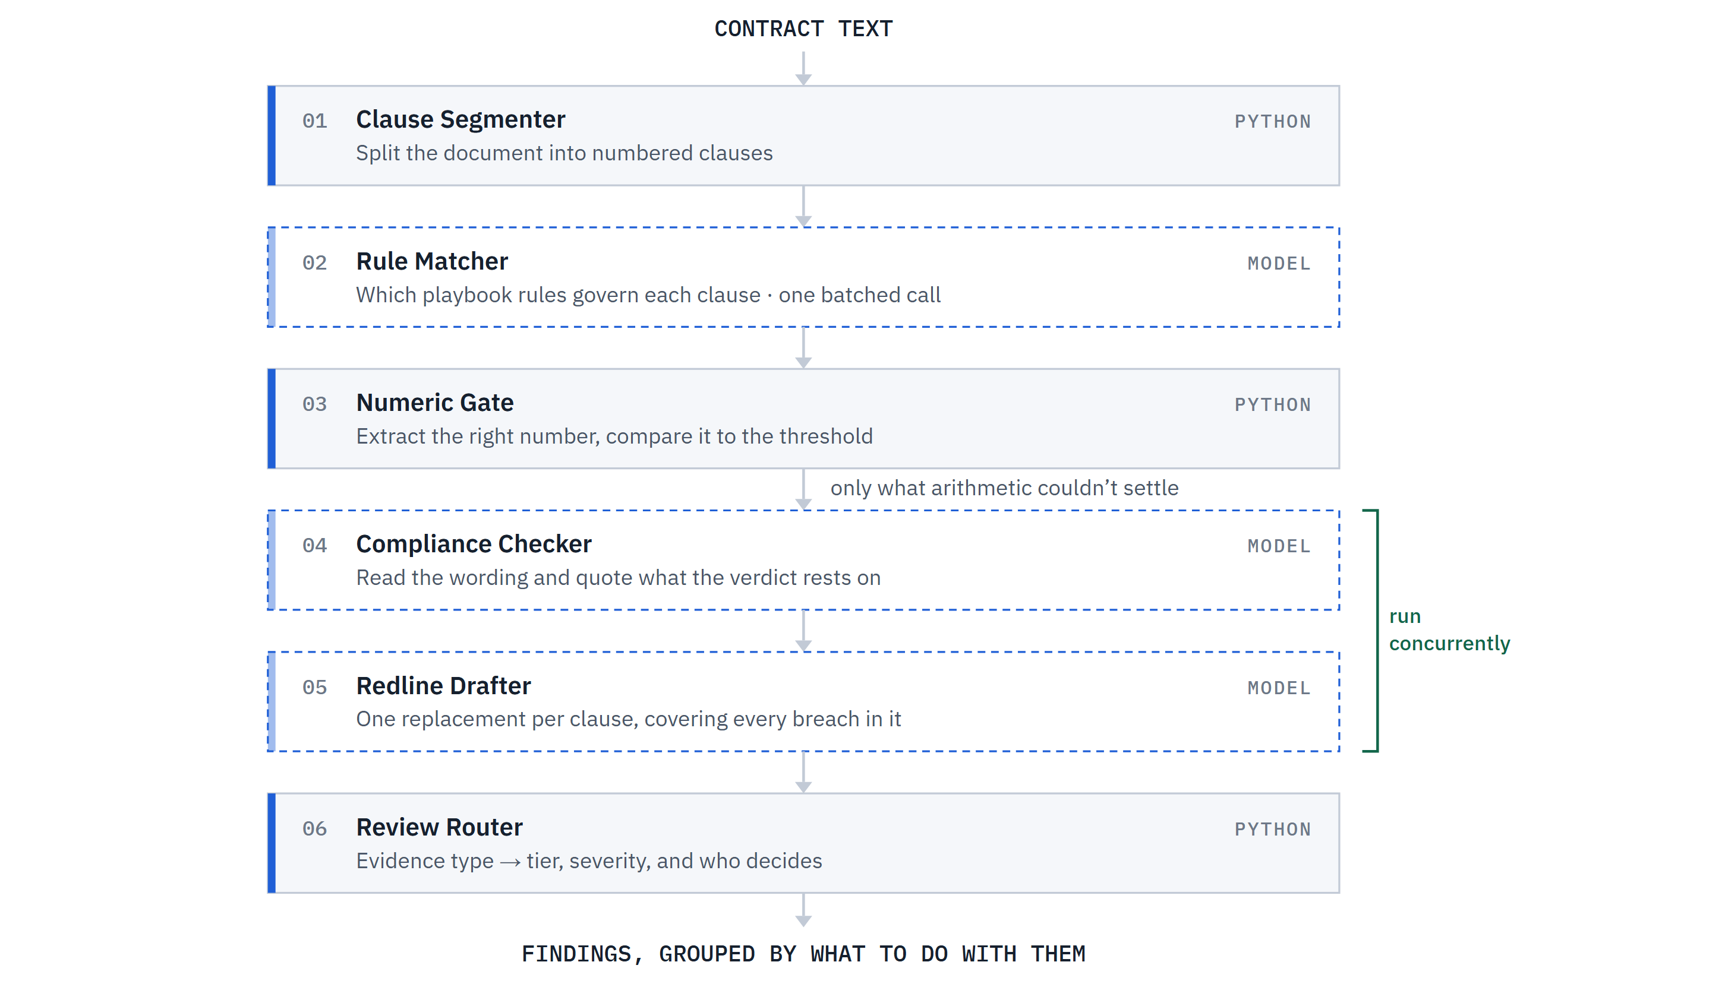
02 ARCHITECTURE
Six steps, and the model only runs where it earns its place
One endpoint runs a fixed pipeline. Each step is one module, split at the top level into app/tools (deterministic) and app/agents (model-backed), so the diagram and the directory listing are the same thing.
Deterministic Python — repeatable, unit-tested, runs with no API key
Model call — structured JSON output

Slide 3
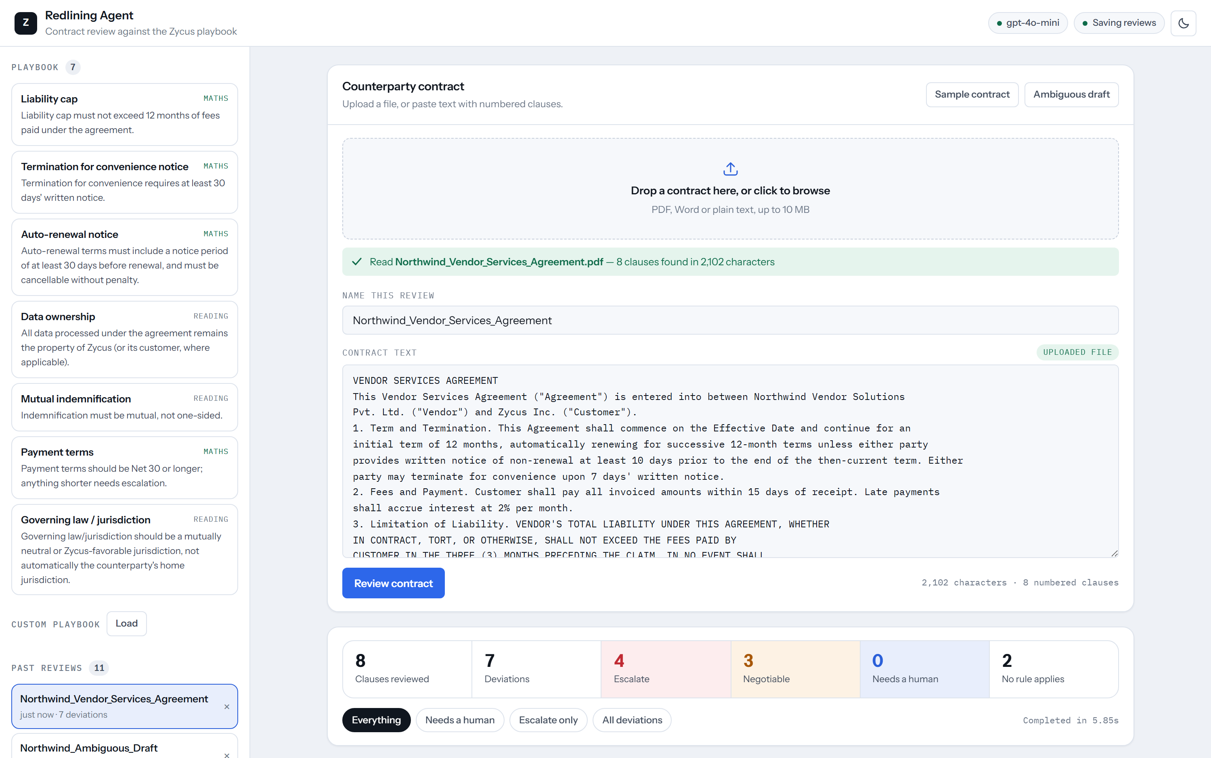
03 THE PRODUCT
Every finding shows its working
Findings are grouped by what the reviewer should do with them, not by clause order. Each card carries the arithmetic or the quoted wording the verdict rests on.
Everything in one frame
A real PDF read into the editor, shown before any model call is spent on it.
The playbook and the audit trail in the rail.
The whole contract summarised before any scrolling.
Findings filtered to what needs a human, or what to escalate.
Upload, playbook, audit trail and results on one screen, in light or dark.

Slide 4
04 WHERE THE AI GOT IT WRONG
Two bugs Claude wrote, and its own tests passed
Every module here was AI-generated. Both bugs survived review and a green test suite, and were caught only by reading the product output against the sample contract.
BUG 1 · CORRECT IN EACH PART, WRONG AS A WHOLE
BUG 2 · RIGHT CODE, WRONG ASSUMPTION
Two redlines on one clause,
each undoing the other
The model is a poor judge
of its own confidence
Clause 1 breaches two rules at once. Claude drafted per clause-rule pair, which reads sensibly one function at a time, and kept the other breach each time:
Asked for confidence handling, Claude let the model score itself and thresholded on it. It never fired once. Against a deliberately vague draft:
WORDING IT QUOTED AS EVIDENCE
CONF.
VERDICT
Redline A — auto-renewal
“a commercially reasonable amount”
0.80
violation
Set notice to 30 days, kept “terminate for convenience upon 7 days”
“reasonable prior written notice, to be determined”
0.90
violation
Redline B — termination
Set notice to 30 days, kept “non-renewal at least 10 days”
“such jurisdiction as the parties may mutually determine”
0.90
no violation
Paste either one and you fix a violation while shipping the other. Every test passed: the bug lives only in the relationship between two findings.
Confidence sat at 0.8–0.9 however little the clause committed to. The code was not buggy; the wrong assumption was about model behaviour.
FIX
FIX
Drafting is grouped by clause, so a clause gets one replacement satisfying every rule it breaches. A regression test asserts clause 1 yields one text containing neither value.
A deterministic vagueness check now overrides confidence downward, as arithmetic already overrode it upward. Vague draft went from 4 auto-suggested to 0, with all 5 sent to a human.

Slide 5
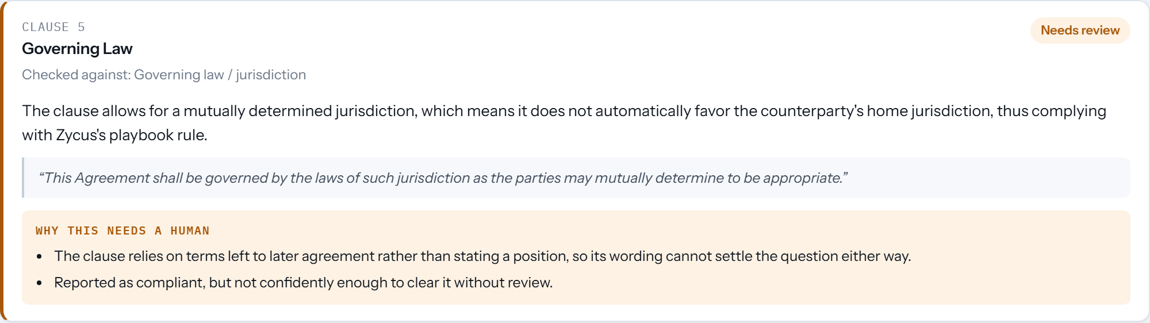
05 THE UNCERTAINTY DECISION
Confidence is not the model's to declare
The deliberate call: a finding's tier is decided in Python from what kind of evidence exists, never from the model's own estimate. That is what makes the top tier mean something.
HIGH
MEDIUM
LOW
A number was extracted and compared to the threshold. 7 days < 30 days is arithmetic.
No number, but the model quoted unambiguous wording and the clause states a real position.
The clause defers to an outside standard, or a deviation was asserted with nothing quoted to support it.
Auto-suggest the redline.
Auto-suggest, marked for a look.
Flag for a human. No auto-suggestion.
Confidence and severity stay separate
Collapsing them hides the two cases that matter most: certain but minor, and uncertain but serious.
Over-flagging is the safe error
A false flag costs a reviewer a glance. A false pass is a clause nobody read, signed.
The model called this clause compliant at 0.90. It names no jurisdiction, so it is surfaced rather than cleared.
Silence is never approval
A clause no rule covers is reported as uncovered, which also surfaces gaps in the playbook.

Slide 6
06 WHERE IT LANDED
What it catches, and what it refuses to guess at
7/7
0
132
~6s
planted breaches caught and attributed
false flags on the two clean clauses
tests, 96 needing no API key
full review, steps run concurrently
Judgment, not just detection
Severity comes from the playbook's own reasoning rather than the size of the gap. Payment terms are escalated because the rule itself says shorter terms need escalation, even though Net 15 is the smallest numeric miss. The notice-period gaps are the largest misses proportionally and stay negotiable, because they are procedural.
CLAUSE
FINDING
EVIDENCE
CALL
3
Liability capped at 3 months, not 12
arithmetic
Escalate
2
Net 15 against a Net 30 floor
arithmetic
Escalate
4
Indemnity runs one way only
quoted wording
Escalate
5
Vendor owns all data and derivatives
quoted wording
Escalate
1
7-day termination and 10-day renewal notice
arithmetic
Negotiable
6
Vendor's home jurisdiction governs
quoted wording
Negotiable
7, 8
Confidentiality and boilerplate
—
No rule applies
The honest limitation: the vagueness check is a phrase list, so a clause that hedges in wording it does not contain still reaches the model unguarded. It is a floor under the failure mode, not a solution to it.

