Slide 1
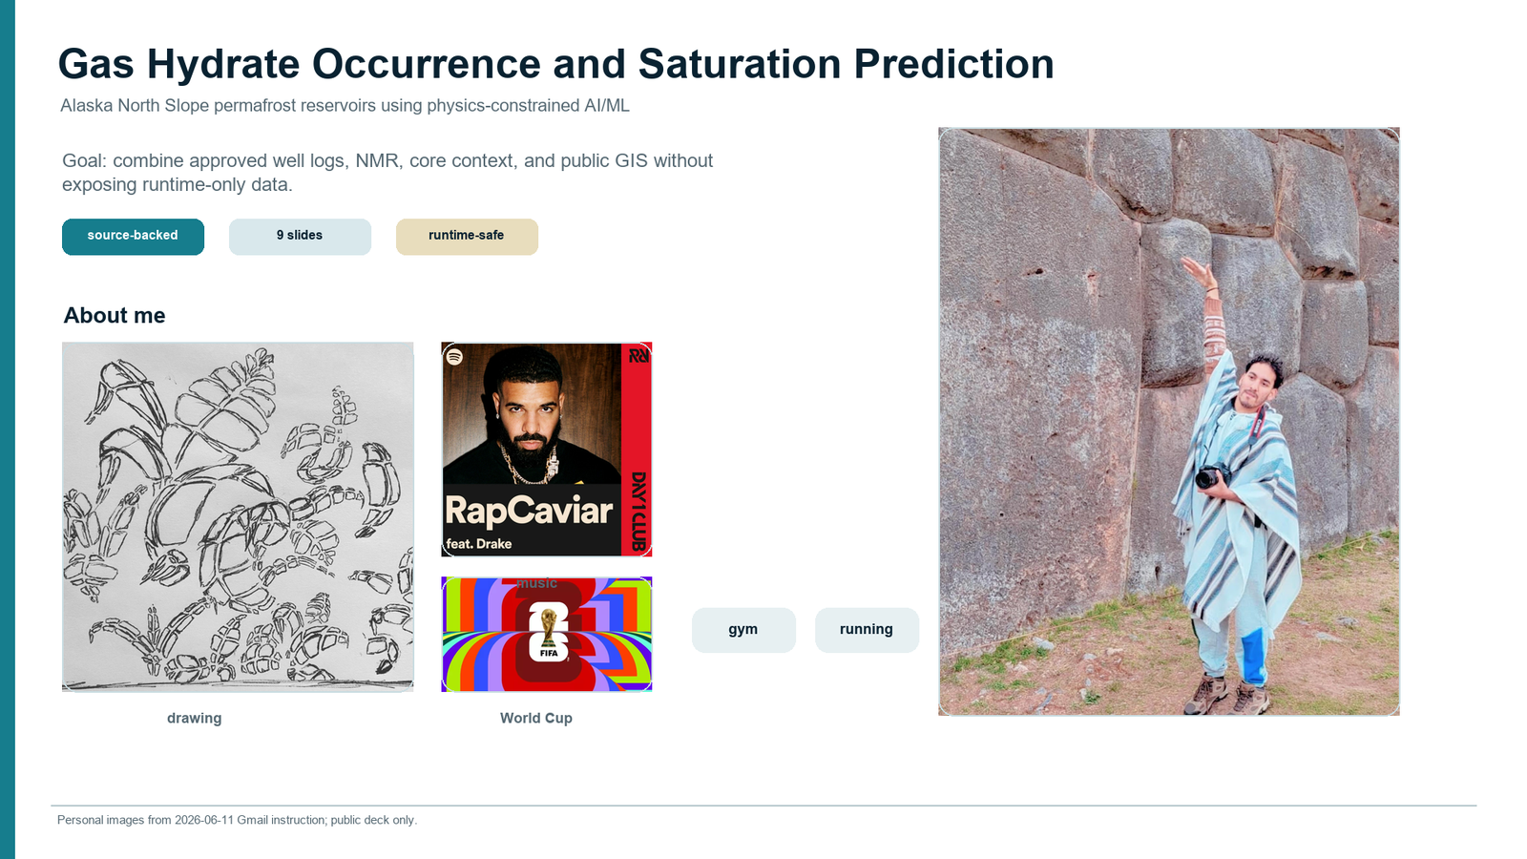

Slide 2
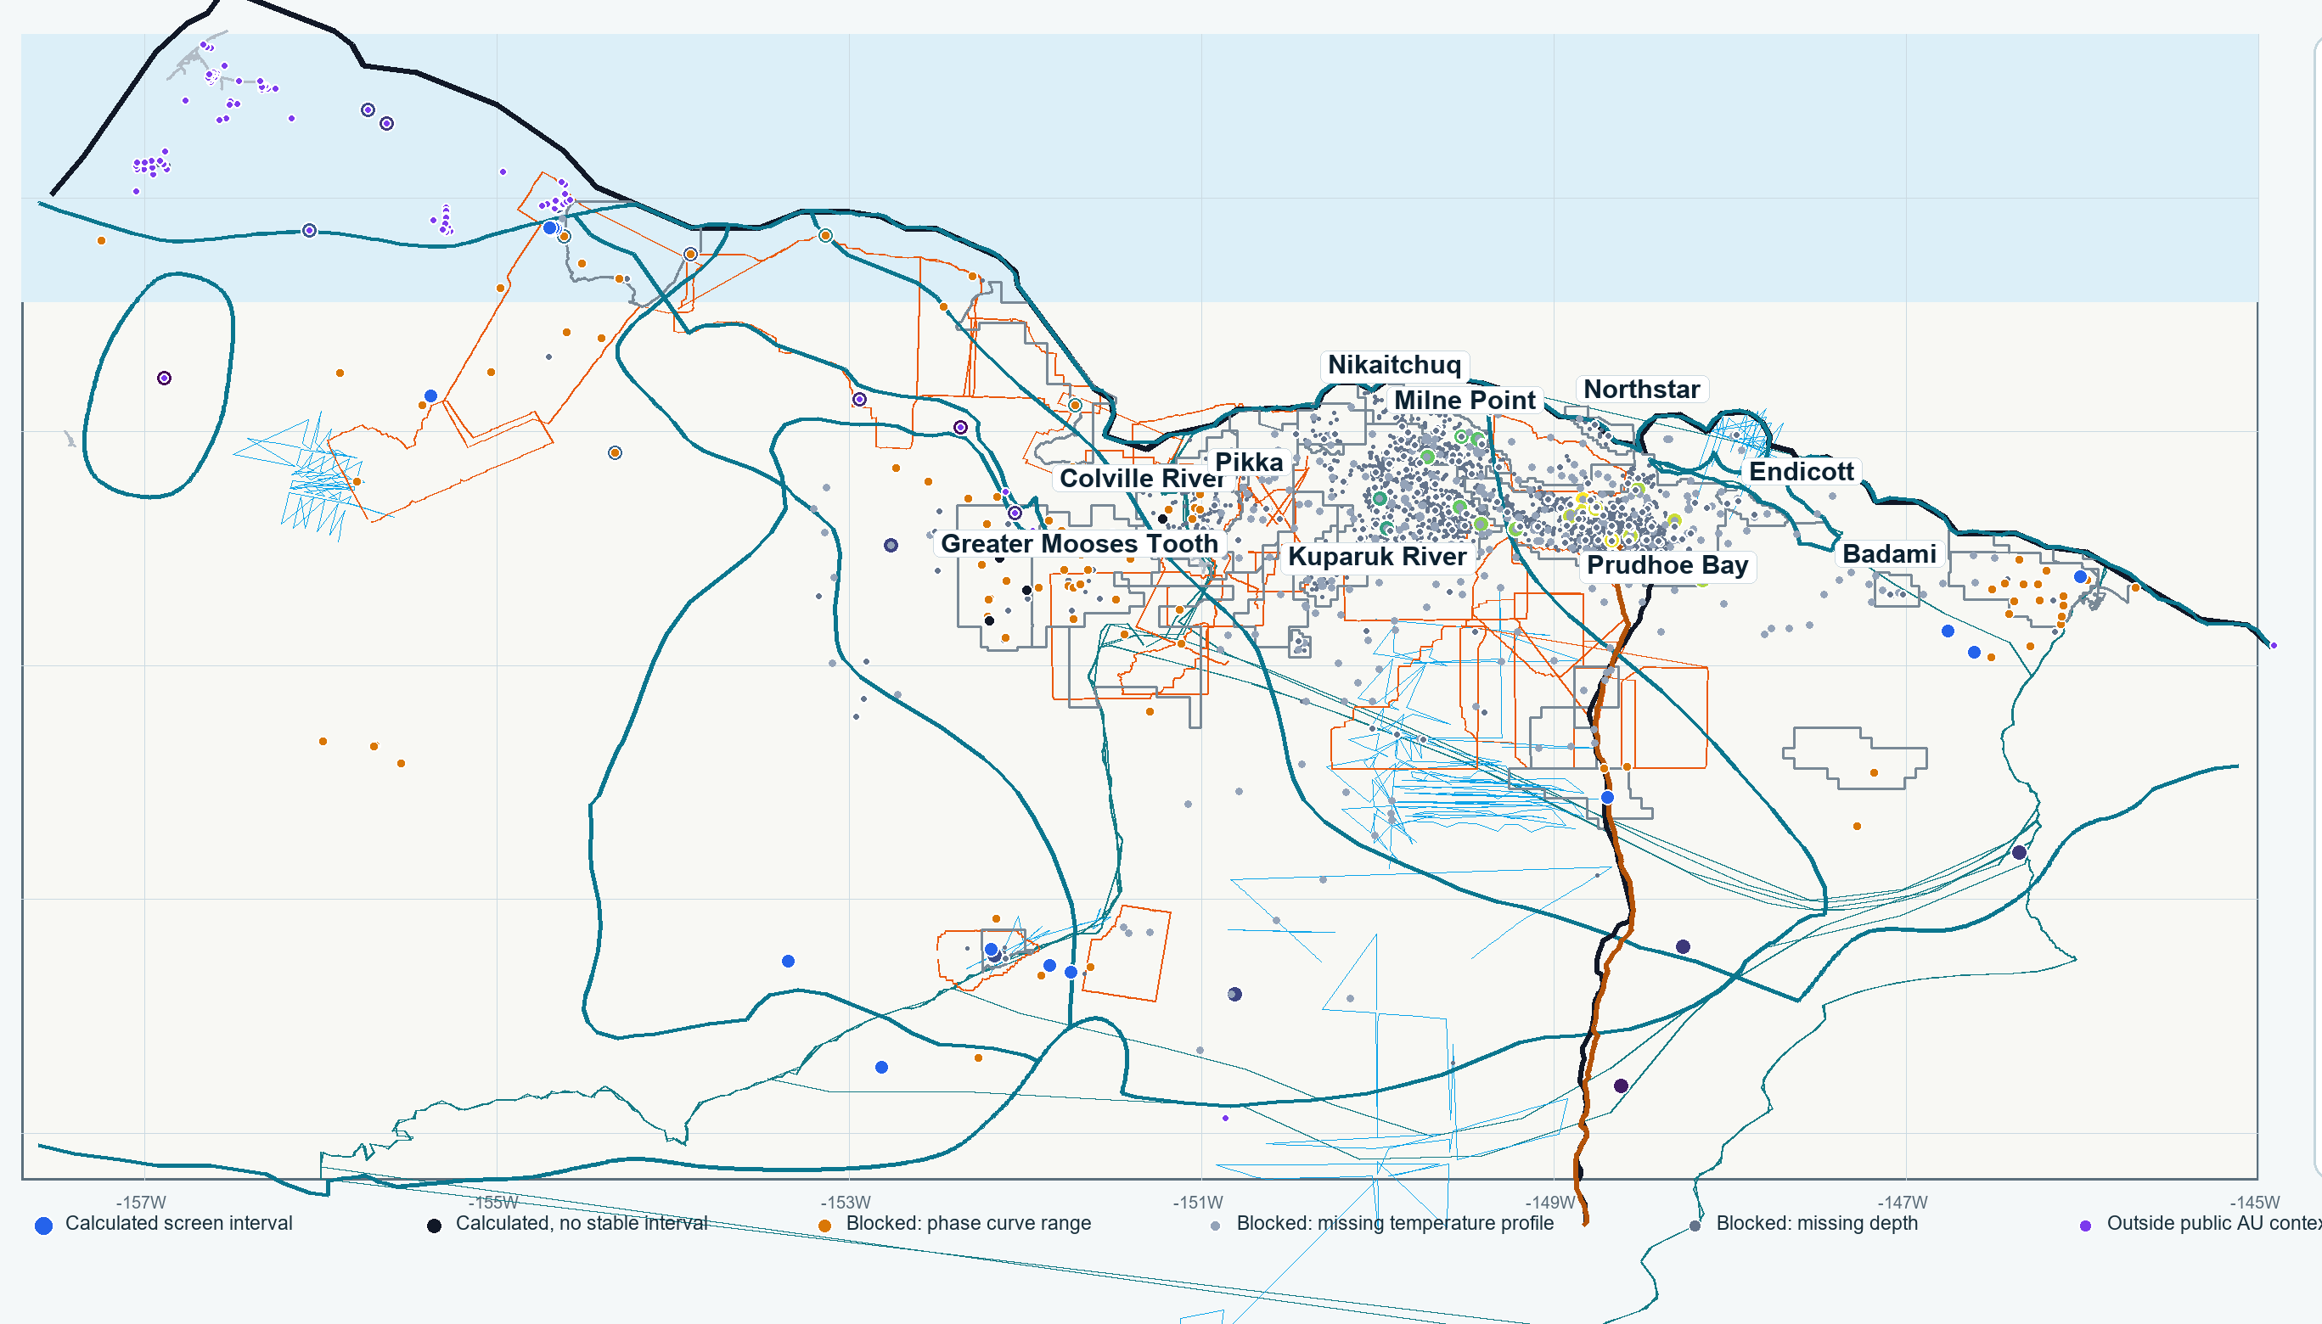
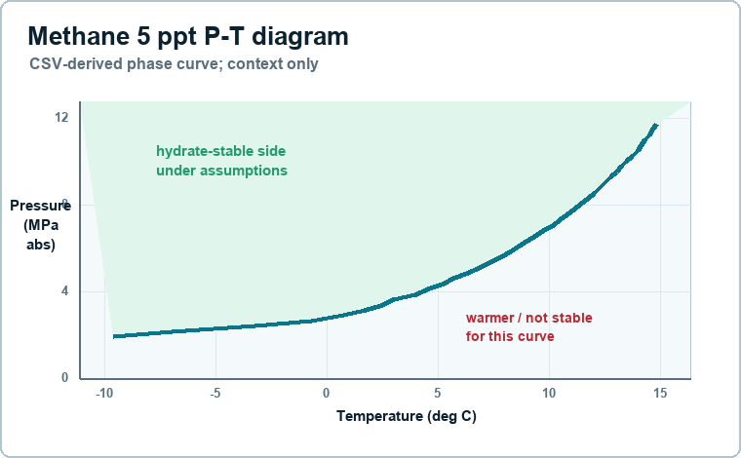
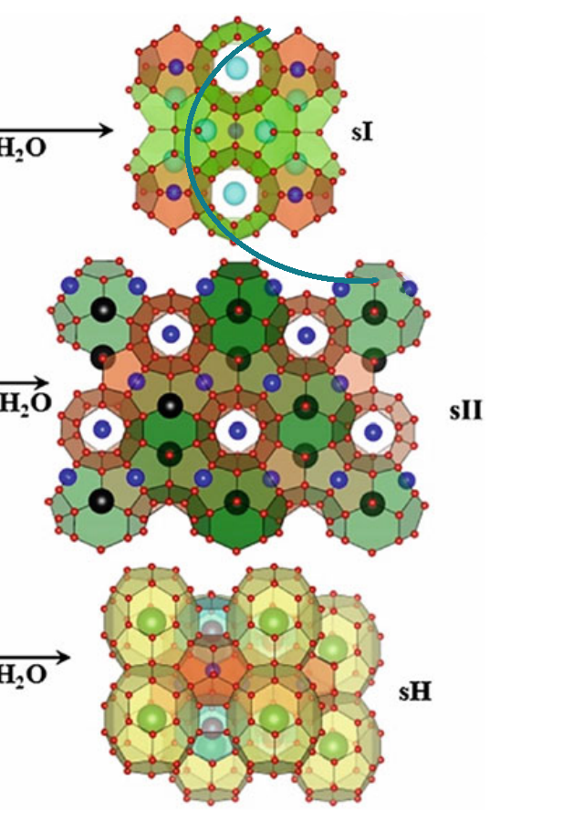
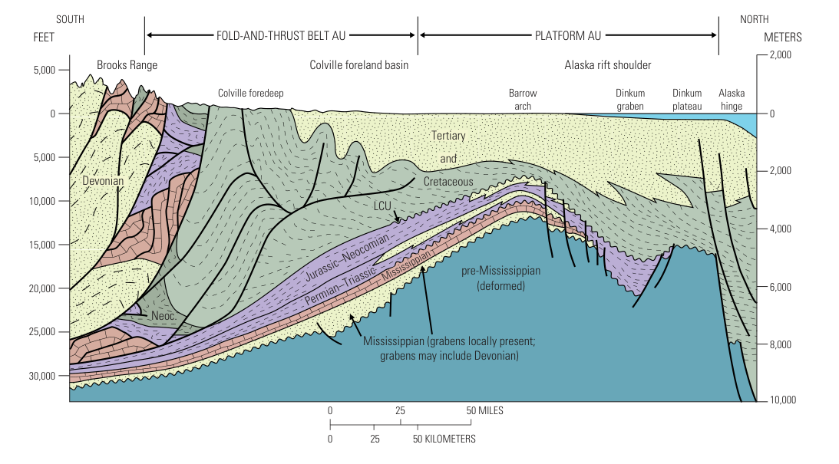
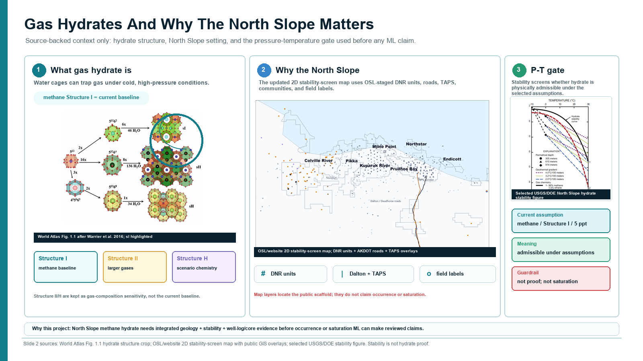
Methane Hydrate and the Alaska North Slope
Source-backed context: what hydrate is, why the region matters, and why P-T conditions vary.
P-T diagram: pressure, temperature, salinity, and gas mix control admissibility.
Structure I circled: methane-dominant baseline.
Combined 2D North Slope map: geology, public wells, permafrost controls, hydrate AUs, roads/TAPS/fields.
sI
sII
sH
noted
methane-rich baseline
larger gases / mixed gas
large hydrocarbon + methane
scenario only
Gas origin
Why it matters
Guardrail
biogenic CH4 vs thermogenic C2+ shifts stability
USGS 2018 mean: about 54 Tcf technically recoverable hydrate gas
context only; not proof, saturation, producibility, or ranking
Regional cross-section context explains why permafrost, structure, and stability vary across the map.
Slide labels are concise; detailed citations stay in the companion notes.
No hydrate proof. No occurrence/saturation claim.

Slide 3
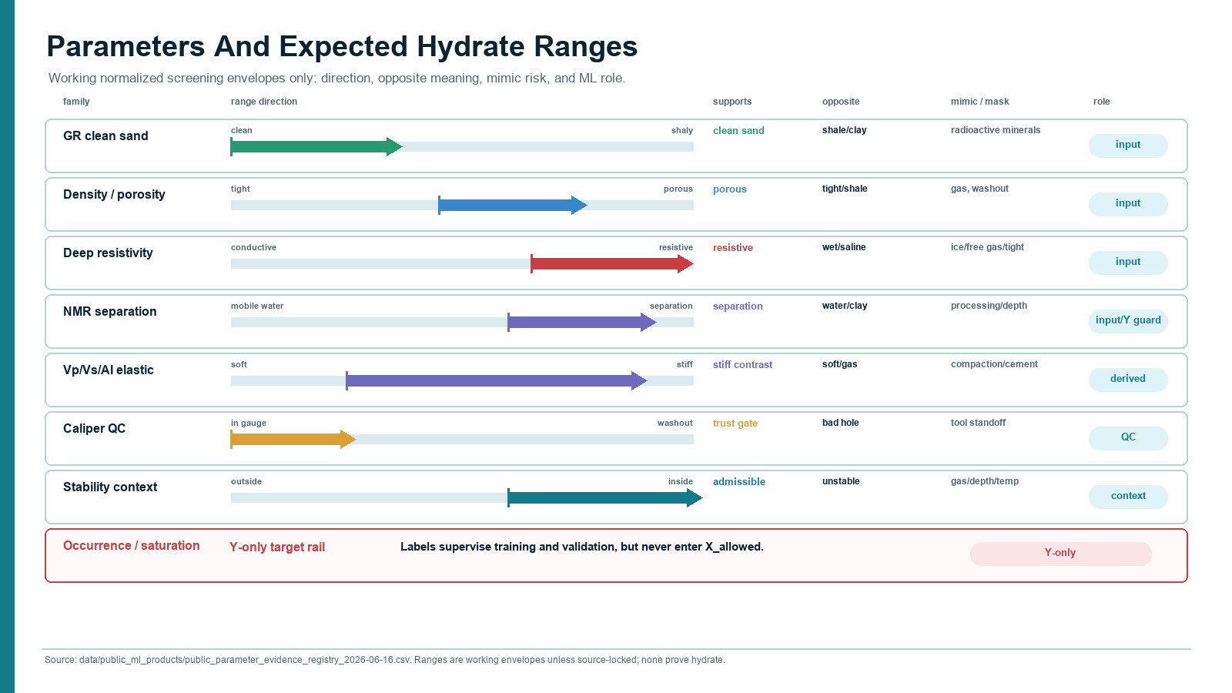
Log Signals, Lithology, And Calibration
Editable well-log scaffold; real four-well/core data remain DOE-runtime exports until reviewed.
Well-log style evidence panel
DOE export placeholder: schematic only, no approved rows or private depths.
Y-only calibration rail
Lith
GR
Rt
Phi/NMR
Vp
Vs
Vp/Vs
AI
Caliper
S_h / Sgh / Sh
NMR_SAT
clean
Hydrate saturation
Swr / S_wr
mixed
phase labels
Targets supervise/review only. They never enter X predictors.
uncertain
stack evidence
clean + resistive + stiff + stable
Depth axis is schematic. Depth stays as alignment/context; log values are future train-only 0-1 scaled views.
caliper caution
washout is QC, not hydrate evidence
measured log
derived signal
QC only
target/reference
placeholder
public-safe
no approved rows in GitHub

Slide 4
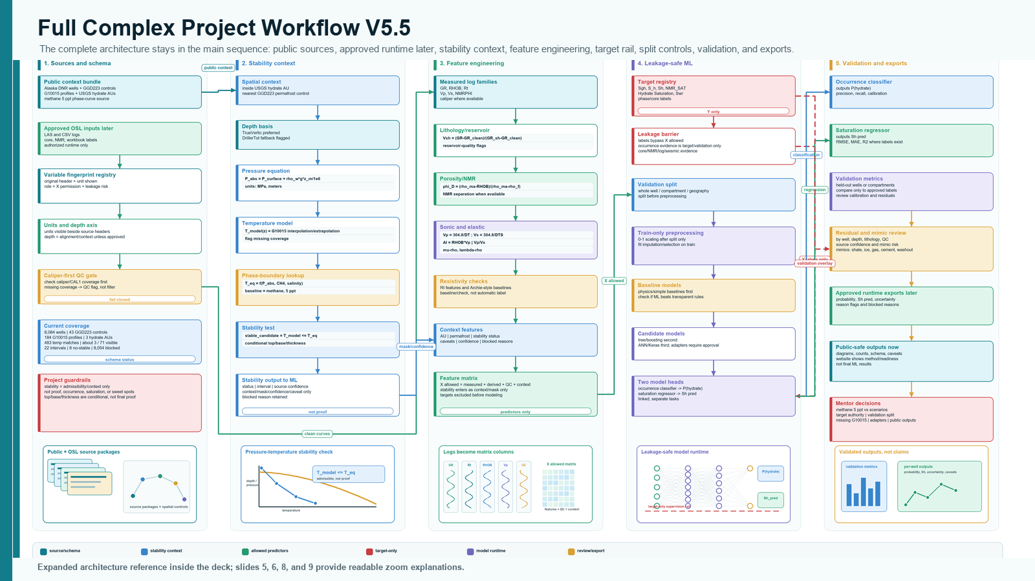
Simplified ML Architecture
Inputs become features only after schema, unit, QC, and leakage checks.
Inputs
Prepare
Leakage barrier
Feature matrix
logs core/NMR lithology/QC stability context
headers units align by depth fingerprints
X inputs only Y targets locked away
measured logs + valid derived features context flags only
Baselines
ANN / Keras later
Two outputs
physics/rules tree/boosting
learned patterns after baseline checks
occurrence classification saturation regression
Target-only rail: occurrence labels + S_h/Sgh/Sh/NMR_SAT/hydrate saturation supervise training and validation only.
Validation before metrics. Whole-well/geographic split before scaling. Reviewed outputs only.

Slide 5
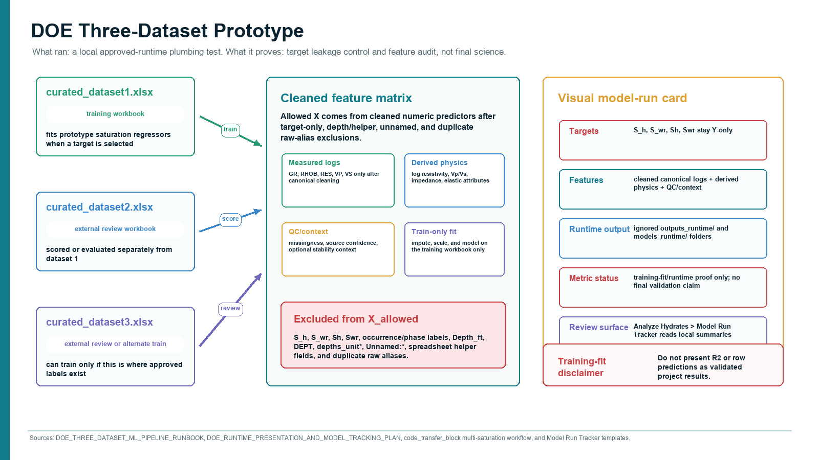
Equation Transformations
Feature engineering and stability context equations; no map, no ML diagram, no log panel.
Pressure-depth
P-T stability
Density porosity
Vp/Vs
P_abs(z) = P_surface + rho_w g z / 1e6
stable if T_model(z) <= T_eq(P_abs, CH4, salinity)
phi_D = (rho_ma - RHOB) / (rho_ma - rho_f)
Vp/Vs = Vp / Vs
context
context
log-derived
elastic
Acoustic impedance
mu-rho
lambda-rho
Archie-style check
AI = RHOB * Vp
mu-rho = RHOB * Vs^2
lambda-rho = RHOB * (Vp^2 - 2Vs^2)
Sw^n ~ a Rw / (phi^m Rt)
elastic
elastic
elastic
reference only
Readable equation cards; detailed citations and derivations stay in Word/end material.
Color key
logs/core
context
Archie-style saturation relation is a source-check/reference card until target role and units are verified; saturation labels remain Y-only.
elastic
reference

Slide 6
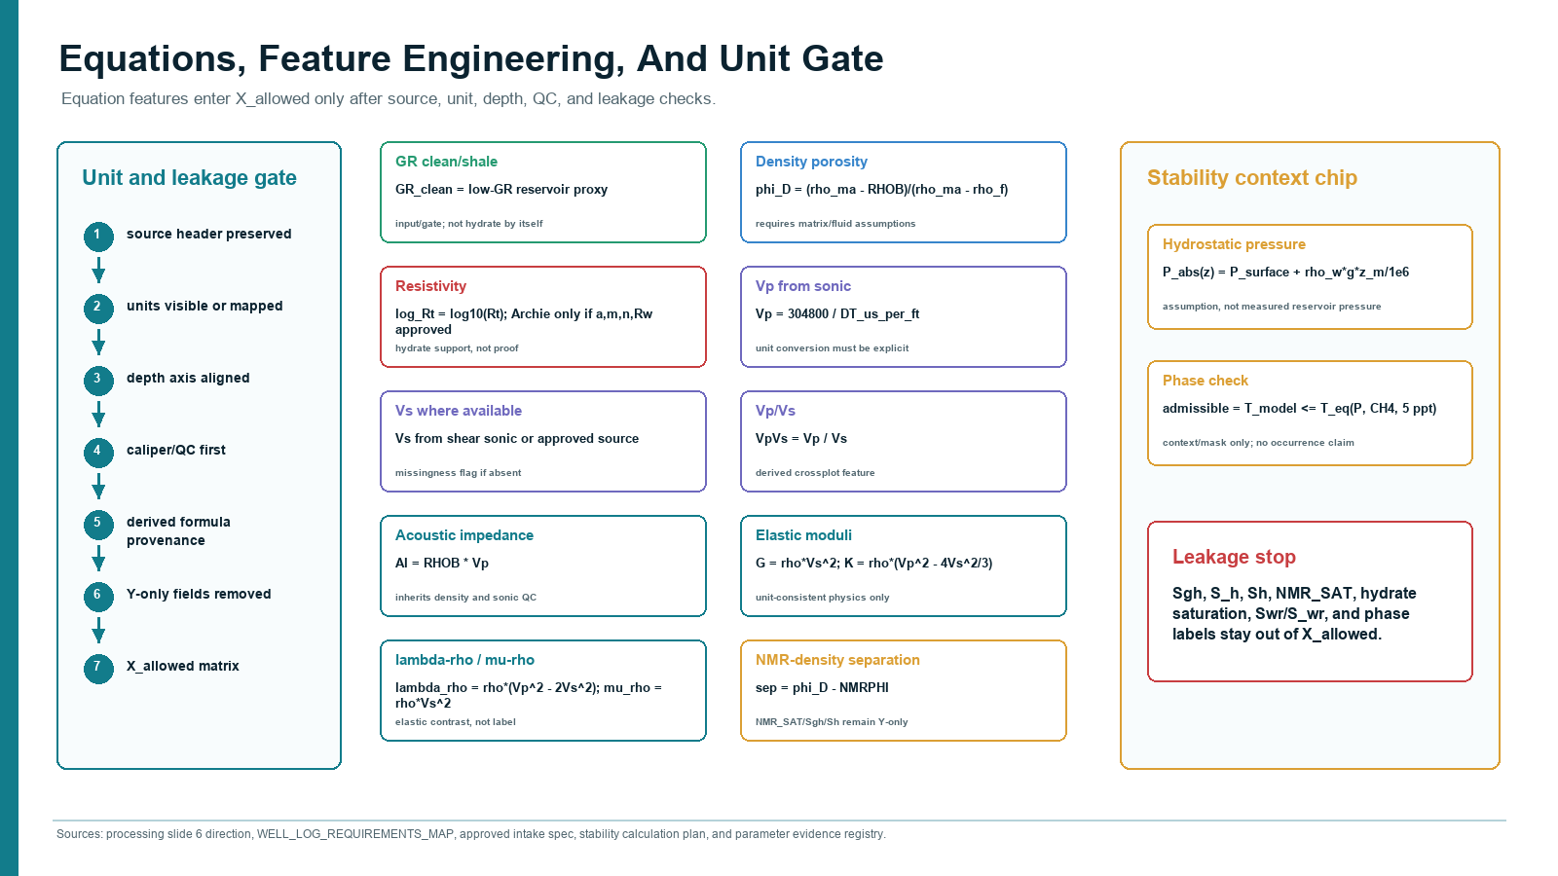
Four-Well Evidence Review Board
High-level review lanes; details and citations stay in Word/speaker notes.
Well A
Well B
Well C
Well D
Lithology/core
clean sand / core support
clean sand / core support
clean sand / core support
clean sand / core support
Guardrail
This board is a review checklist, not a result table.
Logs
GR + Rt + sonic + NMR/density
GR + Rt + sonic + NMR/density
GR + Rt + sonic + NMR/density
GR + Rt + sonic + NMR/density
QC
caliper/washout caution
caliper/washout caution
caliper/washout caution
caliper/washout caution
No final occurrence, saturation, ranking, or producibility claim.
Stability context
admissible under assumptions
admissible under assumptions
admissible under assumptions
admissible under assumptions
Target-only review
S_h / NMR / phase labels
S_h / NMR / phase labels
S_h / NMR / phase labels
S_h / NMR / phase labels
Takeaway: hydrate interpretation becomes stronger only when lithology, logs, QC, stability context, and target-only labels are reviewed together.

Slide 7
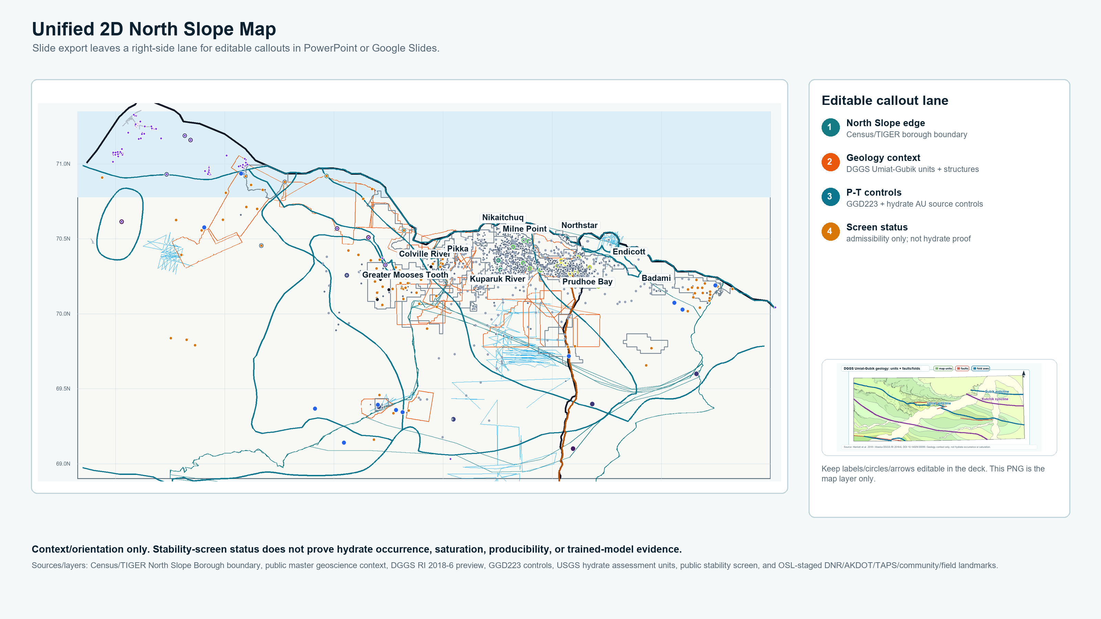
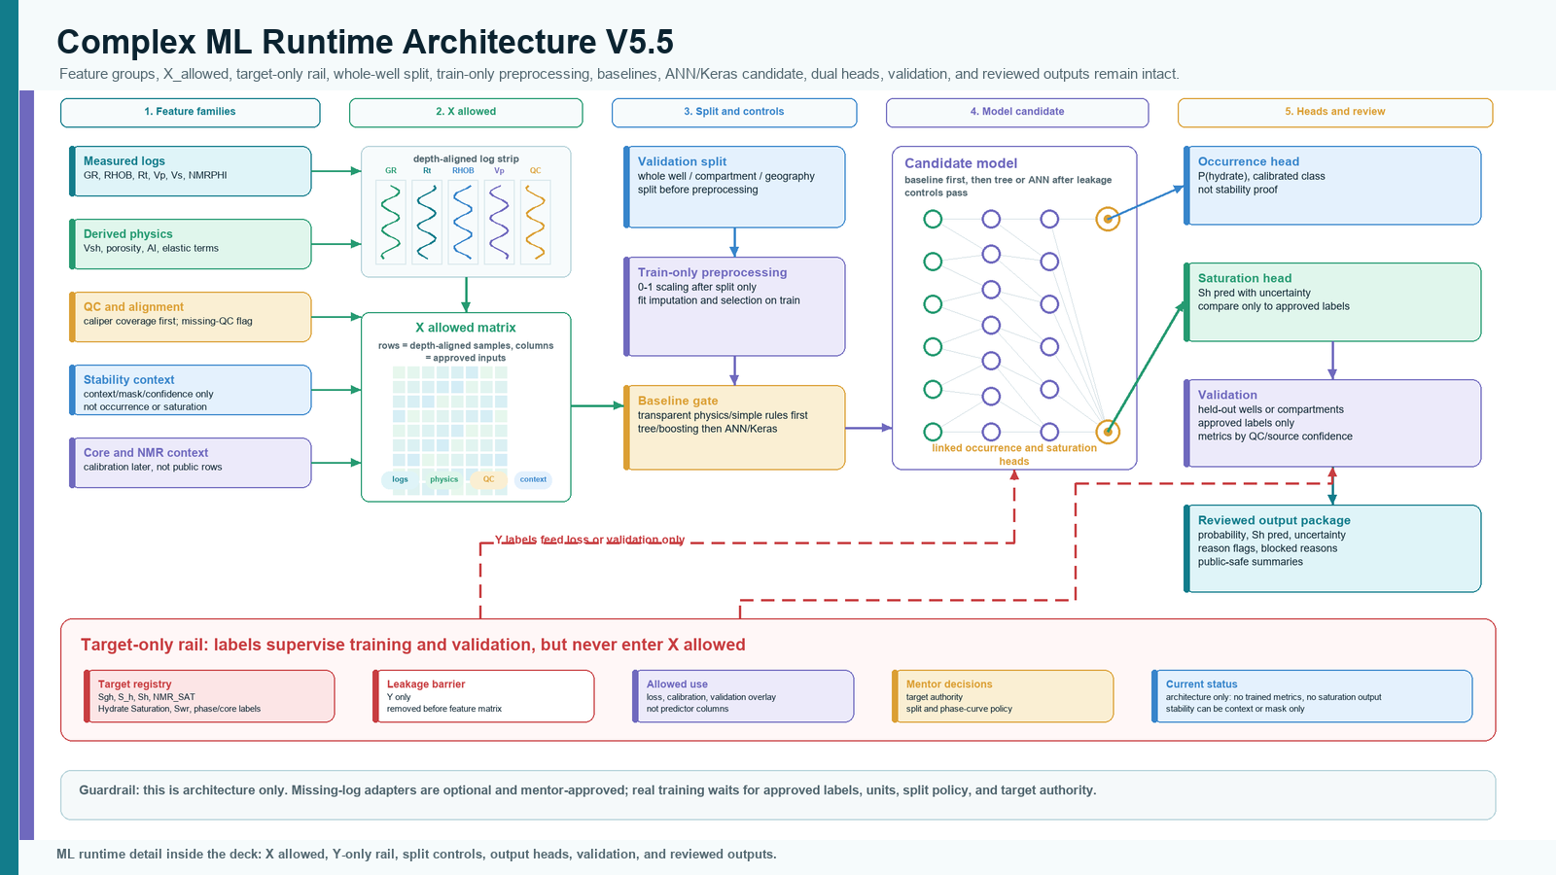
North Slope Stability Context Map
Unified 2D public context map for slide callouts; not an ML overlay.
Public layers
geology, borough edge, roads/TAPS/fields
Controls
GGD223 permafrost + public screen status
Hydrate AUs
regional assessment context only
Use
orientation and caveat support
Not a result
not occurrence, saturation, producibility, or ranking
Caption: public stability-admissibility context under explicit assumptions; source layers are public/regional and do not prove hydrate.
callouts are editable

Slide 8
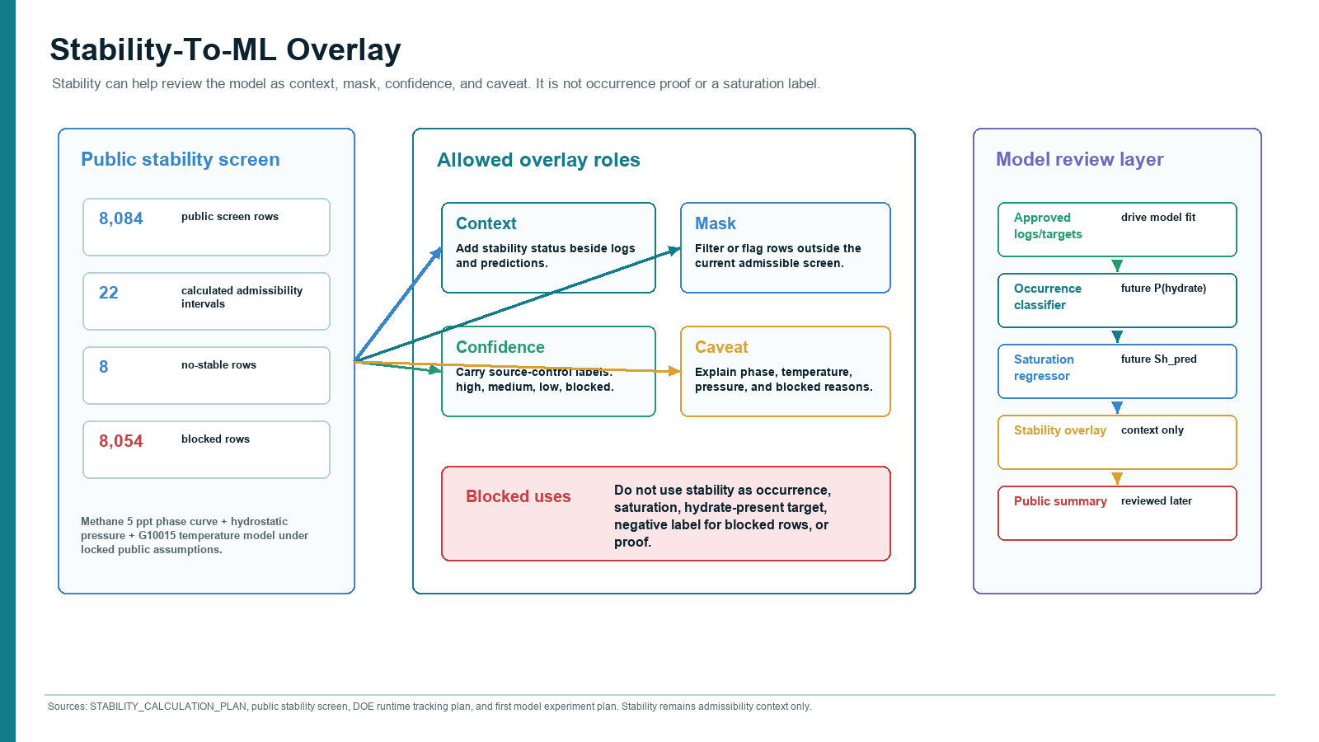

Slide 9
