Slide 1
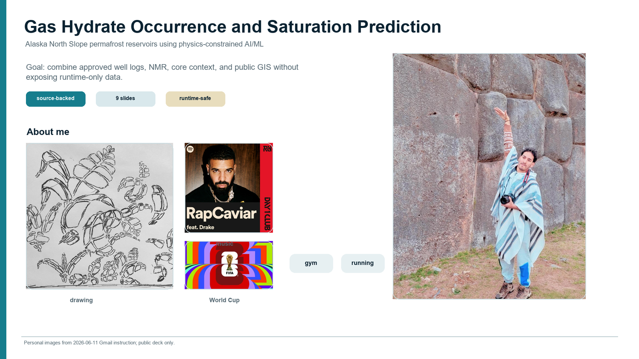

Slide 2
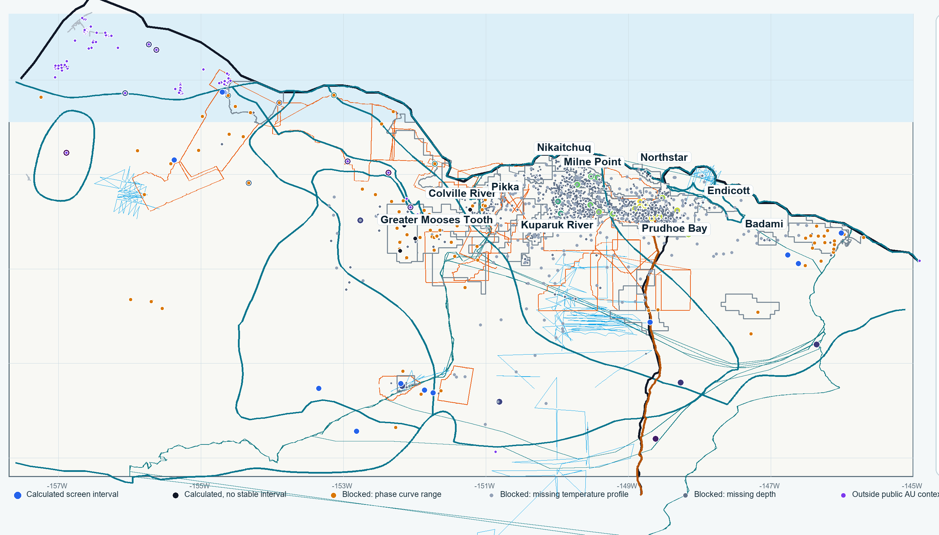
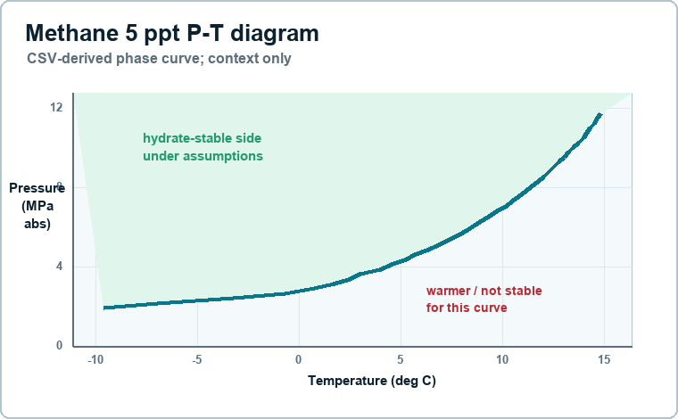
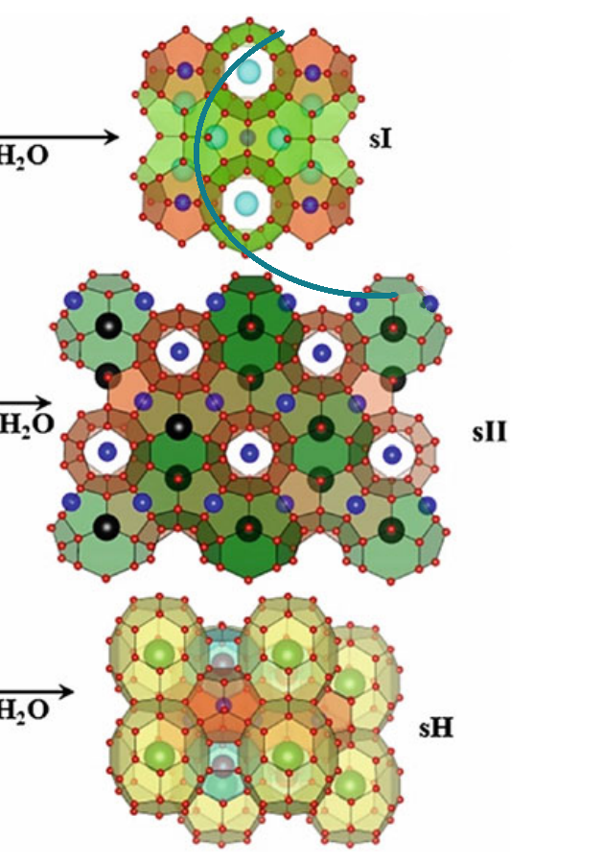
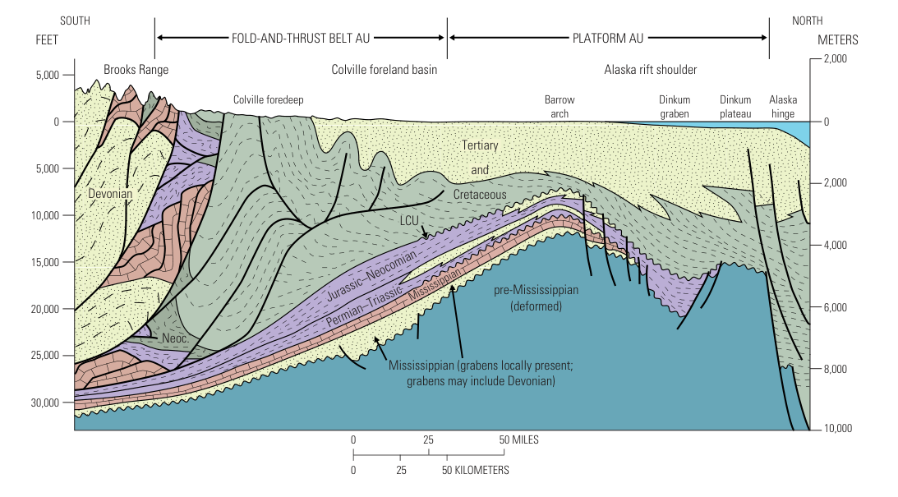
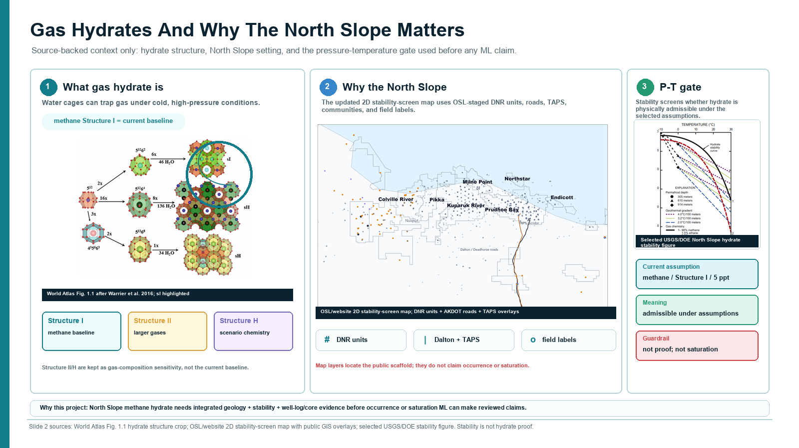
Methane Hydrate and the Alaska North Slope
Source-backed context: what hydrate is, why the region matters, and why P-T conditions vary.
P-T diagram: pressure, temperature, salinity, and gas mix control admissibility.
Structure I circled: methane-dominant baseline.
Combined 2D North Slope map: geology, public wells, permafrost controls, hydrate AUs, roads/TAPS/fields.
sI
sII
sH
noted
methane-rich baseline
larger gases / mixed gas
large hydrocarbon + methane
scenario only
Gas origin
Why it matters
Guardrail
biogenic CH4 vs thermogenic C2+ shifts stability
USGS 2018 mean: about 54 Tcf technically recoverable hydrate gas
context only; not proof, saturation, producibility, or ranking
Regional cross-section context explains why permafrost, structure, and stability vary across the map.
Slide labels are concise; detailed citations stay in the companion notes.
No hydrate proof. No occurrence/saturation claim.

Slide 3
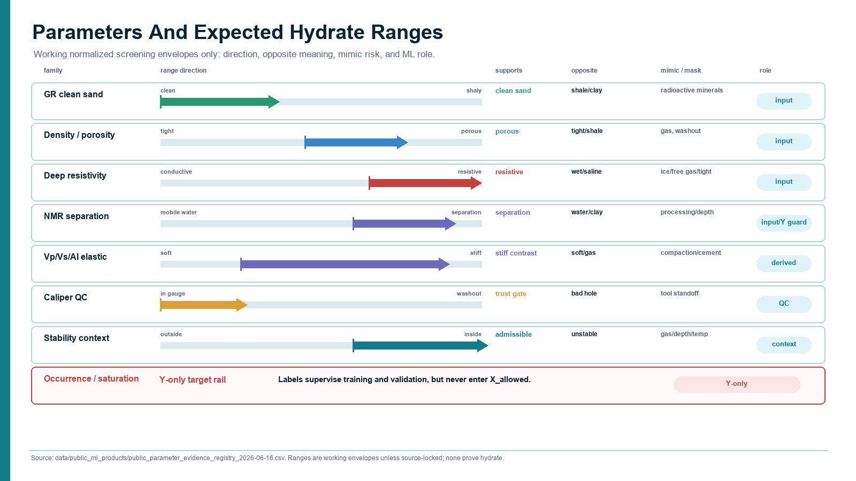

Slide 4
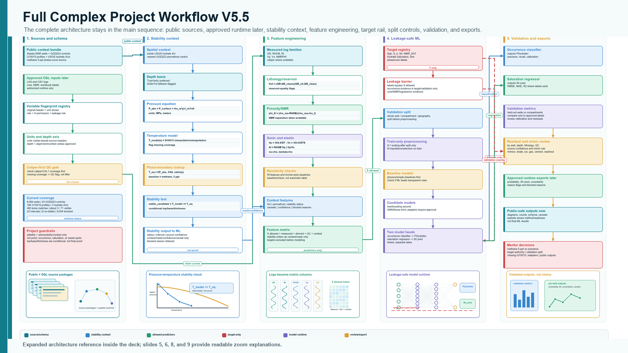

Slide 5
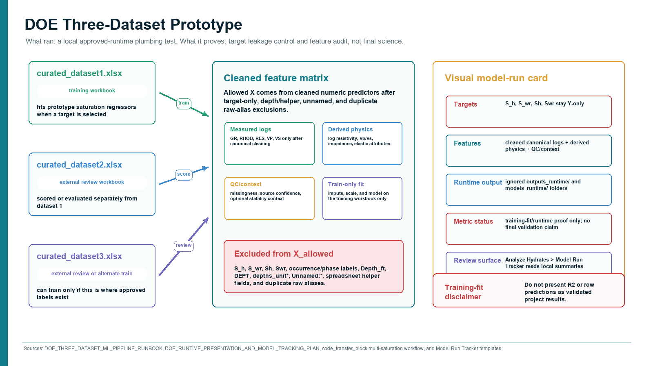

Slide 6
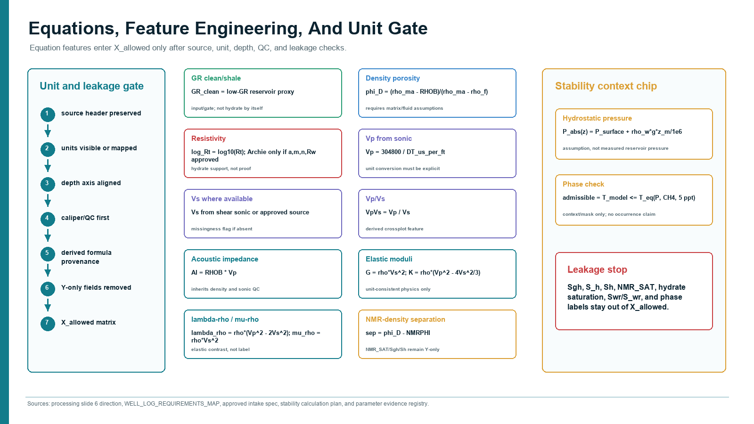

Slide 7
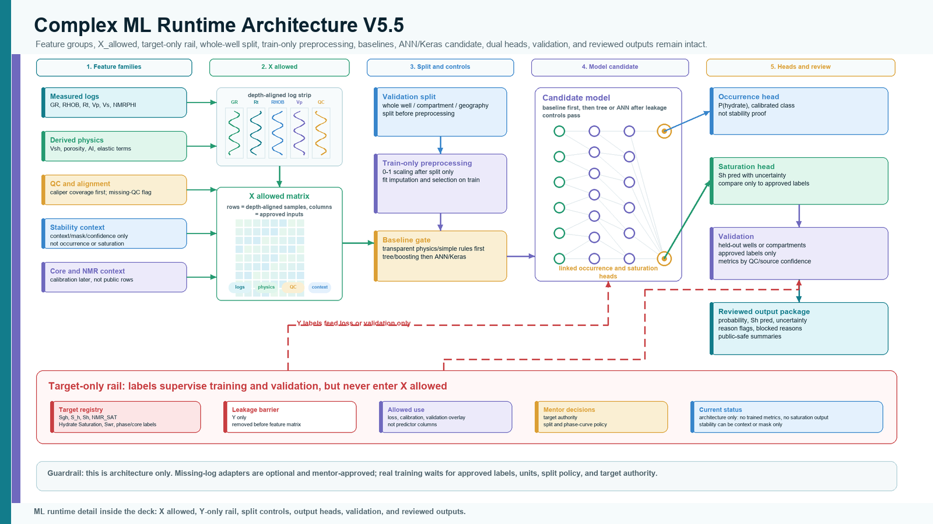

Slide 8
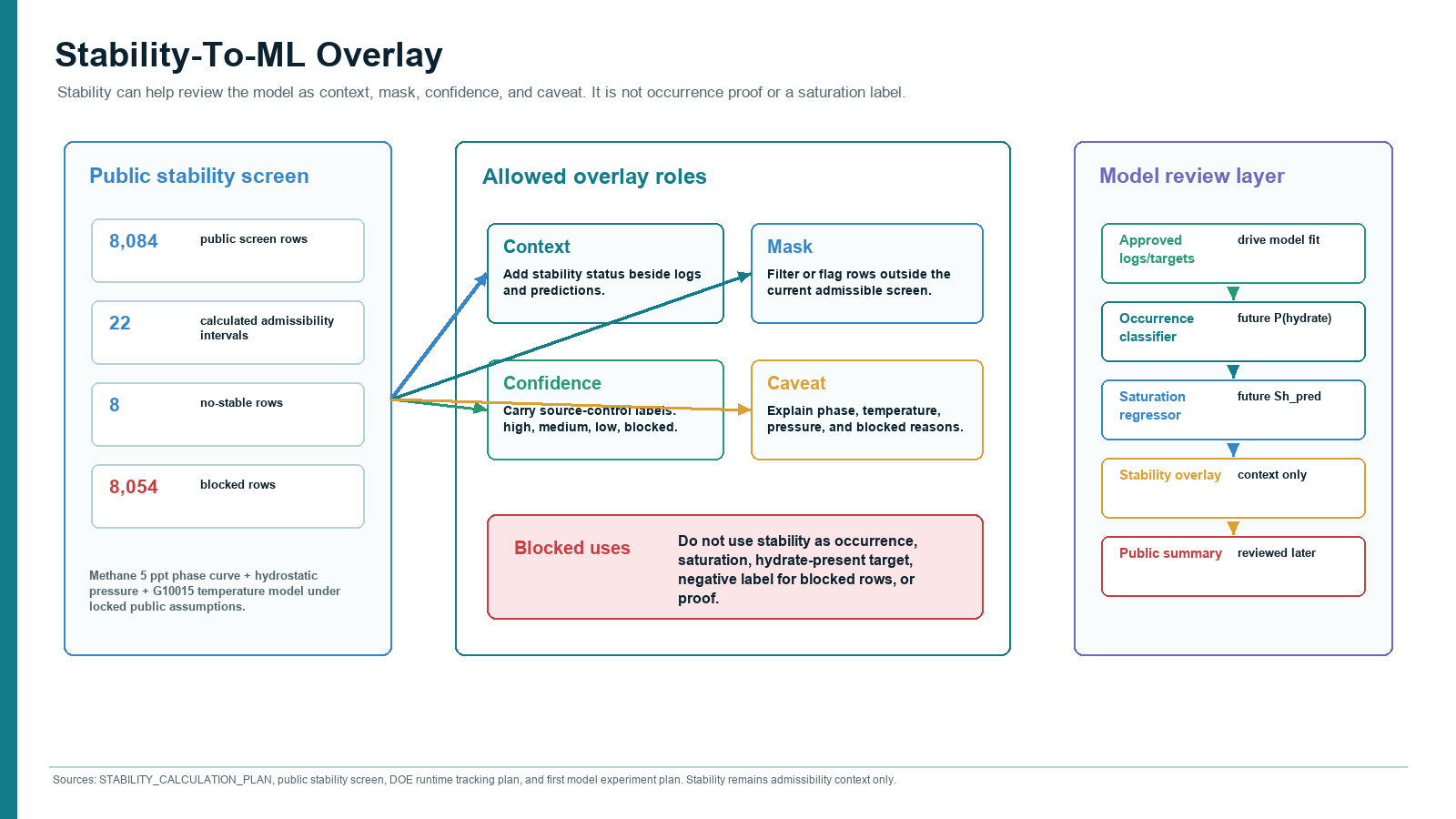

Slide 9
