Slide 1
North Slope Gas Hydrate ML Workflow
Public-source context + approved-runtime pathway
Editable rebuild for mentor review
Editable photo placeholder
Goal: connect regional geology, stability context, well logs, lithology/core calibration, and guarded ML outputs.
Today: no hydrate proof, no trained metrics, no occurrence/saturation predictions.
Replace manually with a professional photo
No rap-caviar content
All text is selectable
Editable deck rebuild; source figures remain separate image objects where scientific content must be preserved.
Notes:
Open cleanly, establish the purpose, and tell the audience this is a workflow and review deck, not a final results deck. The photo slot is intentionally blank for manual replacement.

Slide 2
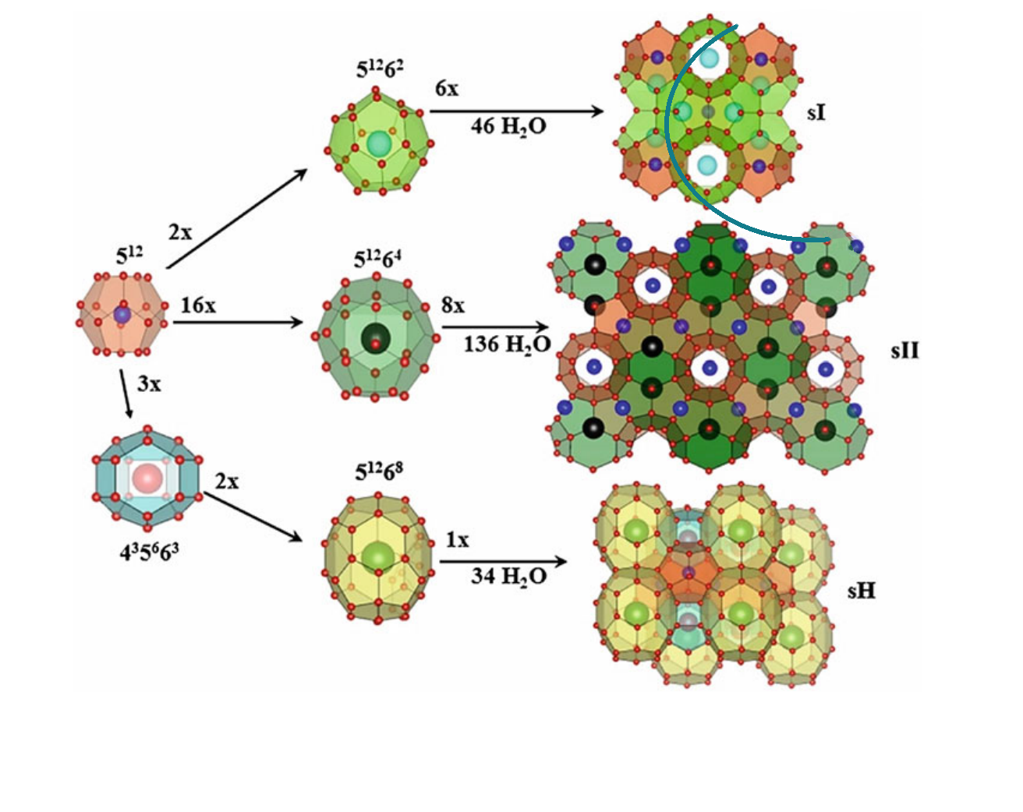
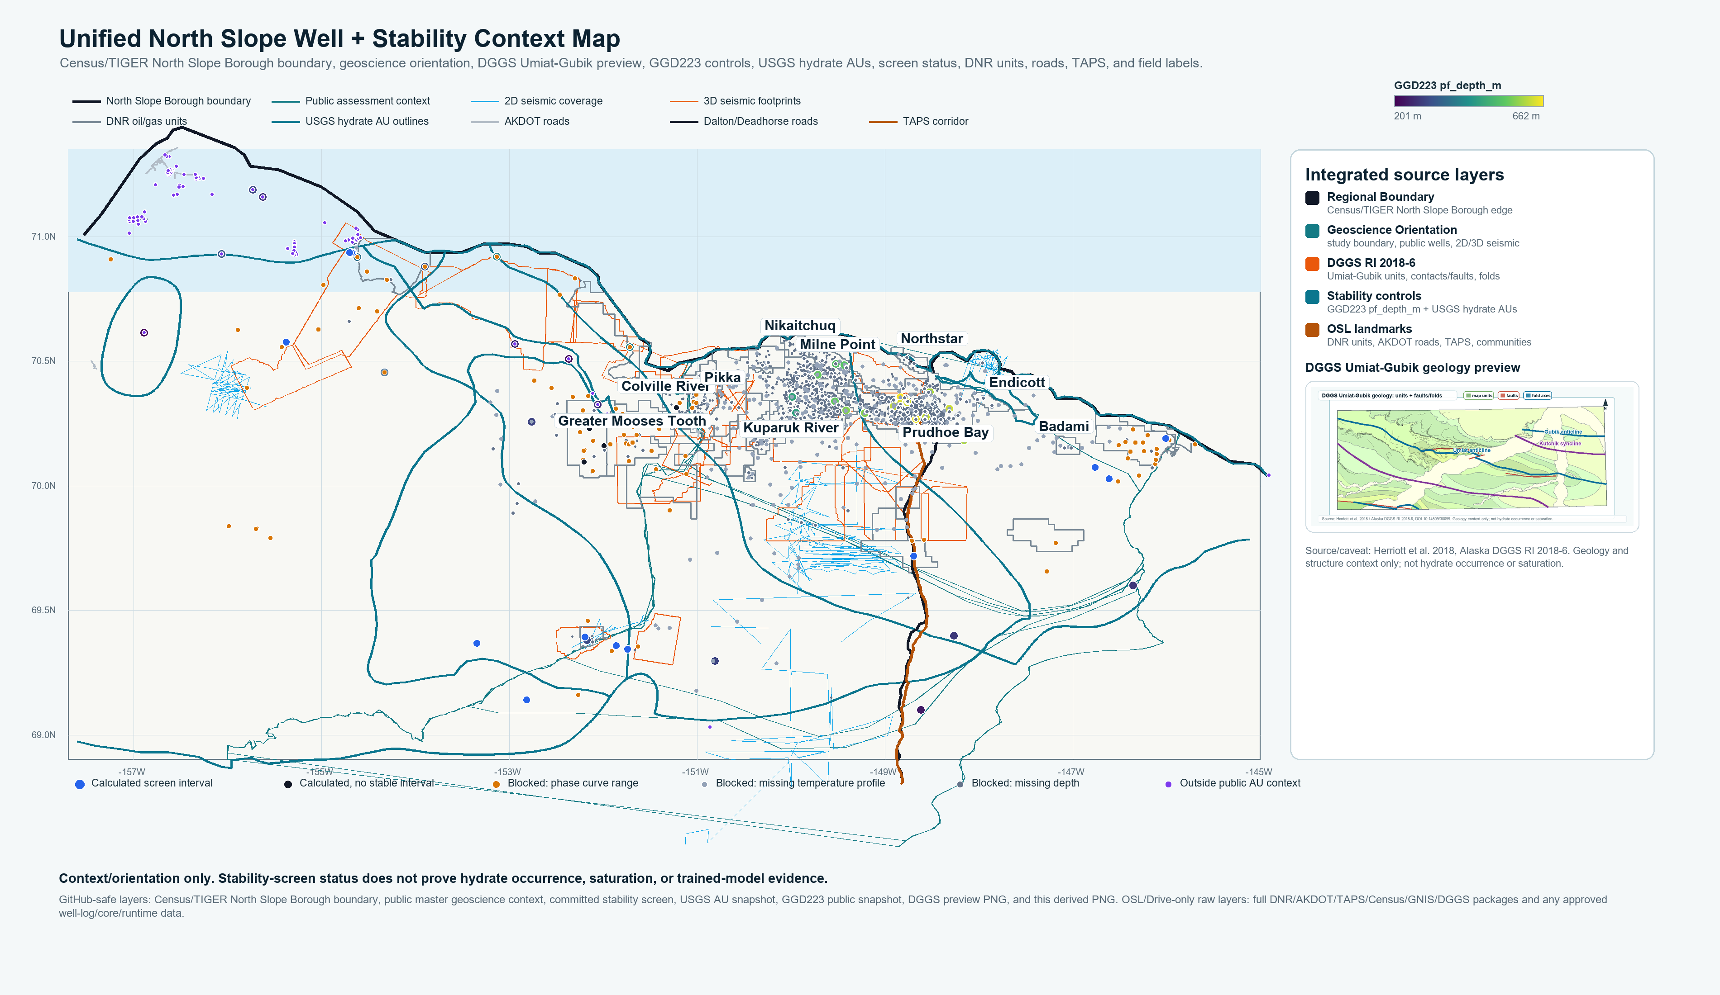
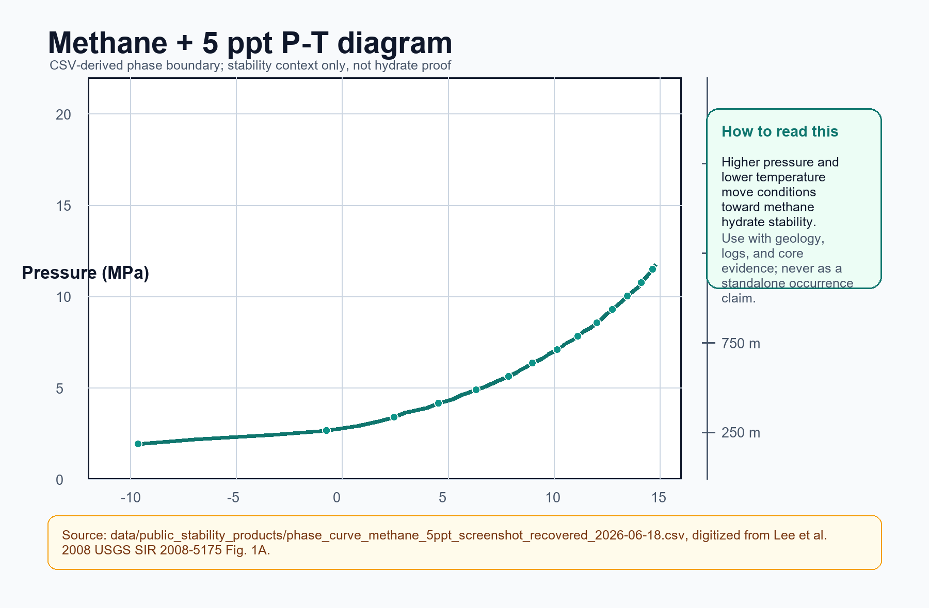
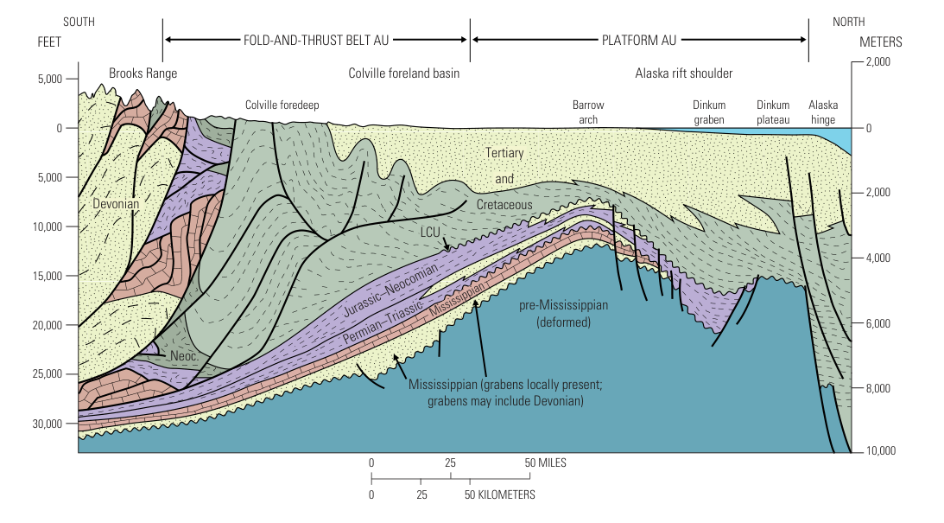
Methane Hydrate + North Slope Context
What hydrate is, why North Slope matters, and why P-T stability is only the first screen
Unified North Slope map
Structure I is the methane baseline; Structure II/H require gas-composition context.
P-T diagram: pressure-temperature admissibility only; not occurrence or saturation evidence.
North Slope hydrate interpretation needs three things together: reservoir-quality sands, P-T context, and log/core calibration.
Biogenic and thermogenic gas sources can both matter; gas composition policy remains a mentor/runtime decision.
Cross-section context: stratigraphy and structure shape the stability setting.
Source figures and map are image objects; labels, circle, callouts, title, and caveat are editable.
Notes:
Use this slide to define methane hydrate, frame the Alaska North Slope, and explain that P-T stability is a necessary context screen, not proof. Detailed citations belong in the companion notes.

Slide 3
Log Signals, Lithology, And Core Calibration
Directional curve movements are evidence to review, not standalone hydrate proof
Depth
Lithology
Core
Lower GR suggests cleaner sand; it is a lithology cue, not hydrate proof.
GR
Res.
Vp/Vs
NMR/den.
500
shale / mixed
Resistivity can rise when hydrate replaces conductive pore water, but tight rock, gas, salinity, invasion, and borehole effects can mimic it.
650
clean sand
Vs matters because shear response ties to the solid frame, contacts, cementation, and hydrate-bearing stiffness.
800
mixed
950
Density, neutron, and NMR separations give context for pore fluids and pore solids, not a final saturation claim.
sand
1100
Core/coring/NMR strip: calibration and target authority after source review.
Sand intervals are log-response targets for review; core/NMR/pressure-core evidence calibrates labels and uncertainty.
Context/orientation only. No hydrate proof, occurrence prediction, saturation prediction, trained metric, or sweet-spot ranking.
Notes:
Walk left to right: lithology first, then curve movement, then core calibration. Emphasize that signals are complementary and mimic-prone. No equation or ML architecture belongs on this slide.

Slide 4
Four-Well Workflow: Audience Version
The complex architecture reduces to six editable steps
Inputs logs + core/NMR + lithology + public context
Prepare preserve headers, units, depth alignment, QC
Leakage barrier inputs separate from saturation and occurrence labels
Model path occurrence and saturation are linked but separate
Validate whole-well or geography-aware split before metrics
Review outputs figures, uncertainty, maps, manuscript exports
What collapsed from the full diagram: source intake, schema, QC, feature engineering, target registry, model runner, tracker, and export panels.
What stays in Word/appendix: full architecture poster, detailed runtime package names, and all source-code/module wiring.
Two-minute story: protect the data boundary, align variables by depth, train only after leakage checks, then review claims with core/lithology evidence.
This is an implementation plan, not a trained model result.
Notes:
Two-minute script: First, the project takes public regional context and approved well data separately. Second, every curve keeps its original header and unit before normalization. Third, saturation and occurrence evidence are held behind a leakage barrier. Fourth, occurrence classification and saturation regression are separate model heads. Fifth, no metric is meaningful until the split is by complete well or geography. Finally, outputs are reviewed figures and uncertainty summaries, not automatic hydrate claims.

Slide 5
Equation-Only Slide: Physics Transforms And Gates
logs
context
derived
Large equations; symbol meanings stay editable below each card
Pressure-depth screen
Acoustic impedance
P_abs = P0 + rho_w x g x z
AI = rho_b x Vp
absolute pressure surface pressure water density gravity depth
impedance bulk density compressional velocity
Velocity ratio
Elastic attributes from logs
R =
Vp
mu-rho = rho_b x Vs^2
velocity ratio
Vs
lambda-rho = rho_b x (Vp^2 - 2Vs^2)
compressional velocity over shear velocity; compare frame and pore-fluid response
shear / lambda-rho features from density, Vp, and Vs; not proof by themselves
Equations transform logs and context into review features. They do not create final hydrate occurrence or saturation claims.
No map, no ML diagram, no trained metrics, and no approved rows on this slide.
Notes:
Keep this slide about what each equation converts. The user can edit every equation label and card. Saturation equations are deliberately not included until exact source equation, units, and target/input role are approved.

Slide 6
Evidence And Unit Gate Before Modeling
A high-level gate keeps measurements, derived features, and targets separate
One sentence takeaway: the model is only credible after units, curve roles, lithology context, and target-only labels are separated.
1. Original headers DEPTH, GR, RHOB, RES, Vp, Vs, NMR
2. Units + depth feet/meters and curve alignment preserved
3. Feature role measured, derived, QC, context
4. Target barrier Sgh / Sh / NMR_SAT stay Y-only
Four-well scope: go deeper on lithology/core review instead of claiming broad model coverage.
False positives are expected: gas, tight rock, salinity, borehole washout, and missing curves must be reviewed.
Outputs stay review-ready: plots, uncertainty, source notes, and mentor decisions before final claims.
Context/orientation only. No hydrate proof, occurrence prediction, saturation prediction, trained metric, or sweet-spot ranking.
Notes:
This slide should be explained in less than one minute. Detailed source tables, exact screenshots, and header lists belong in the companion material.

Slide 7
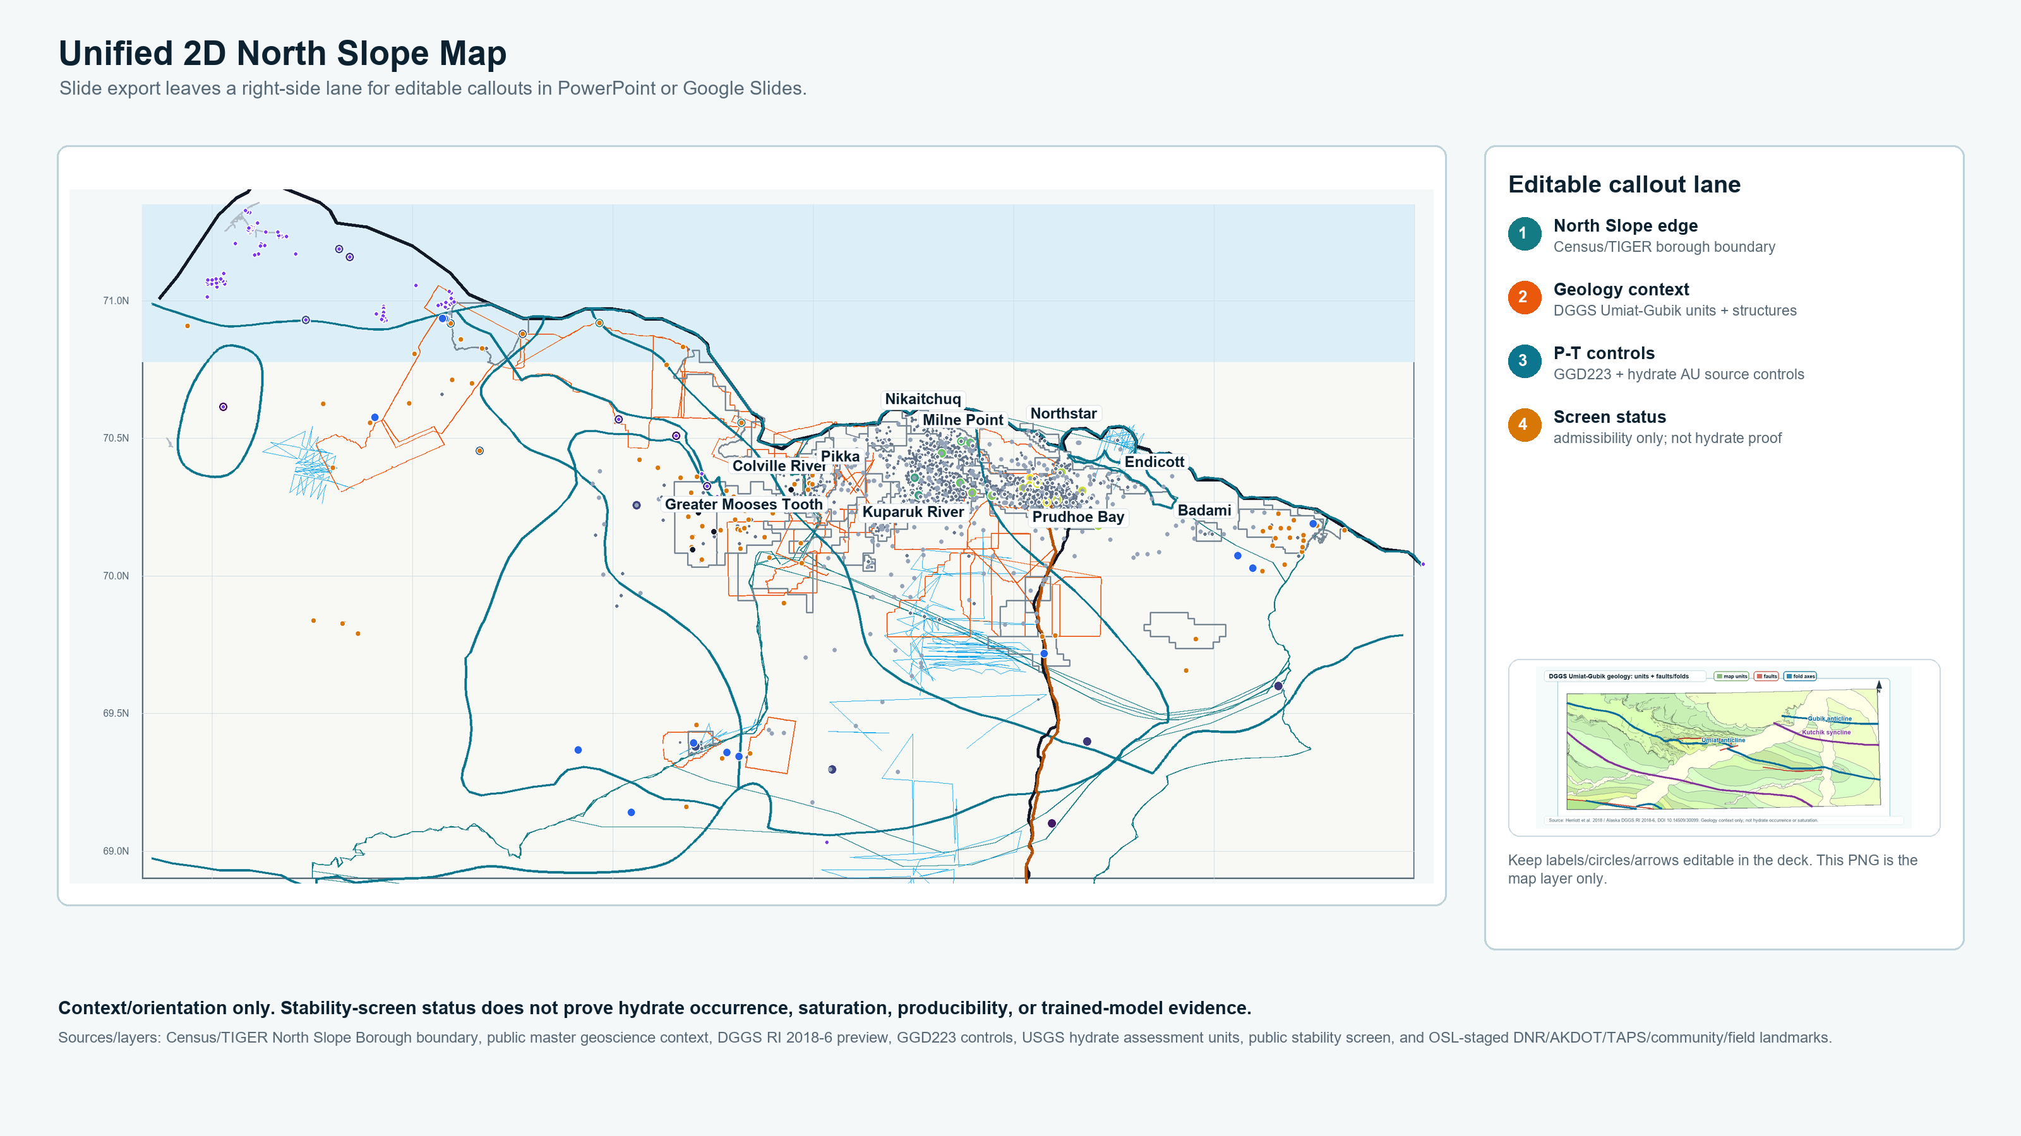
Unified North Slope Well + Stability Context Map
Regional context for discussion only; this is not an ML overlay
What it combines public wells, USGS hydrate AUs, GGD223 controls, DNR units, roads, TAPS, field labels
What colors mean stability-screen status categories, not hydrate occurrence classes
What it cannot claim no saturation, no producibility, no sweet-spot ranking, no trained-model evidence
Use as Slide 7 context and as a discussion anchor for source gaps.
Context/orientation only. Stability-screen status does not prove hydrate occurrence, saturation, or trained-model evidence.
Notes:
Say that this map organizes public context: field labels, roads, TAPS, permafrost controls, hydrate AU outlines, and stability-screen status. Do not use it as a prediction or discovery map.

Slide 8
Planned Four-Well Results Review Logic
Editable placeholders for DOE exports; no fake results
MTE / Mount Elbert header verified
IGS / Ignik Sikumi header verified
Hydrate-01 source-case anchor
HYDRATE 02 source-case anchor
DOE runtime export row-free review figures after approved execution
Lithology/core calibration clean sand vs shale/mixed facies
False-positive review resistivity, gas, salinity, washout, tight rock
Separate outputs occurrence review and saturation review are not merged
Future slots: per-well log panels, calibration table, uncertainty flags, and reviewed map/table exports. Leave blank until DOE/Yubi access and mentor target authority are available.
No trained metrics, occurrence probabilities, saturation predictions, or rankings are shown.
Notes:
Frame this as a results-review plan. The audience should understand what will be produced later, how false positives are controlled, and why occurrence and saturation remain separate.

Slide 9
Built, Not Claimed, And Next Actions
Close with a defensible status instead of unsupported results
Built now - Public GIS/stability scaffold - Unified map and source inventory - Header-only workbook mapping - Public well/API anchors - Equation and feature-role logic - DOE runtime skeleton and tracker
Not claimed yet - Hydrate proof - Final stability intervals - Occurrence prediction - Saturation prediction - Trained metrics - Sweet-spot ranking - Final target-label authority
Next actions - Regain DOE/Yubi access - Download public papers/supplements to Drive/OSL - Run header/runtime audit - Export row-free figures - Review target authority with mentor - Update Word companion
Final message: the project is ready for approved-runtime execution and mentor review, not final hydrate claims.
All slide text, boxes, dividers, and status cards are editable.
Notes:
Close by saying the project has the public context, source discipline, and workflow skeleton ready. The remaining step is approved runtime execution and mentor target authority, not embellishing results.

