Slide 1

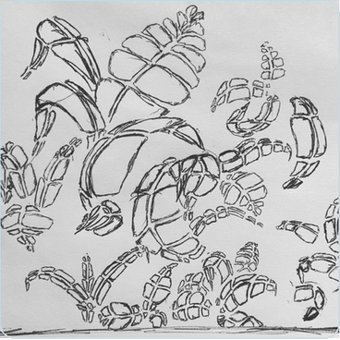
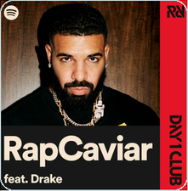

Gas Hydrate Occurrence and Saturation Prediction
Alaska North Slope permafrost reservoirs using physics-constrained AI/ML
Goal: combine approved well logs, NMR, core context, and public GIS without exposing runtime-only data.
source-backed
9 slides
runtime-safe
About me
gym
running
drawing
World Cup
Personal images from 2026-06-11 Gmail instruction; public deck only.
Notes:
Use this opener as personal context only; no scientific claims are made here.

Slide 2
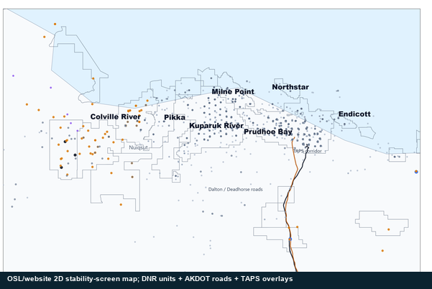
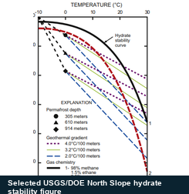
Gas Hydrates And Why The North Slope Matters
Source-backed context only: hydrate structure, North Slope setting, and the pressure-temperature diagram used before any ML claim.
1
What gas hydrate is
2
Why the North Slope
3
P-T diagram
Water cages can trap gas under cold, high-pressure conditions.
The updated 2D stability-screen map uses OSL-staged DNR units, roads, TAPS, communities, and field labels.
The diagram screens whether hydrate is physically admissible under selected assumptions.
methane Structure I = current baseline
Editable hydrate structure schematic
Structure I
methane-dominant baseline for this project
Structure II
larger hydrocarbons or mixed gas context
Selected USGS/DOE North Slope hydrate stability figure
Structure H
Current assumption
larger molecule and scenario-chemistry context
methane / Structure I / 5 ppt
Public 2D context map: DNR units + AKDOT roads + TAPS overlays
Meaning
Structure I
Structure II
Structure H
admissible under assumptions
methane baseline
larger gases
scenario chemistry
#
DNR units
|
Dalton + TAPS
o
field labels
Guardrail
not proof; not saturation
Structure II and H can host larger hydrocarbons or mixed gas; methane Structure I is the project baseline.
Map layers locate the public scaffold; they do not claim occurrence or saturation.
Why this project: North Slope methane hydrate needs integrated geology + stability + well-log/core evidence before occurrence or saturation ML can make reviewed claims.
Context only: hydrate structure, public North Slope map layers, and a P-T stability diagram. Stability is not hydrate proof.
Notes:
Use this slide to set context. The hydrate structure image has no drawn circle. The P-T panel is an admissibility diagram only.

Slide 3
Parameters And Expected Hydrate Ranges
Working normalized screening envelopes only: direction, opposite meaning, mimic risk, and ML role.
family
range direction
supports
opposite
mimic / mask
role
GR clean sand
clean
shaly
clean sand
shale/clay
radioactive minerals
input
Density / porosity
tight
porous
porous
tight/shale
gas, washout
input
Deep resistivity
conductive
resistive
resistive
wet/saline
ice/free gas/tight
input
NMR separation
mobile water
separation
separation
water/clay
processing/depth
input/Y guard
Vp/Vs/AI elastic
soft
stiff
stiff contrast
soft/gas
compaction/cement
derived
Caliper QC
in gauge
washout
trust gate
bad hole
tool standoff
QC
Stability context
outside
inside
admissible
unstable
gas/depth/temp
context
Occurrence / saturation
Y-only target rail
Labels supervise training and validation, but never enter X_allowed.
Y-only
Source: data/public_ml_products/public_parameter_evidence_registry_2026-06-16.csv. Ranges are working envelopes unless source-locked; none prove hydrate.
Notes:
Explain directional movement, not final thresholds. Target labels stay out of X_allowed.

Slide 4
Four-Well Workflow: Audience Version
The full architecture is reduced to editable steps: source intake, QC, leakage guardrails, model path, validation, and reviewed outputs.
Editable main flow
1
Inputs
2
Prepare
3
Leakage barrier
4
Model path
5
Validate
6
Review outputs
approved logs + core/NMR + lithology + public GIS context
preserve headers, units, depth axis, and missingness flags
remove saturation and occurrence labels from predictors
occurrence and saturation stay linked but separate
whole-well or geography-aware split before metrics
figures, uncertainty, maps, and manuscript exports
What is collapsed from the full diagram
What stays out of predictor inputs
Two-minute talk-track structure
source library and workbook intake detail
hydrate saturation labels
Start with what data are allowed.
schema mapping and unit normalization
core hydrate observations
Explain how source names and units survive QC.
feature families and runtime branches
pressure-core saturation
Show why targets are separated from features.
export packaging for Word, slides, and website
occurrence labels and final interpretations
End with reviewed outputs, not unsupported results.
Y-only evidence supports labels, calibration, validation, and review.
This slide explains process, not final ML performance. Approved runtime outputs are reviewed later against lithology, core/NMR calibration, uncertainty, and false positives.
Sources: project revision base, science-to-ML logic ladder, baseline source ledger, and editable rebuild source-of-truth notes.
Notes:
Two-minute script: first, the workflow begins with approved logs and core/NMR/lithology evidence while public GIS remains context only. Second, every header, unit, and depth axis is preserved so features are traceable. Third, saturation and occurrence labels are locked into the Y-only rail and cannot leak into X_allowed. Fourth, occurrence and saturation can be modeled as linked but separate outputs after validation. Close by saying the current deck explains the review system, not final hydrate results.

Slide 5
Equation Checks For The Four-Well Workflow
log input
core/lab
stability
check
Large editable checks only: source-backed quantities, real fraction bars, readable words under each symbol, and no result claim.
Hydrostatic pressure-depth relation
Velocity ratio
Acoustic impedance
Pabs(z) = P0 +
rho w g z
Vp
VpVs =
AI = RHOB * Vp
1e6
Vs
Pabs
P0
rho w
g
z
1e6
VpVs
Vp
Vs
AI
RHOB
Vp
absolute pressure
surface pressure
fluid density
gravity
depth
Pa to MPa
velocity ratio
P wave velocity
S wave velocity
acoustic impedance
bulk density
P wave velocity
Shear rigidity
Electrical saturation baseline - optional review check only
a * Rw
Sw^n =
Sh ~= 1 - Sw
G = RHOB * Vs^2
Rt * phi^m
G
RHOB
Vs
Sw
n
a
Rw
Rt
phi
m
Sh
shear modulus
bulk density
S wave velocity
water saturation
saturation exponent
Archie constant
water resistivity
deep resistivity
porosity
cementation exponent
review estimate
Guardrail: equations convert or compare quantities. They do not prove hydrate occurrence, final stability, saturation, producibility, or ranking.
Sources: stability calculation plan; email equation set; science logic ladder; baseline source ledger; well-log requirements map.
Notes:
Use this slide as equation checks only. Words under symbols are intentionally large and editable. Do not present equations as hydrate proof or final results.

Slide 6
Equations, Feature Engineering, And Unit Gate
Equation features enter X_allowed only after source, unit, depth, QC, and leakage checks.
Unit and leakage gate
GR clean/shale
Density porosity
Stability context chip
GR_clean = low-GR reservoir proxy
phi_D = (rho_ma - RHOB)/(rho_ma - rho_f)
1
source header preserved
input/gate; not hydrate by itself
requires matrix/fluid assumptions
Hydrostatic pressure
Resistivity
Vp from sonic
P_abs(z) = P_surface + rho_w*g*z_m/1e6
2
units visible or mapped
log_Rt = log10(Rt); Archie only if a,m,n,Rw approved
Vp = 304800 / DT_us_per_ft
assumption, not measured reservoir pressure
hydrate support, not proof
unit conversion must be explicit
3
depth axis aligned
Phase check
Vs where available
Vp/Vs
admissible = T_model <= T_eq(P, CH4, 5 ppt)
4
caliper/QC first
Vs from shear sonic or approved source
VpVs = Vp / Vs
context/mask only; no occurrence claim
missingness flag if absent
derived crossplot feature
5
derived formula provenance
Acoustic impedance
Elastic moduli
AI = RHOB * Vp
G = rho*Vs^2; K = rho*(Vp^2 - 4Vs^2/3)
Leakage stop
6
Y-only fields removed
inherits density and sonic QC
unit-consistent physics only
Sgh, S_h, Sh, NMR_SAT, hydrate saturation, Swr/S_wr, and phase labels stay out of X_allowed.
7
X_allowed matrix
lambda-rho / mu-rho
NMR-density separation
lambda_rho = rho*(Vp^2 - 2Vs^2); mu_rho = rho*Vs^2
sep = phi_D - NMRPHI
elastic contrast, not label
NMR_SAT/Sgh/Sh remain Y-only
Sources: processing slide 6 direction, WELL_LOG_REQUIREMENTS_MAP, approved intake spec, stability calculation plan, and parameter evidence registry.
Notes:
This is the gate between source variables and model-ready features. Keep targets out of X_allowed.

Slide 7
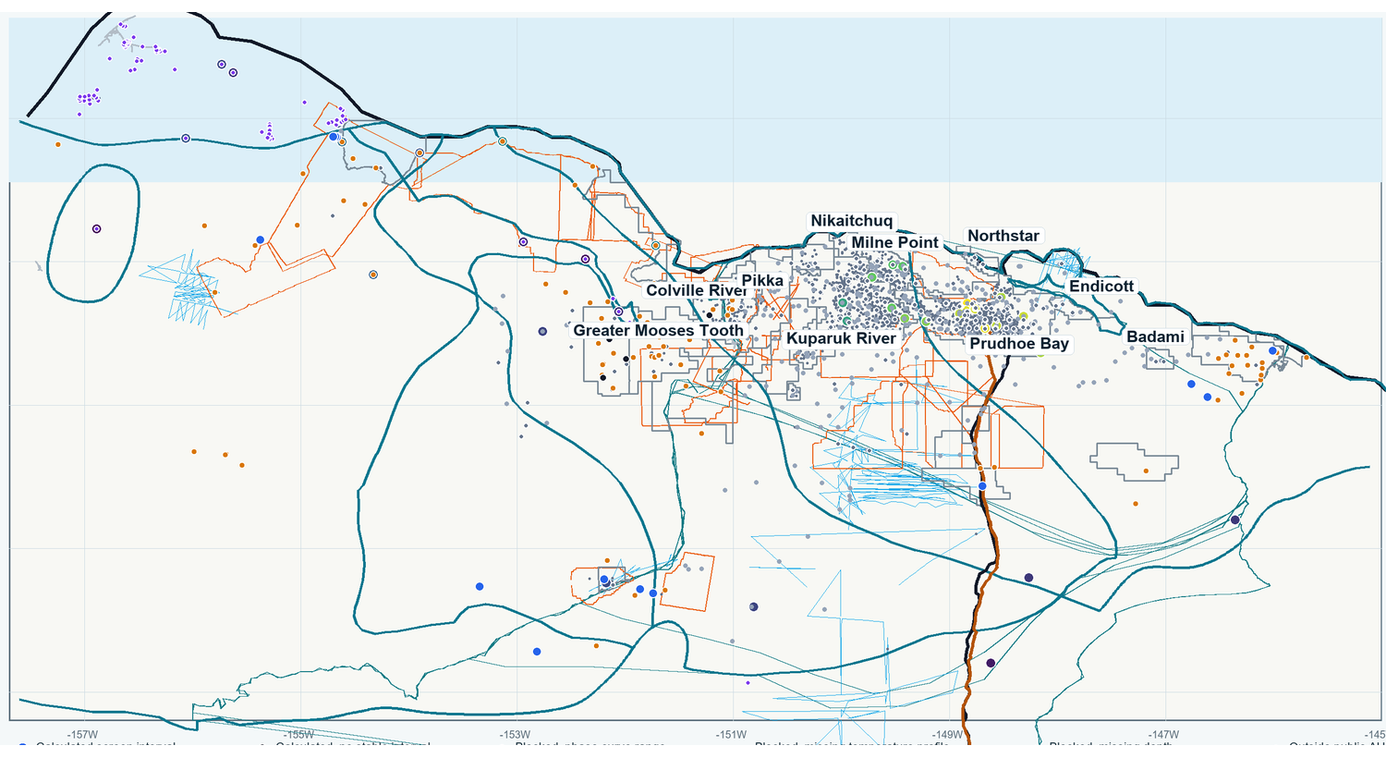
Unified North Slope Well + Stability Context Map
Regional context only: public GIS layers and stability-screen status for discussion, not an ML overlay or hydrate proof.
Readable orientation layers
USGS hydrate AU outlines, DNR oil/gas unit outlines, AKDOT roads, Dalton/Deadhorse roads, TAPS corridor, field labels, and public wells.
Status points stay separate
Point colors are stability-screen status categories. They are not occurrence labels, saturation labels, or trained-model outputs.
How to discuss it
Use the map to locate the wells and public geologic context before showing planned result-review logic.
Calculated screen interval
Calculated, no stable interval
Blocked: phase curve range
Outside public AU context
Required caveat
Context/orientation only. Stability-screen status does not prove hydrate occurrence, saturation, or trained-model evidence.
Map source: public/OSL-staged unified North Slope GIS export. Raw DNR/AKDOT/TAPS/GNIS/DGGS packages remain Drive/OSL-only when not GitHub-safe.
Notes:
Use this map as context only. Mention public field labels, DNR units, roads, TAPS, USGS hydrate AU outlines, GGD223 controls, and stability-screen status. Do not call it an ML overlay or a hydrate occurrence map.

Slide 8
Stability-To-ML Overlay
Stability can help review the model as context, mask, confidence, and caveat. It is not occurrence proof or a saturation label.
Public stability screen
Allowed overlay roles
Model review layer
8,084
public screen rows
Context
Mask
Approved logs/targets
drive model fit
Add stability status beside logs and predictions.
Filter or flag rows outside the current admissible screen.
22
calculated admissibility intervals
Occurrence classifier
future P(hydrate)
Confidence
Caveat
Saturation regressor
8
no-stable rows
Carry source-control labels: high, medium, low, blocked.
Explain phase, temperature, pressure, and blocked reasons.
future Sh_pred
8,054
blocked rows
Stability overlay
context only
Blocked uses
Do not use stability as occurrence, saturation, hydrate-present target, negative label for blocked rows, or proof.
Public summary
reviewed later
Methane 5 ppt phase curve + hydrostatic pressure + G10015 temperature model under locked public assumptions.
Sources: STABILITY_CALCULATION_PLAN, public stability screen, DOE runtime tracking plan, and first model experiment plan. Stability remains admissibility context only.
Notes:
Use stability as context/mask/confidence/caveat only, never as occurrence or saturation labels.

Slide 9
What We Have Done, What Is Not Claimed, What Is Next
V5.5 makes the current contribution explicit while keeping every result claim inside the approved-runtime guardrails.
What we have done
What is not claimed
What is next
1
V5.4 deck updated into a V5.5 mentor sequence.
1
No hydrate proof.
1
Run DOE workflow in the approved runtime and keep outputs ignored until review.
2
Personal opener and source-backed hydrate/North Slope visuals preserved.
2
No final stability top/base/thickness claim.
2
Confirm target priority for S_h, S_wr, Sh, Swr and fraction-vs-percent policy.
3
Full complex workflow and ML runtime diagrams kept in the main sequence.
3
No public row-level approved data.
3
Review feature exclusions and stability overlay settings with mentor.
4
DOE three-dataset prototype, cleaned feature audit, and Model Run Tracker explained.
4
No occurrence prediction or saturation prediction.
4
Assign whole-well or compartment validation before final metrics.
5
Stability overlay framed as context, mask, confidence, and caveat only.
5
No final trained ML metrics, sweet spots, producibility ranking, or target authority.
5
Bring back only public-safe summaries after data-owner review.
Source/provenance trail
V5.5 panels are generated by build_full_workflow_diagram_deliverables.py from V5.4 panels, V5.2 authority plates, public stability products, DOE runbook/tracker docs, and source_visual_inventory.
Public scaffold: 8,084 stability rows; 22 calculated admissibility intervals; about 3/71 approved datasets visible for schema/runtime prototyping.
Notes:
Close by emphasizing current build status, not final hydrate claims.

