Slide 1
IBM Hack Challenge
(Help me with my mood)

Slide 2

Techieez
Adithya AN
Niresh Kumar R
AaliyaBanu Z
RupaSaiSree R
Frontend Developer
Backend Developer
Frontend Developer
Backend Developer

Slide 3





Tools
Android Studio
APIs
Watson Tone
Analyzer
Facebook API
Twitter API
`
Technology Stack
Platform
Android

Slide 4
Architecture Diagram
Getting user feed from fb or
Fb api call or

Slide 5

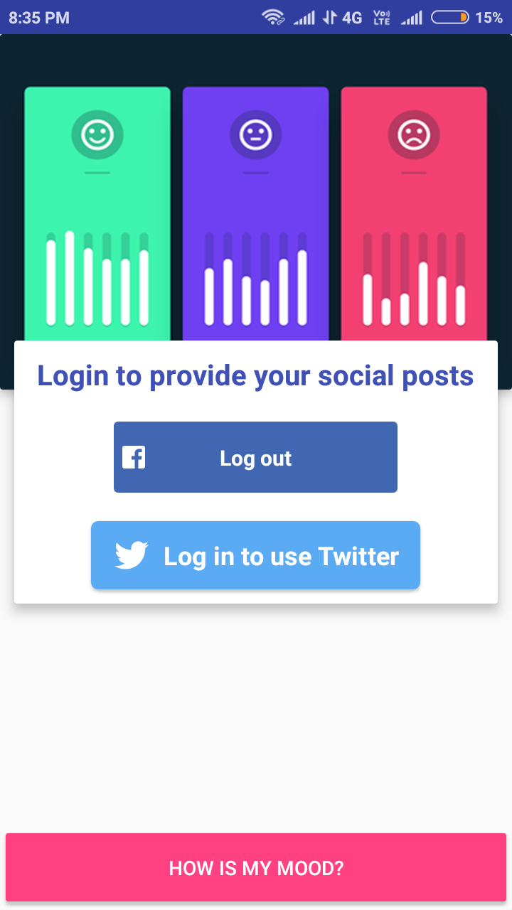
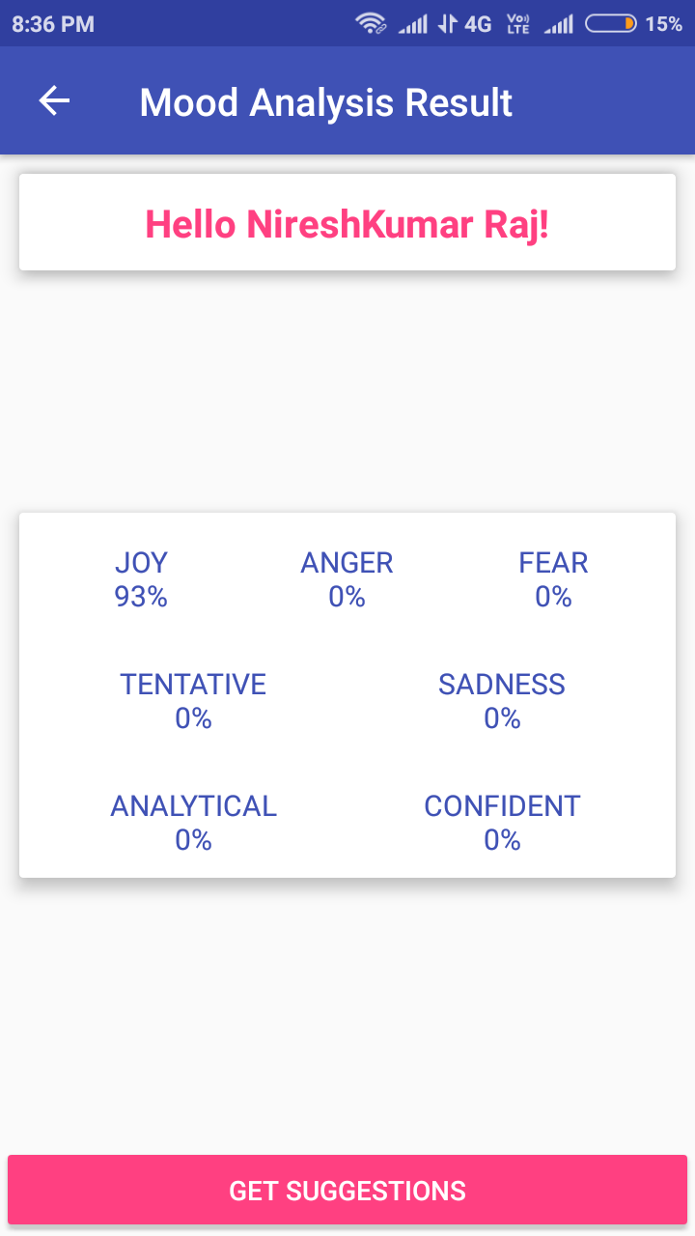
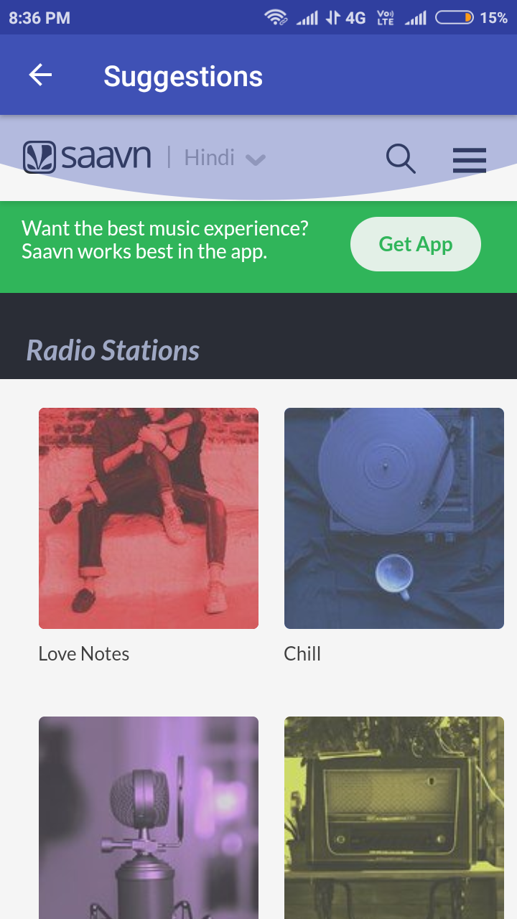
Screenshots

Slide 6
Key Functionalities
IBM Tone Analyser
Twitter API
Facebook API
Our Mobile App
Gets user’s tweets and preferences
Gets user’s posts and likes
Identifies the tone of the user.
The application uses the tone obtained from the Tone Analyzer and suggests methods to change the mood of a person .

Slide 7
Watson Tone Analyzer
The Tone Analyzer service analyzes the tone of input content.
Understand emotions, social tendencies and perceived writing style.
Uses linguistic analysis to detect emotional and language tones in written text.

Slide 8
Material Design
Make important things fast
Pictures are faster than words
Real objects are more fun than buttons and menus

Slide 9
Links to the Project;
GITHUB URL:
https://github.com/Rnkumar/IbmHackChallenge
Youtube Demo Url:
https://www.youtube.com/watch?v=Mt22Ccew_Sc

Slide 10

Thank you.

