Slide 1

Rapid ESOP
(EMPLOYEE STOCK OWNERSHIP PLAN)
ESOP MANAGEMENT SYSTEM
Presented by :
SAVALIYA SMIT ASHOKBHAI (200303108050)
PARMAR RIDHAM NILESHBHAI (200303108056)
MIROLIYA PARTH DIPAKBHAI (200303108170)
SOJITRA ZEEL MAGANBHAI (200303108175)
Under guidance of :
Prof. PRIYAM MEHTA
Assistant Professor
(IT Department)

Slide 2
Outline
Introduction
Motivation
Aim & Objectives
Applications
Literature Survey
Methodology
Proposed Work Flow
Implementation
Conclusion
References

Slide 3
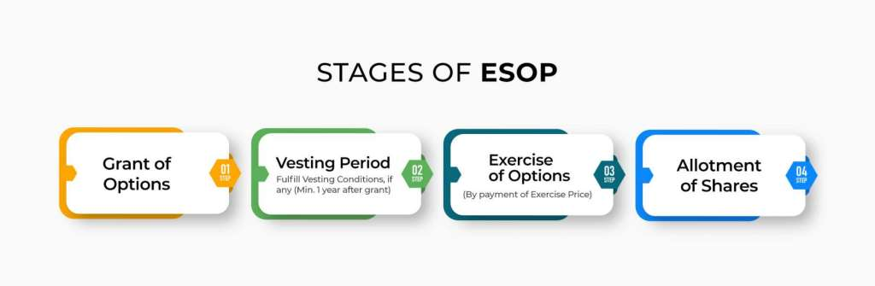
INTRODUCTION
ESOP stands for Employee Stock Ownership Plan, which is a specialized employee benefit plan designed to provide employees with an ownership stake in the company they work for.
The main purpose of ESOP is to align the interests of employees with those of the company's shareholders. By owning a portion of the company, employees have a vested interest in its success and are motivated to contribute to its growth and profitability.

Slide 4
Rapid esop
An ESOP Management System is a software platform or solution designed to streamline the administration and management of an Employee Stock Ownership Plan (ESOP). The ESOP management system typically includes a range of features and functionalities tailored to the specific needs of ESOP administration. Here are some key components and capabilities commonly found in ESOP management systems:
Participant Information Management
Share Allocation and Valuation
Vesting Schedules
Contract based ESOP vesting
Existing employee and external investors will engage ESOP transactions.

Slide 5
motivation
Rapid ESOP vision is to transform how equity is manage and traded in the private capital markets in the country .
Here we shown some key motivations and benefits of implementing such a system.
Efficiency and Accuracy: An ESOP Management System streamlines and automates various administrative tasks. This leads to increased efficiency in managing ESOP transactions, participant records, and compliance-related activities of employees.
Transparency and Empowerment: The system offers ESOP participants easy access to their individual account statements, vested shares, and transaction history. Enhanced transparency empowers employees to understand their ownership stake, fostering a sense of ownership and pride in the company's success.

Slide 6
motivation
Real-time Insights: With the system's reporting capabilities, management gains real-time insights into ESOP performance, participation rates, and ownership distribution. This data-driven approach allows for better decision-making and strategic planning.
Enhanced Employee Engagement: ESOPs are known to boost employee morale and engagement. An efficient management system amplifies these benefits by simplifying the ESOP process, making it easier for employees to participate and monitor their ownership stake.
Cost Savings: While implementing an ESOP Management System incurs an initial investment, the long-term cost savings in terms of reduced administrative hours and improved efficiency can be significant.
Future-proofing and Scalability: As the company grows, the ESOP Management System can adapt and scale to meet the changing needs of the ESOP and its expanding participant base.

Slide 7
Aim & objectives
Make a system which will help employees who have their own ESOP and want to sell and buy it to anyone who want to buy or sell.
Rapid ESOP helps companies digitally manage their ESOP programs.
Rapid ESOP marketplace provides solutions for shareholder and employees liquidity .
If an employee wants to send a message or if the company needs to share any information, they can do so by using the message box. It's a convenient way for both parties to communicate and exchange messages easily.
To harness the power of Rapid ESOPs as a dynamic performance incentive tool, acknowledging and rewarding employees based on their exceptional contributions to the company's growth and outstanding performance.

Slide 8
APPLICATIONS
Rapid ESOP software solution seeks to automate the equity management process for startups including work flows around ESOPs and transactions.
Rapid ESOP seeks to automate all processes for equity matters in private markets via it's digital platform.
Our platform offers an opportunity for external individuals to participate in ESOP transactions by buying and selling ESOPs.
Rapid ESOP can provide resources and tools to educate employees about the benefits of ESOP participation, its impact on their financial future, and the broader implications for the company's success.
Employees seeking expert advice and information on Employee Stock Ownership Plans (ESOPs) are encouraged to reach out to the designated expert. This expert will provide valuable advice and ideas related to ESOPs, assisting employees in making informed decisions about their participation in the program

Slide 9
Paper 1: The impact of ESOP on employee motivation
LITERATURE SURVEY
Publication - Year | Author name | Approach (Methodology) | Advantages | Limitations
2020 | Smith, J. and Johnson, L. | Quasi-experimental design with pre-and-post surveys, comparing employees in ESOP companies to non-ESOP companies | Employees in ESOP companies showed higher motivation levels compared to non-ESOP counterparts. | Limited sample size from specific industries may not generalize the results.

Slide 10
Paper 2: ESOP and company performance
Publication Year | Author name | Approach (Methodology) | Advantages | Limitations
2021 | Lee, S. and Chen, W | We conducted a study using financial data from publicly-traded companies over a ten-year period. | ESOP adoption was positively correlated with improved company performance over the long term. | The study only considered publicly-traded firms and may not apply to private companies

Slide 11
Paper 3: Employee perspectives on ESOPs
Publication Year | Author name | Approach (Methodology) | Advantages | Limitations
2019 | Brown, M. and Garcia, R. | Qualitative case studies and interviews with employees from five companies with ESOPs. | Employees generally viewed ESOPs positively, associating them with increased job satisfaction and commitment. | The study focused on specific industries, limiting generalizability

Slide 12

Methodology
We have designed the front-end of the system with great attention to detail, using the powerful React.js and bootstrap framework. By utilizing React.js, we have developed two user-friendly dashboards: one for the company and another for the employees. This ensures that everyone can easily navigate and use the system without any confusion. The experience has been made seamless and straightforward, so both the company and the employees find it easy to use.

Slide 13

We have built the backend using the efficient Spring Boot framework of Java. With Spring Boot, we created a powerful API that manages all the ESOP data. This includes both the company's ESOP information and the details related to employees' ESOP ownership. This robust architecture ensures that data is handled smoothly and effectively, enabling efficient management of ESOP for everyone involved, including the company and its employees.

Slide 14
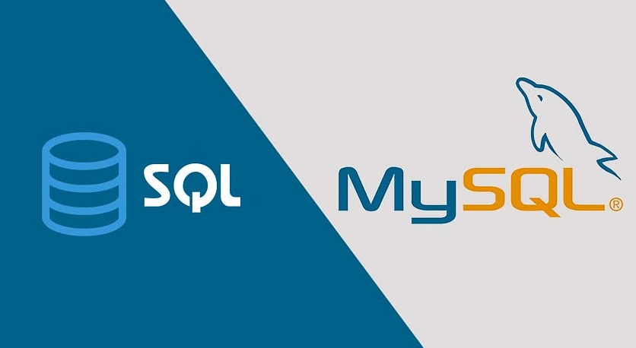
We decided to use the strong and dependable MySQL database to store and manage all the data for both employees and companies securely. MySQL has a track record of reliability and scalability, making it a great choice for our needs. It allows us to store and retrieve data smoothly, and we can effectively manage all ESOP-related information with confidence. Rest assured that your data is kept confidential and intact, providing a secure foundation for all users involved in the ESOP system.

Slide 15
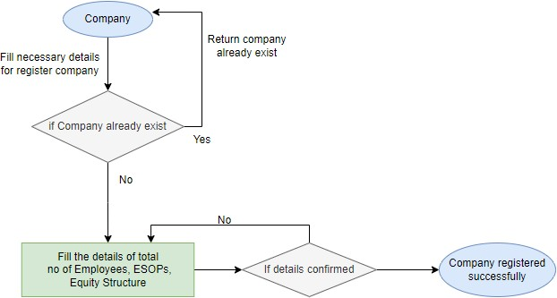
Proposed work flow
Company registration process

Slide 16
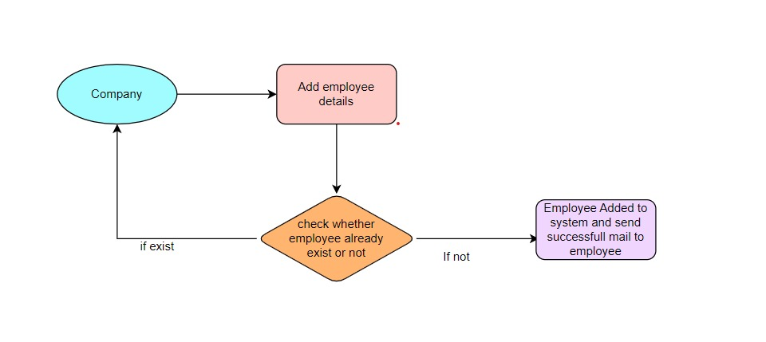
Employee registration process

Slide 17
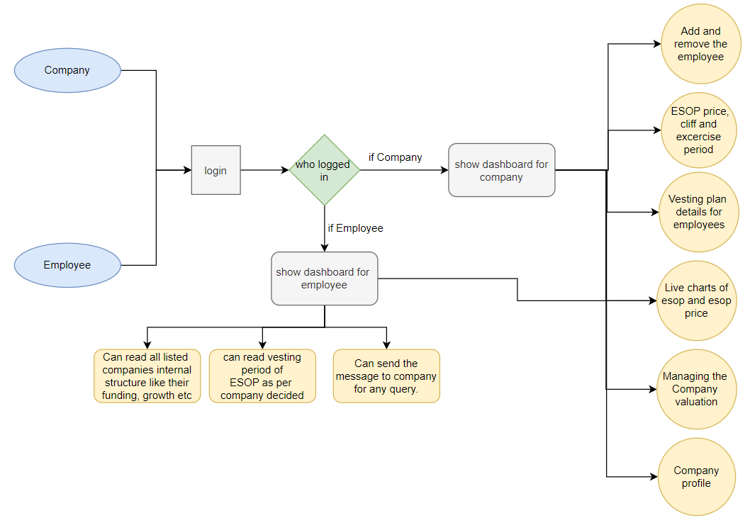
Company and employee login process

Slide 18
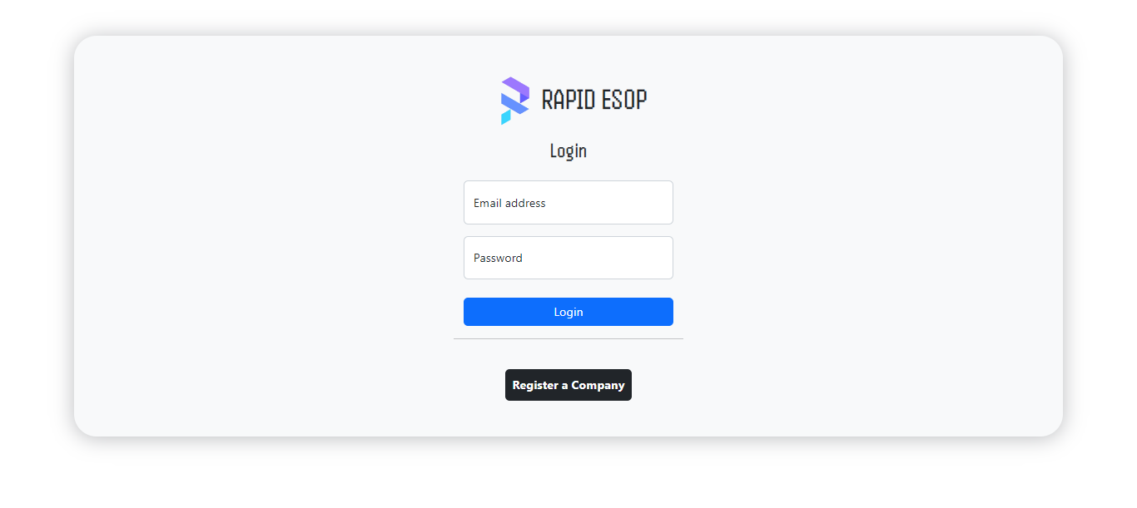
IMPLEMENTATION
Company login

Slide 19
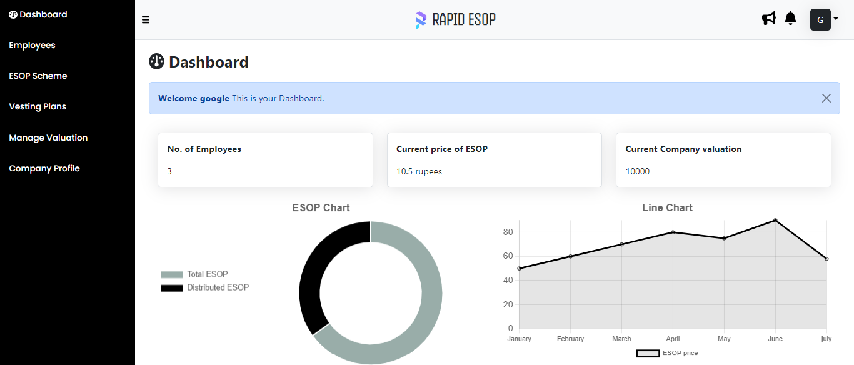
Company dashboard

Slide 20
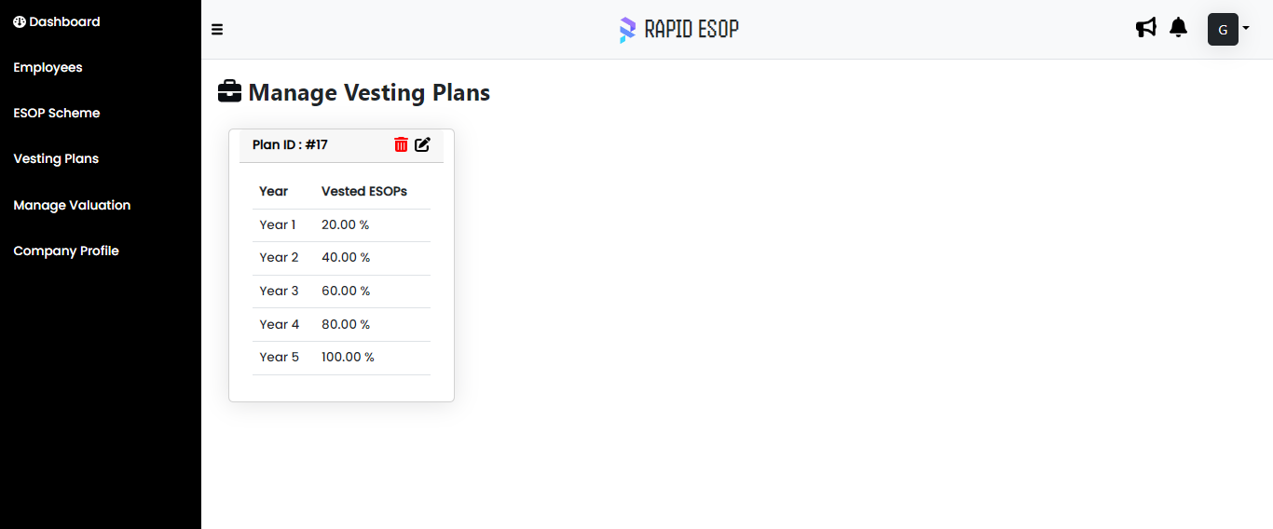
Vesting plans

Slide 21
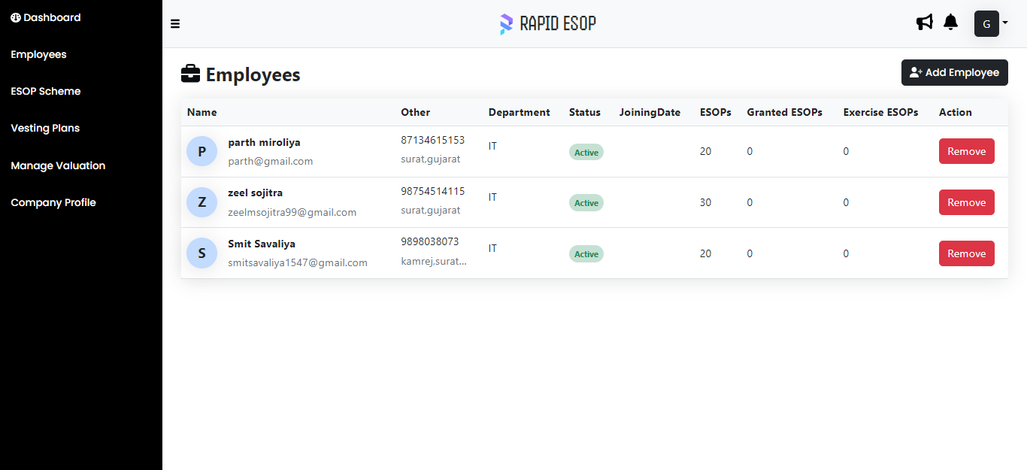
Show all Employees

Slide 22
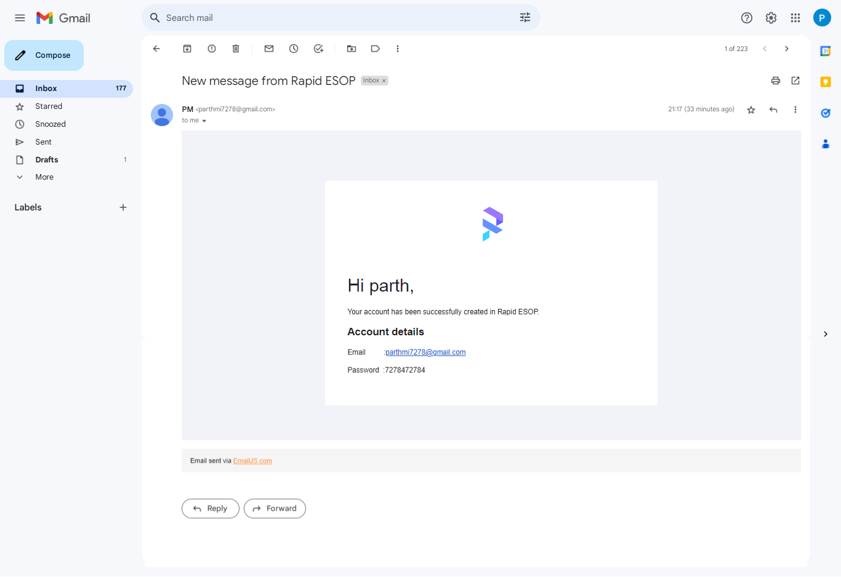
Sending Email and Password of employee by Gmail

Slide 23
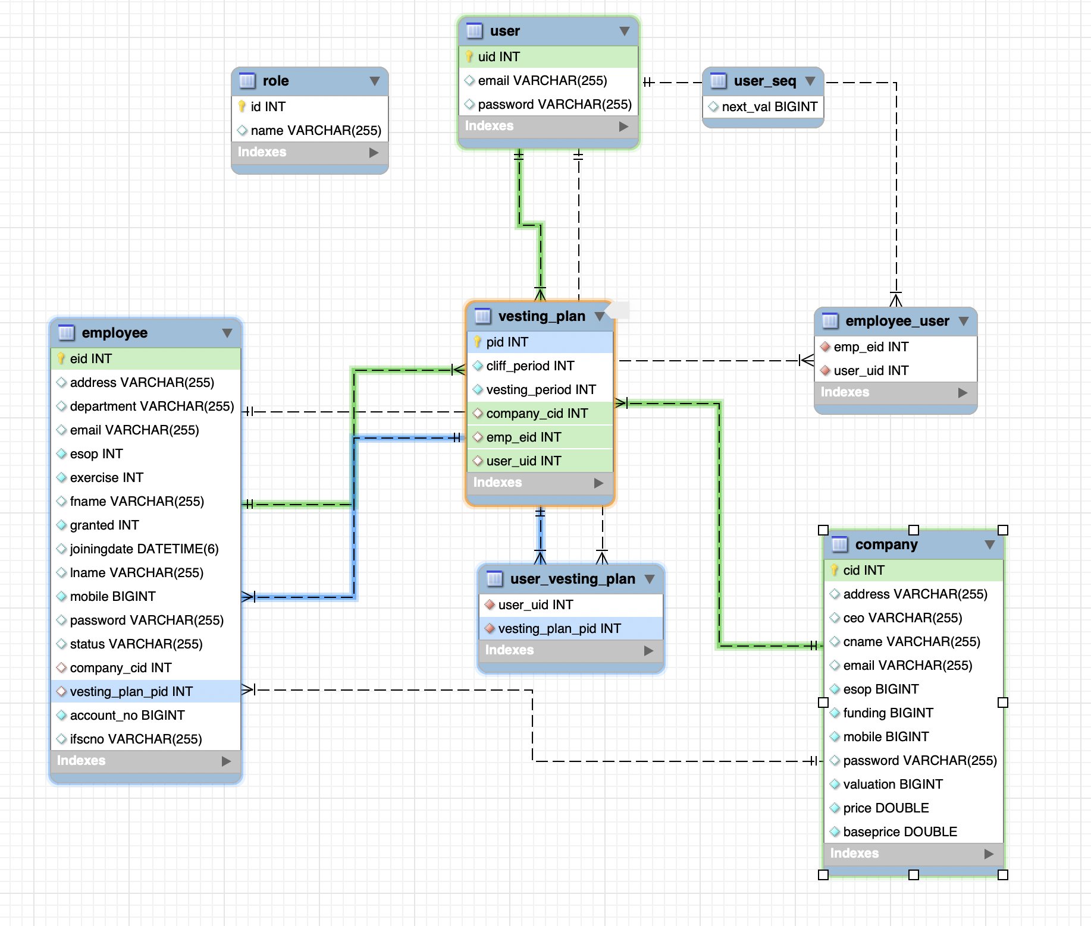
Database working flow

Slide 24
conclusion
Rapid ESOP makes it easy to handle all equity-related matters for your company, right from its early stages to the IPO (Initial Public Offering) phase. Rapid ESOP ensures smooth management of employee ownership plans and enables effective communication with investors and shareholders, creating a seamless experience for everyone involved.

Slide 25
References
Esop Guardian:-
ESOP Guardian is a comprehensive web based system for managing ESOPs of any Company. It is an integrated tool which is developed and designed by Corporate Professionals that manages the complete lifecycle of Employee Stock Option Plans.
Link:- https://esopguardian.com
Qapita:-
Qapita provides a digital equity management platform for private companies. The platform enables capitalization table management, employee stock ownership plan management, digital share issuance for companies, and more. It was founded in 2019 and is based in Singapore, Singapore.
Link:- https://www.qapita.com/

Slide 26
THANK YOU

