Slide 1
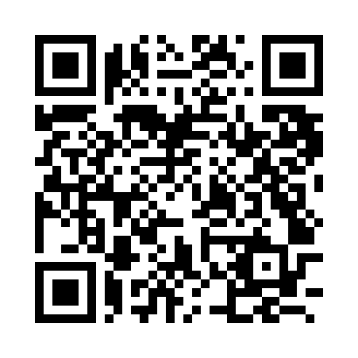
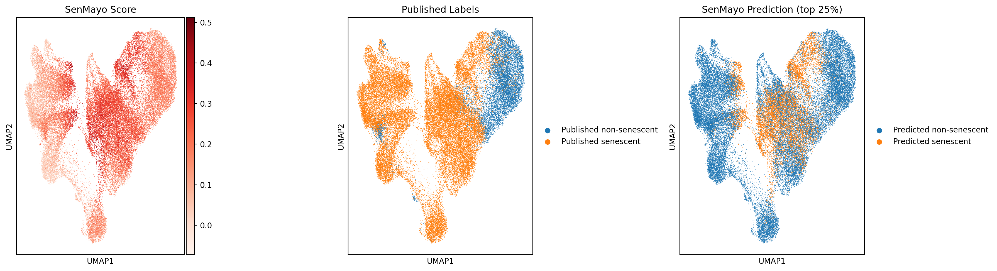
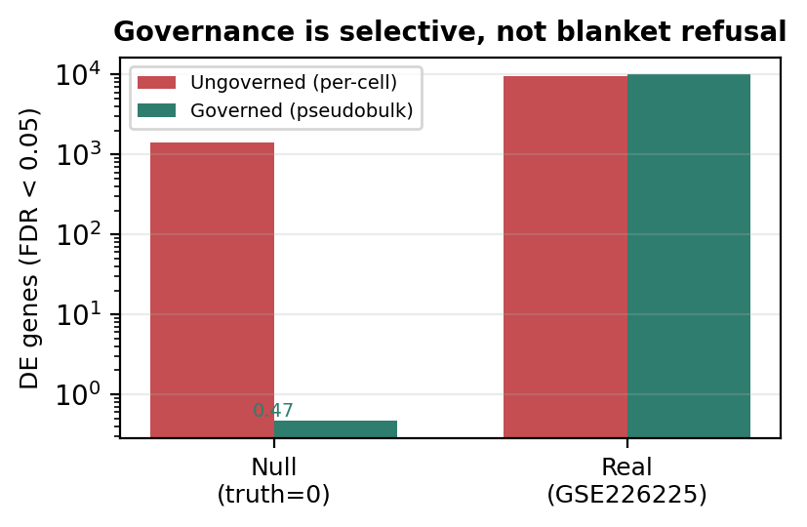
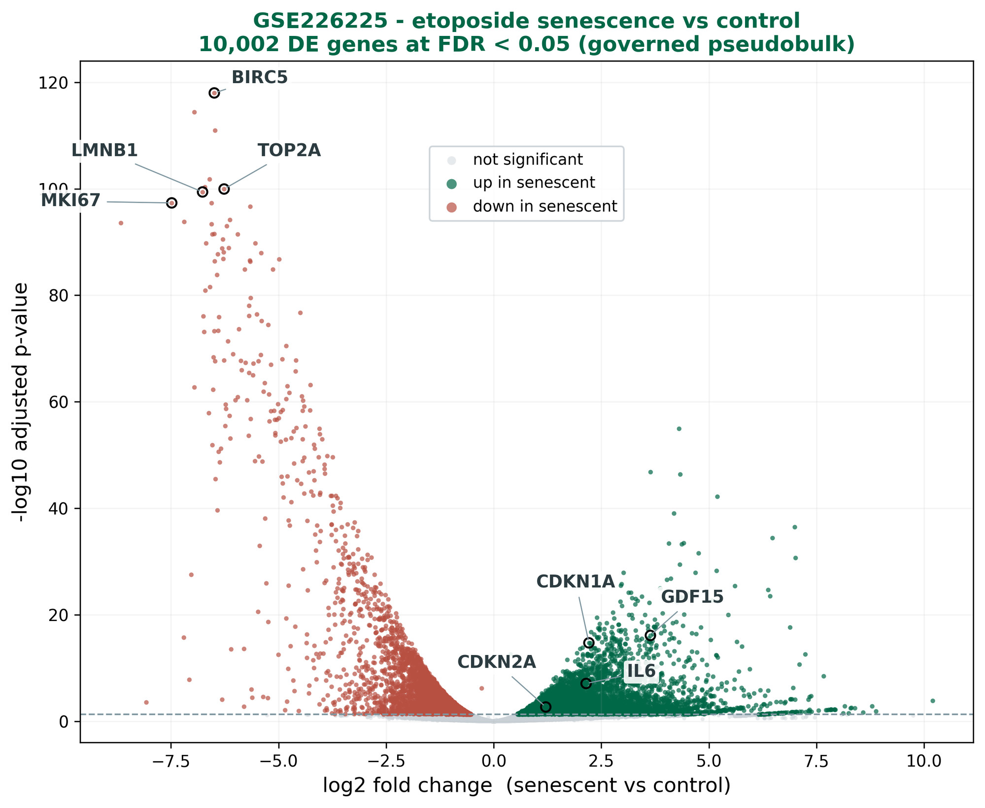
Senescence Agent
github.com/Ro-netizen004/senescence-agent
A Governed AI Agent for Trustworthy Single-Cell Aging Analysis
Rodela Ghosh · Aviral Gupta
Computer Science & Engineering, University of South Florida · Mentor: Dr. Fei He
The agent proposes; the deterministic core decides.
5-state verdicts: descriptive-only · low-power · not-significant · significant-inferential · blocked
THE PRODUCT Senescence Agent lets a researcher analyze single-cell aging data in plain English — running the full Scanpy pipeline — and refuses to report statistically invalid conclusions.
Conversational interface
Automated Scanpy pipeline
Senescence & aging analysis
Built-in validity firewall
THE PROBLEM
METHODS — HOW WE BUILT IT
Senescent cells stop dividing but linger, driving aging and age-related disease.
Single-cell RNA-seq can find them — millions of cells per experiment — but the analysis is a bottleneck.
Worse, automated LLM agents commit pseudoreplication: they treat each cell as an independent sample, reporting hundreds of “discoveries” that aren’t real.
A confident false result is worse than none — it misdirects real aging research.
Goal: make single-cell senescence analysis both accessible and statistically valid.
User
React
FastAPI
Agent
Scanpy
tools
The LLM only proposes — all statistics, claim permissions, and user-facing text are deterministic. Three-tier routing; Scanpy tool layer.
VALIDITY FIREWALL — TWO DETERMINISTIC GATES
1
Admissibility · before the test
Can this data support the inference? Blocks: no replicate column · < 2 replicates/group · confounded contrast · circular setup. → an invalid claim is never computed.
App output: SenMayo + UMAP
2
Justification · after the test
Is the conclusion justified? A 5-state machine; validity flags override significance. A small p-value alone never earns a conclusion.
CHAT OUTPUT (DESeq2 table) 10,002 genes padj<0.05 · fibroblast senescent vs control BIRC5 -6.5 · MKI67 -5.2 · CDKN1A +2.5 · IL6 +1.6 [System] inference_state=SIGNIFICANT_INFERENTIAL
VALIDATION — MEASURABLE METRICS (against ground truth)
NULL DATA · Tabula Muris Senis · truth = 0 genes
Mean false DE genes (FDR < 0.05):
Ungoverned per-cell → governed pseudobulk. 5 tissues × 13 cell types, 200 perms.
Ungoverned = 100% false-discovery rate in all 13 configs. FDR correction alone does NOT fix it — the fix is the statistical unit.
REAL DATA · GSE226225 (human WI-38)
~10,000 real DE genes recovered
etoposide-induced senescence (10 d, 3 reps) vs proliferating controls (2)
Canonical markers, correct direction: CDKN1A, CDKN2A (p16), GDF15, IL6 up; MKI67, LMNB1, TOP2A, BIRC5 down.
Governed pseudobulk DESeq2 on sample-level counts.
Not just cautious — still sensitive to real biology.
Validation visualization of governed pseudobulk DESeq2 (GSE226225). The chat UI reports results as tables; this plot illustrates the recovered biology.
Wild agent: CellAgent (published) autonomously planned per-cell rank_genes_groups on the same null — ignoring sample_id. Faithful but invalid: execution passes; statistical unit does not.
LIMITATIONS
FUTURE WORK
ACKNOWLEDGEMENTS & REFERENCES
• Low replicate counts in aging atlases — where validity matters most. • Real-data test: one cell line; only 2 proliferating controls. • Firewall targets pseudoreplication — not every validity error yet. • Senescence scored with SenMayo only; volcano is a validation viz, not chat UI.
• Auto-detect case/control groupings beyond aging atlases. • Demonstrate confounding as the next validity error. • More human cohorts + end-to-end external-agent benchmarks. • Harden for deployment in aging labs.
Mentor: Dr. Fei He · TASH Hackathon, USF. Squair et al. 2021; Zimmerman et al. 2021; Saul et al. 2022 (SenMayo); Xiao et al. 2024 (CellAgent); Chen 2025 (EviBound); Huang et al. 2025 (POPPER). Contact: rg21@usf.edu · ML4H 2026 paper in preparation

