Slide 1
CHAPTER 10: BIG DATA
ITP55 – Advanced Database Systems

Slide 2
MOTIVATION
Very large volumes of data being collected
Driven by growth of web, social media, and more recently internet-of-things
Web logs were an early source of data
Analytics on web logs has great value for advertisements, web site structuring, what posts to show to a user, etc

Slide 3
BIG DATA STORAGE SYSTEMS
Distributed file systems
Shardring across multiple databases
Key-value storage systems
Parallel and distributed databases

Slide 4
BIG DATA STORAGE SYSTEMS
A distributed file system stores data across a large collection of machines, but provides single file-system view
Highly scalable distributed file system for large data-intensive applications.
E.g., 10K nodes, 100 million files, 10 PB
Provides redundant storage of massive amounts of data on cheap and unreliable computers
Files are replicated to handle hardware failure
Detect failures and recovers from them
Examples:
Google File System (GFS)
Hadoop File System (HDFS)

Slide 5
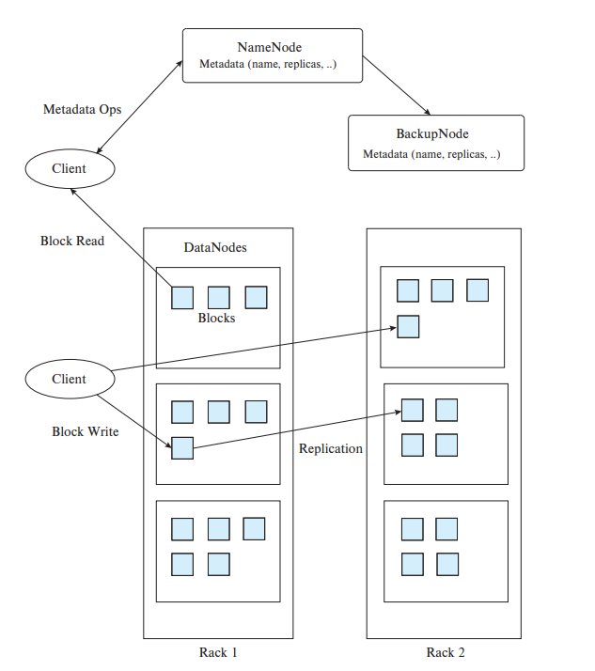
BIG DATA STORAGE SYSTEMS
Single Namespace for entire cluster
Files are broken up into blocks
Typically 64 MB block size
Each block replicated on multiple DataNodes
Client
Finds location of blocks from NameNode
Accesses data directly from DataNode

Slide 6
BIG DATA STORAGE SYSTEMS
NameNode
Maps a filename to list of Block IDs
Maps each Block ID to DataNodes containing a replica of the block
DataNode: Maps a Block ID to a physical location on disk
Data Coherency
Write-once-read-many access model
Client can only append to existing files
Distributed file systems good for millions of large files
But have very high overheads and poor performance with billions of smaller tuples

Slide 7
BIG DATA STORAGE SYSTEMS
Sharding: partition data across multiple databases
Partitioning usually done on some partitioning attributes (also known as partitioning keys or shard keys e.g. user ID
E.g., records with key values from 1 to 100,000 on database 1, records with key values from 100,001 to 200,000 on database 2, etc.
Application must track which records are on which database and send queries/updates to that database

Slide 8
BIG DATA STORAGE SYSTEMS
Positives: scales well, easy to implement
Drawbacks:
Not transparent: application has to deal with routing of queries, queries that span multiple databases
When a database is overloaded, moving part of its load out is not easy
Chance of failure more with more databases
need to keep replicas to ensure availability, which is more work for application

Slide 9
BIG DATA STORAGE SYSTEMS
Key-value storage systems store large numbers (billions or even more) of small (KB-MB) sized records
Records are partitioned across multiple machines and
Queries are routed by the system to appropriate machine
Records are also replicated across multiple machines, to ensure availability even if a machine fails
Key-value stores ensure that updates are applied to all replicas, to ensure that their values are consistent

Slide 10
BIG DATA STORAGE SYSTEMS
Key-value stores may store
uninterpreted bytes, with an associated key
E.g., Amazon S3, Amazon Dynamo
Wide-table (can have arbitrarily many attribute names) with associated key
Google BigTable, Apache Cassandra, Apache Hbase, Amazon DynamoDB
Allows some operations (e.g., filtering) to execute on storage node
JSON
MongoDB, CouchDB (document model)

Slide 11
BIG DATA STORAGE SYSTEMS
Parallel databases run multiple machines (cluser)
Developed in 1980s, well before Big Data
Parallel databases were designed for smaller scale (10s to 100s of machines)
Did not provide easy scalability

Slide 12
BIG DATA STORAGE SYSTEMS
Replication used to ensure data availability despite machine failure
But typically restart query in event of failure
Restarts may be frequent at very large scale
Map-reduce systems (coming up next) can continue query execution, working around failures

Slide 13
BIG DATA STORAGE SYSTEMS
Replication and Consistency
Availability (system can run even if parts have failed) is essential for parallel/distributed databases
Via replication, so even if a node has failed, another copy is available
Consistency is important for replicated data
All live replicas have same value, and each read sees latest version
Often implemented using majority protocols
E.g., have 3 replicas, reads/writes must access 2 replicas

Slide 14
BIG DATA STORAGE SYSTEMS
Replication and Consistency
Very large systems will partition at some point
Choose one of consistency or availability
Traditional database choose consistency
Most Web applications choose availability
Except for specific parts such as order processing

Slide 15
STREAMING DATA
Streaming data refers to data that arrives in a continuous fashion
Contrast to data-at-rest
Applications include:
Stock market: stream of trades
e-commerce site: purchases, searches
Sensors: sensor readings
Internet of things
Network monitoring data
Social media: tweets and posts can be viewed as a stream

Slide 16
STREAMING DATA
Querying Streaming Data
Windowing: Break up stream into windows, and queries are run on windows
Stream query languages support window operations
Windows may be based on time or tuples
Must figure out when all tuples in a window have been seen
Easy if stream totally ordered by timestamp
Punctuations specify that all future tuples have timestamp greater that some value

Slide 17
STREAMING DATA
Querying Streaming Data
Continuous Queries: Queries written e.g. in SQL, output partial results based on stream seen so far; query results updated continuously
Have some applications, but can lead to flood of updates

Slide 18
GRAPH DATABASES
Graphs are a very general data model
ER model of an enterprise can be viewed as a graph
Every entity is a node
Every binary relationship is an edge
Ternary and higher degree relationships can be modelled as binary relationships

Slide 19
GRAPH DATABASES
Graphs can be modelled as relations
node(ID, label, node_data)
edge(fromID, toID, label, edge_data)
Above representation too simplistic
Graph databases like Neo4J can provide a graph view of relational schema
Relations can be identified as representing either nodes or edges
Query languages for graph databases make it
easy to express queries requiring edge traversal
allow efficient algorithms to be used for evaluation

Slide 20
End of Chapter 10

