Slide 1
CHAPTER 7: DATABASE NORMALIZATION
ITP55 – Advanced Database Systems

Slide 2
DEFINITION
This is the process which allows you to winnow out redundant data within your database.
This involves restructuring the tables to successively meeting higher forms of Normalization.
A properly normalized database should have the following characteristics
Scalar values in each fields
Absence of redundancy.
Minimal use of null values.
Minimal loss of information.

Slide 3
LEVELS OF NORMALIZATION
Levels of normalization based on the amount of redundancy in the database.
Various levels of normalization are:
First Normal Form (1NF)
Second Normal Form (2NF)
Third Normal Form (3NF)
Boyce-Codd Normal Form (BCNF)
Fourth Normal Form (4NF)
Fifth Normal Form (5NF)
Domain Key Normal Form (DKNF)

Slide 4
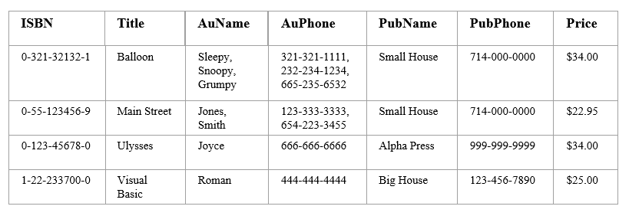
FIRST NORMAL FORM (1NF)
A table is considered to be in 1NF if all the fields contain only scalar values (as opposed to list of values).

Slide 5
FIRST NORMAL FORM (1NF)
Place all items that appear in the repeating group in a new table
Designate a primary key for each new table produced.
Duplicate in the new table the primary key of the table from which the repeating group was extracted or vice versa.

Slide 6
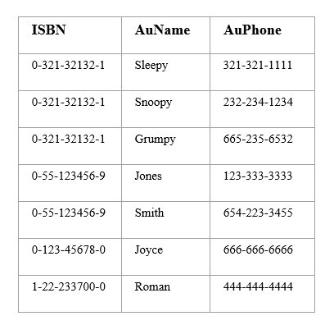
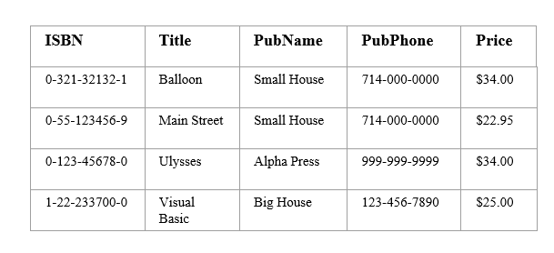
FIRST NORMAL FORM (1NF)

Slide 7
FUNCTIONAL DEPENDENCIES
If one set of attributes in a table determines another set of attributes in the table, then the second set of attributes is said to be functionally dependent on the first set of attributes.
The value of the determinant decides the value of another attribute.
Represented by ->
“A -> B” reads B is functionally dependent on A or B depends on A
If you know the value of A, you know the value of B

Slide 8
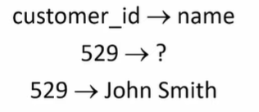
FUNCTIONAL DEPENDENCIES
Functional Dependencies Examples
AuthNo -> AuthName, AuthEmail, AuthAddress
AuthEmail -> AuthNo
PaperNo -> Primary-AuthNo, Title, Abstract, Status

Slide 9
SECOND NORMAL FORM (2NF)
For a table to be in 2NF, there are two requirements
The database is in first normal form
All non-key attributes in the table must be functionally dependent on the entire primary key
Note: Remember that we are dealing with non-key attributes

Slide 10
SECOND NORMAL FORM (2NF)
If a data item is fully functionally dependent on only a part of the primary key, move that data item and that part of the primary key to a new table.
If other data items are functionally dependent on the same part of the key, place them in the new table also
Make the partial primary key copied from the original table the primary key for the new table. Place all items that appear in the repeating group in a new table

Slide 11
SECOND NORMAL FORM (2NF)
2NF EXAMPLE
Old Schema : {Title, PubId, AuId, Price, AuAddress}
New Schema : {Title, PubId, AuId, Price}
New Schema : {AuId, AuAddress}

Slide 12
SECOND NORMAL FORM (2NF)
2NF EXAMPLE
Old Schema : {Studio, Movie, Budget, StudioCity}
New Schema : {Movie, Studio, Budget}
New Schema : {Studio, City}

Slide 13
THIRD NORMAL FORM (3NF)
This form dictates that all non-key attributes of a table must be functionally dependent on a candidate key i.e. there can be no interdependencies among non-key attributes.
For a table to be in 3NF, there are two requirements
The table should be second normal form
No attribute is transitively dependent on the primary key

Slide 14
THIRD NORMAL FORM (3NF)
Move all items involved in transitive dependencies to a new entity.
Identify a primary key for the new entity.
Place the primary key for the new entity as a foreign key on the original entity.

Slide 15
THIRD NORMAL FORM (3NF)
3NF EXAMPLE
Old Schema: {Title, PubID, PageCount, Price }
New Schema: {PubID, PageCount, Price}
New Schema: {Title, PubID, PageCount}

Slide 16
BOYCE-CODD NORMAL FORM (BCNF)
BCNF does not allow dependencies between attributes that belong to candidate keys.
BCNF is a refinement of the third normal form in which it drops the restriction of a non-key attribute from the 3rd normal form.
Third normal form and BCNF are not same if the following conditions are true:
The table has two or more candidate keys
At least two of the candidate keys are composed of more than one attribute
The keys are not disjoint i.e. The composite candidate keys share some attributes

Slide 17
BOYCE-CODD NORMAL FORM (BCNF)
Place the two candidate primary keys in separate entities
Place each of the remaining data items in one of the resulting entities according to its dependency on the primary key.

Slide 18
BOYCE-CODD NORMAL FORM (BCNF)
BCNF EXAMPLE
Old Schema: {City, Street, ZipCode }
New Schema1: {ZipCode, Street}
New Schema2: {City, Street}
Loss of relation {ZipCode} -> {City}
Alternate New Schema: {ZipCode, Street }
Alternate New Schema2: {ZipCode, City}

Slide 19
FOURTH NORMAL FORM (4NF)
Fourth normal form eliminates independent many-to-one relationships between columns.
To be in Fourth Normal Form,
a relation must first be in Boyce-Codd Normal Form.
a given relation may not contain more than one multi-valued attribute.

Slide 20
FOURTH NORMAL FORM (4NF)
Fourth normal form eliminates independent many-to-one relationships between columns.
To be in Fourth Normal Form,
a relation must first be in Boyce-Codd Normal Form.
a given relation may not contain more than one multi-valued attribute.

Slide 21
FOURTH NORMAL FORM (4NF)
Move the two multi-valued relations to separate tables
Identify a primary key for each of the new entity.

Slide 22
FOURTH NORMAL FORM (4NF)
4NF EXAMPLE
Old Schema: MovieName, ScreeningCity, Genre}
New Schema: {MovieName, ScreeningCity}
New Schema: {MovieName, Genre}

Slide 23
FIFTH NORMAL FORM (5NF)
Fifth normal form is satisfied when all tables are broken into as many tables as possible in order to avoid redundancy. Once it is in fifth normal form it cannot be broken into smaller relations without changing the facts or the meaning.

Slide 24
DOMAIN KEY NORMAL FORM (DKNF)
The relation is in DKNF when there can be no insertion or deletion anomalies in the database.

Slide 25
End of Chapter 6

