Slide 1
CHAPTER 8: COMPLEX DATA TYPES
ITP55 – Advanced Database Systems

Slide 2
SEMI-STRUCTURED DATA
Many applications require storage of complex data, whose schema changes often
The relational model’s requirement of atomic data types may be an overkill
Data exchange can benefit greatly from semi-structured data
Exchange can be between applications, or between back-end and front-end of an application
Web-services are widely used today, with complex data fetched to the front-end and displayed using a mobile app or JavaScript
JSON and XML are widely used semi-structured data models

Slide 3
SEMI-STRUCTURED DATA
Multivalued data types
Sets, multisets
E.g.,: set of interests {‘basketball, ‘La Liga’, ‘cooking’, ‘anime’, ‘jazz’}
Key-value map (or just map for short)
Store a set of key-value pairs
E.g., {(brand, Apple), (ID, MacBook Air), (size, 13), (color, silver)}
Operations on maps: put(key, value), get(key), delete(key)

Slide 4
SEMI-STRUCTURED DATA
Multivalued data types
Array database: a database that provides specialized support for arrays
E.g., compressed storage, query language extensions etc
Oracle GeoRaster, PostGIS, SciDB, etc

Slide 5
SEMI-STRUCTURED DATA
Nested Data Types
Hierarchical data is common in many applications
JSON: JavaScript Object Notation
Widely used today
XML: Extensible Markup Language
Earlier generation notation, still used extensively

Slide 6
SEMI-STRUCTURED DATA
JSON: JavaScript Object Notation
Textual representation widely used for data exchange
Types: integer, real, string, and
Objects: are key-value maps, i.e. sets of (attribute name, value) pairs
Arrays are also key-value maps (from offset to value)

Slide 7
SEMI-STRUCTURED DATA
{ "ID": "22222", "name": { "firstname: "Albert", "lastname: "Einstein" }, "deptname": "Physics", "children": [ {"firstname": "Hans", "lastname": "Einstein" }, {"firstname": "Eduard", "lastname": "Einstein" } ] }

Slide 8
SEMI-STRUCTURED DATA
JSON is ubiquitous in data exchange today
Widely used for web services
Most modern applications are architected around on web services
JSON is verbose
Compressed representations such as BSON (Binary JSON) used for efficient data storage

Slide 9
SEMI-STRUCTURED DATA
XML: Extensible Markup Language
XML uses tags to mark up text
Tags make the data self-documenting
Tags can be hierarchical

Slide 10
SEMI-STRUCTURED DATA
<purchase order> <identifier> P-101 </identifier> <purchaser> <name> Cray Z. Coyote </name> <address> Route 66, Mesa Flats, Arizona 86047, USA </address> </purchaser> <supplier> <name> Acme Supplies </name> <address> 1 Broadway, New York, NY, USA </address> </supplier> <itemlist> <item> <identifier> RS1 </identifier> <description> Atom powered rocket sled </description> <quantity> 2 </quantity> <price> 199.95 </price> </item> <item>…</item> </itemlist> <total cost> 429.85 </total cost> …. </purchase order>

Slide 11
SEMI-STRUCTURED DATA
XQuery language developed to query nested XML structures
Not widely used currently
SQL extensions to support XML
Store XML data
Generate XML data from relational data
Extract data from XML data types

Slide 12
SEMI-STRUCTURED DATA
The Resource Description Framework (RDF) is a data representation standard based on the entity-relationship model.
Simplified representation for facts, represented as triples (subject, predicate, object)
E.g., (NBA-2019, winner, Raptors) (Washington-DC, capital-of, USA) (Washington-DC, population, 6,200,000)

Slide 13
SEMI-STRUCTURED DATA
Models objects that have attributes, and relationships with other objects
Like the ER model, but with a flexible schema
(ID, attribute-name, value)
(ID1, relationship-name, ID2)
Has a natural graph representation

Slide 14
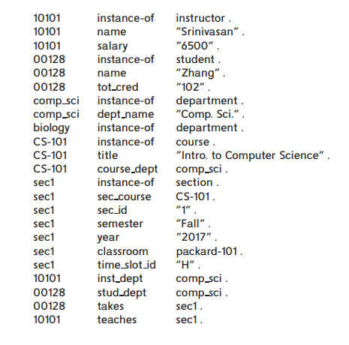
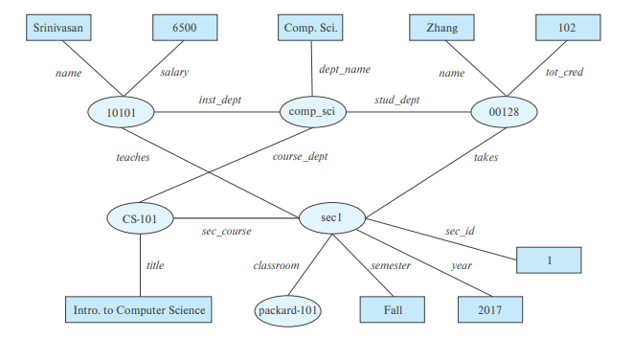
SEMI-STRUCTURED DATA

Slide 15
OBJECT ORIENTATION
Object-relational data model provides richer type system
with complex data types and object orientation
Applications are often written in object-oriented programming languages
Type system does not match relational type system
Switching between imperative language and SQL is troublesome

Slide 16
OBJECT ORIENTATION
Approaches for integrating object-orientation with databases
Build an object-relational database, adding object-oriented features to a relational database
Automatically convert data between programming language model and relational model; data conversion specified by object-relational mapping
Build an object-oriented database that natively supports object-oriented data and direct access from programming language

Slide 17
OBJECT ORIENTATION
Approaches for integrating object-orientation with databases
Build an object-relational database, adding object-oriented features to a relational database
Automatically convert data between programming language model and relational model; data conversion specified by object-relational mapping
Build an object-oriented database that natively supports object-oriented data and direct access from programming language

Slide 18
OBJECT ORIENTATION
User-defined types
create type Person (ID varchar(20) primary key, name varchar(20), address varchar(20)) ref from(ID); create table people of Person;

Slide 19
OBJECT ORIENTATION
Table types
create type interest as table ( topic varchar(20), degree_of_interest int); create table users ( ID varchar(20), name varchar(20), interests interest);

Slide 20
OBJECT ORIENTATION
Type inheritance
create type Student under Person (degree varchar(20)) ; create type Teacher under Person (salary integer);

Slide 21
OBJECT ORIENTATION
Creating reference types
create type Person (ID varchar(20) primary key, name varchar(20), address varchar(20)) ref from(ID); create table people of Person;

Slide 22
OBJECT ORIENTATION
Creating reference types
create type Department ( dept_name varchar(20), head ref(Person) scope people);
create table departments of Department;

Slide 23
OBJECT ORIENTATION
Object-relational mapping (ORM) systems allow
Specification of mapping between programming language objects and database tuples
Automatic creation of database tuples upon creation of objects
Automatic update/delete of database tuples when objects are update/deleted
Interface to retrieve objects satisfying specified conditions
Tuples in database are queried, and object created from the tuples
Example: Hibernate ORM for Java; Django ORM for Phyton

Slide 24
TEXTUAL DATA
Textual data consists of unstructured text.
The term information retrieval generally refers to the querying of unstructured textual data.
Simple model of keyword queries: given query keywords, retrieve documents containing all the keywords
More advanced models rank relevance of documents
Today, keyword queries return many types of information as answers
E.g., a query “cricket” typically returns information about ongoing cricket matches

Slide 25
SPATIAL DATA
Spatial databases store information related to spatial locations, and support efficient storage, indexing and querying of spatial data.
Geographic data -- road maps, land-usage maps, topographic elevation maps, political maps showing boundaries, land-ownership maps, and so on.
Geographic information systems are special-purpose databases tailored for storing geographic data.
Round-earth coordinate system may be used
(Latitude, longitude, elevation)

Slide 26
SPATIAL DATA
Geometric data: design information about how objects are constructed . For example, designs of buildings, aircraft, layouts of integrated-circuits.
2 or 3 dimensional Euclidean space with (X, Y, Z) coordinates

Slide 27
SPATIAL DATA
Geometric Information Representation
A line segment can be represented by the coordinates of its endpoints.
A polyline or linestring consists of a connected sequence of line segments and can be represented by a list containing the coordinates of the endpoints of the segments, in sequence.
Approximate a curve by partitioning it into a sequence of segments
Useful for two-dimensional features such as roads.
Some systems also support circular arcs as primitives, allowing curves to be represented as sequences of arc
Polygons is represented by a list of vertices in order.
The list of vertices specifies the boundary of a polygonal region.
Can also be represented as a set of triangles (triangulation)

Slide 28
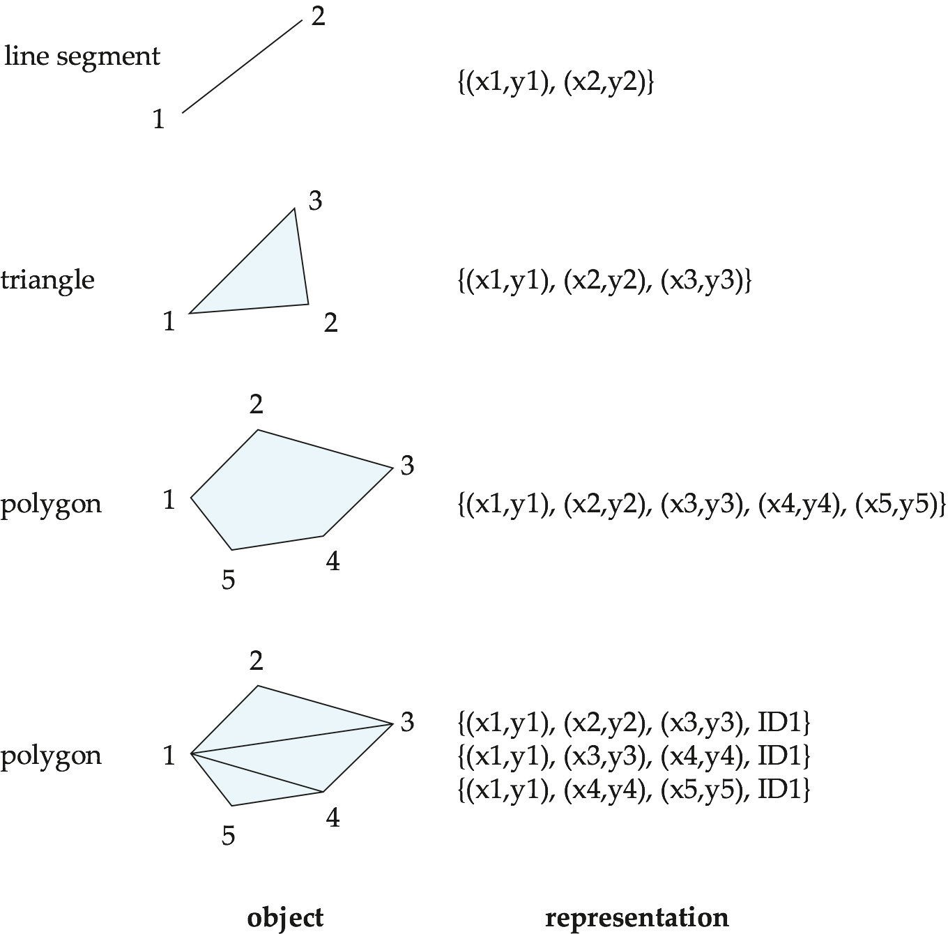
SPATIAL DATA

Slide 29
SPATIAL DATA
Geographic Data
Raster data consist of bit maps or pixel maps, in two or more dimensions.
Example 2-D raster image: satellite image of cloud cover, where each pixel stores the cloud visibility in a particular area.
Additional dimensions might include the temperature at different altitudes at different regions, or measurements taken at different points in time.
Design databases generally do not store raster data.

Slide 30
SPATIAL DATA
Geographic Data
Vector data are constructed from basic geometric objects: points, line segments, triangles, and other polygons in two dimensions, and cylinders, spheres, cuboids, and other polyhedrons in three dimensions.
Vector format often used to represent map data.
Roads can be considered as two-dimensional and represented by lines and curves.
Some features, such as rivers, may be represented either as complex curves or as complex polygons, depending on whether their width is relevant.
Features such as regions and lakes can be depicted as polygons.

Slide 31
End of Chapter 8

