Slide 1
CHAPTER 4: INTERMEDIATE SQL
ITP55 – Advanced Database Systems

Slide 2
Join Expressions
An INNER JOIN is a JOIN operation that allows you to specify an explicit join clause.
You can specify the join clause by specifying ON with a boolean expression.
The scope of expressions in the ON clause includes the current tables and any tables in outer query blocks to the current SELECT.

Slide 3


Join Expressions
select * from book;
select * from author;
select * from book
inner join author
on book.author_id = author.author_id;

Slide 4
Join Expressions
A LEFT OUTER JOIN is one of the JOIN operations that allow you to specify a join clause. It preserves the unmatched rows from the first (left) table, joining them with a NULL row in the shape of the second (right) table.
The scope of expressions in either the ON clause includes the current tables and any tables in query blocks outer to the current SELECT.
The ON clause can reference tables not being joined and does not have to reference either of the tables being joined (though typically it does).

Slide 5

Join Expressions
select * from book;
select * from author;
select * from book
left outer join author
on book.author_id = author.author_id
order by id;

Slide 6
Join Expressions
A RIGHT OUTER JOIN is one of the JOIN operations that allow you to specify a JOIN clause. It preserves the unmatched rows from the second (right) table, joining them with a NULL in the shape of the first (left) table. A LEFT OUTER JOIN B is equivalent to B RIGHT OUTER JOIN A, with the columns in a different order.
The scope of expressions in the ON clause includes the current tables and any tables in query blocks outer to the current SELECT.
The ON clause can reference tables not being joined and does not have to reference either of the tables being joined (though typically it does).

Slide 7

Join Expressions
select * from book;
select * from author;
select * from book
left outer join author
on book.author_id = author.author_id
order by id;

Slide 8
Join Expressions
A CROSS JOIN is a JOIN operation that produces the Cartesian product of two tables. Unlike other JOIN operators, it does not let you specify a join clause. You may, however, specify a WHERE clause in the SELECT statement.

Slide 9
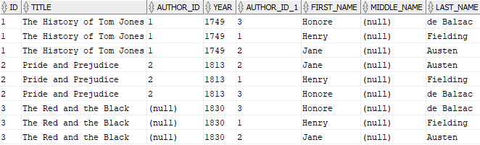
Join Expressions
select * from book;
select * from author;
select * from book
cross join author
order by id;

Slide 10
Join Expressions
A NATURAL JOIN is a JOIN operation that creates an implicit join clause for you based on the common columns in the two tables being joined. Common columns are columns that have the same name in both tables.
A NATURAL JOIN can be an INNER join, a LEFT OUTER join, or a RIGHT OUTER join. The default is INNER join.

Slide 11
Join Expressions
If the SELECT statement in which the NATURAL JOIN operation appears has an asterisk (*) in the select list, the asterisk will be expanded to the following list of columns (in this order):
All the common columns
Every column in the first (left) table that is not a common column
Every column in the second (right) table that is not a common column

Slide 12

Join Expressions
select * from book;
select * from author;
select * from book
natural join author
order by id;

Slide 13
Join Expressions
select * from book;
select * from author;
select * from book
join author
using (author_id)
order by id;

Slide 14

Join Expressions
select * from book;
select * from author;
select * from book
natural left outer join author
order by id;

Slide 15
Views
Views are virtual tables formed by a query.
A view is a dictionary object that you can use until you drop it.
Views are not updatable
create view v as Q;

Slide 16
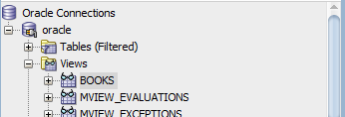
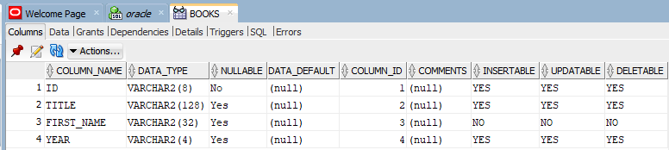
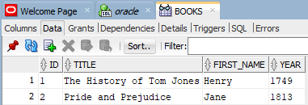
Views
create view books as
select id, title, author.first_name, year
from book, author
where book.author_id = author.author_id;

Slide 17

Views
select *
from books
where year in ('1813', '1900');

Slide 18
Transactions
A transaction consists of a sequence of query and/or update statements. The SQL standard specifies that a transaction begins implicitly when an SQL statement is executed. One of the following SQL statements must end the transaction:
Commit work commits the current transaction; that is, it makes the updates performed by the transaction become permanent in the database. After the transaction is committed, a new transaction is automatically started.

Slide 19
Transactions
Rollback work causes the current transaction to be rolled back; that is, it undoes all the updates performed by the SQL statements in the transaction. Thus, the database state is restored to what it was before the first statement of the transaction was executed.

Slide 20
Integrity Constraints
Integrity constraints ensure that changes made to the database by authorized users do not result in a loss of data consistency
The not null constraint prohibits the insertion of a null value for the attribute
A unique constraint defines a set of columns that uniquely identify rows in a table only if all the key values are not NULL. If one or more key parts are NULL, duplicate keys are allowed.

Slide 21
Integrity Constraints
A check constraint can be used to specify a wide range of rules for the contents of a table.
Referential integrity constraints ensure that a value that appears in one relation (the referencing relation) for a given set of attributes also appears for a certain set of attributes in another relation (the referenced relation)

Slide 22
Integrity Constraints
create table instructor(
id varchar (5),
name varchar (20) not null,
dept_name varchar (20),
salary numeric (8,2)
constraint SAL_CK check (salary > 29000),
primary key (ID),
foreign key (dept name) references department
);

Slide 23
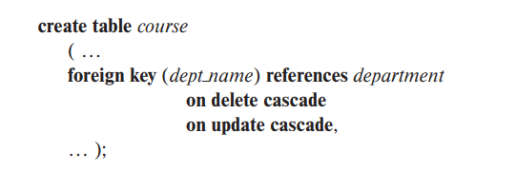
Integrity Constraints
A foreign key clause can specify that if a delete or update action
on the referenced relation violates the constraint, then, instead of rejecting the action, the system must take steps to change the tuple in the referencing relation to restore the constraint.

Slide 24
Integrity Constraints
Because of the clause on delete cascade associated with the foreign-key declaration, if a delete of a tuple in department results in this referential-integrity constraint being violated, the system does not reject the delete.
Instead, the delete “cascades” to the course relation, deleting the tuple that refers to the department that was deleted.

Slide 25
SQL Data Types and Schemas
date: A calendar date containing a (four-digit) year, month, and day of the month.
time: The time of day, in hours, minutes, and seconds.
timestamp: A combination of date and time
date '2018-04-25'
time '09:30:00'
timestamp '2018-04-25 10:29:01.45'

Slide 26
SQL Data Types and Schemas
Type conversion
select cast(ID as numeric(5)) as inst_id
from instructor
order by inst_id;

Slide 27
SQL Data Types and Schemas
SQL allows a default value to be specified for an attribute
create table student(
id varchar (5),
name varchar (20) not null,
dept_name varchar (20),
tot_cred numeric (3,0) default 0,
primary key (ID)
);

Slide 28
SQL Data Types and Schemas
SQL, provides large-object data types for character data (clob) and binary data (blob).
book_review clob(10KB)
image blob(10MB)
movie blob(2GB)

Slide 29
SQL Data Types and Schemas
SQL user defined data types: distinct types
create type Dollars as numeric(12,2) final;
create table department(
dept_name varchar (20),
building varchar (15),
budget Dollars
);

Slide 30
SQL Data Types and Schemas
A schema is a collection of database objects.
A schema is owned by a database user and has the same name as that user.
Schema objects are logical structures created by users.
Objects such as tables or indexes hold data, or can consist of a definition only, such as a view or synonym.
Other database objects include views, synonyms, etc

Slide 31
Index in SQL
An index on an attribute of a relation is a data structure that allows the database system to find those tuples in the relation that have a specified value for that attribute efficiently, without scanning through all the tuples of the relation.
Indices are not required for correctness, since they are redundant data structures.
Indices are important for efficient processing of transactions, including both update transactions and queries.

Slide 32
Index in SQL
Indices are also important for efficient enforcement of integrity constraints such as primary-key and foreign-key constraints.
However, because of the space cost of indices, as well as the effect of indices on update processing, it is not easy to automatically make the right choices about what indices to maintain.

Slide 33
Index in SQL
create index <index-name>
on <relation-name> (<attribute-list>);
create index dept index
on instructor (dept_name);
drop index <index-name>;

Slide 34
Authorization
We may assign a user several forms of authorizations on parts of the database. Authorizations on data include:
Authorization to read data.
Authorization to insert new data.
Authorization to update data.
Authorization to delete data.
Each of these types of authorizations is called a privilege.

Slide 35
Authorization
The SQL data-definition language includes commands to grant and revoke privileges. The grant statement is used to confer authorization.
grant <privilege list>
on <relation name or view name>
to <user/role list>;
grant select on department to John, Satoshi;

Slide 36
Authorization
To revoke an authorization, we use the revoke statement.
revoke <privilege list>
on <relation name or view name>
from <user/role list>;
revoke select on department from John, Satoshi;
revoke update (budget) on department from John;

Slide 37
Authorization
A role is a set or group of privileges that can be granted to users or another role.
create role <role-name>;
create role instructor;
grant select on takes
to instructor;

Slide 38
End of Chapter 3

