Slide 1
CHAPTER 5: ADVANCED SQL
ITP55 – Advanced Database Systems

Slide 2
Accessing SQL from a Programming Language
There are two approaches to accessing SQL from a general-purpose programming language:
Dynamic SQL allows the program to construct an SQL query as a character string at runtime, submit the query, and then retrieve the result into program variables a tuple at a time. The dynamic SQL component of SQL allows programs to construct and submit SQL queries at runtime.

Slide 3
Accessing SQL from a Programming Language
Embedded SQL: The SQL statements are identified at compile time using a preprocessor, which translates requests expressed in embedded SQL into function calls.

Slide 4
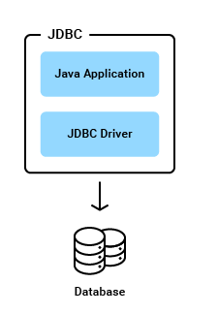
Accessing SQL from a Programming Language
The Java Database Connectivity (JDBC) standard defines an application program interface (API) that Java programs can use to connect to database servers.

Slide 5
Accessing SQL from a Programming Language
//step1 load the driver class
Class.forName("oracle.jdbc.driver.OracleDriver");
//step2 create the connection object
Connection con=DriverManager.getConnection(
"jdbc:oracle:thin:@localhost:1521:xe","system","oracle");
//step3 create the statement object
Statement stmt=con.createStatement();
//step4 execute query
ResultSet rs=stmt.executeQuery("select * from emp");
while(rs.next())
System.out.println(rs.getInt(1)+" "+rs.getString(2)+" "+rs.getString(3));
//step5 close the connection object
con.close();

Slide 6
Accessing SQL from a Programming Language
A PreparedStatement is a pre-compiled SQL statement.
When PreparedStatement is created, the SQL query is passed as a parameter. This Prepared Statement contains a pre-compiled SQL query, so when the PreparedStatement is executed, DBMS can just run the query instead of first compiling it.
We can use the same PreparedStatement and supply with different parameters at the time of execution.
An important advantage of PreparedStatements is that they prevent SQL injection attacks.

Slide 7
Accessing SQL from a Programming Language
Prepared Statements
PreparedStatement pStmt = conn.prepareStatement(
"insert into instructor values(?,?,?,?)");
pStmt.setString(1, "88877");
pStmt.setString(2, "Perry");
pStmt.setString(3, "Finance");
pStmt.setInt(4, 125000);
pStmt.executeUpdate();
pStmt.setString(1, "88878");
pStmt.executeUpdate();

Slide 8
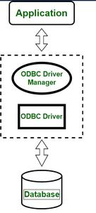
Accessing SQL from a Programming Language
The Open Database Connectivity (ODBC) standard defines an API that applications can use to open a connection with a database, send queries and updates, and get back results. Applications such as graphical user interfaces, statistics packages, and spreadsheets can make use of the same ODBC API to connect to any database server that supports ODBC.

Slide 9
Accessing SQL from a Programming Language
try{
String url="jdbc:odbc:mydsn";
Class.forName("sun.jdbc.odbc.JdbcOdbcDriver");
Connection c=DriverManager.getConnection(url);
Statement st=c.createStatement();
ResultSet rs=st.executeQuery("select * from login");
while(rs.next()){
System.out.println(rs.getString(1));
}
}catch(Exception ee){System.out.println(ee);}
}}

Slide 10
Accessing SQL from a Programming Language
ODBC is a C-based API that is platform-independent and can be used on Windows, macOS, and Linux systems.
Microsoft developed it and allows access to various databases, including Microsoft SQL Server, Oracle, MySQL, etc.
Drivers must be installed on the client machine to connect to the database.

Slide 11
Functions and Procedures
Procedures and functions allow “business logic” to be stored in the database and executed from SQL statements
You can write user-defined functions in PL/SQL or Java to provide functionality that is not available in SQL or SQL built-in functions. User-defined functions can appear in a SQL statement anywhere SQL functions can appear, that is, wherever an expression can occur.

Slide 12
Functions and Procedures
For example, user-defined functions can be used in the following:
The select list of a SELECT statement
The condition of a WHERE clause
CONNECT BY, START WITH, ORDER BY, and GROUP BY clauses
The VALUES clause of an INSERT statement
The SET clause of an UPDATE statement

Slide 13
Functions and Procedures
Example: Get Formatted Address
-- creating table person_info
CREATE TABLE person_info
(
PERSON_ID number(5) primary key,
FIRST_NAME varchar2(20),
LAST_NAME varchar2(20)
);

Slide 14
Functions and Procedures
--creating table person_address_details
CREATE TABLE person_address_details
(
PERSON_ADDRESS_ID number(5) primary key,
PERSON_ID number(5) references person_info(person_id),
CITY varchar2(15),
STATE varchar2(15),
COUNTRY varchar2(20),
ZIP_CODE varchar2(10)
);

Slide 15
Functions and Procedures
create or replace FUNCTION get_complete_address(
in_person_id IN NUMBER
)
RETURN VARCHAR2
IS person_details VARCHAR2(130);
BEGIN
SELECT 'Name-'||person.first_name||' '|| person.last_name||',
City-'|| address.city ||', State-'||address.state||',
Country-'||address.country||', ZIP Code-'||address.zip_code
INTO person_details
FROM person_info person, person_address_details address
WHERE person.person_id = in_person_id
AND address.person_id = person.person_id;
RETURN(person_details);
END get_complete_address;

Slide 16
Functions and Procedures
INSERT INTO person_info VALUES (10,'Luis','Thomas');
INSERT INTO person_info VALUES (20,'Wang','Moris');
INSERT INTO person_address_details VALUES (101,10,'Vegas','Nevada','US','88901');
INSERT INTO person_address_details VALUES (102,20,'Carson','Nevada','US','90220');

Slide 17
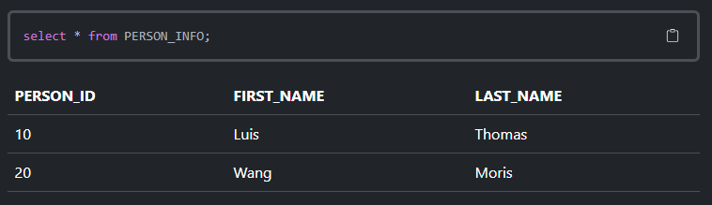
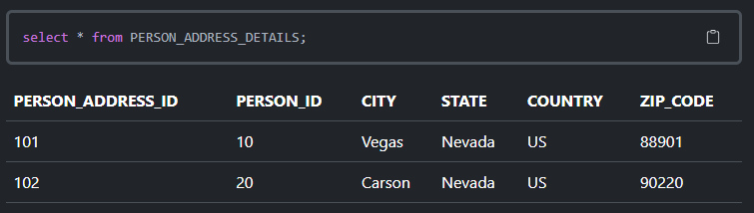
Functions and Procedures

Slide 18
Functions and Procedures
Two ways of invoking a function:
SELECT get_complete_address(10) AS "Person Address" FROM DUAL;
SET SERVEROUTPUT ON;
EXECUTE dbms_output.put_line(get_complete_address(20));

Slide 19
Triggers
A trigger is a statement that the system executes automatically as a side effect of a modification to the database. To define a trigger, we must:
Specify when a trigger is to be executed. This is broken up into an event that causes the trigger to be checked and a condition that must be satisfied for trigger execution to proceed.
Specify the actions to be taken when the trigger executes.

Slide 20
Triggers
The event can be any of the following:
A data manipulation language (DML) statement executed against a table e.g., INSERT, UPDATE, or DELETE. For example, if you define a trigger that fires before an INSERT statement on the customers table, the trigger will fire once before a new row is inserted into the customers table.
A data definition language (DDL) statement executes e.g., CREATE or ALTER statement. These triggers are often used for auditing purposes to record changes of the schema.
A system event such as startup or shutdown of the Oracle Database.
A user event such as login or logout.

Slide 21
Triggers
Oracle triggers are useful in many cases such as the following:
Enforcing complex business rules that cannot be established using integrity constraint such as UNIQUE, NOT NULL, and CHECK.
Preventing invalid transactions.
Gathering statistical information on table accesses.
Generating value automatically for derived columns.
Auditing sensitive data.

Slide 22
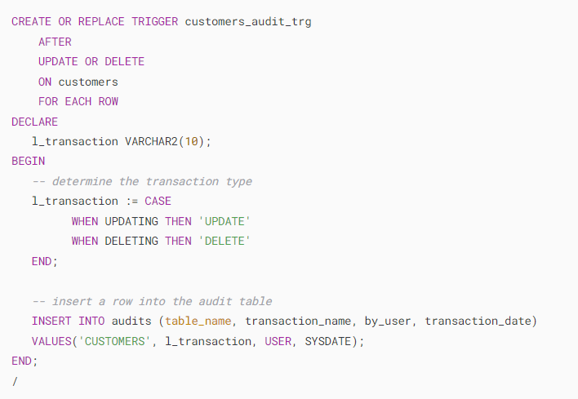
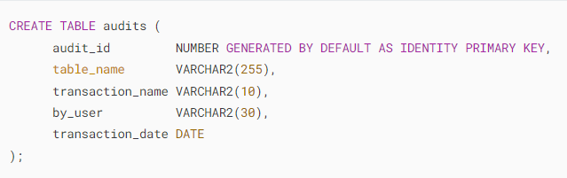
Triggers

Slide 23
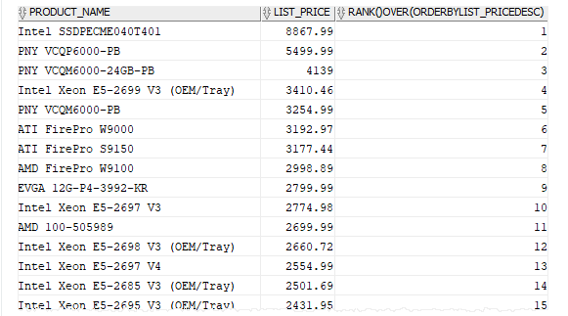
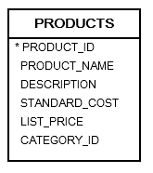
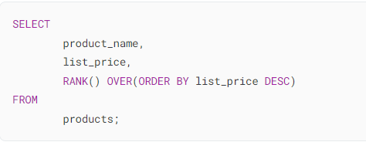
Advanced Aggregation Features
RANK calculates the rank of a value in a group of values. The return type is NUMBER.

Slide 24
Advanced Aggregation Features
PIVOT clause that allows you to write cross-tabulation queries which transpose rows into columns, aggregating data in the process of the transposing. As a result, the output of a pivot operation returns more columns and fewer rows than the starting data set

Slide 25
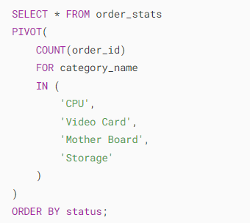
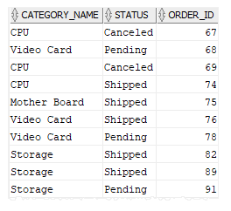
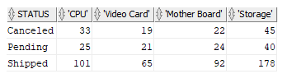
Advanced Aggregation Features

Slide 26
End of Chapter 5

