Slide 1
CHAPTER 6: DATABASE DESIGN USING THE E-R MODEL
ITP55 – Advanced Database Systems

Slide 2
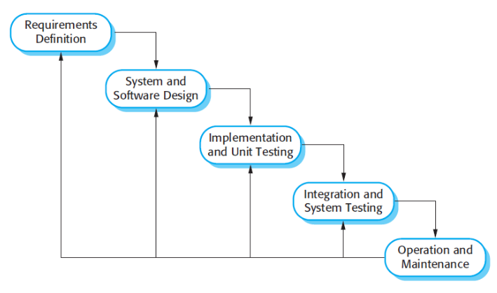
RECALL

Slide 3
Design Phases
Initial phase - characterize fully the data needs of the prospective database users.
Second phase -- choosing a data model
Applying the concepts of the chosen data model
Translating these requirements into a conceptual schema of the database.
A fully developed conceptual schema indicates the functional requirements of the enterprise.
Describe the kinds of operations (or transactions) that will be performed on the data.

Slide 4
Design Phases
Final Phase - Moving from an abstract data model to the implementation of the database
Logical Design – Deciding on the database schema.
Database design requires that we find a “good” collection of relation schemas.
Business decision – What attributes should we record in the database?
Computer Science decision – What relation schemas should we have and how should the attributes be distributed among the various relation schemas?
Physical Design – Deciding on the physical layout of the database

Slide 5
Design Phases
In designing a database schema, we must ensure that we avoid two major pitfalls:
Redundancy: a bad design may result in repeat information. Redundant representation of information may lead to data inconsistency among the various copies of information
Incompleteness: a bad design may make certain aspects of the enterprise difficult or impossible to model.

Slide 6
Design Phases
Design Approaches
Entity Relationship Model - Models an enterprise as a collection of entities and relationships
Normalization Theory - Formalize what designs are bad, and test for them

Slide 7
The Entity-Relationship Model
The entity-relationship (E-R) data model was developed to facilitate database design by allowing specification of an enterprise schema that represents the overall logical structure of a database
Basic ERD concepts: https://www.youtube.com/watch?v=xsg9BDiwiJE
Advanced ERD concepts: https://www.youtube.com/watch?v=hktyW5Lp0Vo

Slide 8
End of Chapter 6

