Slide 1
CHAPTER 1: INTRODUCTION
ITP55 – Advanced Database Systems

Slide 2
Outline
Database-System Applications
Purpose of Database Systems
View of Data
Database Languages
Database Design
Database Engine
Database Architecture
Database Users and Administrators
History of Database Systems

Slide 3
Database Systems
A database-management system (DBMS) is a collection of interrelated data and a set of programs to access those data.
Database refers to collection of data
The primary goal of a DBMS is to provide a way to store and retrieve database information that is both convenient and efficient.

Slide 4
Database Applications Examples
Enterprise Information
Sales: customers, products, purchases
Accounting: payments, receipts, assets
Human Resources: Information about employees, salaries, payroll taxes.
Manufacturing: management of production, inventory, orders, supply chain.
Banking and finance
customer information, accounts, loans, and banking transactions.
Credit card transactions
Finance: sales and purchases of financial instruments (e.g., stocks and bonds; storing real-time market data
Universities: registration, grades

Slide 5
Database Applications Examples
Airlines: reservations, schedules
Telecommunication: records of calls, texts, and data usage, generating monthly bills, maintaining balances on prepaid calling cards
Web-based services
Online retailers: order tracking, customized recommendations
Online advertisements
Document databases
Navigation systems: For maintaining the locations of varies places of interest along with the exact routes of roads, train systems, buses, etc.

Slide 6
Purpose of Database Systems
In the early days, database applications were built directly on top of file systems, which leads to:
Data redundancy and inconsistency: data is stored in multiple file formats resulting induplication of information in different files
Difficulty in accessing data
Need to write a new program to carry out each new task
Data isolation
Multiple files and formats
Integrity problems
Integrity constraints (e.g., account balance > 0) become “buried” in program code rather than being stated explicitly
Hard to add new constraints or change existing ones

Slide 7
Purpose of Database Systems
Atomicity of updates
Failures may leave database in an inconsistent state with partial updates carried out
Example: Transfer of funds from one account to another should either complete or not happen at all
Concurrent access by multiple users
Concurrent access needed for performance
Uncontrolled concurrent accesses can lead to inconsistencies
Ex: Two people reading a balance (say 100) and updating it by withdrawing money (say 50 each) at the same time
Security problems
Hard to provide user access to some, but not all, data

Slide 8
University Database Example
Data consists of information about:
Students
Instructors
Classes
Application program examples:
Add new students, instructors, and courses
Register students for courses, and generate class rosters
Assign grades to students, compute grade point averages (GPA) and generate transcripts

Slide 9
View of Data
A database system is a collection of interrelated data and a set of programs that allow users to access and modify these data.
A major purpose of a database system is to provide users with an abstract view of the data.
Data models
A collection of conceptual tools for describing data, data relationships, data semantics, and consistency constraints.
Data abstraction
Hide the complexity of data structures to represent data in the database from users through several levels of data abstraction.

Slide 10
Data Models
A collection of tools for describing
Data
Data relationships
Data semantics
Data constraints
Relational model
Entity-Relationship data model (mainly for database design)
Object-based data models (Object-oriented and Object-relational)
Semi-structured data model (XML)
Other older models:
Network model
Hierarchical model

Slide 11
Relational Model
In the relational model, data are represented in the form of tables.
Each table has multiple columns, and each column has a unique name.
Each row of the table represents one piece of information.

Slide 12
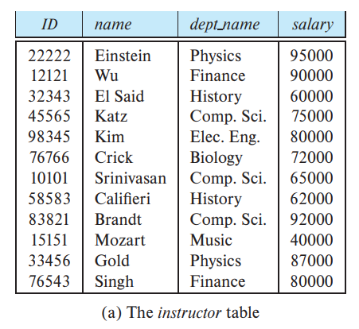
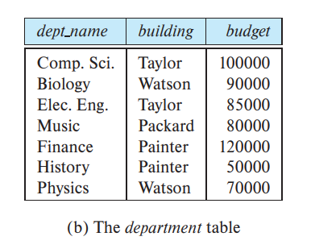
Relational Model

Slide 13
Levels of Abstraction
Physical level: describes how a record is stored (example: in memory)
Logical level: describes what data are stored in database, and the relationships among the data.
View level: the highest level of abstraction describes only part of the entire database. The view level of abstraction exists to simplify user interaction with the system.

Slide 14
Levels of Abstraction

Slide 15
Instances and Schemas
Schema – the overall design of the database
Instance - the actual content of the database at a particular point in time
Logical Schema – describes the database design at the logical level
Physical Schema – describes the database design at the physical level

Slide 16
Database Languages
A database system provides a data-definition language (DDL) to specify the database schema and a data-manipulation language (DML) to express database queries and updates

Slide 17
Database Languages
Data definition language (DDL) statements let you to perform these tasks:
Create, alter, and drop schema objects
Grant and revoke privileges and roles
Analyze information on a table, index, or cluster
Establish auditing options
Add comments to the data dictionary

Slide 18
Database Languages
Data manipulation language (DML) statements access and manipulate data in existing schema objects. These statements do not implicitly commit the current transaction.
Common DML statements: DELETE, INSERT, SELECT, UPDATE

Slide 19
Database Languages
There are basically two types of data-manipulation language:
Procedural DMLs require a user to specify what data are needed and how to get those data.
Declarative DMLs (also referred to as nonprocedural DMLs) require a user to specify what data are needed without specifying how to get those data.

Slide 20
Database Languages
A query is a statement requesting the retrieval of information.
The portion of a DML that involves information retrieval is called a query language

Slide 21
Database Design
The process of designing the general structure of the database:
Logical Design – Deciding on the database schema. Database design requires that we find a “good” collection of relation schemas.
Physical Design – Deciding on the physical layout of the database

Slide 22
Database Engine
A database system is partitioned into modules that deal with each of the responsibilities of the overall system.
The functional components of a database system can be divided into
The storage manager,
The query processor component,
The transaction management component.

Slide 23
Store Manager
A program module that provides the interface between the low-level data stored in the database and the application programs and queries submitted to the system.
The storage manager is responsible to the following tasks:
Interaction with the OS file manager
Efficient storing, retrieving and updating of data
The storage manager components include:
Authorization and integrity manager
Transaction manager
File manager
Buffer manager

Slide 24
Store Manager
The storage manager implements several data structures as part of the physical system implementation:
Data files -- store the database itself
Data dictionary -- stores metadata about the structure of the database, in particular the schema of the database.
Indices -- can provide fast access to data items. A database index provides pointers to those data items that hold a particular value.

Slide 25
Query Processor
The query processor components include:
DDL interpreter -- interprets DDL statements and records the definitions in the data dictionary.
DML compiler -- translates DML statements in a query language into an evaluation plan consisting of low-level instructions that the query evaluation engine understands.
The DML compiler performs query optimization; that is, it picks the lowest cost evaluation plan from among the various alternatives.
Query evaluation engine -- executes low-level instructions generated by the DML compiler.

Slide 26
Transaction Management
A transaction is a collection of operations that performs a single logical function in a database application
Transaction-management component ensures that the database remains in a consistent (correct) state despite system failures (e.g., power failures and operating system crashes) and transaction failures.
Concurrency-control manager controls the interaction among the concurrent transactions, to ensure the consistency of the database.

Slide 27
Database Architecture
Centralized databases
One to a few cores, shared memory
Client-server,
One server machine executes work on behalf of multiple client machines.
Parallel databases
Many core shared memory
Shared disk
Shared nothing
Distributed databases
Geographical distribution
Schema/data heterogeneity

Slide 28
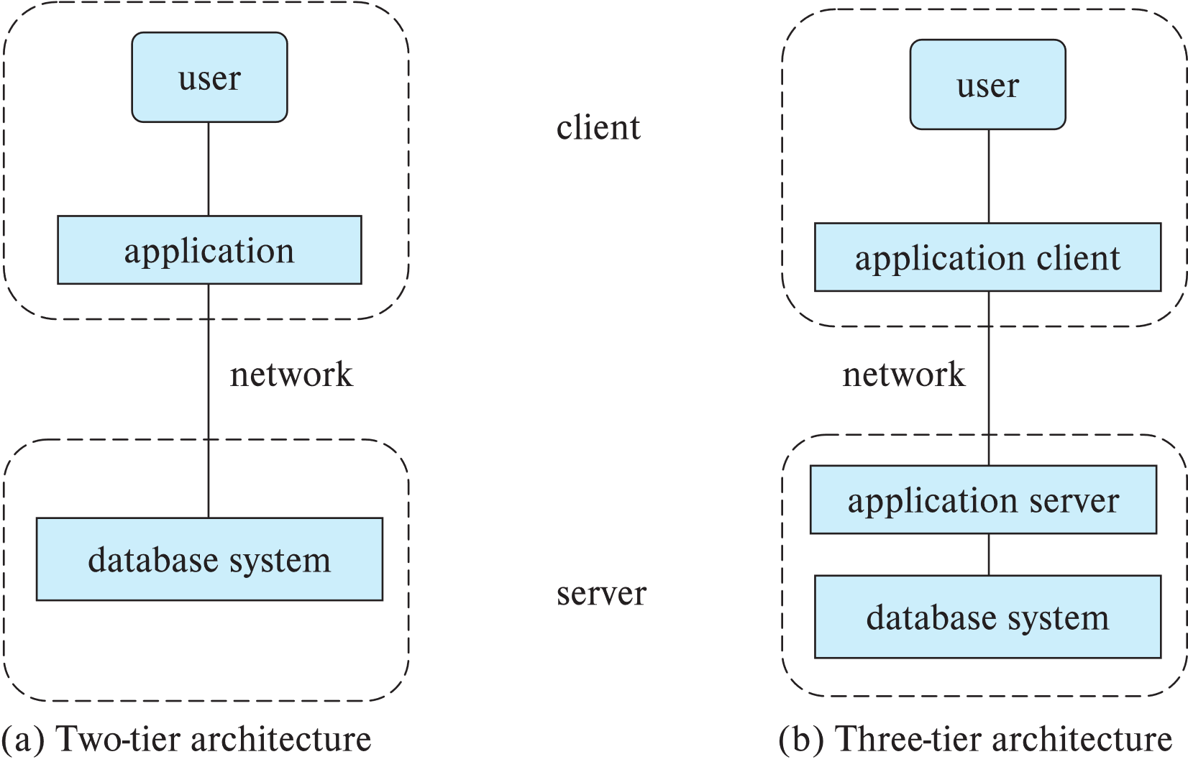
Database Architecture

Slide 29
Database Applications
Database applications are usually partitioned into two or three parts
Two-tier architecture -- the application resides at the client machine, where it invokes database system functionality at the server machine
Three-tier architecture -- the client machine acts as a front end and does not contain any direct database calls.
The client end communicates with an application server, usually through a forms interface.
The application server in turn communicates with a database system to access data.

Slide 30
Database Users
Naıve users are unsophisticated users who interact with the system by using predefined user interfaces, such as web or mobile applications.
Application programmers are computer professionals who write application programs.
Sophisticated users interact with the system without writing programs

Slide 31
Database Administrator
A person who has central control over the system is called a database administrator (DBA). Functions of a DBA include:
Schema definition
Storage structure and access-method definition
Schema and physical-organization modification
Granting of authorization for data access
Routine maintenance

Slide 32
Database Administrator
Periodically backing up the database
Ensuring that enough free disk space is available for normal operations, and upgrading disk space as required
Monitoring jobs running on the database

Slide 33
History of Database Systems
1950s and early 1960s:
Data processing using magnetic tapes for storage
Tapes provided only sequential access
Punched cards for input

Slide 34
History of Database Systems
Late 1960s and 1970s:
Hard disks allowed direct access to data
Network and hierarchical data models in widespread use
Ted Codd defines the relational data model
Would win the ACM Turing Award for this work
IBM Research begins System R prototype
UC Berkeley (Michael Stonebraker) begins Ingres prototype
Oracle releases first commercial relational database
High-performance (for the era) transaction processing

Slide 35
History of Database Systems
1980s:
Research relational prototypes evolve into commercial systems
SQL becomes industrial standard
Parallel and distributed database systems
Wisconsin, IBM, Teradata
Object-oriented database systems

Slide 36
History of Database Systems
1990s:
Large decision support and data-mining applications
Large multi-terabyte data warehouses
Emergence of Web commerce
2000s
Big data storage systems
Google BigTable, Yahoo PNuts, Amazon,
“NoSQL” systems.
Big data analysis: beyond SQL
Map reduce and friends

Slide 37
History of Database Systems
2010s
SQL reloaded
SQL front end to Map Reduce systems
Massively parallel database systems
Multi-core main-memory databases

Slide 38
End of Chapter 1

