Slide 1
CHAPTER 2: INTRODUCTION TO RELATIONAL MODEL
ITP54 – Advanced Database Systems

Slide 2
Structure of Relational Databases
A relational database consists of a collection of tables, each of which is assigned a unique name.
In general, a row in a table represents a relationship among a set of values.
A tuple is simply a sequence (or list) of values.
In the relational model the term relation is used to refer to a table, while the term tuple is used to refer to a row. Similarly, the term attribute refers to a column of a table.

Slide 3
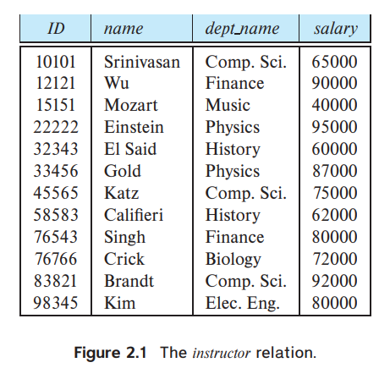
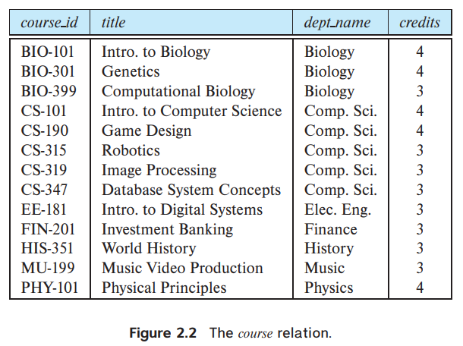
Structure of Relational Databases

Slide 4
Structure of Relational Databases
We use the term relation instance to refer to a specific instance of a relation, that is, containing a specific set of rows. The instance of instructor has 12 tuples, corresponding to 12 instructors.

Slide 5
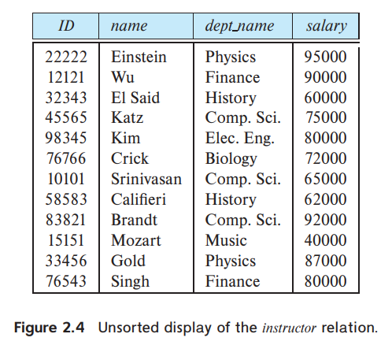
Structure of Relational Databases
For each attribute of a relation, there is a set of permitted values, called the domain of that attribute. Thus, the domain of the salary attribute of the instructor relation is the set of all possible salary values, while the domain of the name attribute is the set of all possible instructor names.

Slide 6
Structure of Relational Databases
A domain is atomic if elements of the domain are considered to be indivisible units. For example, suppose the table instructor had an attribute phone number, which can store a set of phone numbers corresponding to the instructor.
The null value is a special value that signifies that the value is unknown or does not exist.

Slide 7
Database Schema
Database schema is the logical design of the database, and the database instance, which is a snapshot of the data in the database at a given instant in time
The concept of a relation schema corresponds to the programming-language notion of type definition.

Slide 8
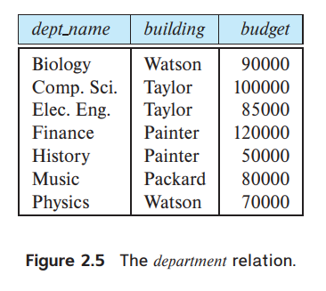
Database Schema
Consider the department relation, the schema for that relation is:
department (dept_name, building, budget)

Slide 9
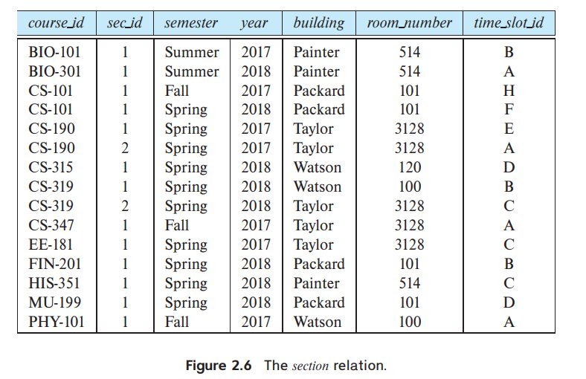
Database Schema
Try This

Slide 10
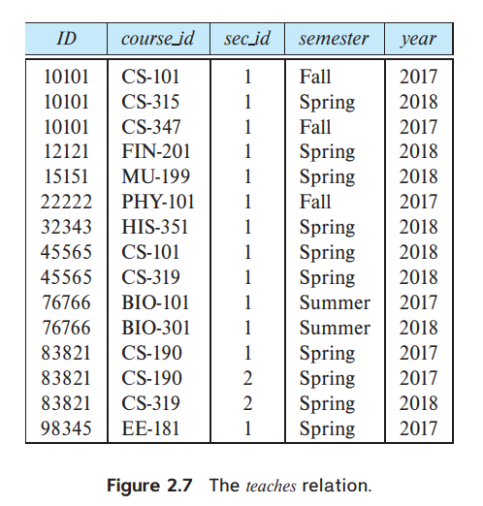
Database Schema
We need a relation to describe the association between instructors and the class sections that they teach. The relation schema to describe this association is:
teaches (ID, course_id, sec_id, semester, year)

Slide 11
Keys
A superkey is a set of one or more attributes that, taken collectively, allow us to identify uniquely a tuple in the relation.
For example, the ID attribute of the relation instructor is sufficient to distinguish one instructor tuple from another. Thus, ID is a superkey. The name attribute of instructor, on the other hand, is not a superkey, because several instructors might have the same name.

Slide 12
Keys
Candidate keys are superkeys which no proper subset is a superkey. For example, the combination of ID and name is a superkey for the relation instructor.
Primary key is a candidate key that is chosen by the database designer as the principal means of identifying tuples within a relation.
Any two individual tuples in the relation are prohibited from having the same value on the key attributes at the same time (primary key constraints)

Slide 13
Keys
Consider the classroom relation:
classroom (building, room_number, capacity)
Also consider the time slot relation:
time_slot (time_slot_id, day, start_time, end time)

Slide 14
Keys
A foreign key is an attribute (or collection of attributes) in a relation, that refers to the primary key in another relation
A foreign-key constraint from attribute(s) A of relation r1 to the primary-key B of relation r2 states that on any database instance, the value of A for each tuple in r1 must also be the value of B for some tuple in r2.

Slide 15
Keys
The relation r1 is also called the referencing relation of the foreign-key constraint, and r2 is called the referenced relation.
For example, the attribute dept_name in instructor is a foreign key from instructor, referencing department; note that dept_name is the primary key of department.
department(dept_name, building, budget) instructor(ID, name, dept_name, salary)

Slide 16
Keys
A referential integrity constraint requires that the values appearing in specified attributes of any tuple in the referencing relation also appear in specified attributes of at least one tuple in the referenced relation.

Slide 17
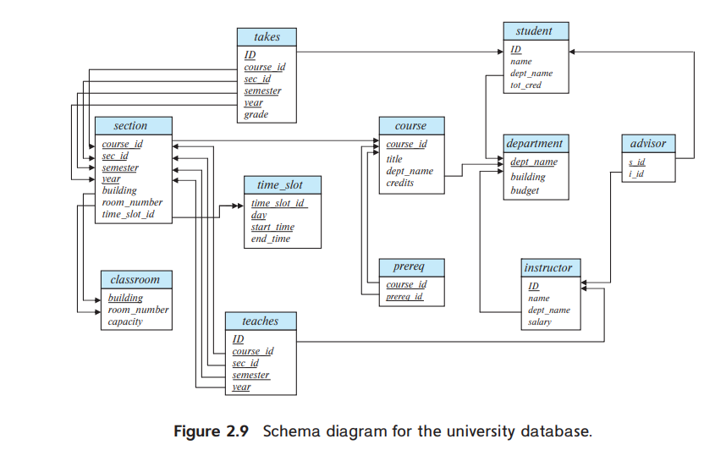
Schema Diagram
A schema diagram is a visual representation of a database system's structure and organization

Slide 18
Relational Query Language
A query language is a language in which a user requests information from the database.
Query languages can be categorized as imperative, functional, or declarative.
In an imperative query language, the user instructs the system to perform a specific sequence of operations on the database to compute the desired result; such languages usually have a notion of state variables, which are updated in the course of the computation. Example: Java

Slide 19
Relational Query Language
In a functional query language, the computation is expressed as the evaluation of functions that may operate on data in the database or on the results of other functions; functions are side-effect free, and they do not update the program state
In a declarative query language, the user describes the desired information without giving a specific sequence of steps or function calls for obtaining that information; the desired information is typically described using some form of mathematical logic. Example: SQL

Slide 20
End of Chapter 2

