Slide 1
CHAPTER 3: INTRODUCTION TO SQL/ ORACLE SQL
ITP55 – Advanced Database Systems

Slide 2
Overview of the SQL
IBM developed the original version of SQL, originally called Sequel, as part of the System R project in the early 1970s.
The Sequel language has evolved since then, and its name has changed to SQL (Structured Query Language).
SQL has clearly established itself as the standard relational database language.

Slide 3
Overview of the SQL
In 1986, the American National Standards Institute (ANSI) and the International Organization for Standardization (ISO) published an SQL standard, called SQL-86.
ANSI published an extended standard for SQL, SQL-89, in 1989. The next version of the standard was SQL-92 standard, followed by SQL:1999, SQL:2003, SQL:2006, SQL:2008, SQL:2011, and most recently SQL:2016.

Slide 4
Overview of the SQL
The SQL language has several parts:
Data-definition language (DDL). The SQL DDL provides commands for defining relation schemas, deleting relations, and modifying relation schemas.
Data-manipulation language (DML). The SQL DML provides the ability to query information from the database and to insert tuples into, delete tuples from, and modify tuples in the database.

Slide 5
Overview of the SQL
Integrity. The SQL DDL includes commands for specifying integrity constraints that the data stored in the database must satisfy. Updates that violate integrity constraints are disallowed.
View definition. The SQL DDL includes commands for defining views.

Slide 6
Overview of the SQL
Transaction control. SQL includes commands for specifying the beginning and end points of transactions.
Embedded SQL and dynamic SQL. Embedded and dynamic SQL define how SQL statements can be embedded within general-purpose programming languages, such as C, C++, and Java.
Authorization. The SQL DDL includes commands for specifying access rights to relations and views.

Slide 7
SQL Data Definition
Basic types:
char(n): A fixed-length character string with user-specified length n. The full form, character, can be used instead.
varchar(n): A variable-length character string with user-specified maximum length n. The full form, character varying, is equivalent.
int: An integer (a finite subset of the integers that is machine dependent). The full form, integer, is equivalent.

Slide 8
SQL Data Definition
smallint: A small integer (a machine-dependent subset of the integer type).
numeric(p, d): A fixed-point number with user-specified precision. The number consists of p digits (plus a sign), and d of the p digits are to the right of the decimal point. Thus, numeric(3,1) allows 44.5 to be stored exactly, but neither 444.5 nor 0.32 can be stored exactly in a field of this type.
real, double precision: Floating-point and double-precision floating-point numbers with machine-dependent precision.
float(n): A floating-point number with precision of at least n digits.

Slide 9
SQL Data Definition
Each type may include a special value called the null value. A null value indicates an absent value that may exist but be unknown or that may not exist at all.

Slide 10
Basic Schema Definition
We define an SQL relation by using the create table command
The general form of the create table command is:
create table r(A1 D1, A2 D2,...,An Dn,
⟨integrity-constraint1⟩,
…,
⟨integrity-constraintk⟩);

Slide 11
Basic Schema Definition
Example:
create table department
(dept_name varchar (20),
building varchar (15),
budget numeric (12,2),
primary key (dept_name));

Slide 12
Basic Schema Definition
SQL supports a number of different integrity constraints:
primary key (…attributes): The primary-key specification says that attributes form the primary key for the relation.
foreign key (…attributes) references s: The foreign key specification says that the values of attributes for any tuple in the relation must correspond to values of the primary key attributes of some tuple in relation s.

Slide 13
Basic Schema Definition
not null: The not null constraint on an attribute specifies that the null value is not allowed for that attribute; in other words, the constraint excludes the null value from the domain of that attribute.

Slide 14
Basic Schema Definition
Examples:
Create a table named department with the following attributes: department name, building name and budget. Set the department name as PK.
Create a table named course with the following attributes: course id, title, department name, credits. Set the course id name as PK. Reference the department name from department table.

Slide 15
Basic Schema Definition
Examples:
3. Create a table named instructor with attributes ID, a non-nullable name, department name, salary where ID is the PK and department name is referenced to department table

Slide 16
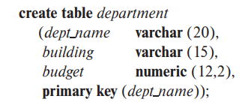
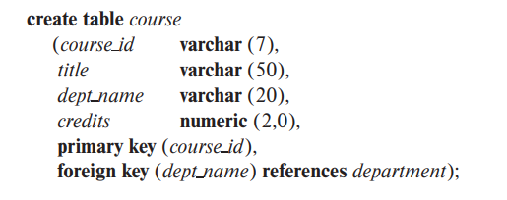
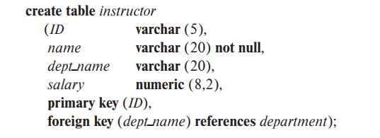
Basic Schema Definition

Slide 17
Basic Schema Definition
The drop table command deletes all information about the dropped relation from the database.
drop table r;
Example: Delete the course section table.
drop table section;

Slide 18
Basic Schema Definition
We use the alter table command to add attributes to an existing relation.
alter table r add A D;
alter table r drop A;
Example: Modify the course table by adding an attribute named cluster.
alter table course add cluster varchar(20);

Slide 19
Basic Structure of SQL Queries
The basic structure of an SQL query consists of three clauses: select, from, and where.
A query takes as its input the relations listed in the from clause, operates on them as specified in the where and select clauses, and then produces a relation as the result.

Slide 20
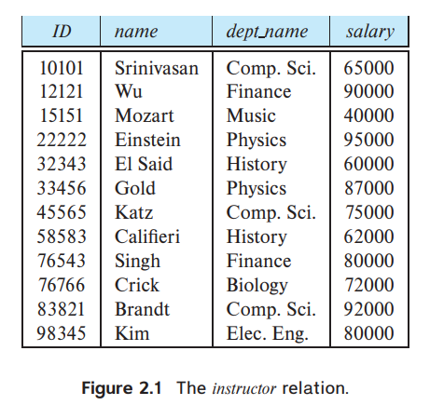
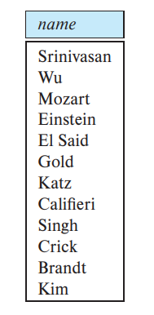
Basic Structure of SQL Queries
Queries on a single relation
select A from r;
Example: Find all names in the instructor table.
select name from instructor;

Slide 21
Basic Structure of SQL Queries
In those cases where we want to force the elimination of duplicates, we insert the keyword distinct after select.
Example: Find all unique department names in the instructor table.
select distinct dept_name from instructor;

Slide 22
Basic Structure of SQL Queries
The select clause may also contain arithmetic expressions involving the operators +, −, ∗, and / operating on constants or attributes of tuples.
select ID, name, dept_name, salary * 1.1 from instructor;

Slide 23
Basic Structure of SQL Queries
The where clause allows us to select only those rows in the result relation of the from clause that satisfy a specified predicate
select A from r where condition;

Slide 24
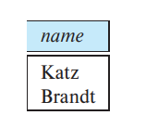
Basic Structure of SQL Queries
Example: Find all the names of instructors from Computer Sci department that has more than 70,000 salary.
select name
from instructor
where dept_name = ‘Comp.Sci.’
and salary > 70000;

Slide 25
Queries on Multiple Relations
Queries often need to access information from multiple relations.
We list the relations that need to be accessed in the from clause and specify the matching condition in the where clause.
select name, instructor.dept_name, building from instructor, department
where instructor.dept_name= department.dept_name;

Slide 26
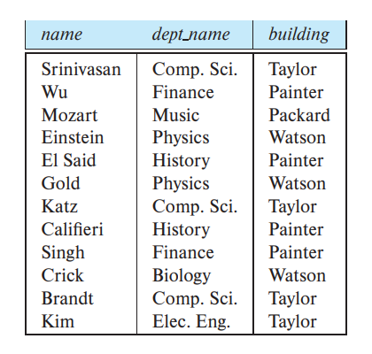
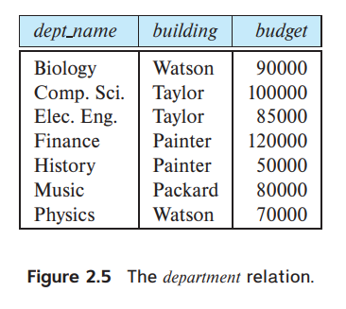
Queries on Multiple Relations

Slide 27
Additional Basic Operations
SQL provides a way of renaming the attributes of a result relation. It uses the as clause, taking the form:
old-name as new-name
select name as instructor_name, course_id
from instructor, teaches
where instructor.ID= teaches.ID;

Slide 28
Additional Basic Operations
Pattern matching can be performed on strings using the operator like. We describe patterns by using two special characters:
Percent (%): The % character matches any substring.
Underscore (_): The _ character matches any character.

Slide 29
Additional Basic Operations
'Intro%' matches any string beginning with “Intro”.
'%Comp%' matches any string containing “Comp” as a substring, for example, 'Intro. to Computer Science', and 'Computational Biology’.
‘_ _ _ ' matches any string of exactly three characters.
' %' matches any string of at least three characters.

Slide 30
Additional Basic Operations
Example: Find all department names from department table where the building has “Watson” on its name.
select dept_name
from department
where building like '%Watson%';

Slide 31
Additional Basic Operations
SQL offers the user some control over the order in which tuples in a relation are displayed. The order by clause causes the tuples in the result of a query to appear in sorted order.

Slide 32
Additional Basic Operations
Example: Sort the names of all the instructors in the instructor table from the Physics department.
select name
from instructor
where dept_name = 'Physics'
order by name;

Slide 33
Additional Basic Operations
Example: Sort all the rows in the instructor by descending salary then by ascending name.
select *
from instructor
order by salary desc, name asc;

Slide 34
Additional Basic Operations
SQL includes a between comparison operator to simplify where clauses that specify that a value be less than or equal to some value and greater than or equal to some other value
select name
from instructor
where salary between 90000 and 100000

Slide 35
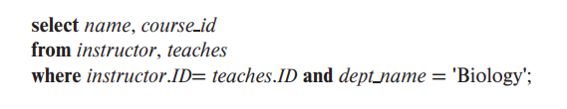
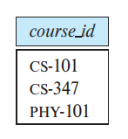
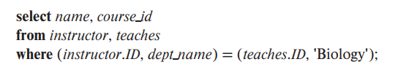
Additional Basic Operations
SQL permits us to use the notation (v1,v2, …,vn) to denote a tuple of arity n containing values v1,v2, …,vn; the notation is called a row constructor.

Slide 36
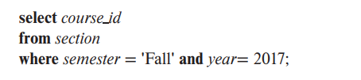
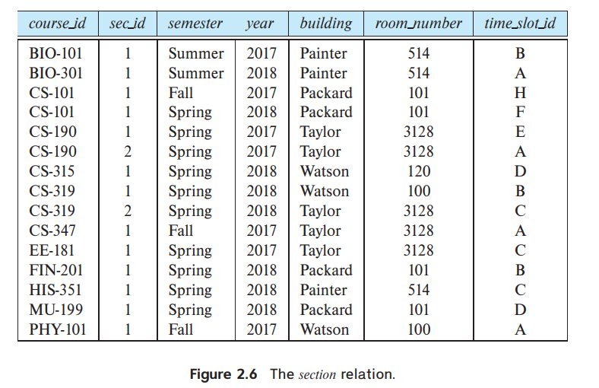

Set Operations
UNION is used to combine the result of two select statements and automatically eliminates duplicates.

Slide 37
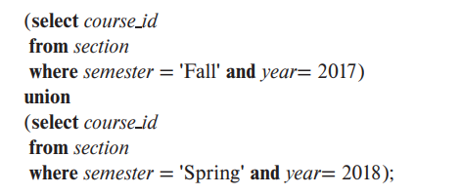
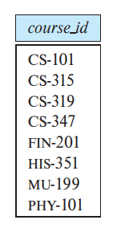
Set Operations

Slide 38
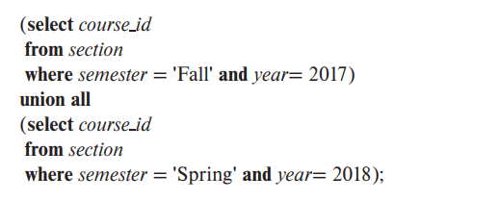
Set Operations
If we want to retain all duplicates, we must write union all in place of union

Slide 39
Set Operations
INTERSECT is used to combine two SELECT statements, but it only returns the records which are common from both SELECT statements.
If we want to retain all duplicates, we must write intersect all in place of intersect

Slide 40
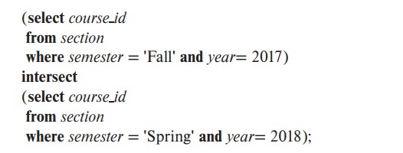
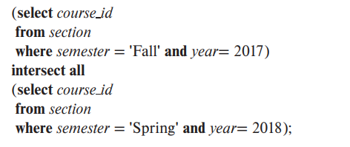
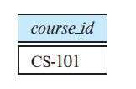
Set Operations

Slide 41
Set Operations
EXCEPT/MINUS includes ONLY results from first result set that are NOT included in second result set
If we want to retain duplicates, we must write except all in place of except

Slide 42
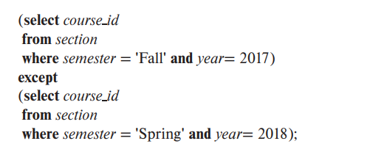
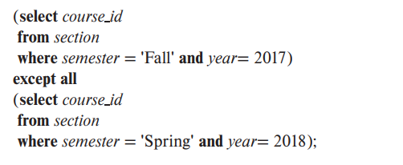
Set Operations

Slide 43
Null Values
SQL uses the special keyword null in a predicate to test for a null value
The predicate is not null succeeds if the value on which it is applied is not null.
select name
from instructor
where salary is null;

Slide 44
Aggregate Functions
Aggregate functions are functions that take a collection (a set or multiset) of values as input and return a single value.
Average: avg
Minimum: min
Maximum: max
Total: sum
Count: count

Slide 45
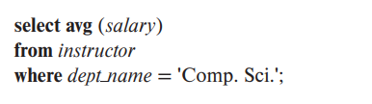
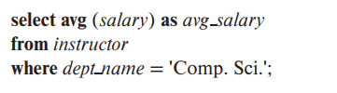
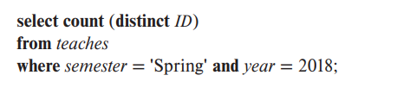

Aggregate Functions

Slide 46
Aggregate Functions
There are circumstances where we would like to apply the aggregate function not only to a single set of tuples, but also to a group of sets of tuples; we specify this in SQL using the group by clause.
The attribute or attributes given in the group by clause are used to form groups.
Tuples with the same value on all attributes in the group by clause are placed in one group.

Slide 47
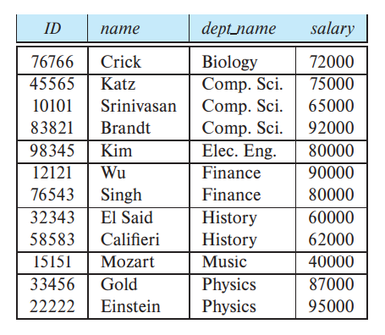
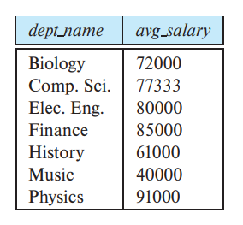
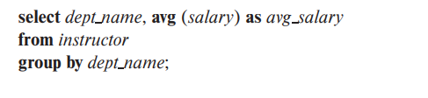
Aggregate Functions

Slide 48
Aggregate Functions
The HAVING clause was added to SQL because the WHERE keyword cannot be used with aggregate functions.
This condition does not apply to a single tuple; rather, it applies to each group constructed by the group by clause.

Slide 49
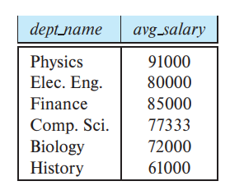
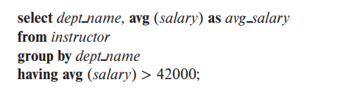
Aggregate Functions

Slide 50
Nested Subqueries
SQL provides a mechanism for nesting subqueries. A subquery is a select-from-where expression that is nested within another query
A common use of subqueries is to perform tests for set membership, make set comparisons, and determine set cardinality by nesting subqueries in the where clause.

Slide 51
Nested Subqueries
SQL allows testing tuples for membership in a relation. The in connective tests for set membership, where the set is a collection of values produced by a select clause.
The not in connective tests for the absence of set membership.

Slide 52
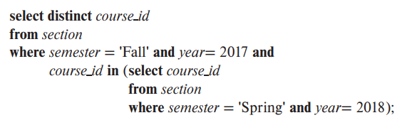
Nested Subqueries

Slide 53
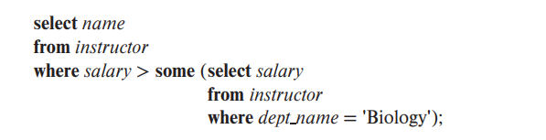
Nested Subqueries
The phrase “greater than at least one” is represented in SQL by > some.
Example: Find the names of all instructors whose salary is greater than at least one instructor in the Biology department.

Slide 54
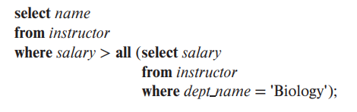
Nested Subqueries
The construct > all corresponds to the phrase “greater than all.”
Example: Find the names of all instructors whose salary is greater than all instructors in the Biology department.

Slide 55
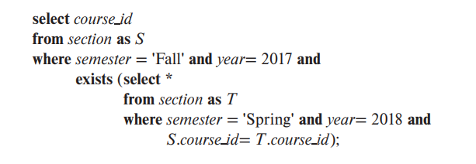
Nested Subqueries
The exists construct returns the value true if the argument subquery is nonempty
Example: Find all courses taught in both the Fall 2017 semester and in the Spring 2018 semester

Slide 56
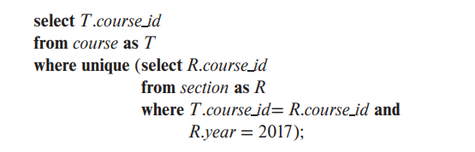
Nested Subqueries
The unique construct returns the value true if the argument subquery contains no duplicate tuples.
Example: Find all courses that were offered at most once in 2017

Slide 57
Nested Subqueries
SQL allows a subquery expression to be used in the from clause. The key concept applied here is that any select-from-where expression returns a relation as a result and, therefore, can be inserted into another select-from-where anywhere that a relation can appear.

Slide 58
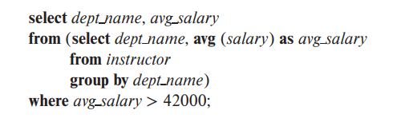
Nested Subqueries
Example: Find the average instructors’ salaries of those departments where the average salary is greater than $42,000.

Slide 59
Modification of the Database
A delete request is expressed in much the same way as a query. We can delete only whole tuples; we cannot delete values on only particular attributes.
delete from r where P;

Slide 60
Modification of the Database
Examples:
1. Delete all tuples in the instructor relation pertaining to instructors in the Finance department.
delete from instructor
where dept name = 'Finance';

Slide 61
Modification of the Database
Examples:
2. Delete all instructors with a salary between $13,000 and $15,000.
3. Delete all tuples in the instructor relation for those instructors associated with a department located in the Watson building.

Slide 62

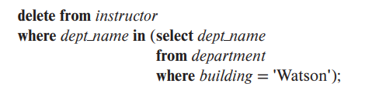
Modification of the Database

Slide 63
Modification of the Database
To insert data into a relation, we either specify a tuple to be inserted or write a query whose result is a set of tuples to be inserted.
The attribute values for inserted tuples must be members of the corresponding attribute’s domain.
Similarly, tuples inserted must have the correct number of attributes.

Slide 64
Modification of the Database
insert into r values (D1, D2, …, Dn);
insert into r(A1, A2, …, An) values (D1, D2, …, Dn);

Slide 65



Modification of the Database
Examples:

Slide 66
Modification of the Database
In certain situations, we may wish to change a value in a tuple without changing all values in the tuple. For this purpose, the update statement can be used.
update r set A = D;

Slide 67
Modification of the Database
Examples:
update instructor
set salary= salary * 1.05;
update instructor
set salary = salary * 1.05
where salary < 70000;

Slide 68
End of Chapter 3

