Slide 1

Visualization
AUTHOR-RoKu

Slide 2
NEED FOR VISUALIZATION
Any effort to help people understand the significance of data by placing it in a visual context.
Patterns, trends and correlations that might go undetected in text-based data can be exposed and recognized easier with data visualization.

Slide 3
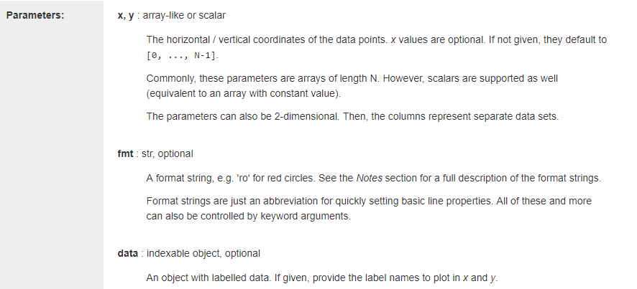
matplotlib.pyplot.plot(*args, scalex=True, scaley=True, data=None, **kwargs)

Slide 4
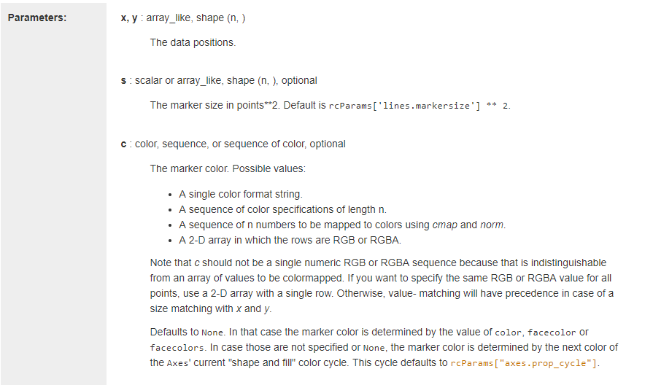
matplotlib.pyplot.scatter(x, y, s=None, c=None, marker=None, cmap=None, norm=None, vmin=None, vmax=None, alpha=None, linewidths=None, verts=None, edgecolors=None, *, data=None, **kwargs)

Slide 5

