Slide 1
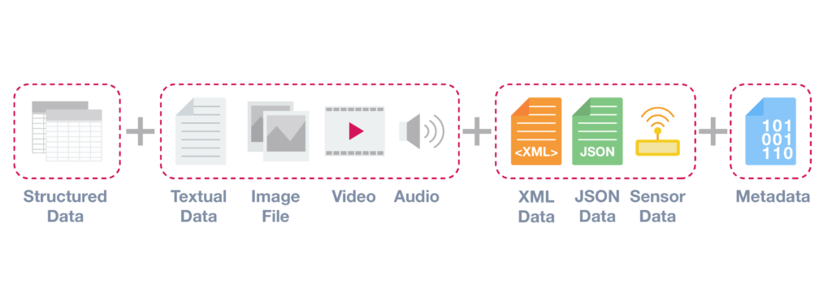
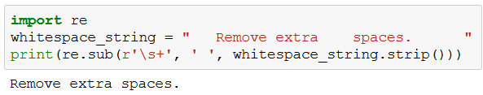
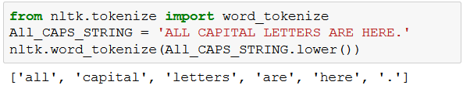
Data Preparation/ Pre-processing
While working on real world problems, one may come across data in various forms like
Structured form – Data which is easy to organize in a structure like in form of tables, spreadsheets, Relational Database etc.
Unstructured form – Data which is hard to organize and does not conforms to any structure like text, images, video etc.
Semi-Structured form – Data which can be organised and can help in structuring some other data like metadata (author, creator of text, date of creation) for sensor data, audio, video.
In our given problem, we are dealing with complaints / text data which we know is an unstructured format. Most traditional Machine Learning algorithms can work on Clean, Uniform & Structured data in numerical form only for bringing about all these changes certain data pre-processing steps are required.
Let’s start with looking at some Data Cleansing techniques:
1. Removing all extra spaces and white spaces.
2. Removing all blank documents/text.
3. Removing all unwanted characters: HTML/XML tags, punctuations, non-alphabets, characters from other languages, emoticons, encoding etc.
4. Tokenizing & Lowering the case

Slide 2
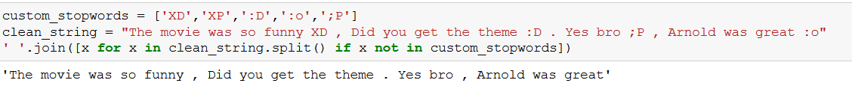
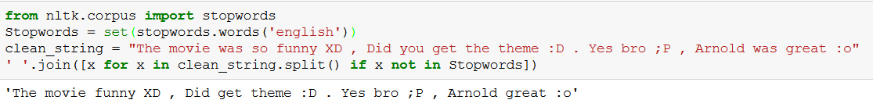
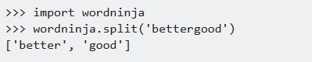
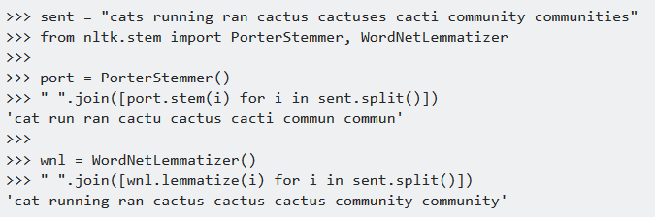
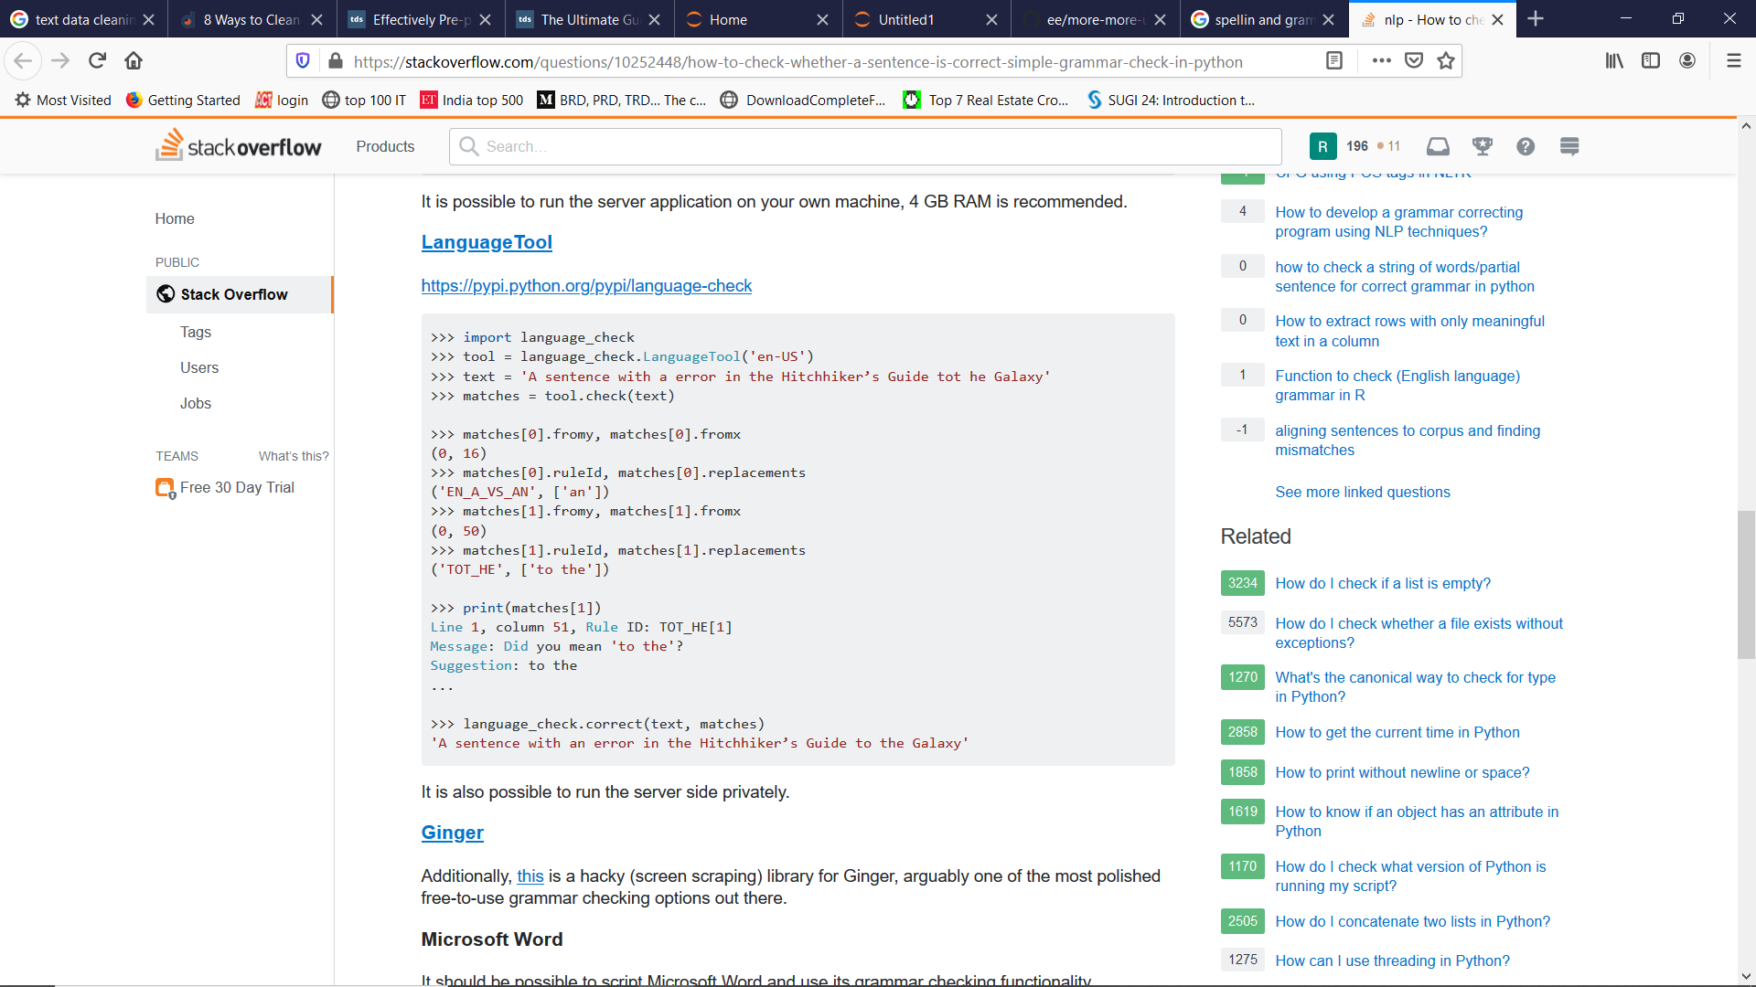
Data Pre-processing
5. Removing custom/common Stopwords – Words which do not add enough meaning to our corpus like adverbs, adjectives, prepositions etc. are called Stopwords.
Removing them reduces dimensionality & can also improve performance of ML algorithms
Custom stop-words are treated on need basis eg: emojis, frequent words after tf-idf
6. Breaking the attached words.
7. Stemming & Lemmatizing -
Both generate the root form of the inflected words.
The difference is that stem might not be an actual word whereas,
lemma is an actual language word. In lemmatization, one uses WordNet corpus and a corpus for stop words as well to produce lemma
8. Spelling & Grammar Correction

Slide 3
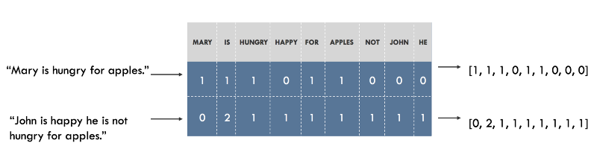
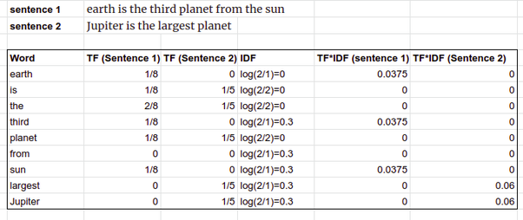
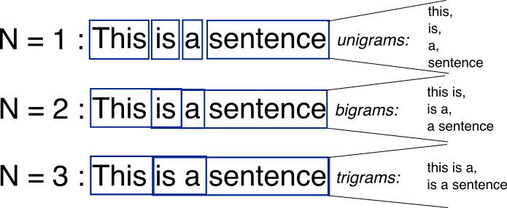
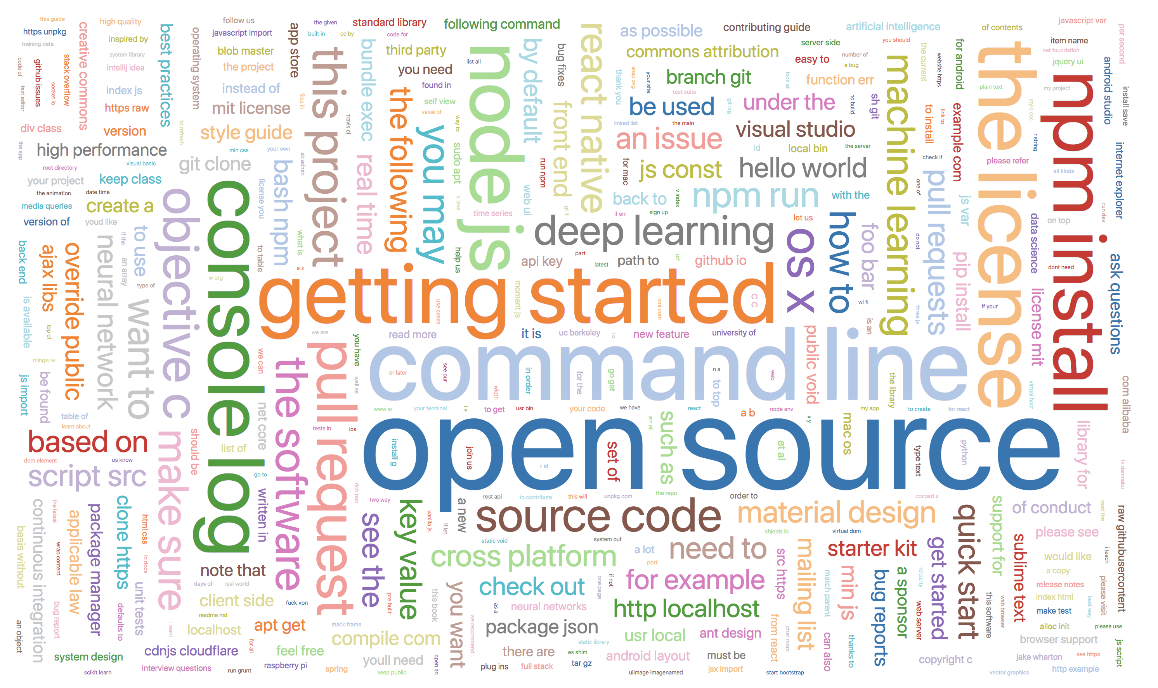
Data Representation
Once data has been cleaned we need to find a good numerical representation of it, before sending it to machine learning models. Commonly used approaches for making word vectors are:
1. Bag Of Words (BOW) is a list of distinct words in a document and a word count for each word.
A Document Term Matrix contains BOW representation of all documents in the corpus.
Disadvantages:
creates a big sparse matrix,
ignores the order, semantics of words &
Can’t find important words or important chunk of words occurring together, to overcome this TF-IDF was invented.
2. Term Frequency- Inverse Document Frequency (TF-IDF) is an extension to BOW, it helps in finding important words, bi-grams, n-grams in a document by comparing their occurrence in the whole corpus.
Disadvantages:
Also creates a big sparse matrix
Ignore semantic relationships of words and their similarity to overcome this word2vec & GloVe was invented.
TF-IDF = # term occurrence in doc * log ( # total documents/ # document containing term)
A word cloud is a visual representation of important words or n-grams in a corpus. A Bigger word or n-gram in a word cloud represents High importance.

