Slide 1
Analysis of growth and properties of titanium Nanotubes
Under the Guidance of
Prof. Rakesh Mote
By: Utkarsh Thakre( 17D100018) , Anish Kulkarni(17D100008), Manan Tayal(170100005), Kaniska Sunick(17D100004)

Slide 2
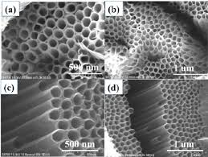
TNTs and their Applications
Titanium Nanotubes have their major application in biomedical implants due to biocompatibility of Ti in the body.
The analysis of the properties of Nanotubes become crucial since the Nanotubes increase the surface area by large extent, thus enhancing the catalytic reactive properties.

Slide 3
Aspects that can be analysed in TNTs growth
Crystal structure or the shape of the nanotubes.
Spatial variation of density length of the nanotubes
Creating a mathematical model to determine structural properties on various characteristic parameters
Effects of electrical and electro-chemical parameters on the nano-tube growth.
Growth characteristics in surfaces with curvature
Deciding use of efficient monitoring techniques
Possibility of controlling growth through complex electric fields
Possibility of controlling growth through microfluidics

Slide 4
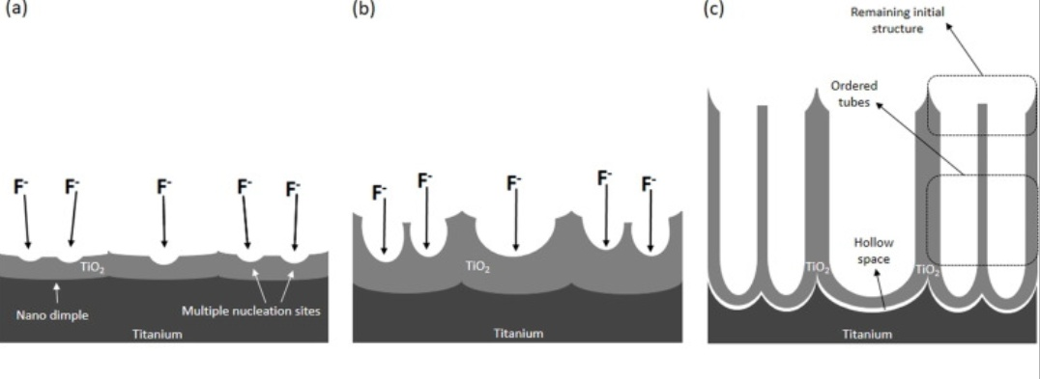
Mechanism of TiO₂ Nanotubes formation
(a) The first stage: the local chemical dissolution of the growing anodic oxide film by F− ions takes place, with the nano-imprinted dimples acting as single or multiple nucleation sites;
(b) In second stage the pronounced dissolution takes place at the bottom of the pores, where the electric filed is stronger
(c) A later stage is achieved after a long period of anodization, after which the initial structure remains in the top region of the film while ordered tubes are underneath.

Slide 5
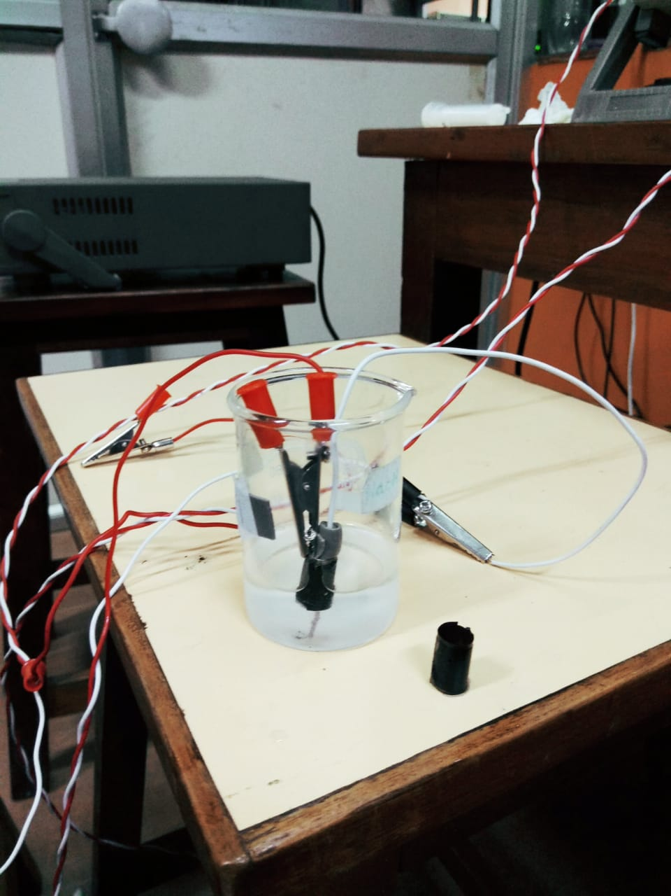
Experimental setup
Aim:
Analysis of TNT growth with variation in spatial geometry of the electrodes.
Analysis of TNT growth on variation of the voltages and time period.
Experimental specifications:
Electrolyte- H₃PO₄+NH₄F
Cathode-pure Ti, Anode-Carbon/Copper Electrode.
Concentration of Electrolyte 0.3M H₃PO₄ + 0.3M NH₄
Normal Temperature Pressure Conditions.
Details:
Two configurations will be considered. Firstly the TNT will be grown on the flat plate with the carbon at certain distance. In second case the Ti plate will be kept in a cylindrical fashion around the carbon electrode. Thus the effect of the geometry variation is expected to be observed.
The TNT nano tubes will be analyzed under variation of different growth parameters i.e Voltage (10V,20V,30V) and Time period.(1 hr, 2hr 3hr)
Characteristics to be observed: diameter of the tubes, wall thickness and length of the TNTs.

Slide 6
Experimental Conditions
Electrolyte with 0.3M H₃PO₄ and 0.3M NH₄ was used at normal room temperature pressure conditions.
First setup had Titanium sheets rolled into a cylindrical shape of diameter 8 mm and kept in form using electrical tape.
Carbon electrode were held in position between the sheet via DST to maintain a uniform distance from the walls of the sheet.
Second setup had Titanium rectangular sheets of 12.6mm, 4mm away from the carbon electrode from the centre of the sheet.
The setups were run for 2 varying input parameters : Voltage, Anodization time.
Voltage setups were run for incremental voltages of 10 V, 20 V, 30 V.
Anodization time for each of the voltages were 1 hour, 2 hour and 3 hours.

Slide 7
Explanations for expected results
By decreasing the electrode distance, both the diameter and length of TiO2 nanotubes can be improved due to the enhanced steady-state current density.
The growth of TiO2 was also found to be more sensitive to the change of electrode distance at high anodizing voltages. Because the enhanced growth of TiO2 nanotube can be achieved without increasing the anodic voltages, the present study provides a promising approach to fabricate TiO2 nanotubes in a more energy-efficient manner.
High-quality NTs can be grown in the anodization range of 10–240 V.
The maximum acid concentration, at which NT can be grown, is 0.7% for Va<60V, and starts decreasing with an increase in anodization voltage, reaching 0.1% at 240 V.

Slide 8
As-grown amorphous TiO2 transform into anatase phase after annealing at 400°C, and further transforms to rutile phase at temperatures above 500°C. The transition temperature from anatase to rutile phase changes with NH4F concentration.
NTs prepared with 0.7% acid has transition temperature above 600°C, while the samples prepared with 0.1% NH4F shows a phase transformation to rutile for temperatures above 500°C.
In the voltage range of 30–120 V XRD measurements showed higher crystal quality of the TiO2 Nanotubes. Various measurements revealed that samples grown in higher acid concentrations have increased defect density and reduced activation energy.
The anodic growth of TiO2 nanotubes is significantly enhanced (≈16–20 times faster) under flow conditions in microfluidics. Flow not only controls the diameter, length, and crystal orientations of TiO2 nanotubes, but also regulates the spatial distribution of nanotubes inside microfluidic devices.

Slide 9
Current status and future work to be done.
We performed several experiments in the cylindrical electrodes under various growth times.
Out of all setups some failed due to short circuiting, since we tried to keep the electrodes in very close proximity.
Due unavailability of more customised and enhanced setup the results may be inconsistent.
Nanotube growth was also tried on the H3PO4 as solvent but deposition was mostly uniform and TNT formation wasn’t visible.
On theoretical introspection it can be said that the TNT growth will be affected only after a geometry variations of lesser than micrometers orders.
Further TNTs have to be analysed in FSEM Microscope for results.

