Slide 1

A .NET MINI PROJECT
Student Attendance &
Management System
ASP.NET Core MVC | .NET 8 | Entity Framework Core | SQL Server | Bootstrap 5
Aditya Kumar Roy
BCA Regular | Division B | Enrollment No: 2405101010001 | Subject: .NET

Slide 2





Problem Statement
Paper registers get lost, damaged or altered
75%
Attendance percentage is calculated by hand
Searching one student's record is slow
Minimum attendance limit the system highlights automatically
Same attendance can be entered twice
Need: one digital system, no duplicates, instant reports
Student, faculty and subject data are scattered
Aditya Kumar Roy | BCA Regular | 2405101010001 | Div B
2

Slide 3






Objectives
Manage Records
Mark Attendance
Prevent Duplicates
Students, faculty and subjects in one place
Subject-wise and division-wise, daily
Enrollment number and attendance
Generate Reports
Secure Login
Apply MVC + EF Core
Student, subject and date-wise with filters
Hashed password and protected pages
Real-life use of .NET concepts
Aditya Kumar Roy | BCA Regular | 2405101010001 | Div B
3

Slide 4
Existing vs Proposed System
Existing System (Manual)
Proposed System (Web App)
Paper register / Excel sheets
Time-consuming and error-prone
No data security
No duplicate checking
Manual percentage and reports
Centralised SQL Server database
Fast entry, automatic calculation
Secure admin login
Duplicate prevention built in
Instant filtered reports and charts
Aditya Kumar Roy | BCA Regular | 2405101010001 | Div B
4

Slide 5





Technology Stack
C# / .NET 8
EF Core 8
SQL Server
ASP.NET Core MVC
ORM and migrations
Relational database
HTML5 + CSS3
Bootstrap 5
Visual Studio 2022
Structure and style
Responsive UI
IDE + JavaScript, Chart.js

Slide 6
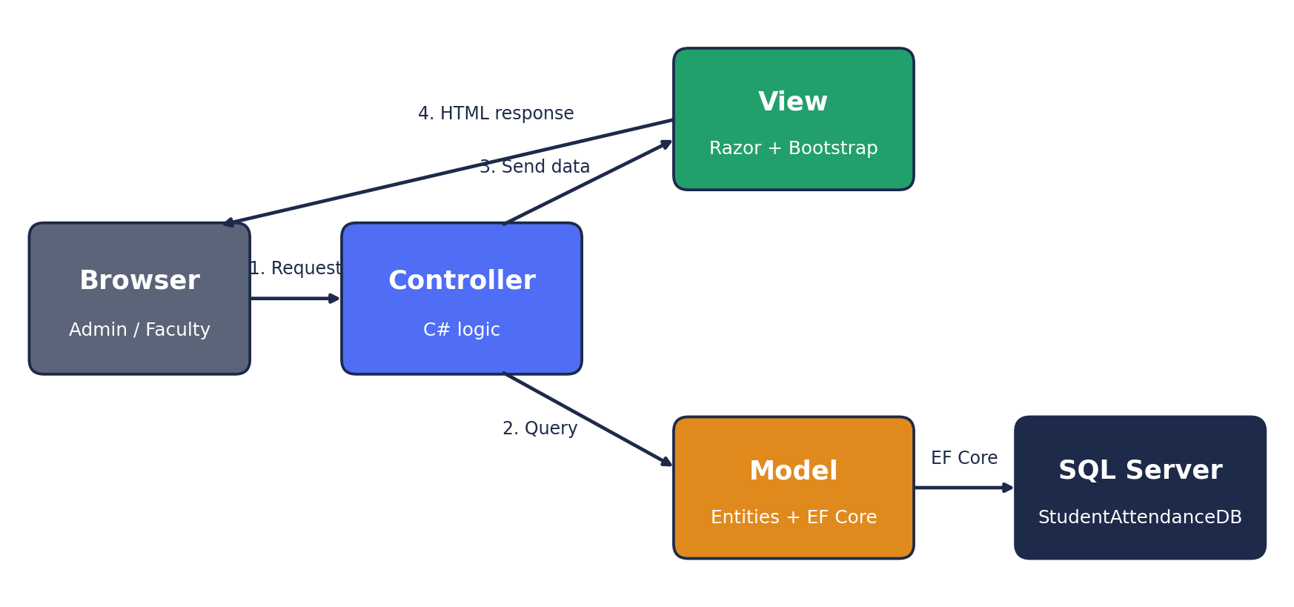
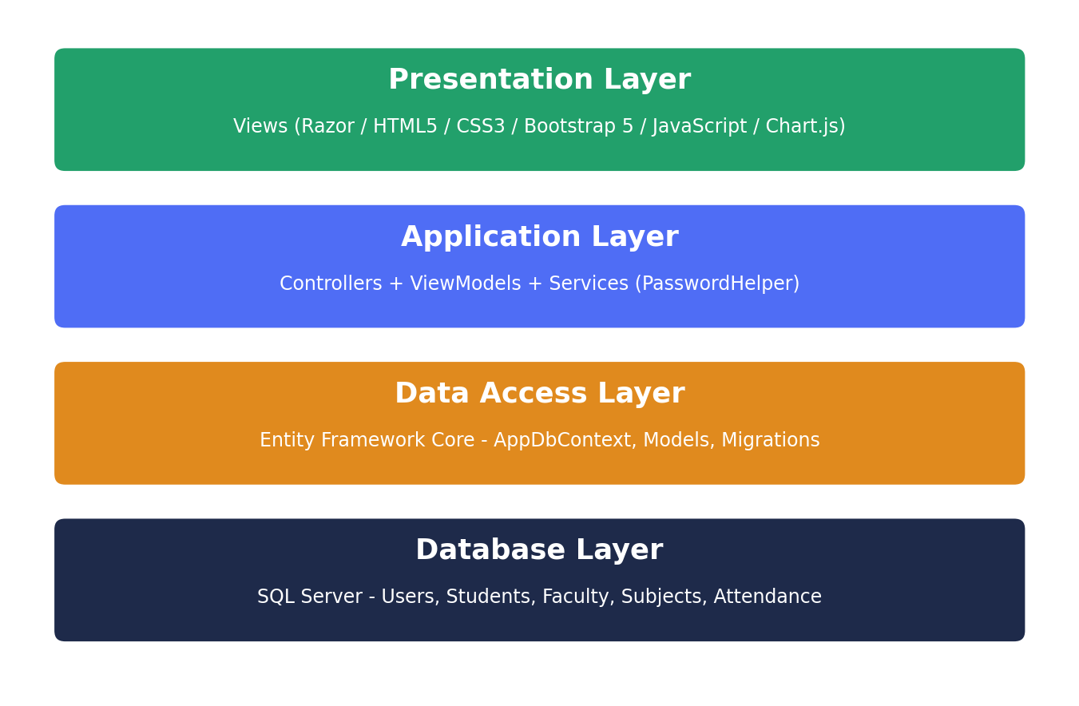
System Architecture (MVC)
Model - Entities + AppDbContext
View - Razor + Bootstrap
Controller - Request logic
Browser sends a request, the Controller queries the database through EF Core, passes data to the View, and the HTML page returns to the browser.
Aditya Kumar Roy | BCA Regular | 2405101010001 | Div B
6

Slide 7


Project Modules
Authentication
Dashboard
Students
Faculty
Login, logout, hashed password
Cards and charts
CRUD + search
CRUD + search
7 modules
1 database
5 tables
Subjects
Attendance
Reports
CRUD + faculty link
Date, subject, division
Filters and percentage
Aditya Kumar Roy | BCA Regular | 2405101010001 | Div B
7

Slide 8
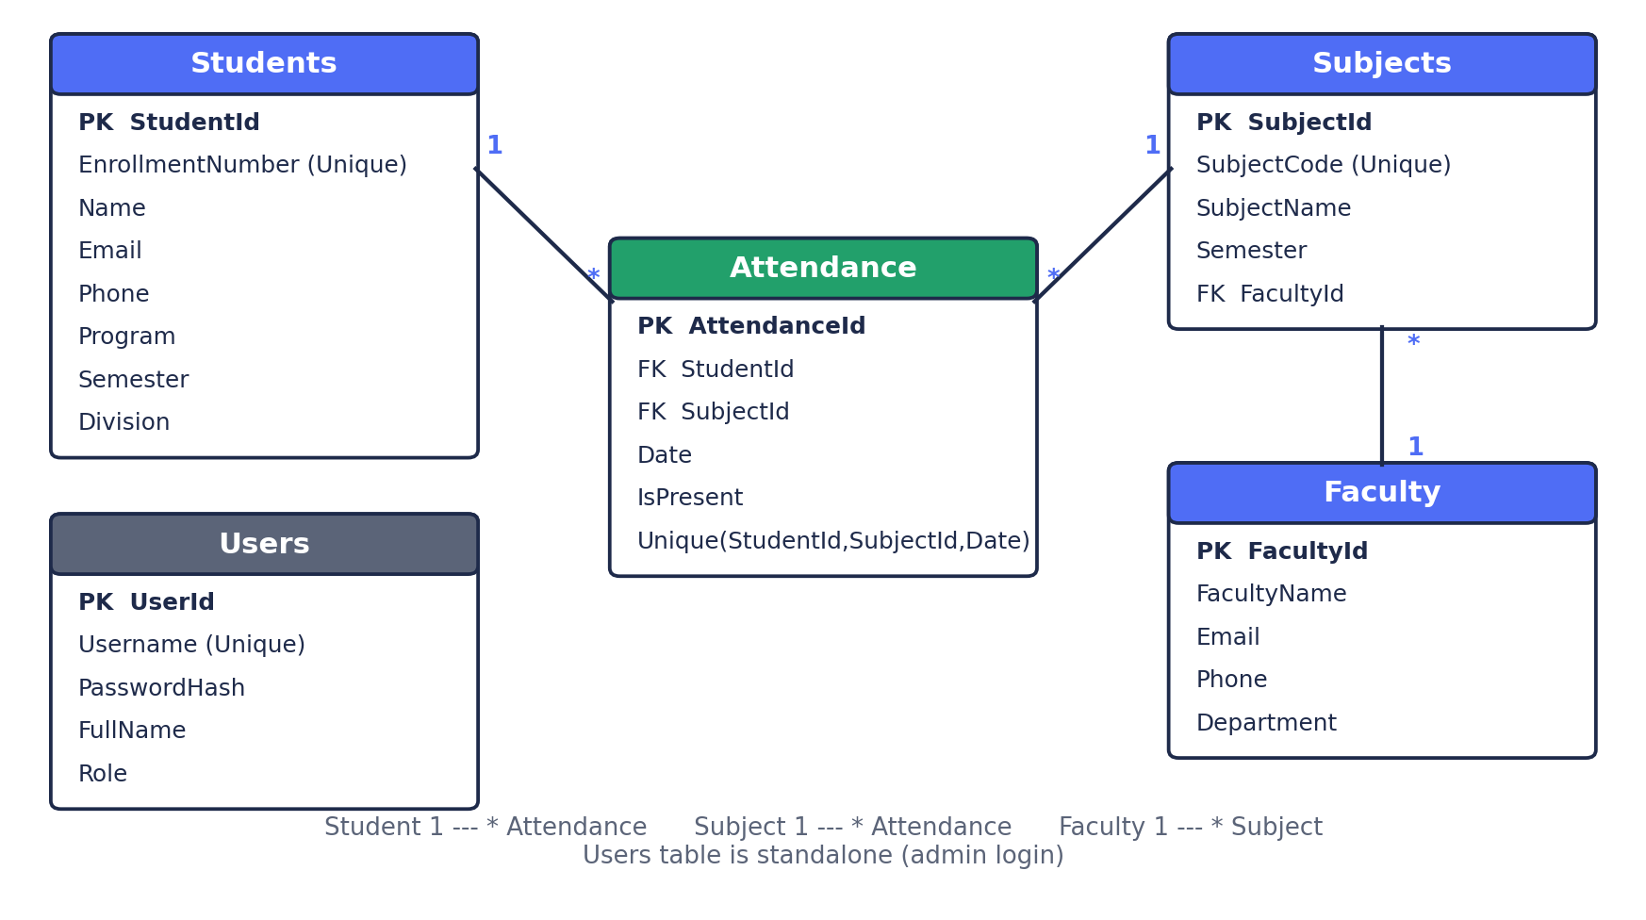
Database Design (ER Diagram)
Relationships
Faculty 1 - * Subjects
Student 1 - * Attendance
Subject 1 - * Attendance
Unique: Enrollment No, Subject Code, (Student + Subject + Date)
Tables: Users, Students, Faculty, Subjects, Attendance
Aditya Kumar Roy | BCA Regular | 2405101010001 | Div B
8

Slide 9





Attendance Workflow
1
2
3
4
5
>
>
>
>
Select Date
Select Subject
Select Division
Mark Present / Absent
Save
Duplicate protection (two layers)
1) Controller updates an existing record instead of inserting again. 2) Unique index on StudentId + SubjectId + Date in SQL Server.
Aditya Kumar Roy | BCA Regular | 2405101010001 | Div B
9

Slide 10


Validation & Security
Validation
Security
Required fields
Email format check
10-digit phone number
Duplicate enrollment number blocked
Duplicate attendance blocked
Client side (jQuery) + server side
PBKDF2 salted password hash
Cookie authentication
Global [Authorize] on every page
Anti-forgery token on all forms
Delete asks for confirmation
Foreign keys protect linked data
Aditya Kumar Roy | BCA Regular | 2405101010001 | Div B
10

Slide 11
Dashboard & Reports
12
5
6
10/12
80%
Students
Faculty
Subjects
Today
Overall
Reports
Student-wise, subject-wise, date-wise
Present / Absent count and %
Filter: student, subject, semester, division, dates
Below 75% shown in red / orange
Print option
Aditya Kumar Roy | BCA Regular | 2405101010001 | Div B
11

Slide 12
Project Structure
StudentAttendanceSystem
Program.cs
appsettings.json
Controllers/ (7 controllers)
Models/ (5 entities)
ViewModels/
Data/ (DbContext, Seeder)
Services/ (PasswordHelper)
Views/ (Razor pages)
wwwroot/ (css, js)
Models
Database tables as C# classes
Views
Razor pages with Bootstrap
Controllers
Handle requests, use EF Core
Program.cs
Services, login, pipeline, route
Aditya Kumar Roy | BCA Regular | 2405101010001 | Div B
12

Slide 13


System Requirements
Hardware
Software
Processor: Intel Core i3 or higher
RAM: 4 GB minimum (8 GB better)
Disk: 10 GB free space
Display: 1366 x 768 or more
Internet: for CDN files
Windows 10 / 11
Visual Studio 2022
.NET 8 SDK
SQL Server / LocalDB
Chrome, Edge or Firefox
Aditya Kumar Roy | BCA Regular | 2405101010001 | Div B
13

Slide 14






Future Scope
Faculty & student logins
SMS / email alerts below 75%
Export to Excel and PDF
QR / biometric attendance
Mobile app + Web API
Deploy on Azure
Aditya Kumar Roy | BCA Regular | 2405101010001 | Div B
14

Slide 15
Conclusion
The system replaces paper registers with a secure, duplicate-free and easy-to-use web application. It applies MVC, Entity Framework Core, SQL Server and Bootstrap in one complete project and can grow with more features.
Thank You
Aditya Kumar Roy | BCA Regular | Div B | Enrollment No: 2405101010001 | Subject: .NET

