Slide 1


Silikon University
Team Fanfir
Ivaylo Glouhchev
Ivan Yonkov
Milena Terzieva
Yana Slavcheva

Slide 2
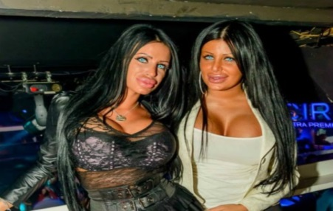

SilikonUni – Silicon valley in Bulgaria
Main idea - SilikonUni is sarcastic SoftUni (www.softuni.bg) mirror site
Who we are in SilikonUni?
We aim to transfer Bulgaria into Silicon valley in Europe – more silicon pussies everywhere
We will introduce you in pop folk industry and make you a super Chalga star!

Slide 3
What we have done?
Responsive website – original HTML and CSS
The website is online and enjoying a lot of attention:
Web: https://silikonuni.slavcheva.net/
The project is open source
GitHub: https://github.com/RoYaLBG/SilikonUni

Slide 4
SilikonUni Demo

Slide 5
Project SilikonUni – Qualities
Flexbox – layout and responsive design
PHP - avoid repeating code
Check website for usability – OK
SASS – mixins for gradients, variables for colors
CSS Animations and Transitions

Slide 6
Team work
Ivaylo Glouhchev – HTML, content, CSS Animations
Ivan Yonkov – PHP, HTML, content
Milena Terzieva – HTML, content, usability
Yana Slavcheva – HTML, SASS, design
Excellent teamwork – enthusiastic atmosphere, regular commits from all members

Slide 7

Questions ?

