Slide 1
Algorithm diagonalDifferenceNonRecursive(A, n)
// A is an array of size n
{
leftDiagonalSum := 0
rightDiagonalSum := 0
for i ← 0 to n-1 do
leftDiagonalSum ← leftDiagonalSum + A[i][i]
rightDiagonalSum ← rightDiagonalSum + A[i][n-1- i]
Difference ← leftDiagonalSum – rightDiagonalSum
If Difference < 0 then
Difference ← -Difference
return Difference
}
Basic Operations

Slide 2

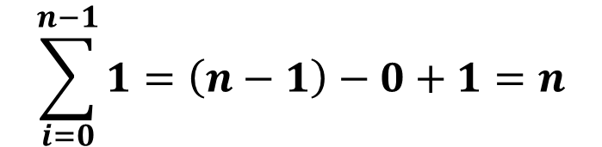
Now Let’s Analyze this Algorithm:
So as we saw the basic operation is located inside a loop so it will be repeated whenever this loop iterates, lets compute this:
So the overall time complexity of this algorithm is
$$\sum_{i=0}^{n−1}{1=\left(n−1\right)−0+1=n}$$
$$θ(n)$$

Slide 3

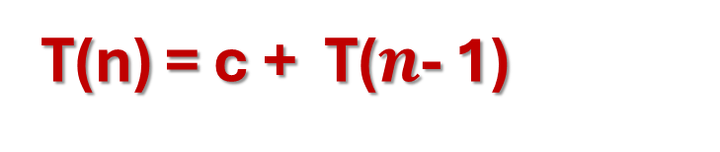
Algorithm diagonalDifferenceRecursive2(A, n, i, leftDiagonalSum, rightDiagonalSum)
// A is an array of size n, initilally “i ← n - 1”
{
If i = -1 then
Difference ← leftDiagonalSum – rightDiagonalSum
if Difference < 0 then
Difference ← -Difference
return Difference
leftDiagonalSum ← leftDiagonalSum + arr[i][i]
rightDiagonalSum ← rightDiagonalSum + arr[i][n – 1 - i]
return diagonalDifferenceRecursive(A, n, i - 1, leftDiagonalSum, rightDiagonalSum)
}
C1
C2
C3
C4
T$(n$- 1)
T(n) = c + T($n$- 1)

Slide 4







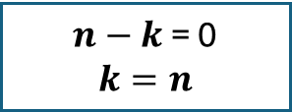




Now Let’s Analyze this Algorithm:
This algorithm takes “n” and “i” as input, and initially “i = n-1” and every time the algorithm invokes itself it decrements the size of the problem by 1 “i-1” ofcourse depending on the initial value of “n”, that’s how we came up with the recurrence relation : T(n) = c + T(n- 1), T(0) = 1
So the overall time complexity of this algorithm is $θ(n)$
$$T(n)=c+T(n−1)$$
$$T\left(n−1\right)=c+T(n−2)$$
$$=2c+T(n−2)$$
$$T\left(n−2\right)=c+T(n−3)$$
$$=3c+T(n−3)$$
$$T\left(n−3\right)=c+T(n−4)$$
$$=4c+T(n−4)$$
$$=kc+T(n−k)$$
$n−k$ = 0
$$k=n$$
$$=nc+T(0)$$
$$=nc+1$$

Slide 5




Algorithm diagonalDifferenceRecursive1(A, n, i, j, leftDiagonalSum, rightDiagonalSum)
// A is an array of size n
{
If i = n then
Difference ← leftDiagonalSum – rightDiagonalSum
if Difference < 0 then
Difference ← -Difference
return Difference
If i = j then
leftDiagonalSum ← leftDiagonalSum + arr[i][j]
If j = n - 1 – i then
rightDiagonalSum ← rightDiagonalSum + arr[i][j]
If j = n – 1 then
return diagonalDifferenceRecursive(A, n, i + 1, 0, leftDiagonalSum, rightDiagonalSum)
Else
return diagonalDifferenceRecursive(A, n, i, j + 1, leftDiagonalSum, rightDiagonalSum)
}
Matrix Size = $n^{2}$
C1
C2
C3
C4
Same problem of size $(n^{2}$ - 1)
Same problem of size $(n^{2}$ - 1)
T($n^{2}$) = c + T($n^{2}$ - 1)

Slide 6












Now Let’s Analyze this Algorithm:
This algorithm takes a square matrix as an input so basically the input size = $n^{2}$, and every time the algorithm invokes himself he decrements the size of the problem by 1 “$n^{2}$-1”, that’s how we came up with the recurrence relation : T($n^{2}$) = c + T($n^{2}$ - 1), T(0) = 1
So the overall time complexity of this algorithm is $θ(n^{2})$
$$T\left(n^{2}\right)=c+T(n^{2}−1)$$
$$T\left(n^{2}−1\right)=c+T(n^{2}−2)$$
$=2c+T(n^{2}−2)$
$$T\left(n^{2}−2\right)=c+T(n^{2}−3)$$
$=3c+T(n^{2}−3)$
$$T\left(n^{2}−3\right)=c+T(n^{2}−4)$$
$=4c+T(n^{2}−4)$
$n^{2}−k$ = 0
$$k=n^{2}$$
$=kc+T(n^{2}−k)$
$=cn^{2}+T(0)$
$=cn^{2}+1$

Slide 7
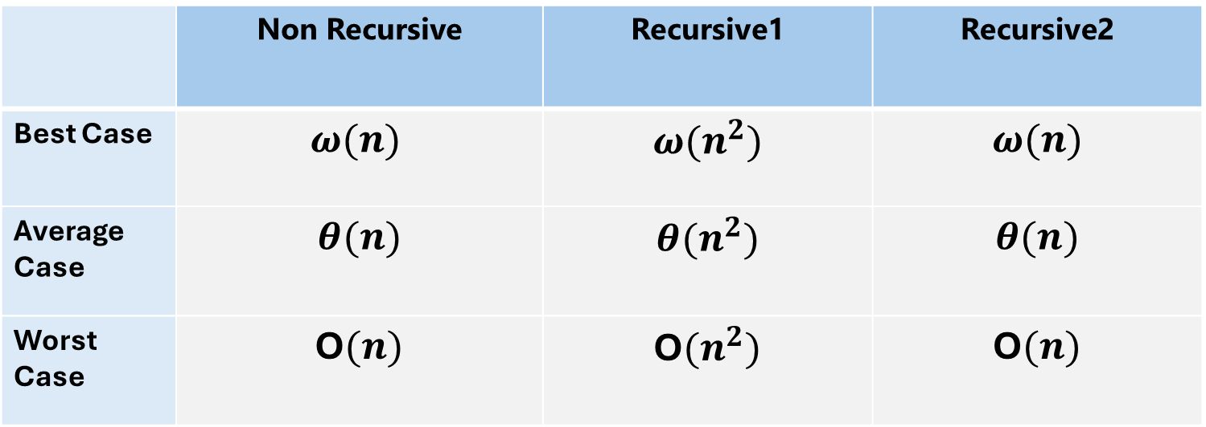
Now Let’s compare between those two algorithms:
 | Non Recursive | Recursive1 | Recursive2
Best Case | $$ω(n)$$ | $$ω(n^{2})$$ | $$ω(n)$$
Average Case | $$θ(n)$$ | $$θ(n^{2})$$ | $$θ(n)$$
Worst Case | O$(n)$ | O$(n^{2})$ | O$(n)$
As we can see, the order of growth of the recursive1 algorithm is bigger than that of the non recursive and the recursive2 , so the non recursive and the recursive2 algorithms take less run time than the recursive1 so they are much better

