Slide 1
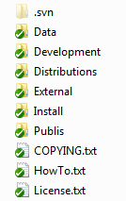
GigaVoxels Project Environment
Root dir
Development : source code
Install : scripts to generate project environment
External : extern dependendies/libraries
Data : common data used in tutorials
Distributions : files required to build installers
Publis : to be removed…

Slide 2
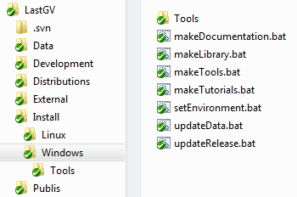
GigaVoxels Project Environment
Project generation
Multi-plateform environment based on CMake
makeXXX : generate project environment for Library, Tutorials and Tools (Visual Studio solutions, Linux makefiles, etc…)
makeDocumentation : Doxygen documentation of the project

Slide 3
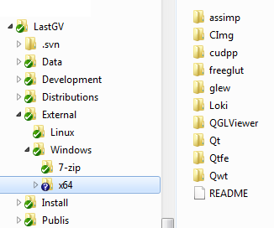
GigaVoxels Project Environment
Dependencies
CORE
CUDA : 5.0
cudpp (cuda prefix sum, reduction, compaction, etc…)
glew/freeglut (OpenGL)
LOKI : C++ template
TUTORIALS / TOOLS specific
Qt, QGLViewer : 3D window, editors
Qwt : Qt plots
Qtfe : transfer functions editor
Assimp : 3D models loader
Cimg, ImageMagick : images loader

Slide 4
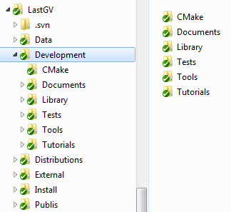
GigaVoxels Project Environment
Development
Library : GigaVoxels library
Tutorials : SDK examples
Tools : viewer, voxelizer, etc…
Tests : benchmarks, studies…
Documents : documentation
CMAKE
all dependency modules used by CMake (to find all required Include and Library directories)
commun CMake files to compile GigaVoxels library, tutorials and tools

Slide 5
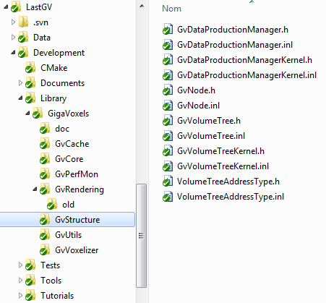
GigaVoxels Project Environment
Source code : LIBRARY
SHARED LIBRARY
(but lots of template…)
- GvCore : commun classes (CUDA features)
- GvStructure : data structure management (octree, N3-tree…)
- GvCache : cache management
- GvRendering : rendering management (GL interop)
- GvUtils : useful base/common classes to ease develoment
- GvVoxelizer : to pre-process meshes
- GvPerfMon : performance monitoring

