Slide 1
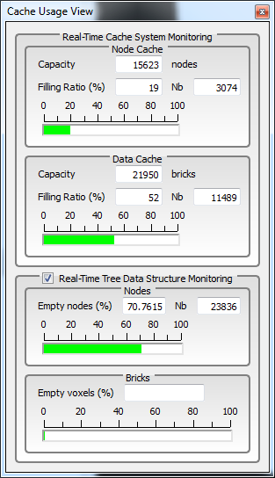
GigaSpace Real-time Monitoring « cache and tree »
Motivations
[ 1 ] - be able to display real-time cache usage
nodes
bricks
[ 2 ] - be able to display real-time tree occupancy
nodes
voxels

Slide 2
GigaSpace Real-time monitoring « cache and data structure »
Real-time cache usage
nodes
bricks
Easy :
already computed in the API (from the GiagSpace flow sequence)

Slide 3
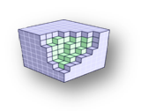
GigaSpace Real-time monitoring « cache and data structure »
Real-time tree occupancy
time consuming : so add a check box to monitor or not
Nodes
EASY : find number of « empty nodes » in current tree
add a kernel traversing full hierarchical tree to find leaves
take into account current « depth max » of the tree
note : as brick production can modified a node status (ex : from « holdind data » to « empty node »), this post-process must be done after all productions (nodes and bricks)
Bricks
compute number of « empty voxels »
time consuming…

