Slide 1
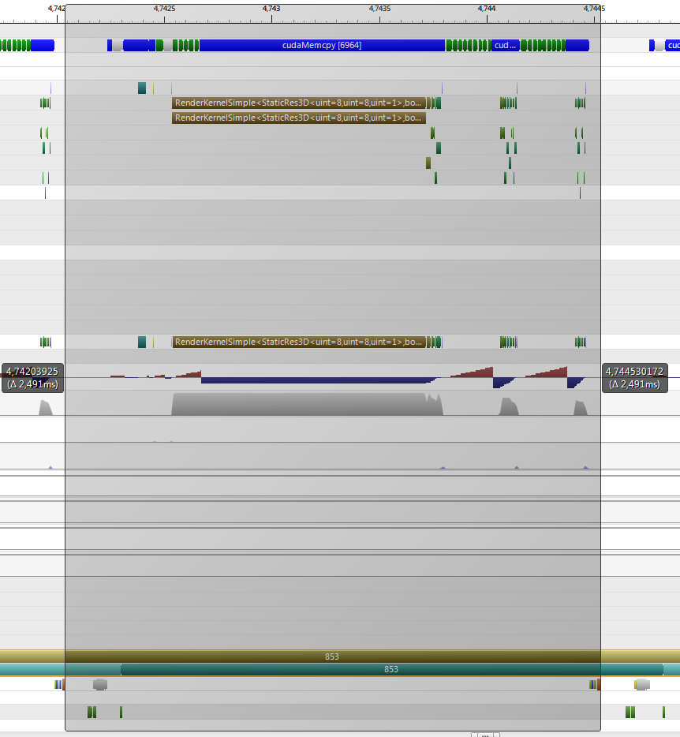
prePass
nodes
timestamps
retrieve
requests
ray-casting
bricks
timestamps
OpenGL
Init frame
OpenGL
draw quad

Slide 2
