Slide 1
Key Features
Tree Data Management (space partitioning) to store and organize data
(octree or generalized N3-tree, + SDK example kd-tree)
Cache System on GPU : LRU mechanismn (least recently used)
(to get temporal coherency)
Data Production Management : on host, GPU, or hybrid mode
Goal : produced data are kept in cache on GPU
Visit algorithm : traverse your data (loaded in cache) as could be done for rendering
Renderer (hierarchical volume ray-casting, cone tracing, emission of requests, brick marching)

Slide 2
GigaVoxels Pipeline
USER
input
USER
output
Renderer
Shader
Visitor
Data Production
Manager
Producers
(nodes, bricks)
Graphics
Library
interoperability
Graphics
Library
interoperability
Data Structure
Cache Manager
- voxel (data types : color, normal…)
- octree, N3-tree, BSP…

Slide 3
Custom features
Voxel data type : user can defined what’s inside a voxel
list of types : uchar4 (ex: color), half4 (ex: normal)…
Producers : fill the data structure
Node producer : fill spatial data structure
Brick producer : fill voxel data
either host or device, or a combination
based on user oracles
Shader :
modify apperance by sampling data along rays

Slide 4
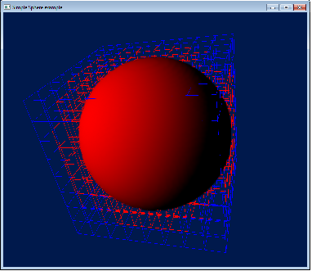
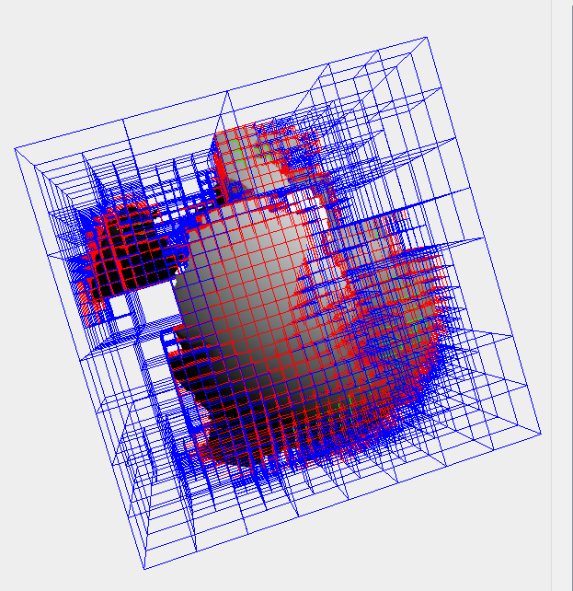
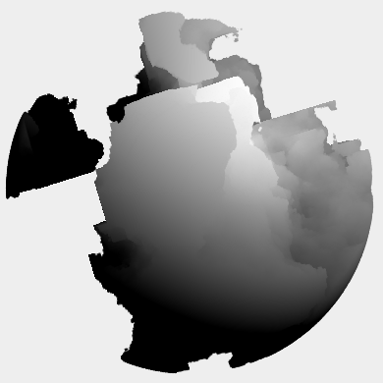
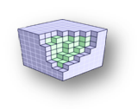
Data Structure [1/2]
Exemple : generate a sphere
user defined “voxel data type” : RGBA color + normal
Generalized N3-tree of nodes
(multi-scale)
Brick of voxels
(user data
stored in each node)
Data Structure

Slide 5
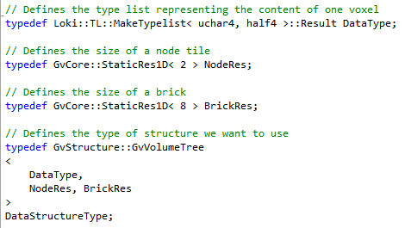
Data Structure [2/2]
Voxel data type : based on list of types [ uchar4 (color), half4 (normal) ]
Data Structure : based on a generalized N3-tree
node resolution : nb of child in each node (for each dimension)
brick resolution : nb of voxels in each node (for each dimension)

Slide 6
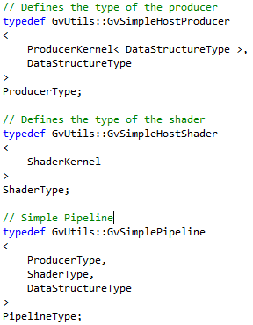
Data Structure [2/2]
GigaVoxels pipeline : access all GigaVoxels objects (renderer, producers…)

Slide 7
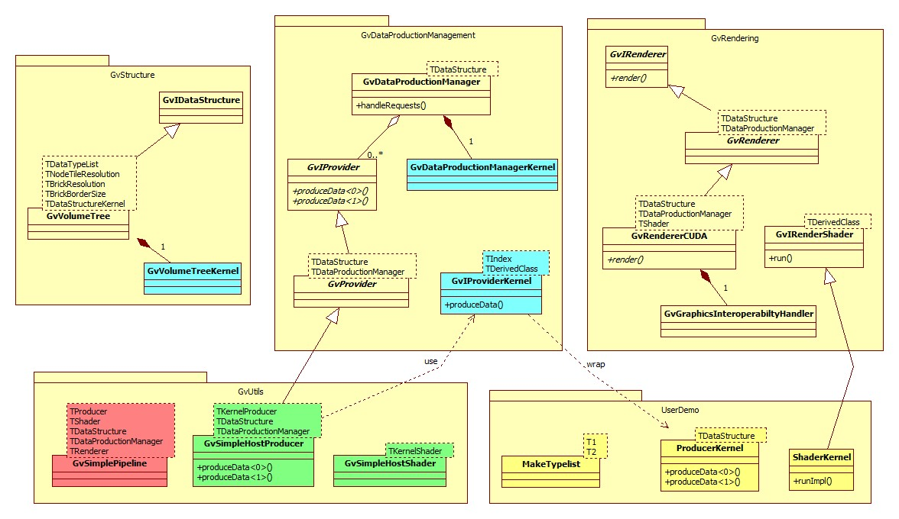
Producers [2/2]

