Slide 1
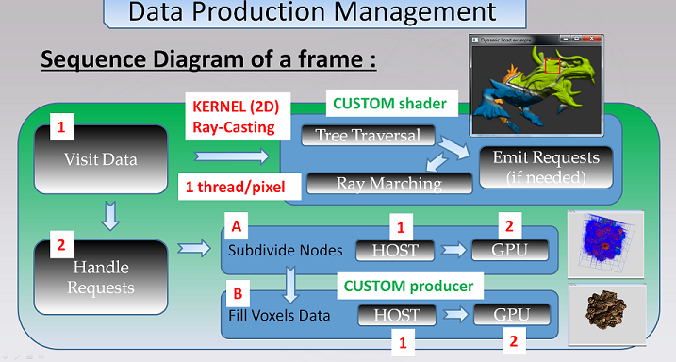
Procedural generation on device

Slide 2
Procedural generation on device [ 1 ] - Nodes production (node refinement)
1
HOST producer
2
produce Nodes
does nothing
CUDA kernel
3
oracle says « what’s inside
each my child nodes ? »
empty, data, max resolution ?
then write « node info » in cache
(2 first bits of each node address)
DEVICE producer
4
produce Nodes
update
1D node pool
nodetile
nodetile
nodetile

Slide 3
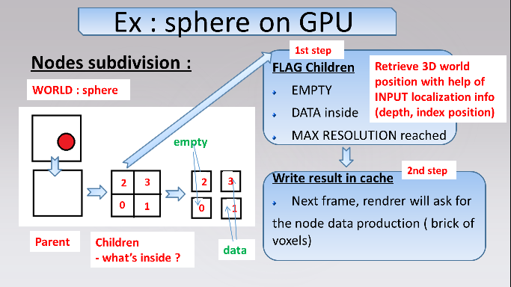
Procedural generation on device [ 1 ] - Nodes production (node refinement)

Slide 4
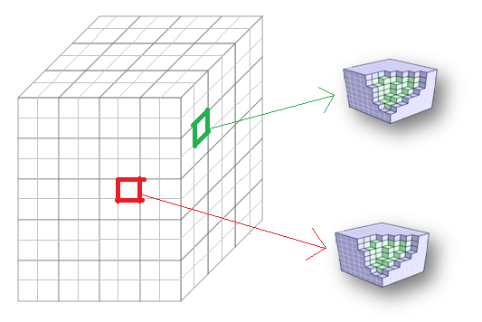
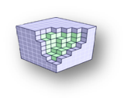
Procedural generation on device [ 2 ] - Bricks production (voxel data)
1
HOST producer
2
produce Bricks
does nothing
CUDA kernel
3
for each brick
-- for each voxel
---- compute value for each user channel
(i.e. color and normal)
DEVICE producer
4
produce Bricks
data pool
Voxel : 2 channels
[ uchar4, half4 ]
brick
update
3D data pool
brick
color
normal

Slide 5
Procedural generation on device [ 2 ] - Bricks production (voxel data)
Voxel : 2 channels
[ uchar4, half4 ]
Example : 1 brick
- 4x4 voxels
- 1 border
voxel data is stored
at voxel center
density is modeled with alpha component of color channel
alpha = 0 outside
alpha = 1 inside
color
normal

