Slide 1
Rendering with Distance Fields
Generate depth maps from mesh in 2 OpenGL passes :
[ 1 ] – depth map of closests faces (GLuint minDepthTex)
[ 2 ] – depth map of farthest faces (GLuint maxDepthTex)
use Frame Buffer Object to do off-screen rendering dn CUDA GL interoperability.
Then, launch the GigaVoxels pass.
modify the renderer at RayInitialization() step :
Replace intersectBox() by 2 texture fetch in min/max depth to determine start and stop rays position.

Slide 2
Rendering with Distance Fields
Optimization(s)
- add StopCriteria() to stop the node refinement
could be done during the NodeVisitor (i.e. descent octree)
maybe like : if ( nodeSize() < coeff * coneAperture ) => stop descent
(reminder : coneAperture is the size of an object in node space that has a footprint of 1 pixel on screen)

Slide 3
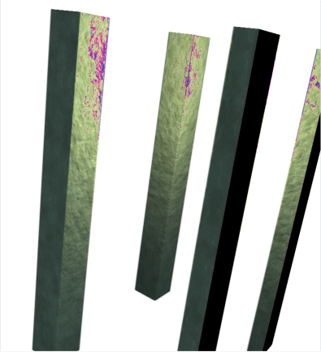
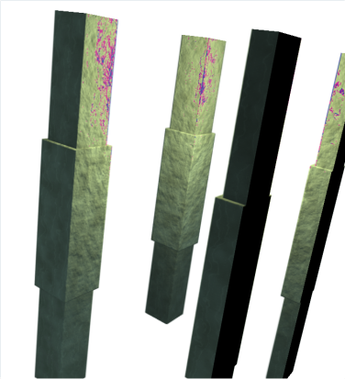
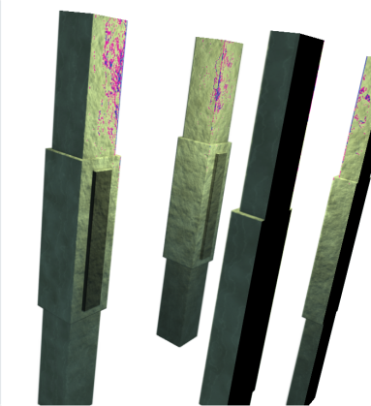

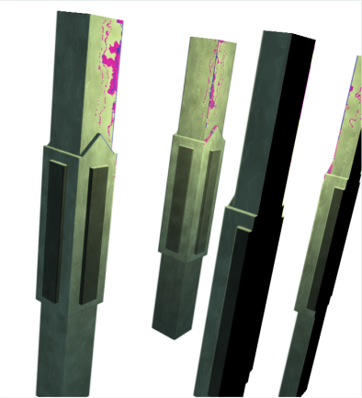
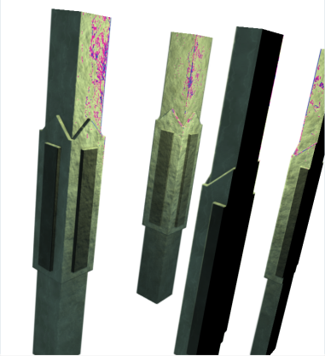
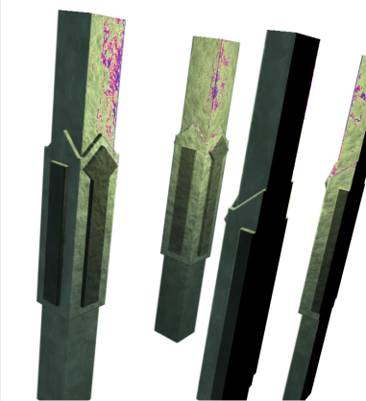
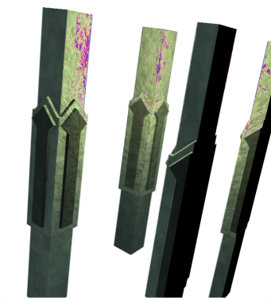
Rendering with Distance Fields

Slide 4

Rendering with Distance Fields

Slide 5
Rendering with Distance Fields

Slide 6
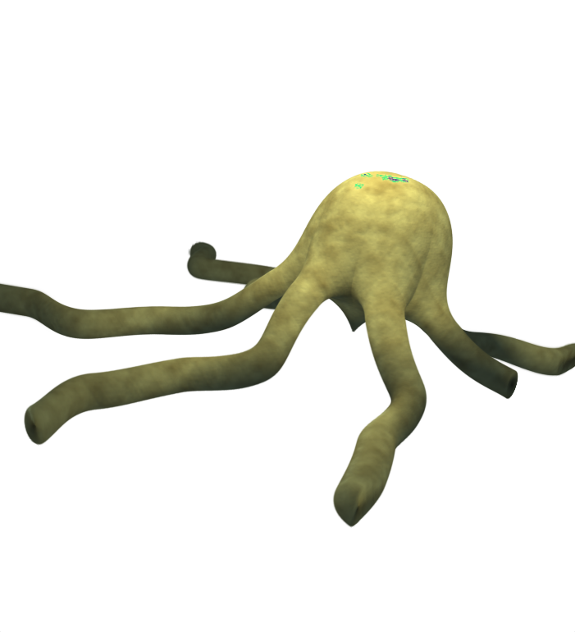
Rendering with Distance Fields

