Slide 1
数据流体系结构案例

Slide 2
例子

Slide 3
  accepts an ordered set of lines (接受一些行)
  each line is an word (每行一个单词)
  The system outputs all lines in alphabetical order. (把所有行的按照字母表顺序输出) sort
matter
yes
no
love
love
matter
no
yes

Slide 4
matter
yes
no
love
love
matter
no
yes
要求：Modifiability (可修改性)
Reusability (系统构件的可复用性)

Slide 5
Solution : Pipes and Filters
Pipe
System I/O
Input
Medium
Input_Filter
Sort_Filter
Output_Filter
Output
Medium

Slide 6
Filters：
  Input filter (“输入”过滤器：从数据源读取输入文件，解析格式，将行写入输出管道)
  Sort filter (“排序”过滤器)
  Output filter (“输出”过滤器)
Pipe：
  in_sort pipe
  sort_out pipe
Pipe
System I/O
Input
Medium
Input_Filter
In_sort
Sort_Filter
sort_out
Output_Filter
Output
Medium

Slide 7
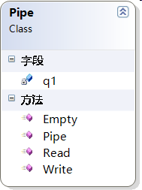
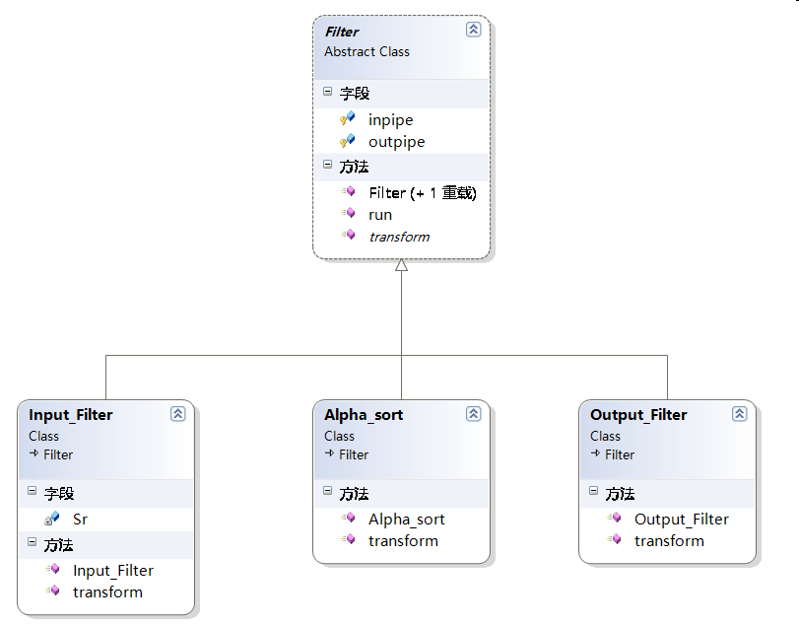

Slide 8
演示
Notes:
管道过滤器.exe

Slide 9
public class Pipe
{
private Queue<String> q1;
public Pipe()
{
q1 = new Queue<String>();
}
public Boolean Empty()
{
Boolean bl=true;
if (q1.Count > 0)
bl = false;
return bl;
}
public String Read()
{
String st = null;
if(!Empty())
st=q1.Dequeue();
return st;
}
public void Write(String str1)
{
q1.Enqueue(str1);
}
}
Notes:
Pipe.cs

Slide 10
public abstract class Filter
{
protected Pipe inpipe;
protected Pipe outpipe;
public Filter()
{
}
public Filter(Pipe input, Pipe output)
{
inpipe = input;
outpipe = output;
}
public abstract void transform();
public void run()
{
transform();
}
}
Notes:
Filter.cs

Slide 11
Input_Filter.cs
Notes:
//Input_Filter.cs
class Input_Filter:Filter
{
StreamReader Sr;
public Input_Filter(FileStream fs, Pipe output1)
: base(null, output1)
{
Sr = new StreamReader(fs);
}
public override void transform()
{
String str;
while ((str = Sr.ReadLine()) != null)
{
outpipe.Write(str);
}
Sr.Close();
// throw new NotImplementedException();
}
}

Slide 12
Alpha_sort.cs
Notes:
//Alpha_sort.cs
//using System.Collections;
class Alpha_sort:Filter
{
public Alpha_sort(Pipe in1, Pipe out1)
: base(in1, out1)
{
}
public override void transform()
{
String str;
ArrayList al = new ArrayList();
while ((str = inpipe.Read()) != null)
{
al.Add(str);
}
al.Sort();
foreach (String i in al)
{
outpipe.Write(i.ToString());
}
//throw new NotImplementedException();
}
}

Slide 13
output_Filter.cs
Notes:
//output_Filter.cs
class Output_Filter : Filter
{
public Output_Filter(Pipe in1, Pipe out1)
: base(in1, out1)
{
}
public override void transform()
{
String str;
while ((str = inpipe.Read()) != null)
{
Console.WriteLine(str);
}
// throw new NotImplementedException();
}
}

Slide 14
Program.cs
Notes:
//Program.cs
class Program
{
static void Main(string[] args)
{//利用管道和过滤进行装配
FileStream fs = new FileStream(".\\input.txt", FileMode.Open);
Pipe in_sort, sort_out;//in_sort输入到排序处理间的管道，sort_out排序到输出管道
in_sort = new Pipe();//建立in_sort管道
//cs_al = new Pipe();
sort_out = new Pipe();//建立sort_out管道
Input_Filter if1 = new Input_Filter(fs, in_sort);//建立Input_Filter过滤器
//circular_shift cs_shift = new circular_shift(in_cs, cs_al);
Alpha_sort sort_shift = new Alpha_sort(in_sort, sort_out);//建立排序过滤
Output_Filter output = new Output_Filter(sort_out, null);//建立输出过滤器
if1.run();
// cs_shift.run();
sort_shift.run();
output.run();
Console.Read();
}
}

Slide 15
如果在排序前 增加一个对单词逆序操作
代码如何修改
Pipe
System I/O
Input
Medium
Input_Filter
Sort_Filter
Reverse_Filter
Output_Filter
Output
Medium
增加一个 Reverse_Filter 过滤器，然后重新组装即可
Notes:
//Reverse_Filter.cs
//增加 using System.IO;
class Reverse_Filter:Filter//单词逆序过滤器
{
public Reverse_Filter(Pipe in1, Pipe out1)
: base(in1, out1)
{ }
public override void transform()//从输入管道 读取一个单词 然后逆序变换后，写入输出管道
{
String str;
while((str=inpipe.Read())!=null)
outpipe.Write(reverse(str));
}
String reverse(string data)//对字符串进行逆序处理
{
char[] ret = data.ToCharArray();
return string.Concat<char>(ret.Reverse<char>());
}
}
class Program1
{
static void Main(string[] args)
{//利用管道和过滤进行装配
FileStream fs = new FileStream("d:\\input1.txt", FileMode.Open);
Pipe in_reverse, reverse_sort, sort_out;//in_sort输入到排序处理间的管道，sort_out排序到输出管道
in_reverse = new Pipe();//建立in_sort管道
reverse_sort = new Pipe();//逆序过滤器到排序过滤间的管道
sort_out = new Pipe();//建立sort_out管道 排序过滤器到输出的管道
Input_Filter if1 = new Input_Filter(fs, in_reverse);//建立Input_Filter过滤器
Reverse_Filter reverse_shift = new Reverse_Filter(in_reverse, reverse_sort);
Alpha_sort sort_shift = new Alpha_sort(reverse_sort, sort_out);//建立排序过滤
Output_Filter output = new Output_Filter(sort_out, null);//建立输出过滤器
if1.run();
reverse_shift.run();
sort_shift.run();
output.run();
Console.Read();
}
}

