Slide 1

Writing Paper/ Thesis/ Report - Table of Content
Structure
Writing Tips:
Title
Abstract
Introduction
1.1. Background
1.2. Problem Statement
1.3. Study Goal and Objectives
2. Literatue Review
3. Methodology
4. Result analysis
5. Conclusion and Recommendation
1. Formatting
2. Writing Style & Clarity
3. Referencing

Slide 2


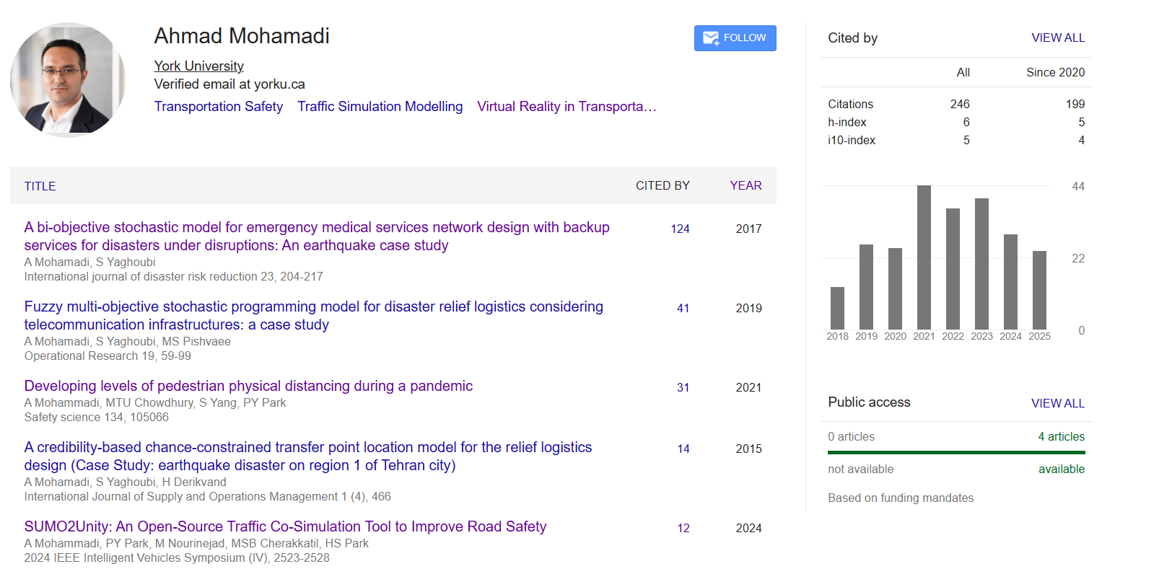
Let’s Grow Together — One Heart, One Community

Slide 3
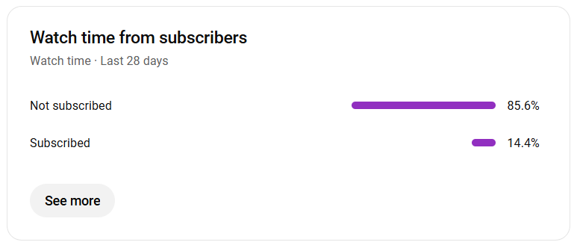
Let’s Grow Together — One Heart, One Community

Slide 4
Writing Paper- Structure
Title
Abstract
Introduction
1.1. Background
1.2. Problem Statement
1.3. Study Goal and Objectives
2. Literatue Review
3. Methodology
4. Result analysis
5. Conclusion and Recommendation
Heart of Paper

Slide 5
Writing Paper- Order
Title
Abstract
Introduction
1.1. Background
1.2. Problem Statement
1.3. Study Goal and Objectives
2. Literatue Review
3. Methodology
4. Result analysis
5. Conclusion and Recommendation
2
8
3
4
1
5
6
7
7

Slide 6
Study Goal and Objectives
Study Goal:
The goal of study is …
This study has three objective as below:
Developing …
Designing …
Implementing …
1
Title
…
1
Take title from here

Slide 7
Study Goal and Objectives
Study Goal:
The goal of study is developing a novel artificial intelligence algorithm to capture risk of collisions between a vehicle and a pedestrian
This study has three objective as below:
Developing input indicators to capture risk of collisions
Designing an artificial intelligence algorithms based on input indicators to identify the risk
Implementing the algorithm in a study are and comparing with existing scenario
Title
Developing a Novel Artificial Intelligence Algorithm for Collisions Risk Assessment

Slide 8
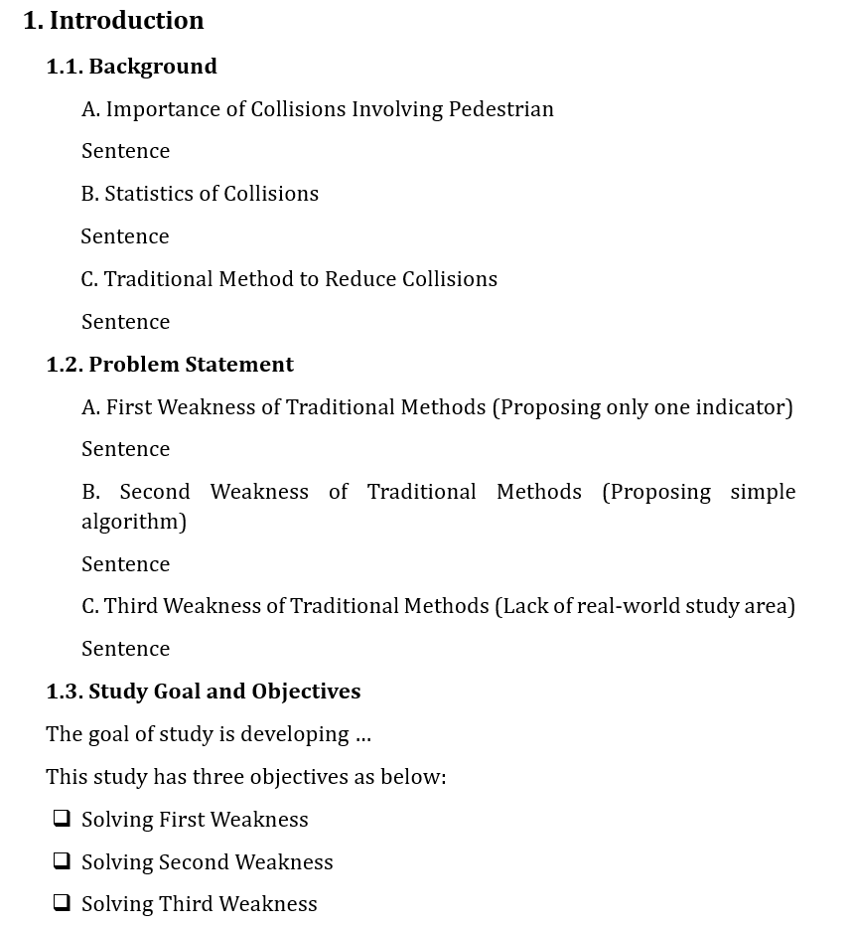
Introduction
1
2
Storyline:
First Level: Write bullet points (short titles) for the content in background
Second Level: Write each sentence
1
2

Slide 9
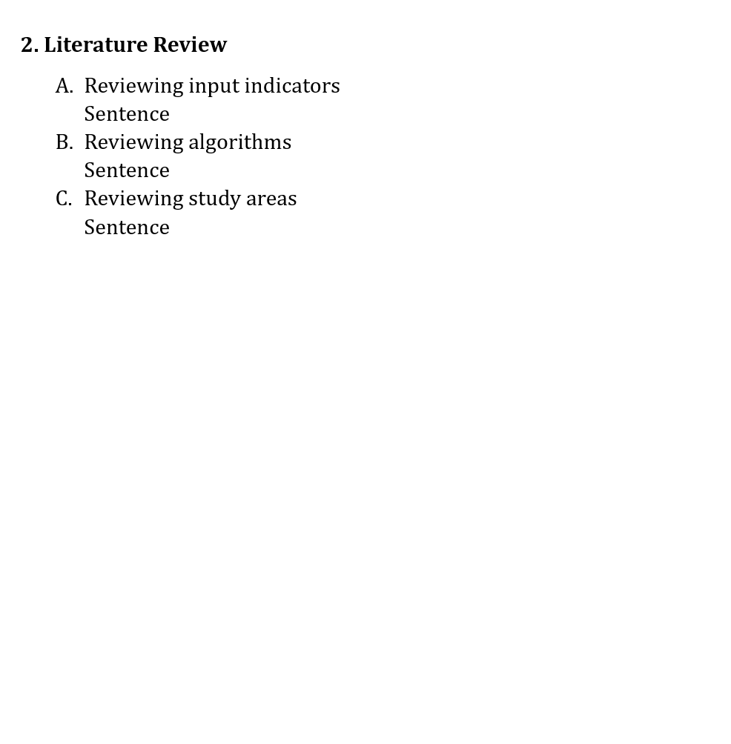
Literature Review
1
First Weakness
2
Reviewing past studies considering three weaknesses in study objectives
Storyline:
First Level: Write bullet points (short titles) for the content in background
Second Level: Write each sentence
Second Weakness
Third Weakness
1
2

Slide 10
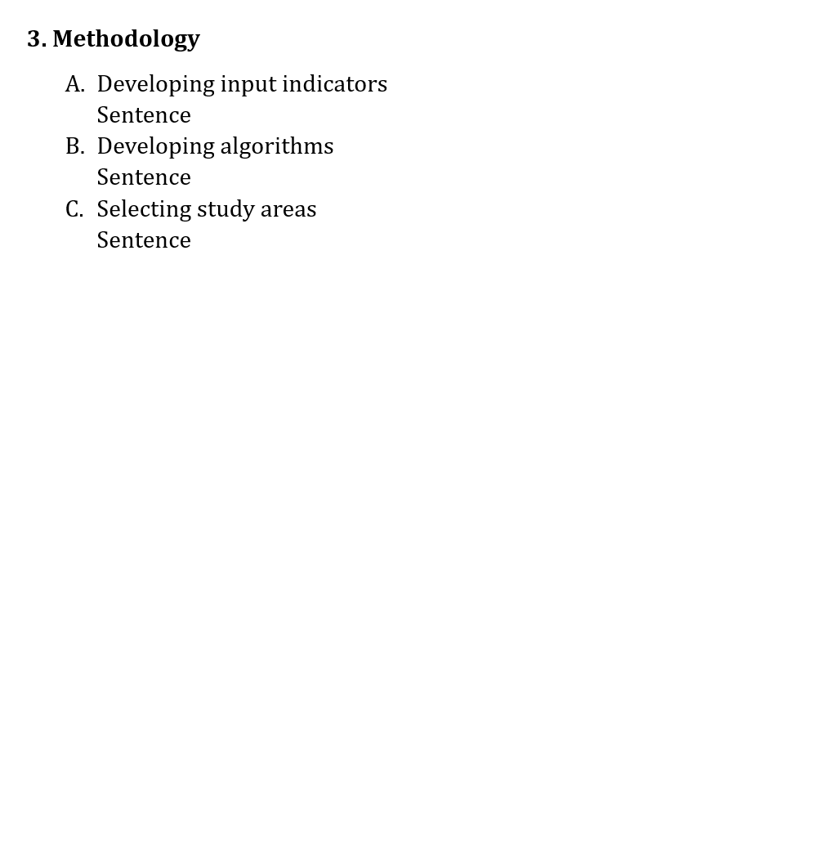
Methodology
1
First Weakness
2
Second Weakness
Write based on three weaknesses
Storyline:
First Level: Write bullet points (short titles) for the content in background
Second Level: Write each sentence
Third Weakness
1
2

Slide 11
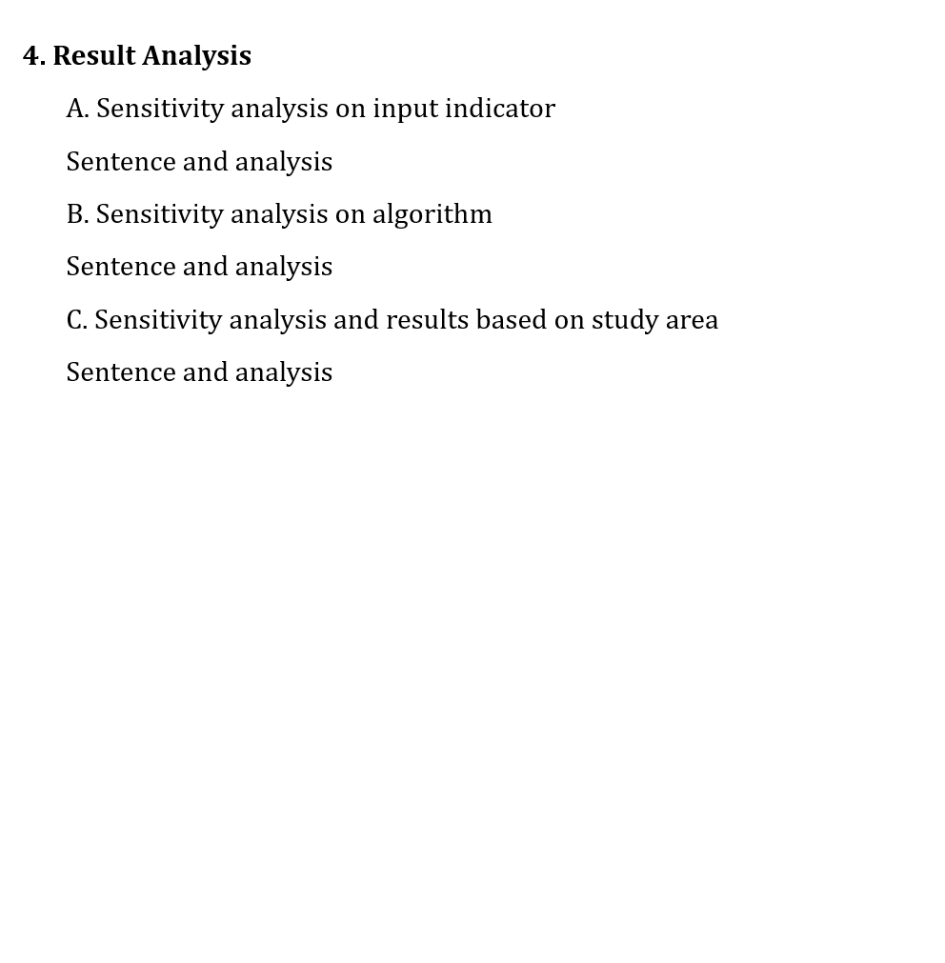
Results
1
First Weakness
2
Second Weakness
Should answer to three weaknesses by providing analysis
Storyline:
First Level: Write bullet points (short titles) for the content in background
Second Level: Write each sentence
Third Weakness
1
2

Slide 12
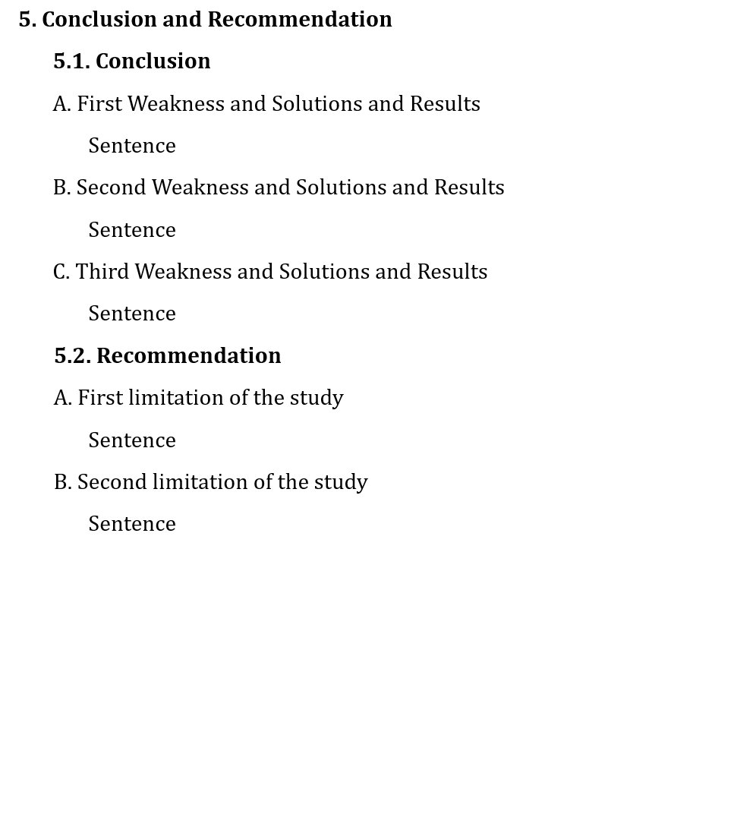
Conclusions and Recommendation
1
First Weakness
2
Conclusion: Summarize your findings based on three weaknesses and three objectives
Recommendation: Explain about Limitations and explain what future studies can do
Storyline:
First Level: Write bullet points (short titles) for the content in background
Second Level: Write each sentence
Second Weakness
Third Weakness
1
2

Slide 13
Writing Tips:
1. Formatting
Justifying the text
Use of Same Font Type Across the Content
Use of Capital Letter
Add Proper Title for Tables/Figures
The Keywords come from Abstract
Use of Abbreviations
2. Writing Style & Clarity
Use of Active Voice
Consistency (same word for same concept)
Avoid long, indirect clauses
Avoid using adverbs as much as possible
Avoid using technical language/terms unless necessary
Avoid using too long and unnecessary words
Explain about Figures and Tables in detail
3. Referencing
Use of Reference
Reference as APA format

Slide 14
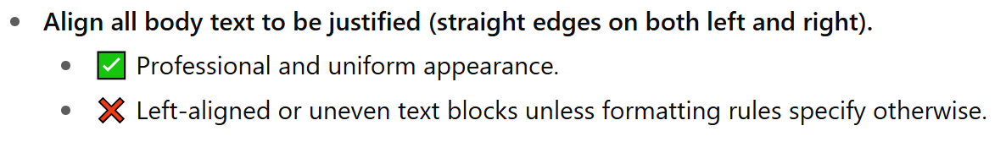
1. Formatting
Justifying the text

Slide 15
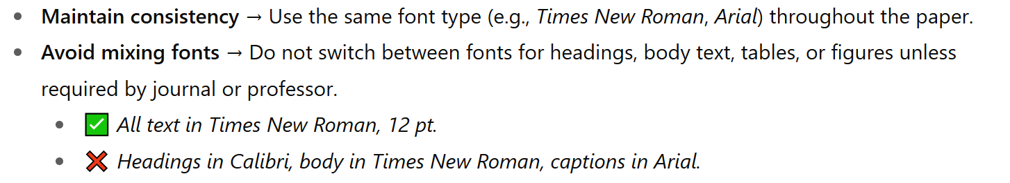
1. Formatting
Use of Same Font Type Across the Content

Slide 16
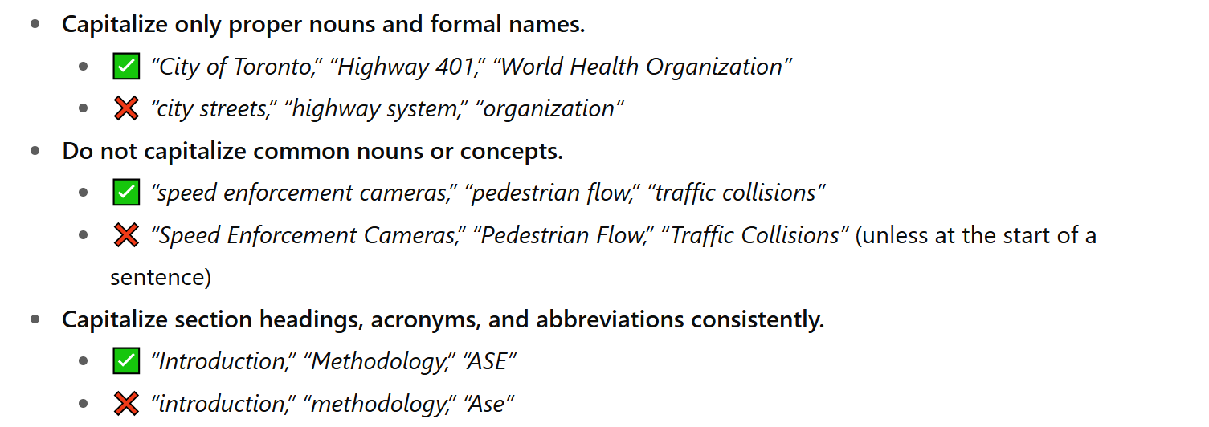
1. Formatting
Use of Capital Letters

Slide 17
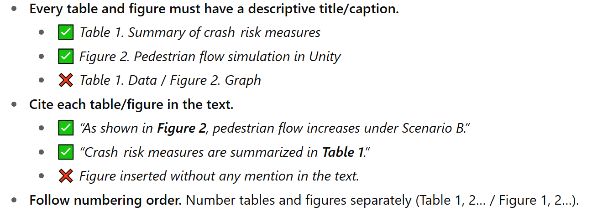
1. Formatting
Add Proper Title for Tables/Figures

Slide 18
1. Formatting
The Keywords come from Abstract

Slide 19
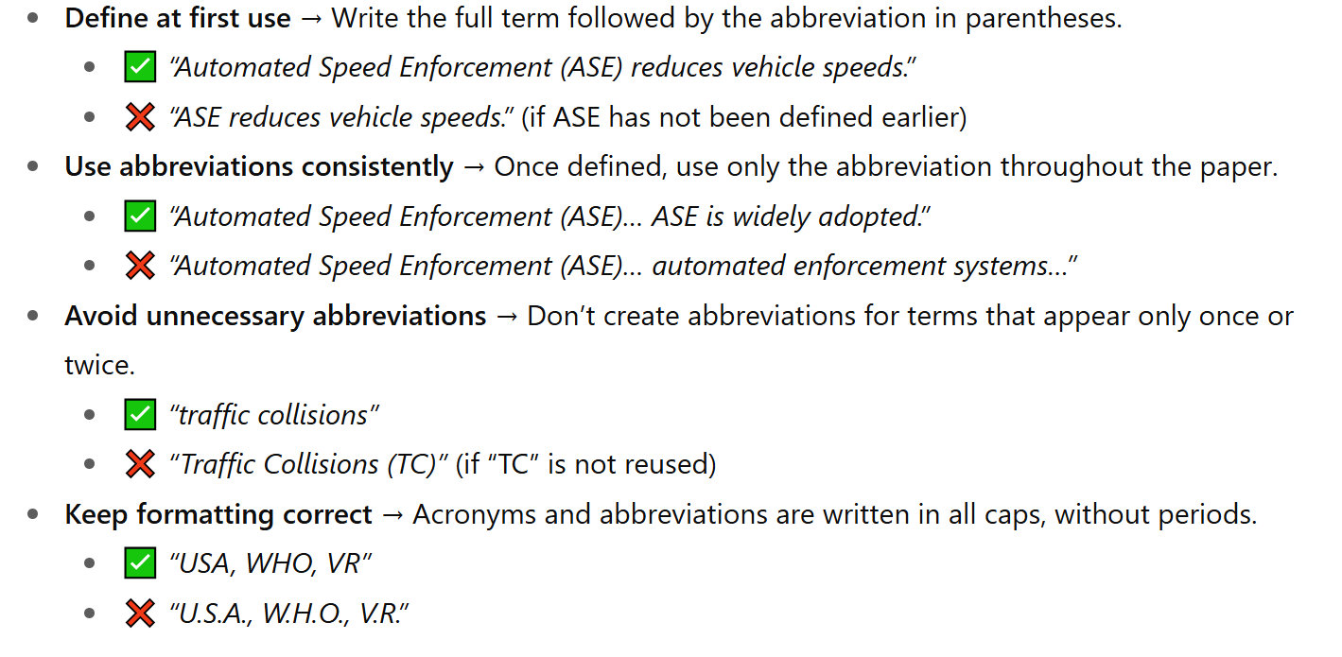
1. Formatting
Use of Abbreviations

Slide 20
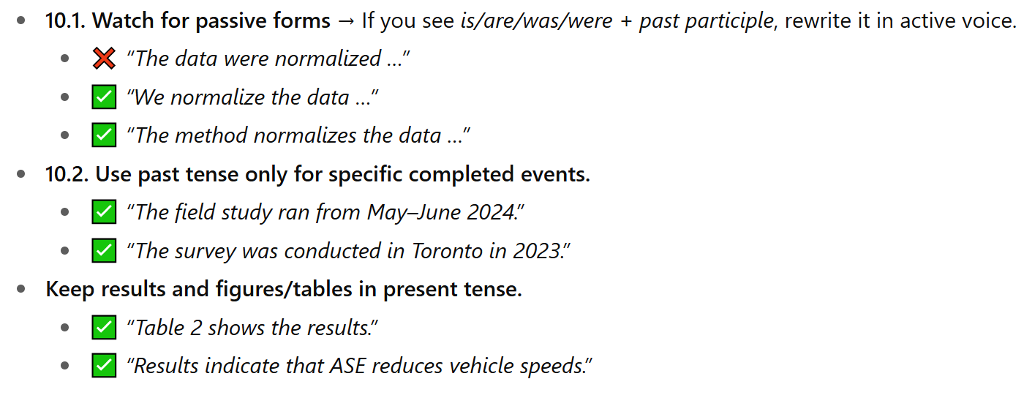
2. Writing Style & Clarity
Use of Active Voice

Slide 21
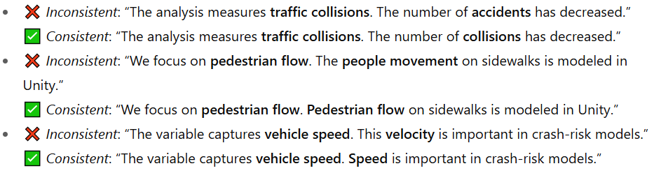
2. Writing Style & Clarity
Consistency --> Use same word to refer to similar concept

Slide 22
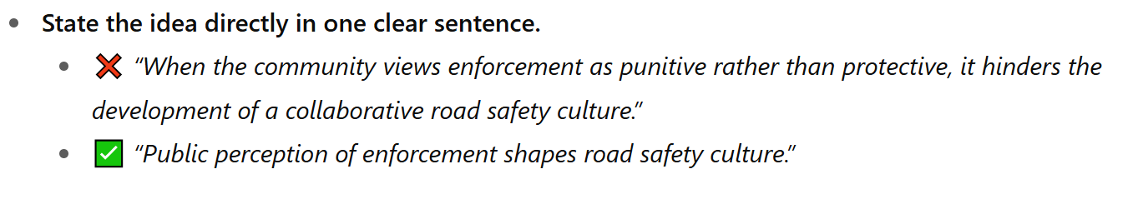
2. Writing Style & Clarity
Avoid long, indirect clauses

Slide 23
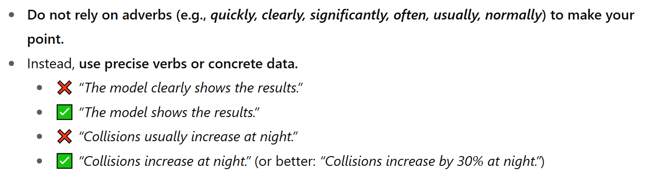
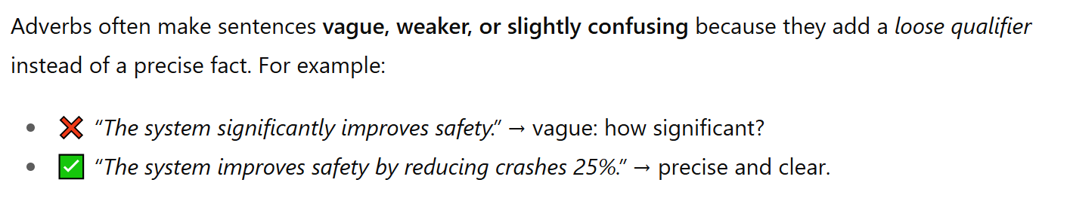
2. Writing Style & Clarity
Avoid using adverb as much as possible

Slide 24
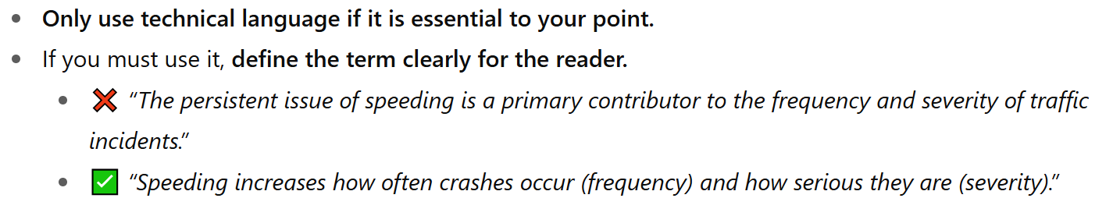
2. Writing Style & Clarity
Avoid using technical language/terms

Slide 25
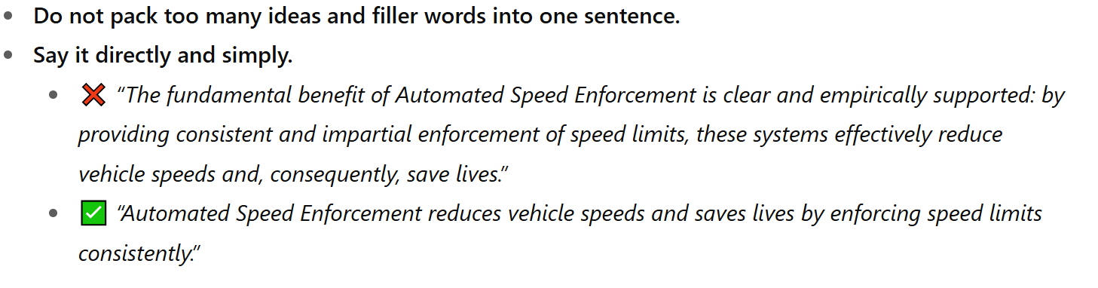
2. Writing Style & Clarity
Avoid using too long and Unnecessary words
Avoid breaking sentences into too many parts with commas, colons

Slide 26
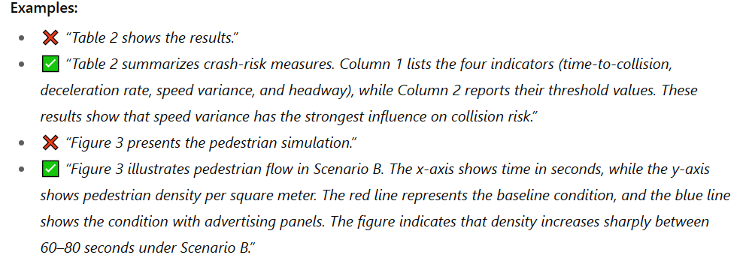
2. Writing Style & Clarity
Explain about Figures and Tables in detail
Do not assume the reader already understands your figures or tables.
Explain clearly:
For tables → describe what each column and row represents, and highlight the main insight.
For figures → explain the legend, axes, colors, symbols, and what the figure shows.

Slide 27
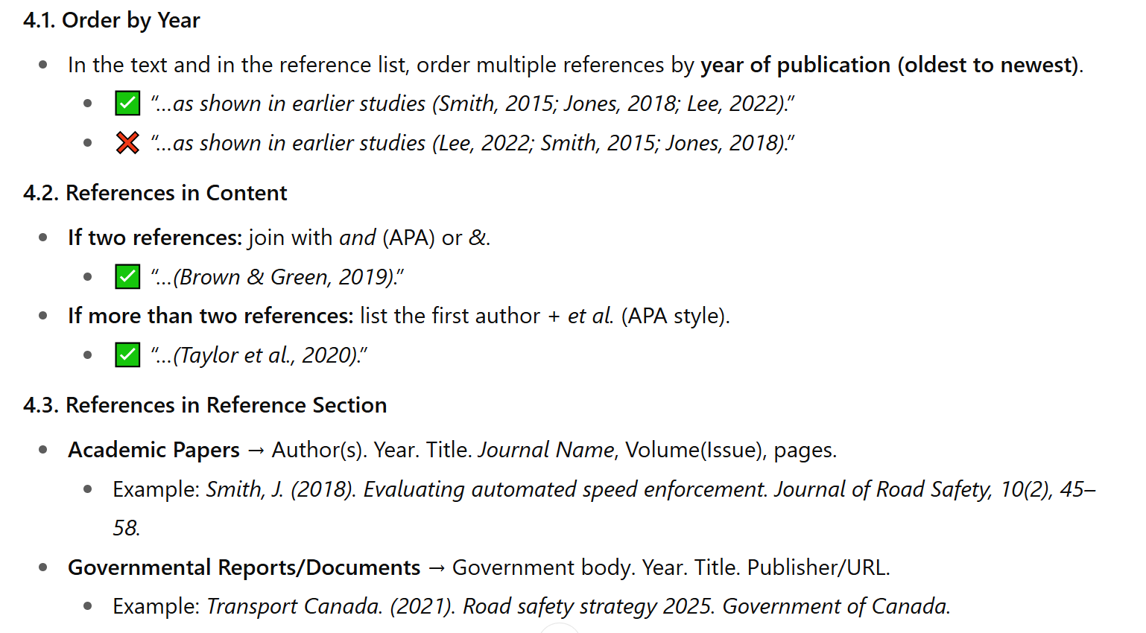
3. Referencing
Use of Reference

Slide 28

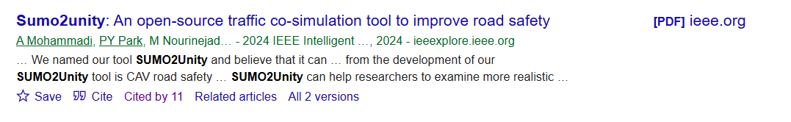
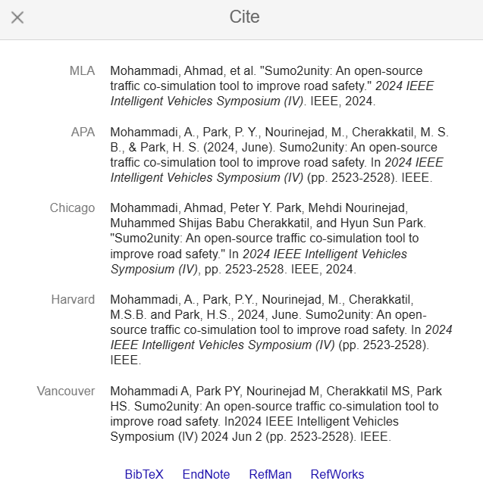
3. Referencing
Reference as APA format
1
2
Copy and paste this into reference section
2

Slide 29
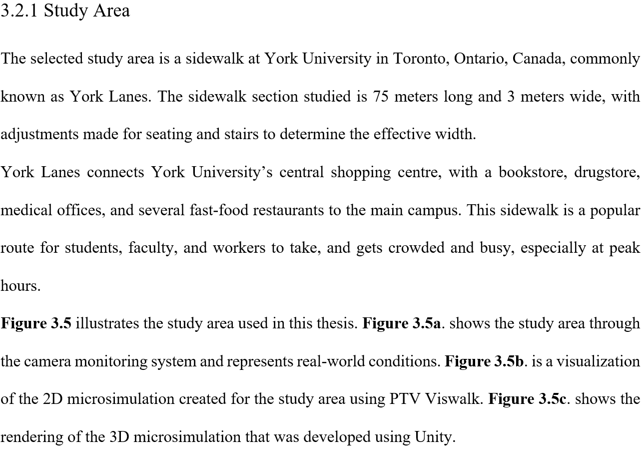
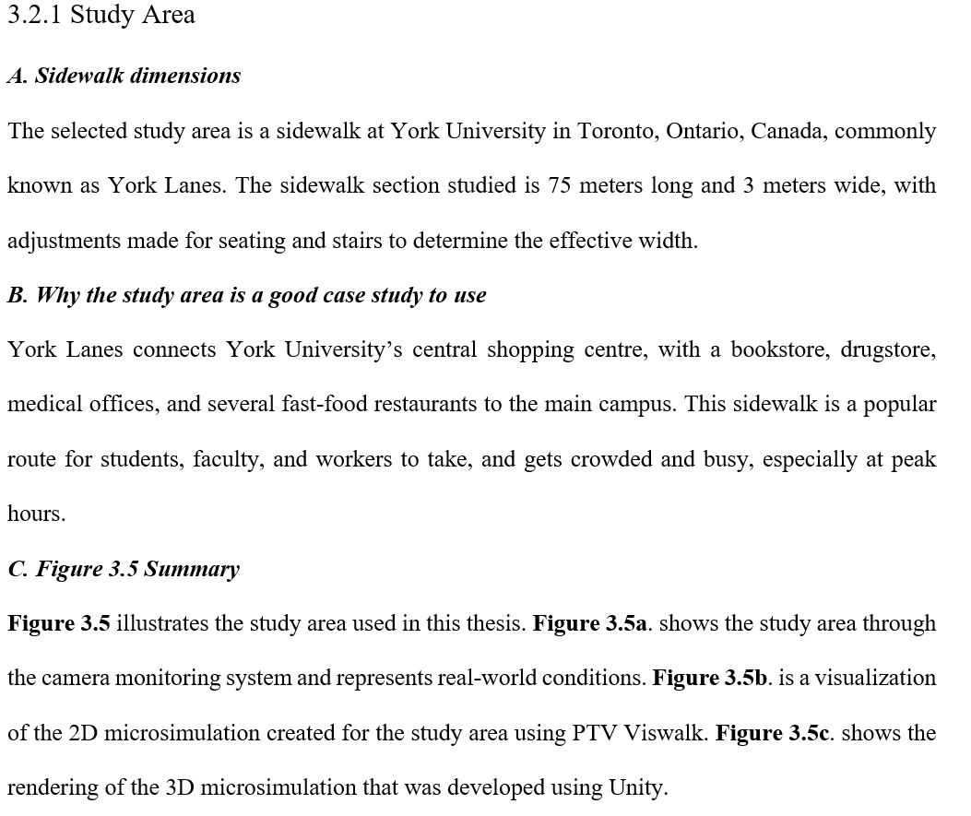
A Sample of First Draft
For Each Sentence → We need to see a Short Title as A, B, C, D …

