Slide 1

Writing Paper/ Thesis/ Report - Table of Content
Structure
Writing Tips:
Title
Abstract
Introduction
1.1. Background
1.2. Problem Statement
1.3. Study Goal and Objectives
2. Literatue Review
3. Methodology
4. Result analysis
5. Conclusion and Recommendation
1. Formatting
2. Writing Style & Clarity
3. Referencing

Slide 2


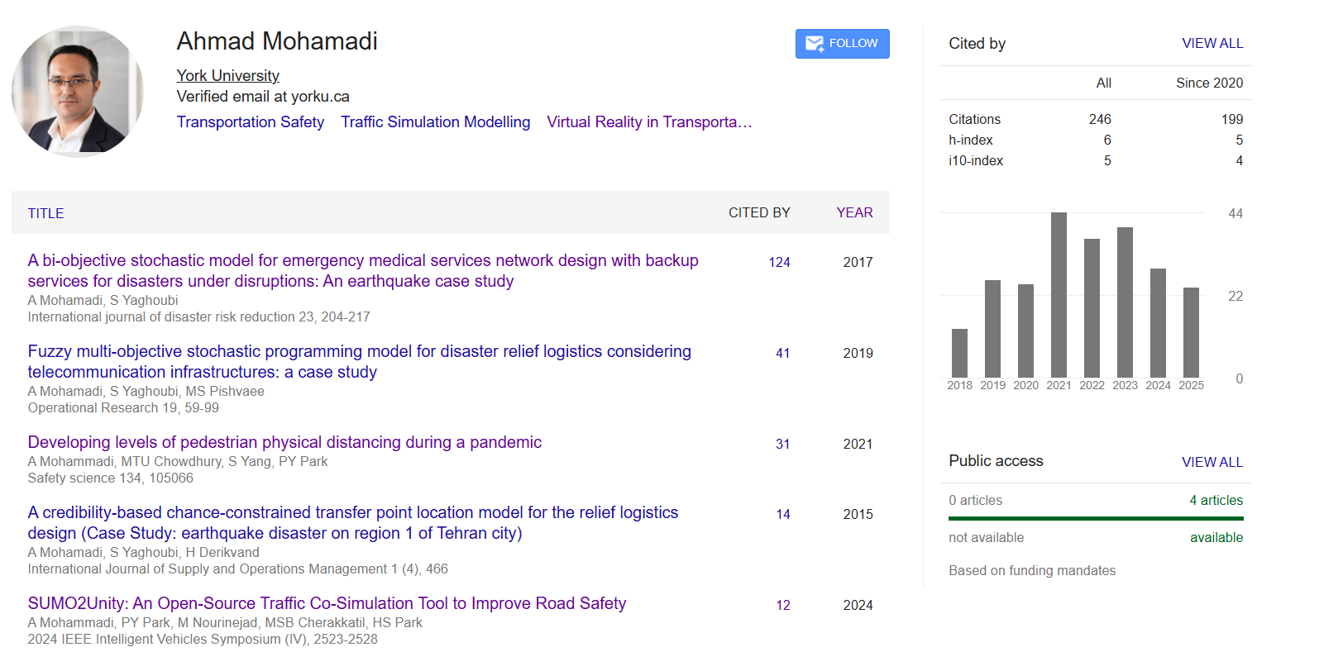
Let’s Grow Together — One Heart, One Community

Slide 3
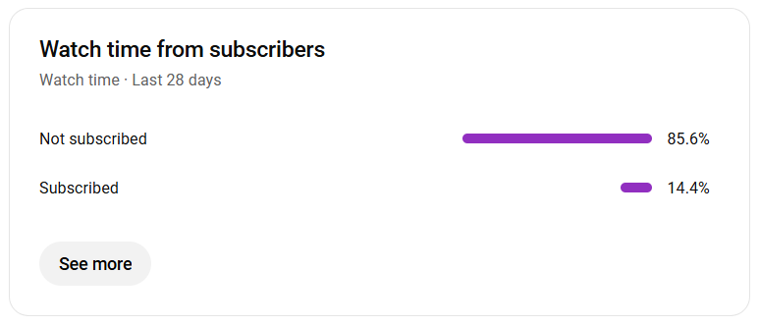
Let’s Grow Together — One Heart, One Community

Slide 4
Writing Paper- Structure
Title
Abstract
Introduction
1.1. Background
1.2. Problem Statement
1.3. Study Goal and Objectives
2. Literatue Review
3. Methodology
4. Result analysis
5. Conclusion and Recommendation
Heart of Paper

Slide 5
Writing Paper- Order
Title
Abstract
Introduction
1.1. Background
1.2. Problem Statement
1.3. Study Goal and Objectives
2. Literatue Review
3. Methodology
4. Result analysis
5. Conclusion and Recommendation
2
8
3
4
1
5
6
7
7

Slide 6
Study Goal and Objectives
Study Goal:
The goal of study is …
This study has three objective as below:
Developing …
Designing …
Implementing …
1
Title
…
1
Take title from here

Slide 7
Study Goal and Objectives
Study Goal:
The goal of study is developing a novel artificial intelligence algorithm to capture risk of collisions between a vehicle and a pedestrian
This study has three objective as below:
Developing input indicators to capture risk of collisions
Designing an artificial intelligence algorithms based on input indicators to identify the risk
Implementing the algorithm in a study are and comparing with existing scenario
Title
Developing a Novel Artificial Intelligence Algorithm for Collisions Risk Assessment

Slide 8
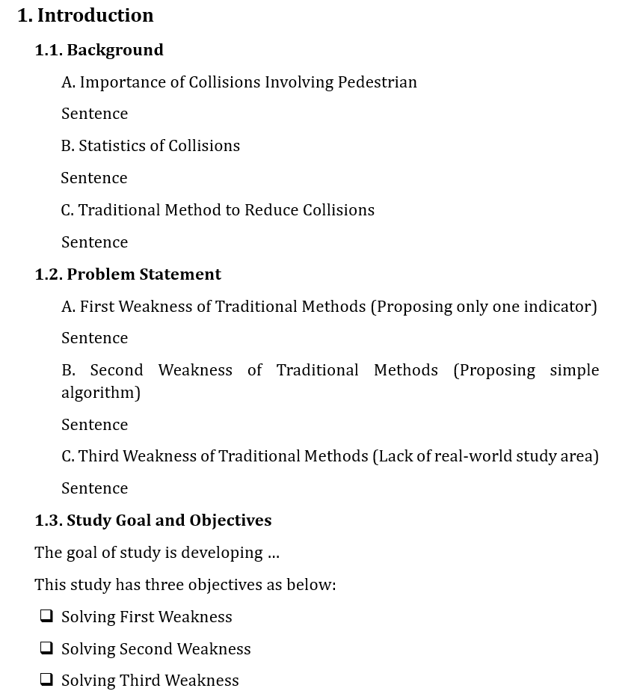
Introduction
1
2
Storyline:
First Level: Write bullet points (short titles) for the content in background
Second Level: Write each sentence
1
2

Slide 9
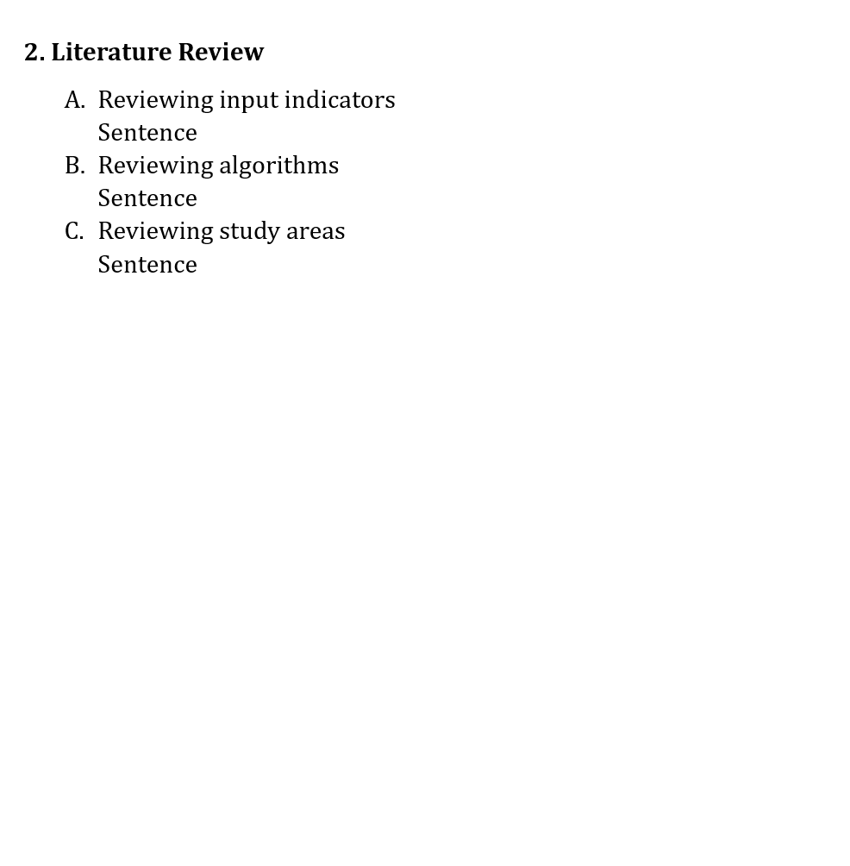
Literature Review
1
First Weakness
2
Reviewing past studies considering three weaknesses in study objectives
Storyline:
First Level: Write bullet points (short titles) for the content in background
Second Level: Write each sentence
Second Weakness
Third Weakness
1
2

Slide 10
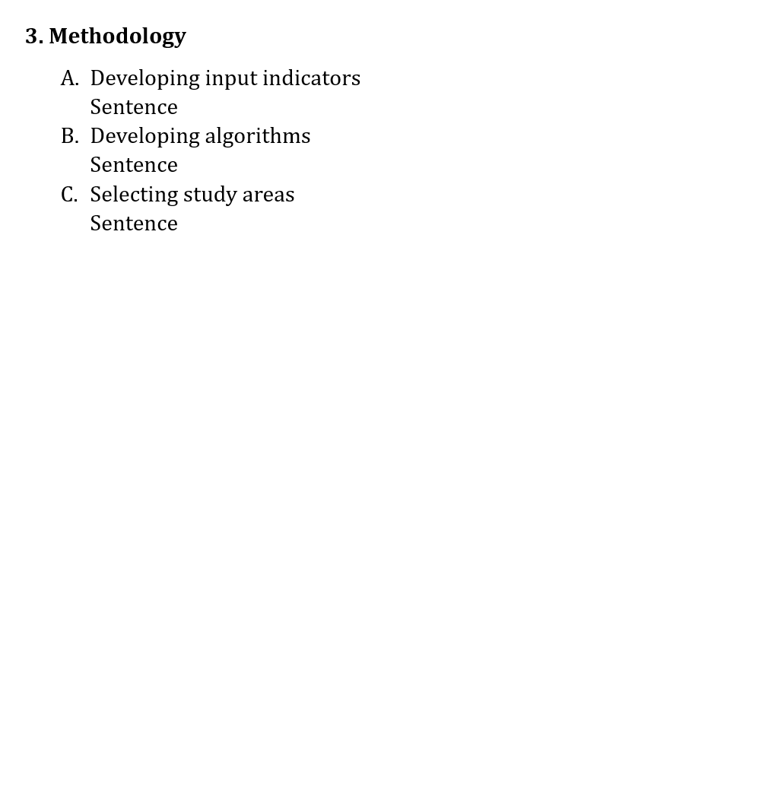
Methodology
1
First Weakness
2
Second Weakness
Write based on three weaknesses
Storyline:
First Level: Write bullet points (short titles) for the content in background
Second Level: Write each sentence
Third Weakness
1
2

Slide 11
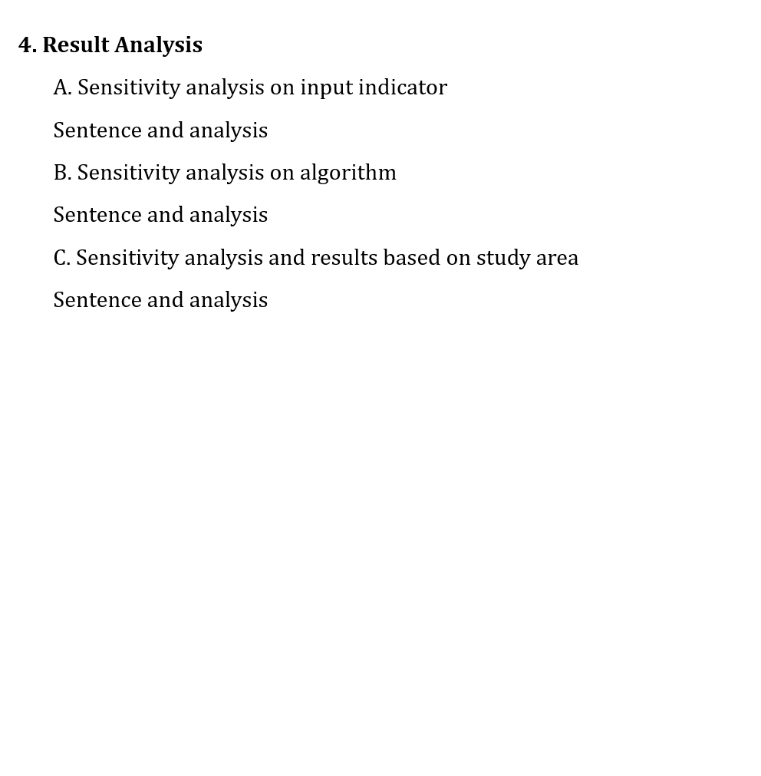
Results
1
First Weakness
2
Second Weakness
Should answer to three weaknesses by providing analysis
Storyline:
First Level: Write bullet points (short titles) for the content in background
Second Level: Write each sentence
Third Weakness
1
2

Slide 12
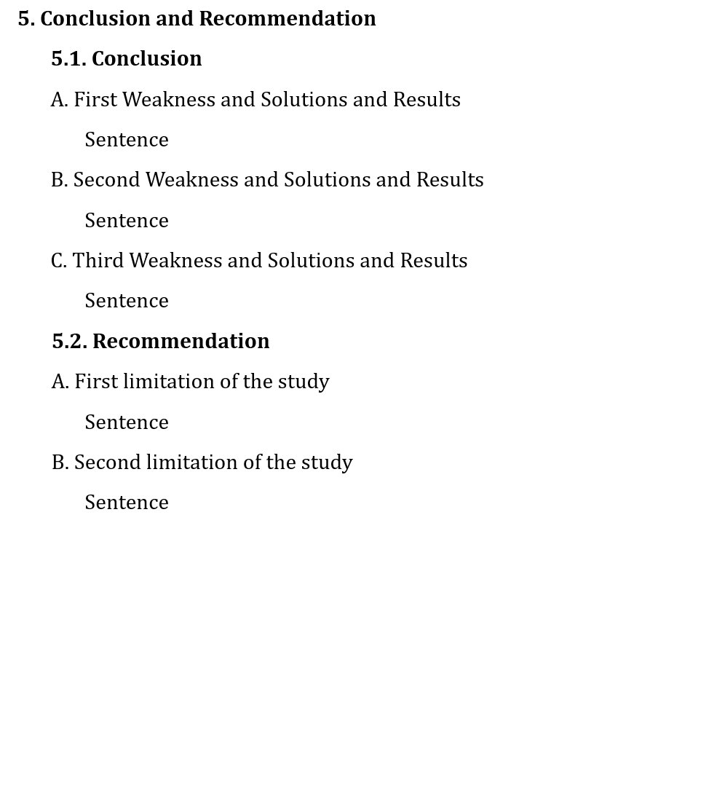
Conclusions and Recommendation
1
First Weakness
2
Conclusion: Summarize your findings based on three weaknesses and three objectives
Recommendation: Explain about Limitations and explain what future studies can do
Storyline:
First Level: Write bullet points (short titles) for the content in background
Second Level: Write each sentence
Second Weakness
Third Weakness
1
2

Slide 13
Writing Tips:
1. Formatting
Justifying the text
Use of Same Font Type Across the Content
Use of Capital Letter
Add Proper Title for Tables/Figures
The Keywords come from Abstract
Use of Abbreviations
2. Writing Style & Clarity
Use of Active Voice
Consistency (same word for same concept)
Avoid long, indirect clauses
Avoid using adverbs as much as possible
Avoid using technical language/terms unless necessary
Avoid using too long and unnecessary words
3. Referencing
Use of Reference
Reference as APA format

Slide 14
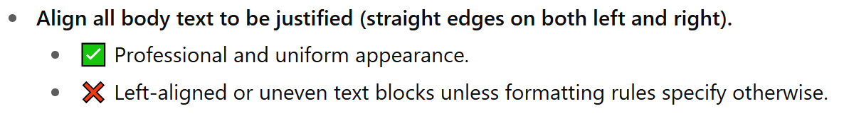
Writing Tips: Formatting
Justifying the text

Slide 15
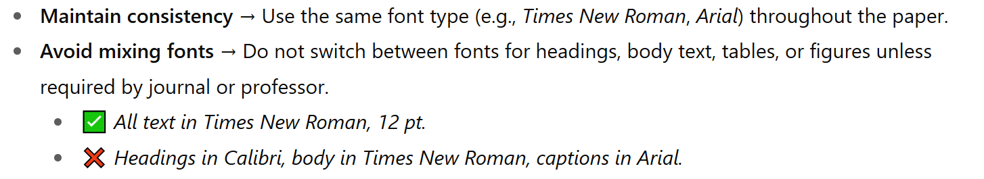
Writing Tips: Formatting
Use of Same Font Type Across the Content

Slide 16
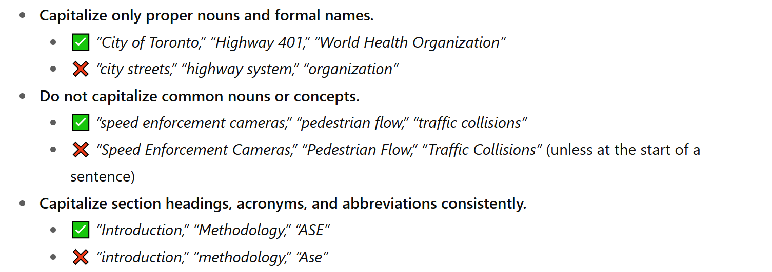
Writing Tips: Formatting
Use of Capital Letters

Slide 17
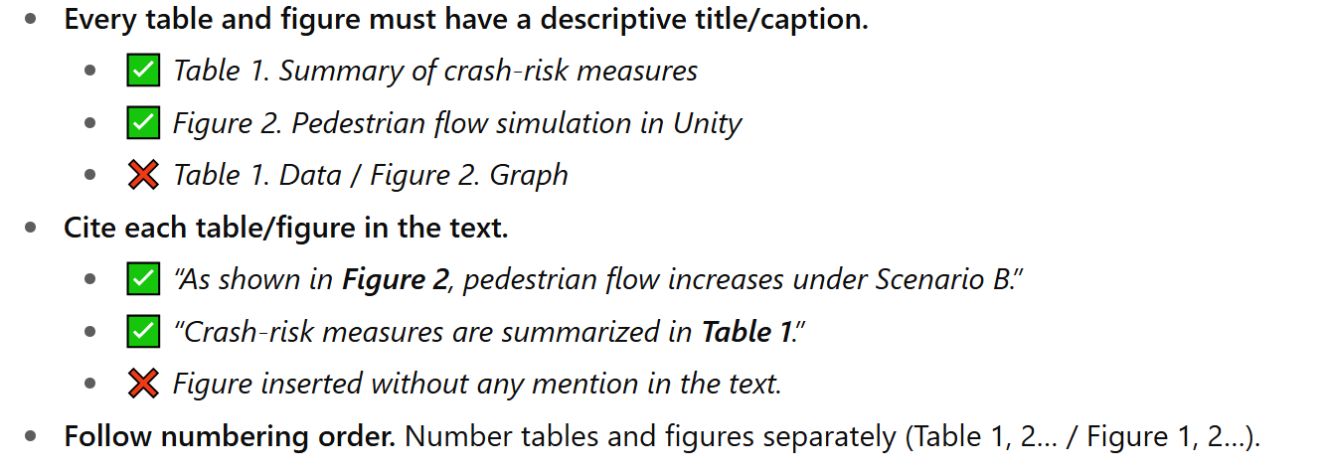
Writing Tips: Formatting
Add Proper Title for Tables/Figures

Slide 18
Writing Tips: Formatting
The Keywords come from Abstract

Slide 19
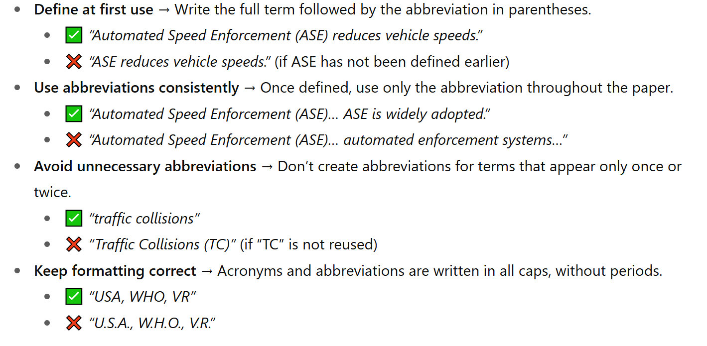
Writing Tips: Formatting
Use of Abbreviations

Slide 20
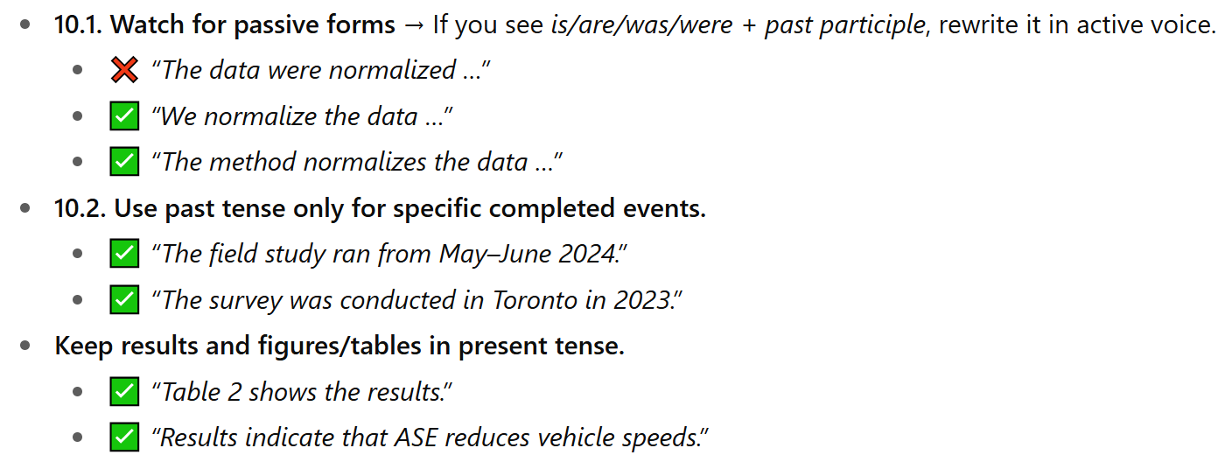
Writing Tips: Writing Style & Clarity
Use of Active Voice

Slide 21
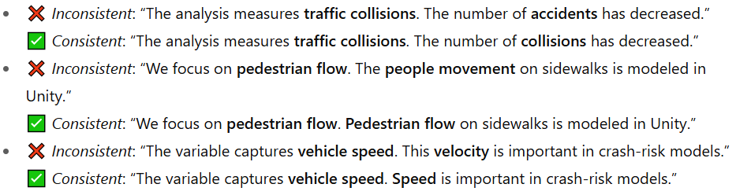
Writing Tips: Writing Style & Clarity
Consistency --> Use same word to refer to similar concept

Slide 22
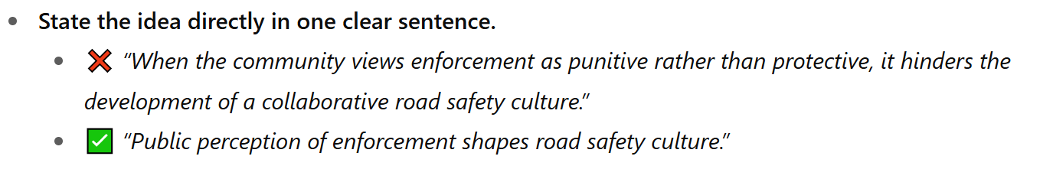
Writing Tips: Writing Style & Clarity
Avoid long, indirect clauses

Slide 23
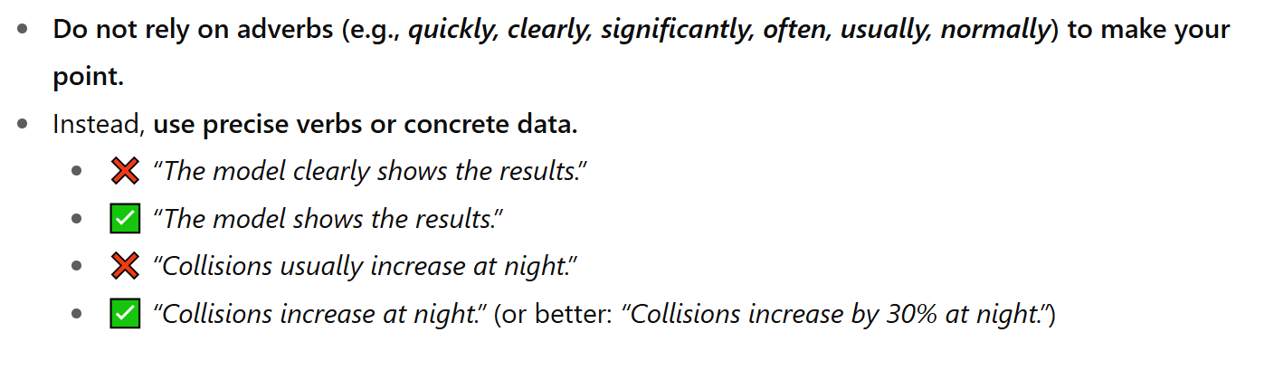
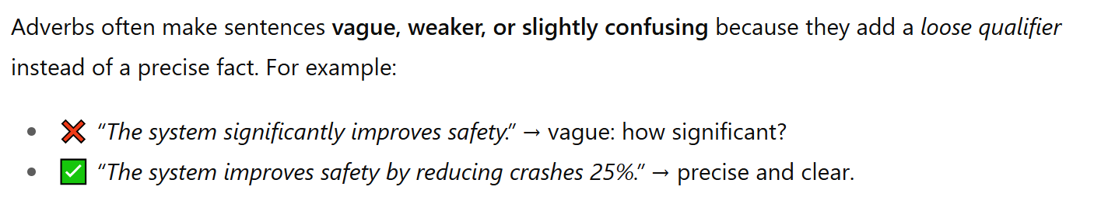
Writing Tips: Writing Style & Clarity
Avoid using adverb as much as possible

Slide 24
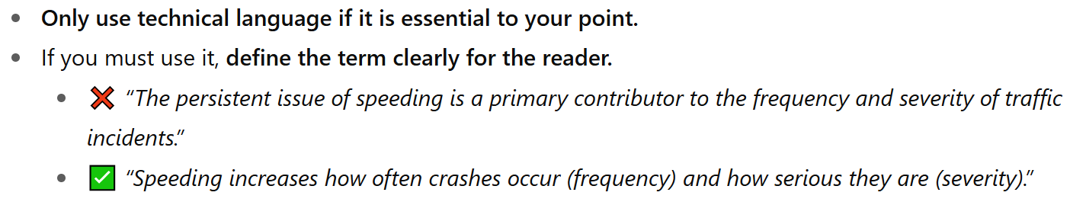
Writing Tips: Writing Style & Clarity
Avoid using technical language/terms

Slide 25
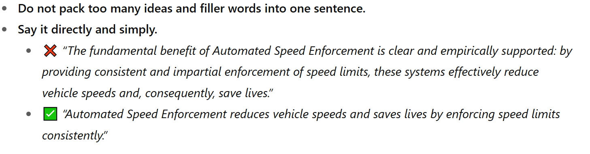
Writing Tips: Writing Style & Clarity
Avoid using too long and Unnecessary words
Avoid breaking sentences into too many parts with commas, colons

Slide 26
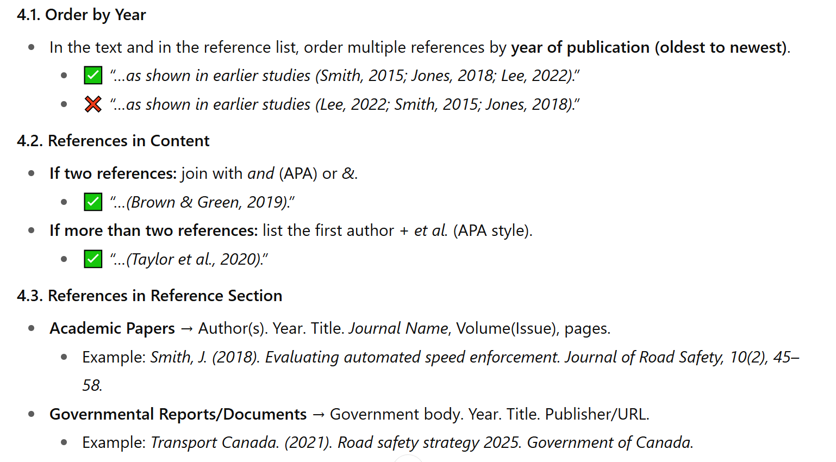
Writing Tips: Referencing
Use of Reference

Slide 27

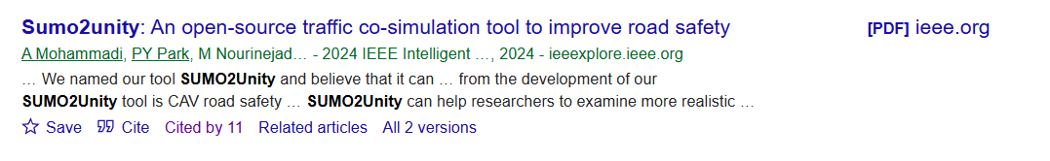
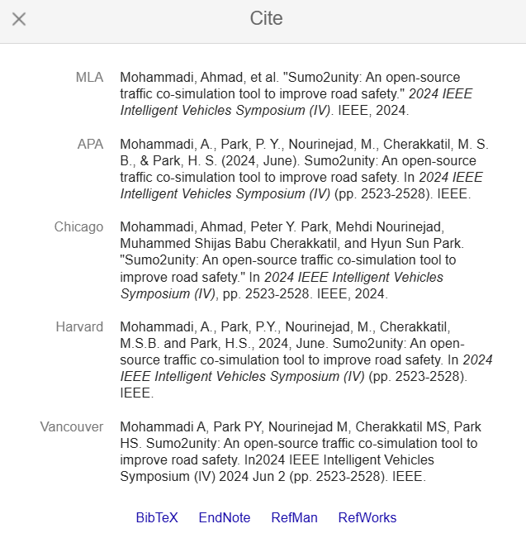
Writing Tips: Referencing
Reference as APA format
1
2
Copy and paste this into reference section
2

Slide 28
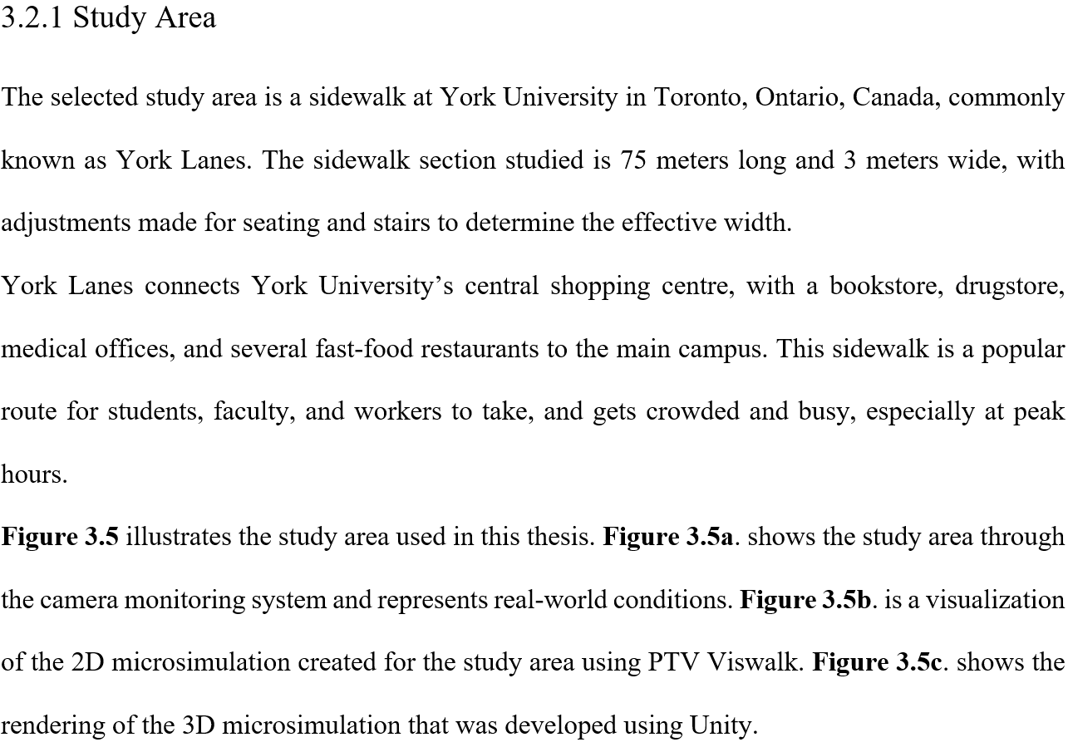
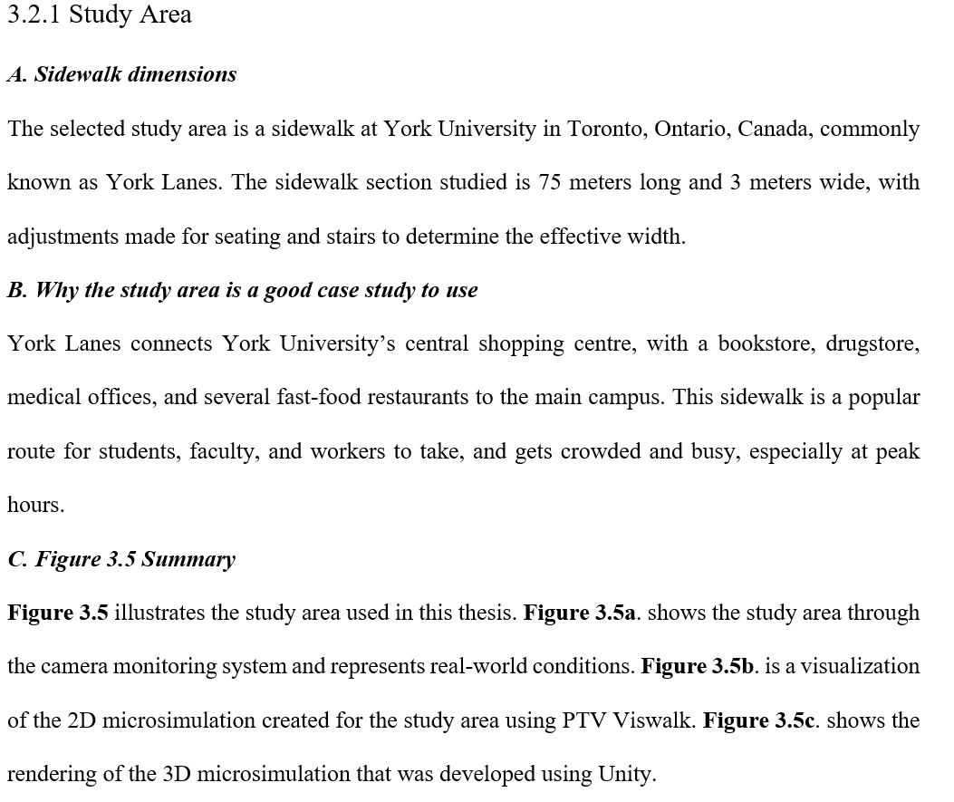
A Sample of First Draft
For Each Sentence → We need to see a Short Title as A, B, C, D …

