Slide 1
Ansible
Playbooks

Slide 2
Table of Contents
Playbooks
Hosts and Users
Inventory File
Modules
Tasks
Handlers
Conditionals and Loops

Slide 3
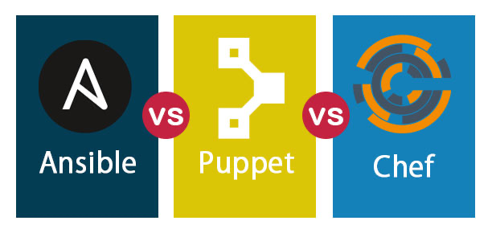
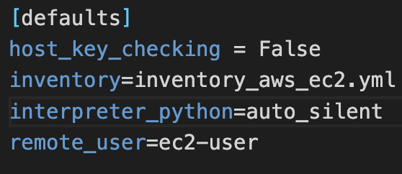

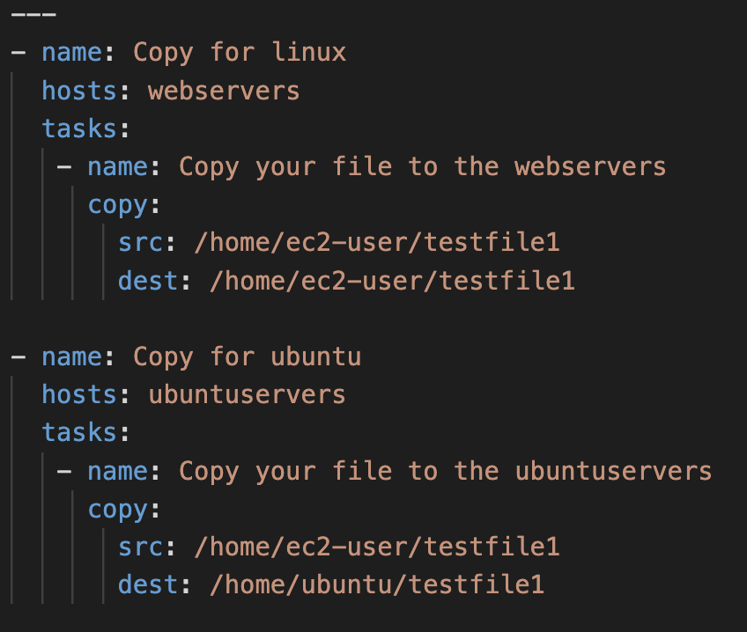


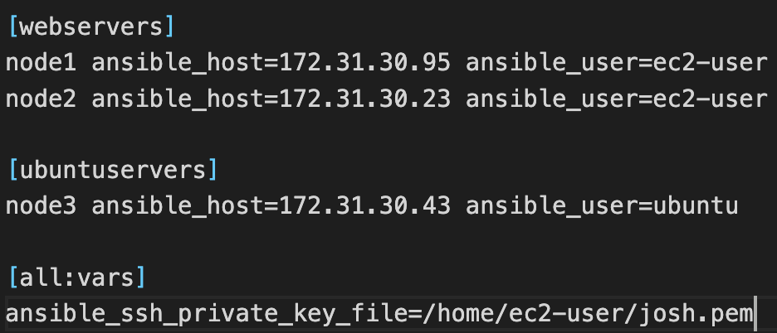



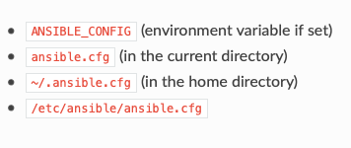

CONTROL NODE
ansible cfg
playbook
NODES
inventory
modules
- /etc/ansible/hosts
- /etc/ansible/ansible.cfg
PUSH Architecture

Slide 4








Playbooks
Address List
Manager
Hillroad Road, 43
Oxford Square, 15
ANSI
Faringdon Road, 4
Roman Walk, 9
Checklist

Slide 5
Playbooks
Inventory
Control Node
Hillroad Road, 43
Oxford Square, 15
Ansible
Faringdon Road, 4
Roman Walk, 9
Playbook

Slide 6
1
Playbooks

Slide 7
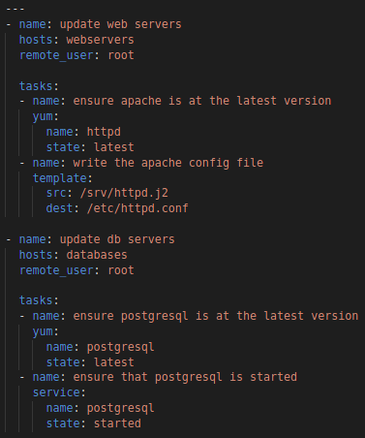
Playbooks
Playbooks
Plain-text YAML files that defines a set of activities (tasks) to be run on hosts.
Human and machine readable.
Can be used to build and configure entire application environments.

Slide 8
Playbooks
playbook.yml

Slide 9
Playbooks
playbook.yml
play-1
play-2

Slide 10
Playbooks
playbook.yml
play-1
play-2

Slide 11
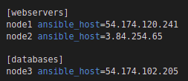
Playbooks
inventory.ini
playbook.yml
play-1
play-2

Slide 12
Playbooks
inventory.ini
playbook.yml
play-1
task-1
task-2
play-2
task-1
task-2

Slide 13
Playbooks
inventory.ini
playbook.yml
play-1
task-1
task-2
modules
play-2
task-1
task-2

Slide 14
Playbooks
inventory.ini
playbook.yml
play-1
task-1
arguments
arguments
task-2
modules
play-2
arguments
task-1
arguments
task-2

Slide 15
Playbooks
inventory.ini
playbook.yml
play-1
task-1
arguments
How to Run
arguments
task-2
modules
Playbooks contain plays
Plays contain tasks
Tasks call modules
- Tasks run sequentially
play-2
arguments
task-1
arguments
task-2

Slide 16
Playbooks
inventory.ini
playbook.yml
play-1
task-1
arguments
How to Run
$ ansible-playbook playbook.yml
arguments
task-2
modules
Playbooks contain plays
Plays contain tasks
Tasks call modules
- Tasks run sequentially
play-2
arguments
task-1
arguments
task-2
Notes:
Modules: Tasks plugins

Slide 17
2
Hosts and Users

Slide 18
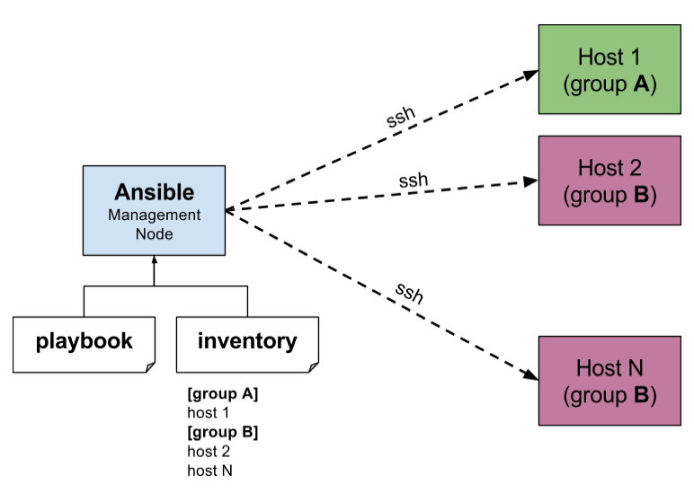
Hosts and Users
For each play in a playbook, you get to choose which machines in your infrastructure to target and what remote user to complete the steps (called tasks) as.
The host defined in the inventory file must match the host used in the playbook and all connection information for the host is retrieved from the inventory file.

Slide 19
3
Inventory File

Slide 20
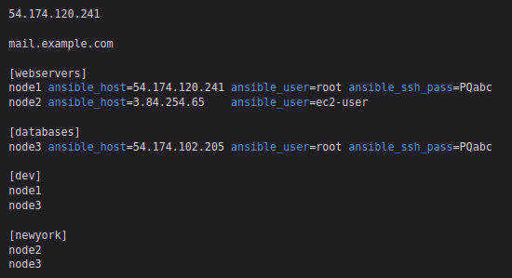
Inventory File
inventory.ini
Ansible works against multiple managed nodes or “hosts” in your infrastructure at the same time, using a list or group of lists know as inventory.
The default location for inventory is a file called /etc/ansible/hosts.
You can specify a different inventory file at the command line using the -i < path > option.

Slide 21
4
Tasks

Slide 22
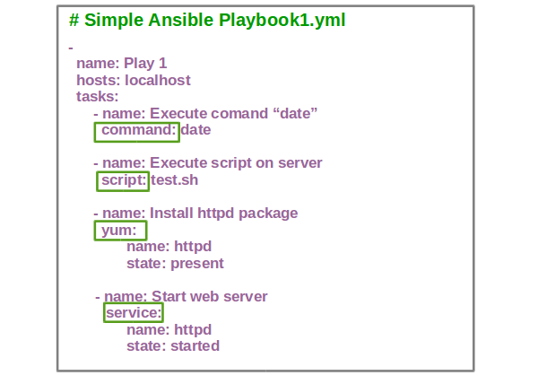
Tasks
Each play contains a list of tasks. Tasks are executed in order, one at a time, against all machines matched by the host pattern, before moving on to the next task.
The goal of each task is to execute a module, with very specific arguments. Variables can be used in arguments to modules.

Slide 23
5
Modules

Slide 24
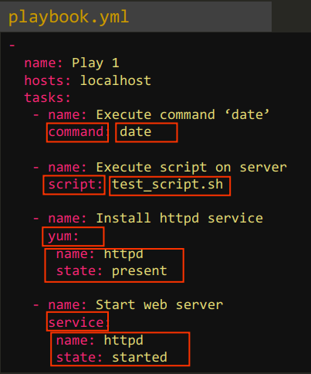
Modules
Modules (also referred to as “task plugins” or “library plugins”) are discrete units of code that can be used from the command line or in a playbook task.
Ansible executes each module, usually on the remote target node, and collects return values.
Modules should be idempotent, and should avoid making any changes if they detect that the current state matches the desired final state.

Slide 25
6
Handlers

Slide 26
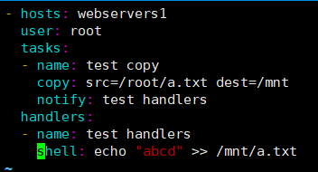
Handlers
Handlers are lists of tasks, not really any different from regular tasks, that are referenced by a globally unique name, and are notified by notifiers. If nothing notifies a handler, it will not run.

Slide 27
7
Variables

Slide 28
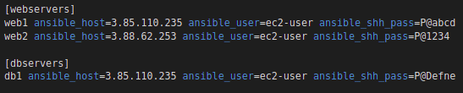
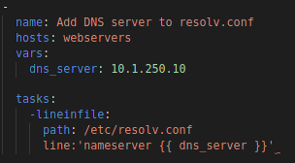
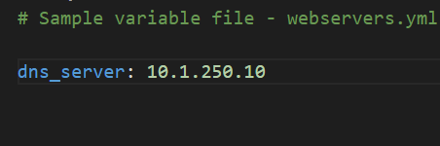
Variables
Variables are used to store values that varies with different items.
Playbook.yml
OR

Slide 29
8
Conditionals

Slide 30
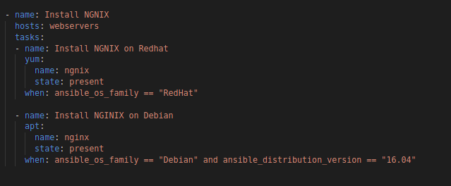
Conditionals

Slide 31
Conditionals
OS_FAMILY | ansible_os_family == "RedHat" | ansible_os_family == "SUSE" | ansible_os_family == "Debian" or ansible_distribution_version == "20.04"
USER | recep alex James Oliver | David polat | tomy robin
NODES | Node1 Node2 | - | Node3

Slide 32
9
Loops

Slide 33
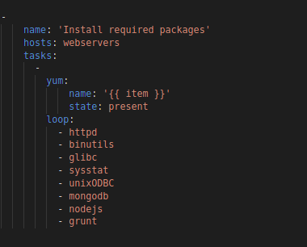
Loops

Slide 34
THANKS!
Any questions?

Slide 35
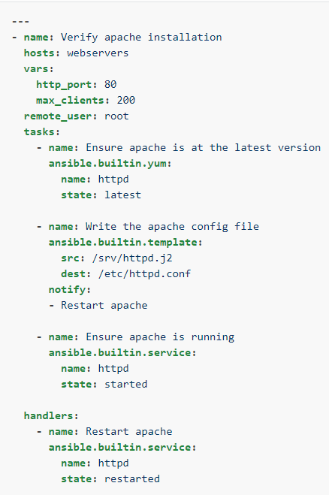
Handlers
Handlers are lists of tasks, not really any different from regular tasks, that are referenced by a globally unique name, and are notified by notifiers. If nothing notifies a handler, it will not run.

Slide 36






Bird Street No:15
Bird Street No:14
Manager
Cat Street No:19
check-lists
painter Ansi
address lists
Cat Street No:21
Cat Street No:20

Slide 37
Host Address: 34.67.58.125
Host Address: 145.4.32.129
Managed Nodes
Control Node
Host Address: 45.78.16.4
Playbook
Inventory
Host Address: 65.16.45.7
Host Address: 47.7.6.87

