Slide 1


SmartHouse
Satish Singh, Roald de Brouwer, Sam Peetermans, Stevie Maes

Slide 2
Requirements of application
Low power - IoT device
Wireless communication:
Default: DASH7
Backup: LoRaWAN
Localization
Indoor (DASH7)
Outdoor (LoRaWAN)
Device configuration
Bluetooth
Dashboard
Live visualization

Slide 3
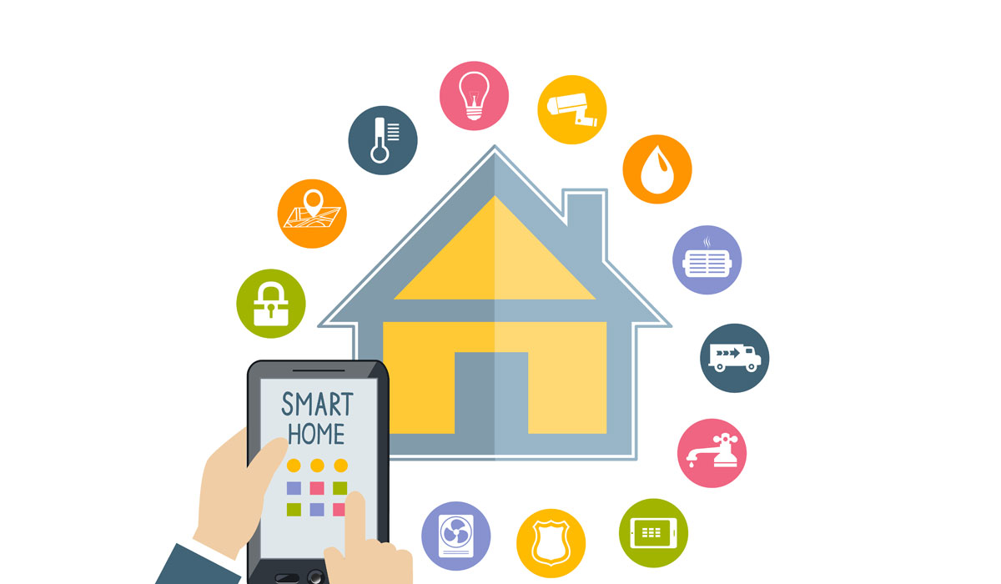
Overview of application
Tracking inside house
Setting temperature outside house
Maximizing energy efficiency

Slide 4
Embedded Software
Stop mode 1 (watchdog)
Accelerometer (double click)
Dash7 / LoRaWAN
Interrupts (priorities)
BLE

Slide 5
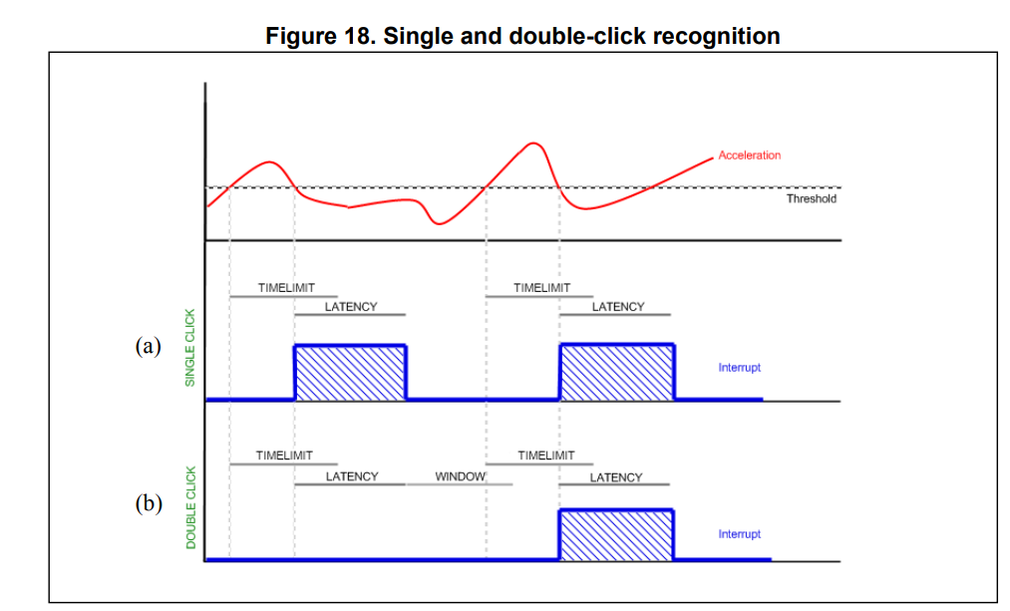
Embedded Software
Stop mode 1 (watchdog)
Accelerometer (double click)
Dash7 / LoRaWAN
Interrupts (priorities)
BLE

Slide 6
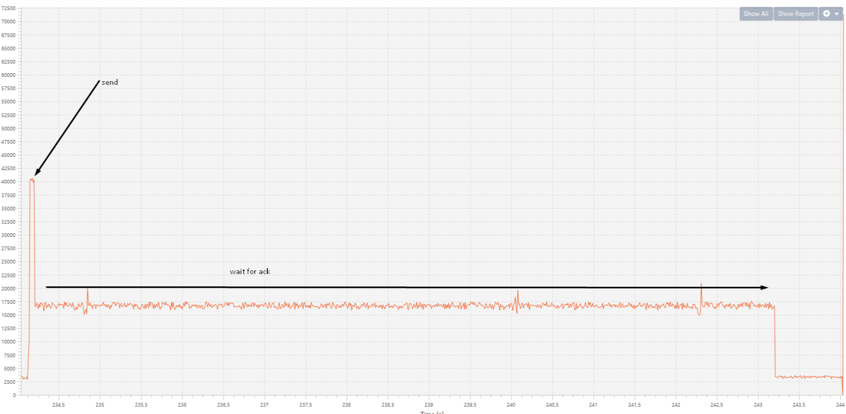
Embedded Software: Dash7
Stop mode 1 (watchdog)
Accelerometer (double click)
Dash7 / LoraWan
Interrupts (priorities)
BLE

Slide 7
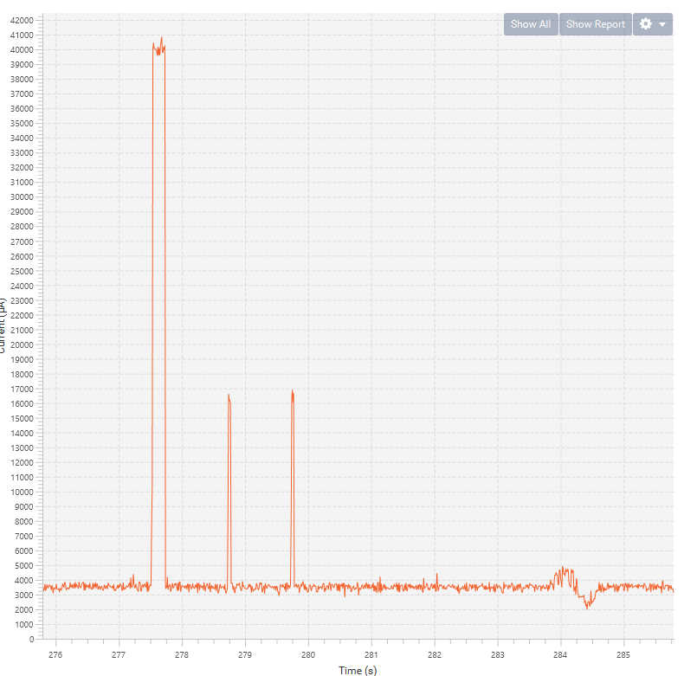
Embedded Software: LoRaWAN
Stop mode 1 (watchdog)
Accelerometer (double click)
Dash7 / LoraWan
Interrupts (priorities)
BLE

Slide 8
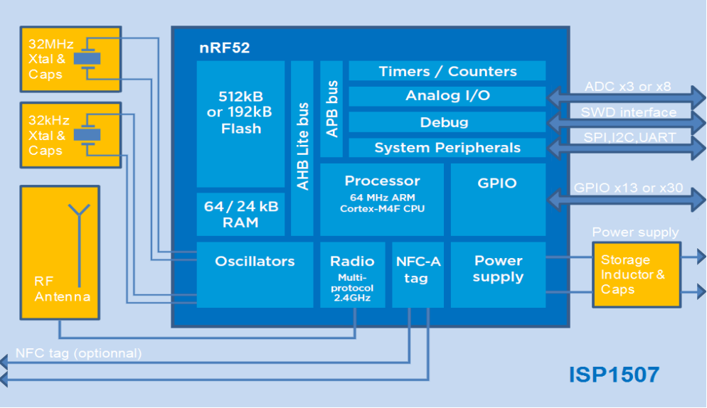
Embedded Software: BLE
Stop mode 1 (watchdog)
Accelerometer (double click)
Dash7 / LoraWan
Interrupts (priorities)
BLE

Slide 9
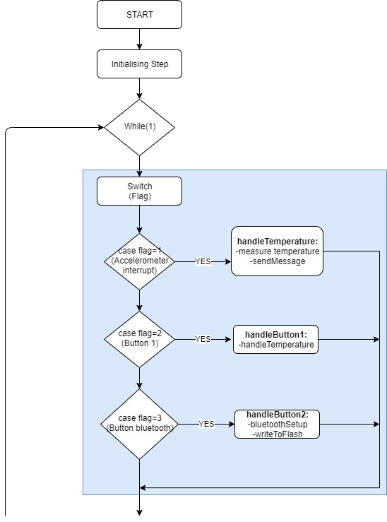
Embedded software

Slide 10
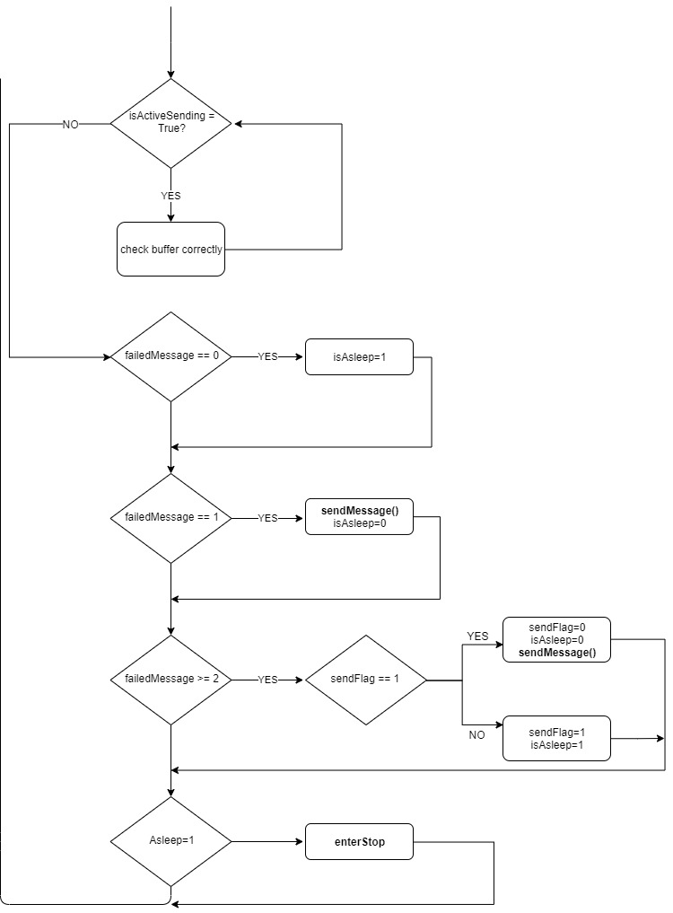
Embedded software

Slide 11
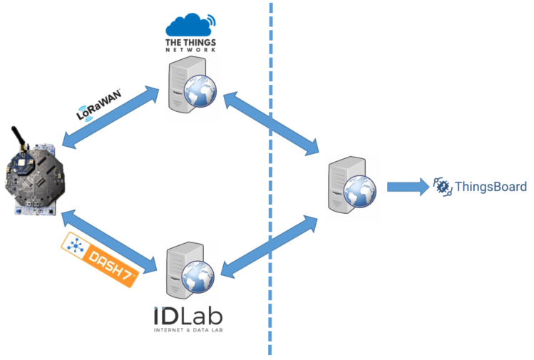
Overview

Slide 12
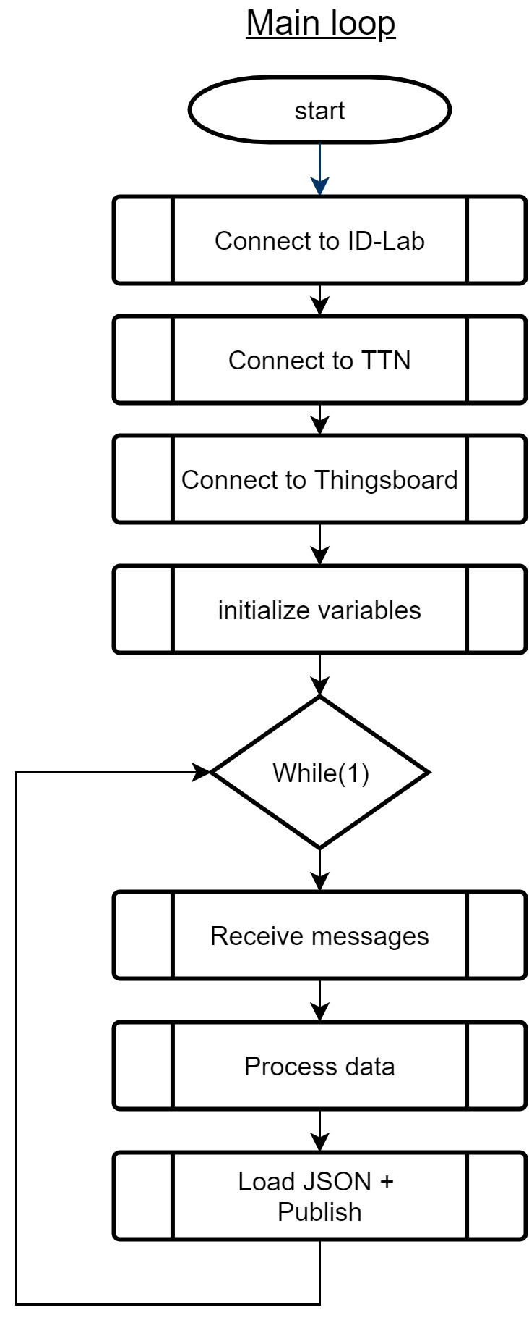
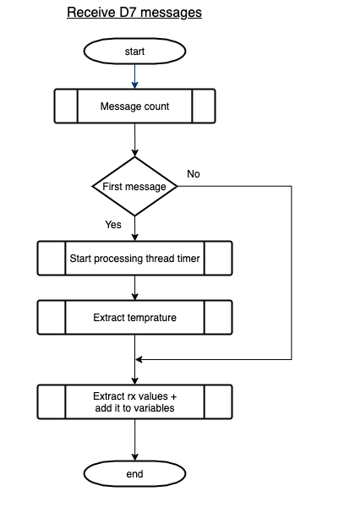
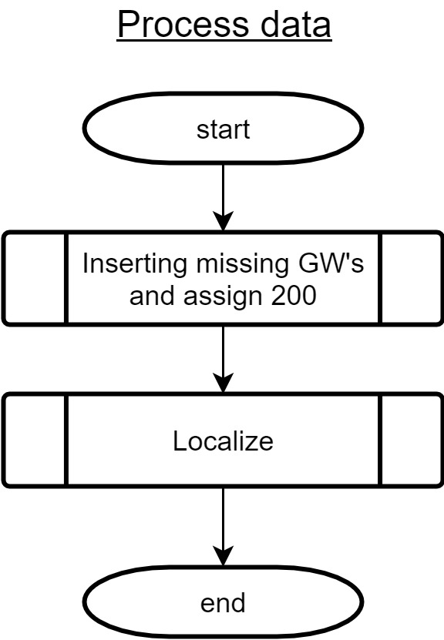
Back-end software

Slide 13
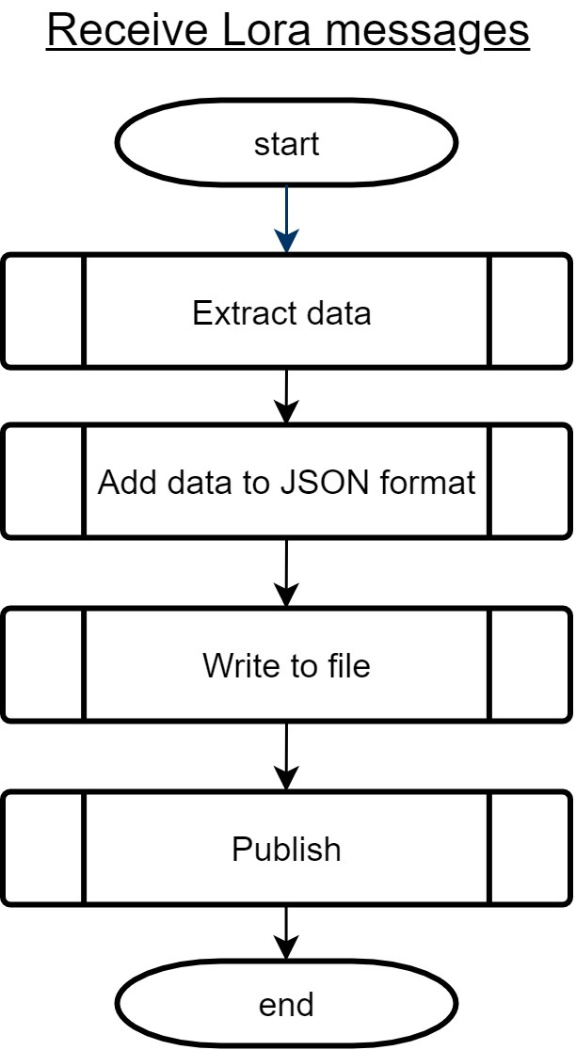
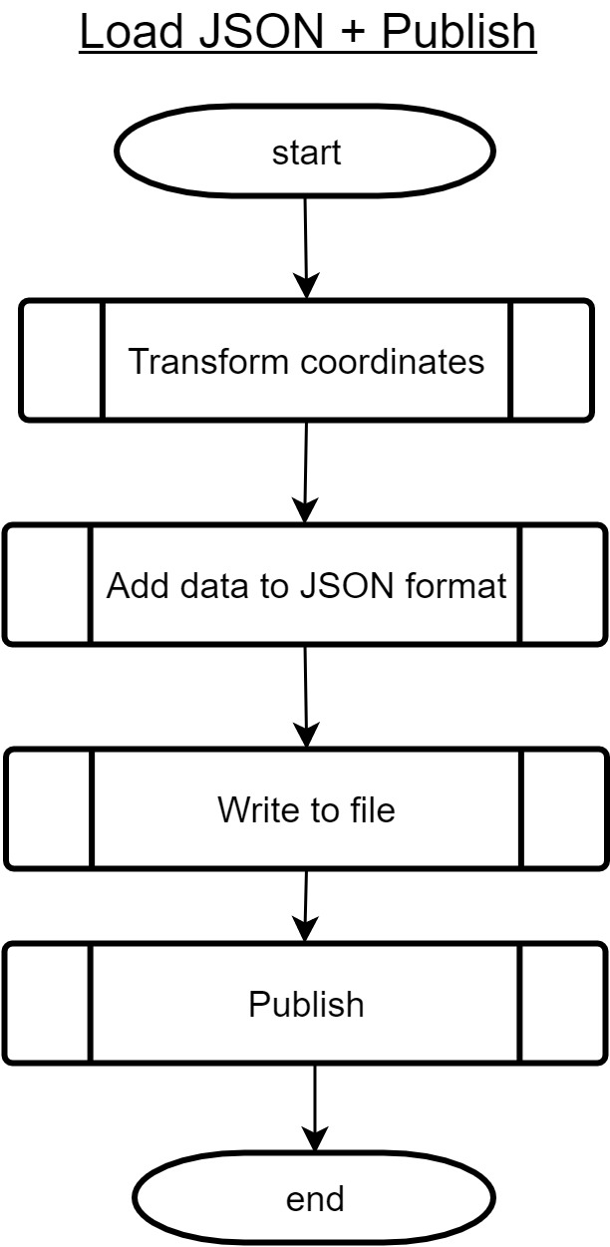
Back-end software

Slide 14


Localisation overview
Fingerprinting
Two main steps
Training step → Database builder
Operational step → Localisation
Notes:
Overview of localisation.
DB builder.

Slide 15
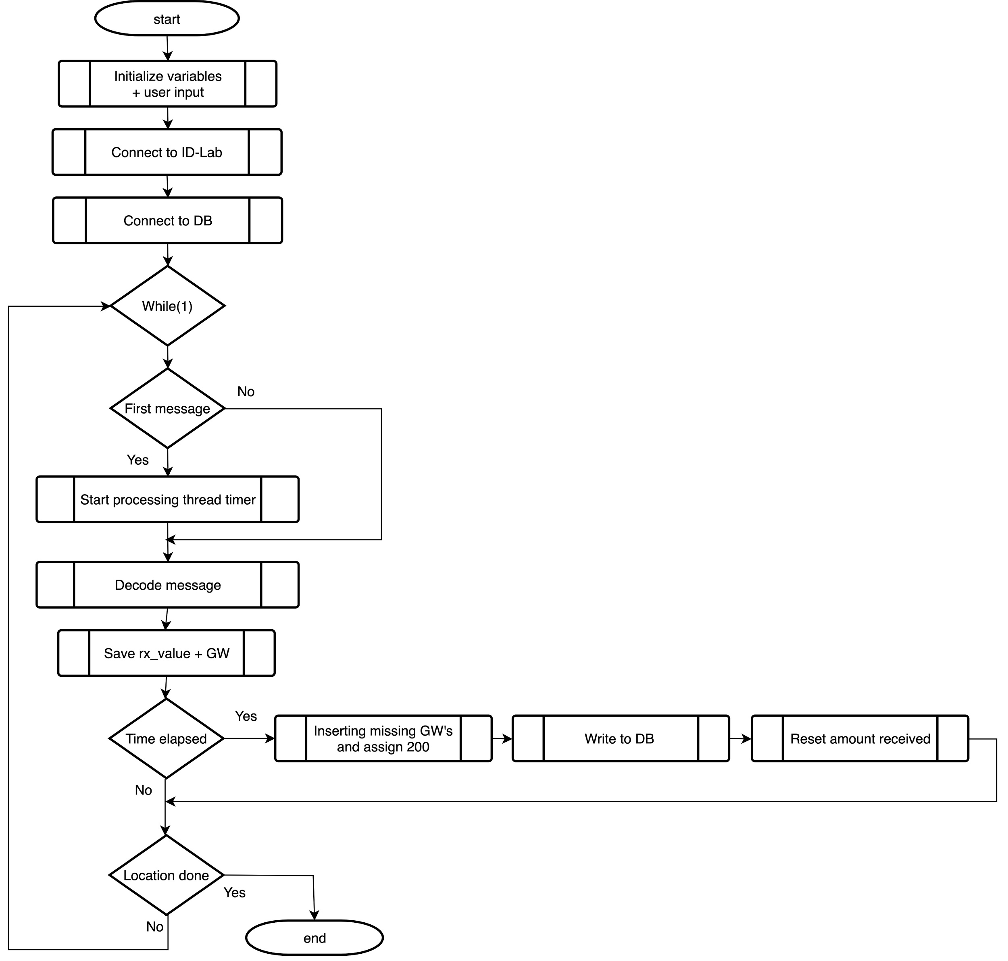
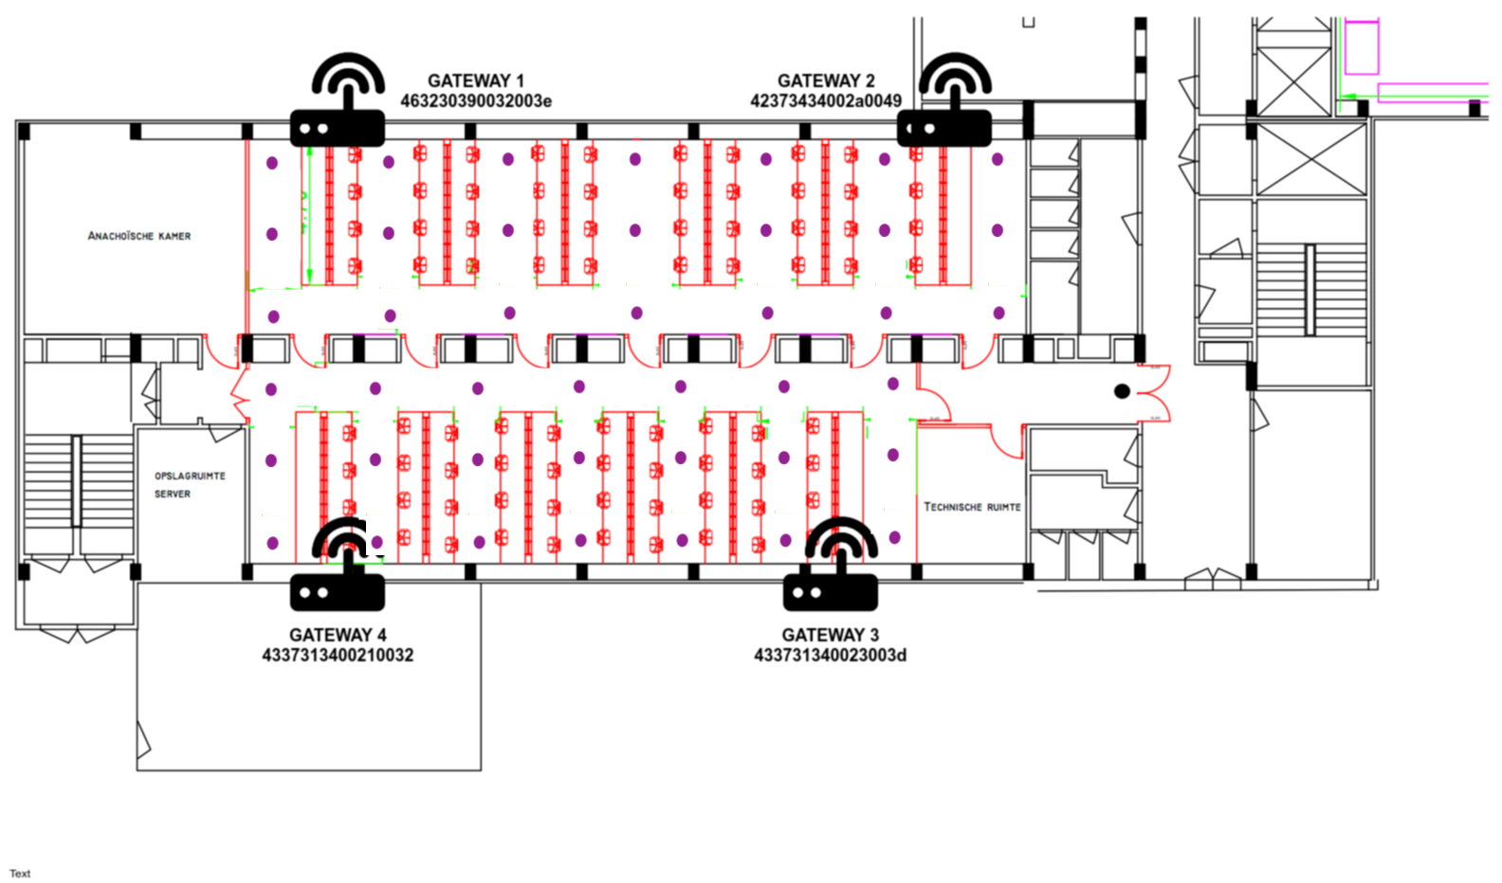
Localisation - Database builder
Notes:
Overview of localisation.
DB builder.

Slide 16
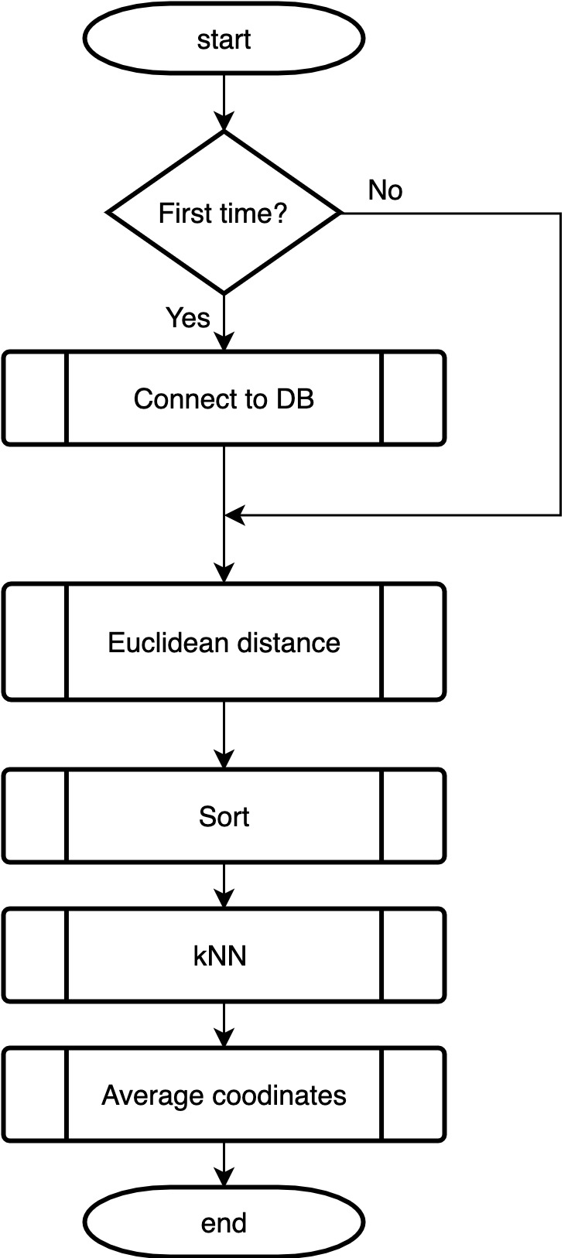
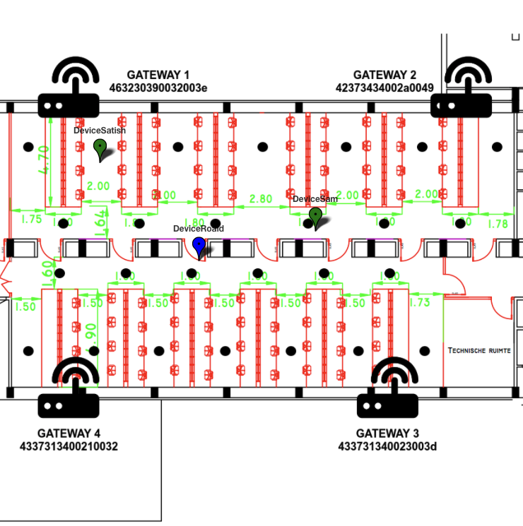
Localisation
Euclidean distance
kNN

Slide 17
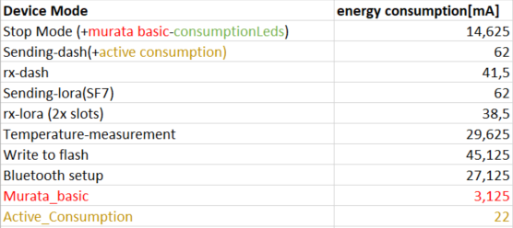
Energy Profiling
Use of 15 interrupts, 3 setups and 10 LoRaWAN messages a day with a battery of 6600 mAh, we have 449 working hours.

Slide 18
Future work
Limiting LoRaWAN messages
Turning off unused modules and peripherals
Controlling lights inside of house
Reduce clock frequency
More failsafes, dummy proof
...

Slide 19
Demo

Slide 20

Questions?

Slide 21
Division of labour
Satish Singh | Embedded code
 | Power measurements
Sam Peetermans | Localisation
 | Backend scripts
Stevie Maes | Setup and maintaining backend
 | Backend scripts
 | Thingsboard
Roald de Brouwer | Thingsboard
 | GUI

