Slide 1

Smart House
Satish Singh, Roald de Brouwer, Sam Peetermans, Stevie Maes

Slide 2
Embedded
Satish Singh
Low power mode
Temperature measurement
Interrupt of accelerometer

Slide 3
Localization
Sam Peetermans
MongoDB
Receiving
Processing

Slide 4
Back-end
Stevie Maes
Subscribe via MQTT on D7 messages
Parsing data
Data in JSON file
Publish JSON file to thingsboard

Slide 5
Visualization
Roald de Brouwer
Setup thingsboard
Temperature graph

Slide 6
Schedule
19/11/2019
Satish Singh | Temperature for BLE
Sam Peetermans | Building database
Stevie Maes | Automation subscribe and publish
Roald de Brouwer | Implementation visualization
Notes:
Using bluetooth you can say what temperatures you’d like or what ranges you’d like to be tracked outside

Slide 7
Visualisation
ThingsBoard

Slide 8
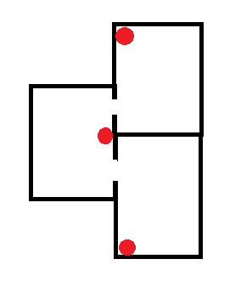
Localisation
Indoor
Outdoor
Notes:
Inside: Dash7
Extension: Outside: Lora / (GPS)

Slide 9

Questions?

