Slide 1
STREET ART

Slide 2
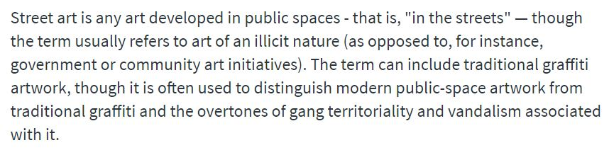
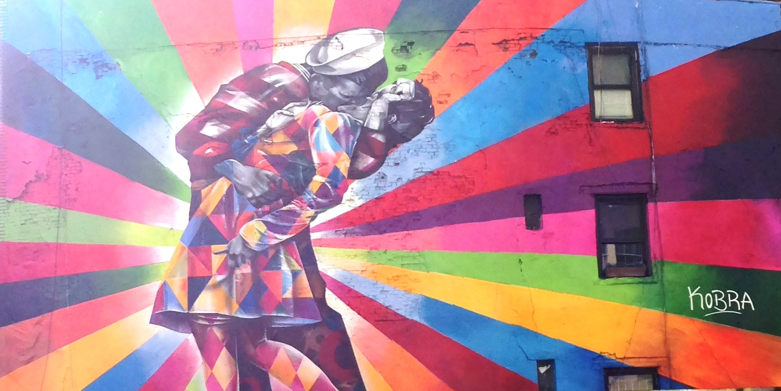
What is Street-art ?

Slide 3
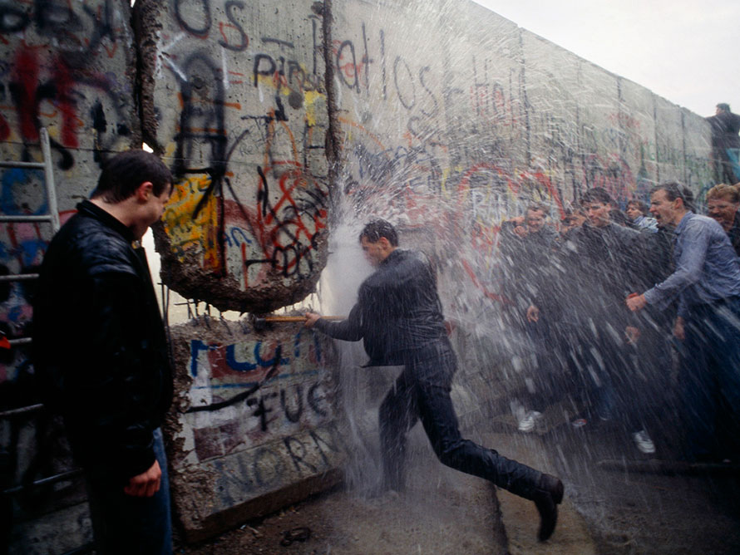
History of Street-Art
1961 Fall of the Berlin wall
1963 with Ernest Pignon Ernest
1991 Metro station of the Louvre museum tagged

Slide 4
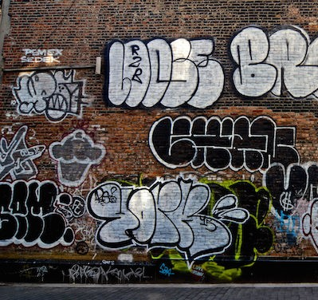
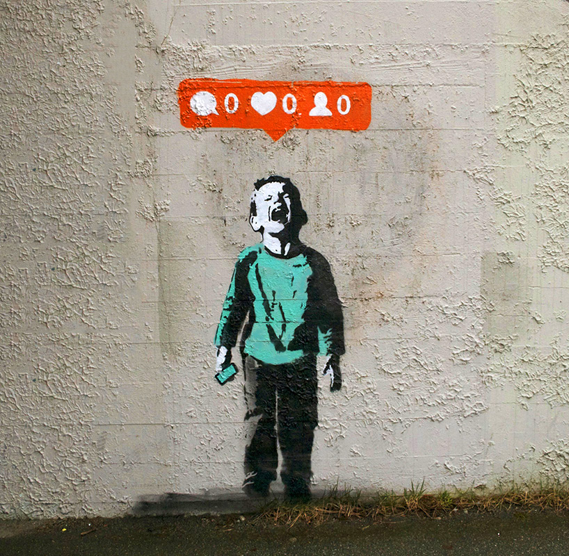
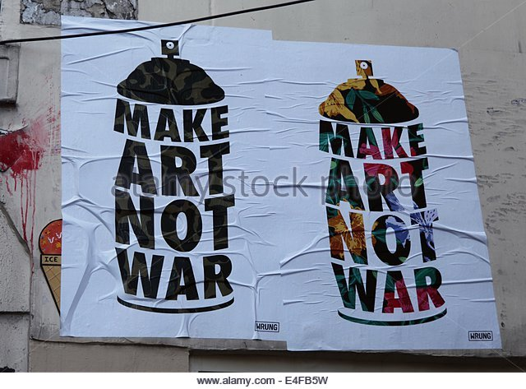
Different ways of doing street art
Collage
Graffiti ?
Stencil

Slide 5
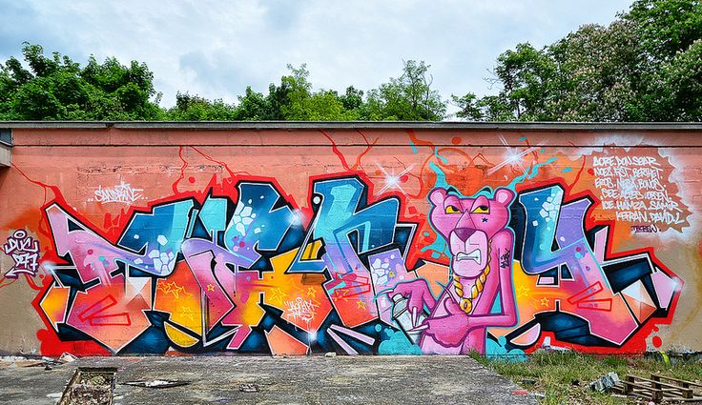
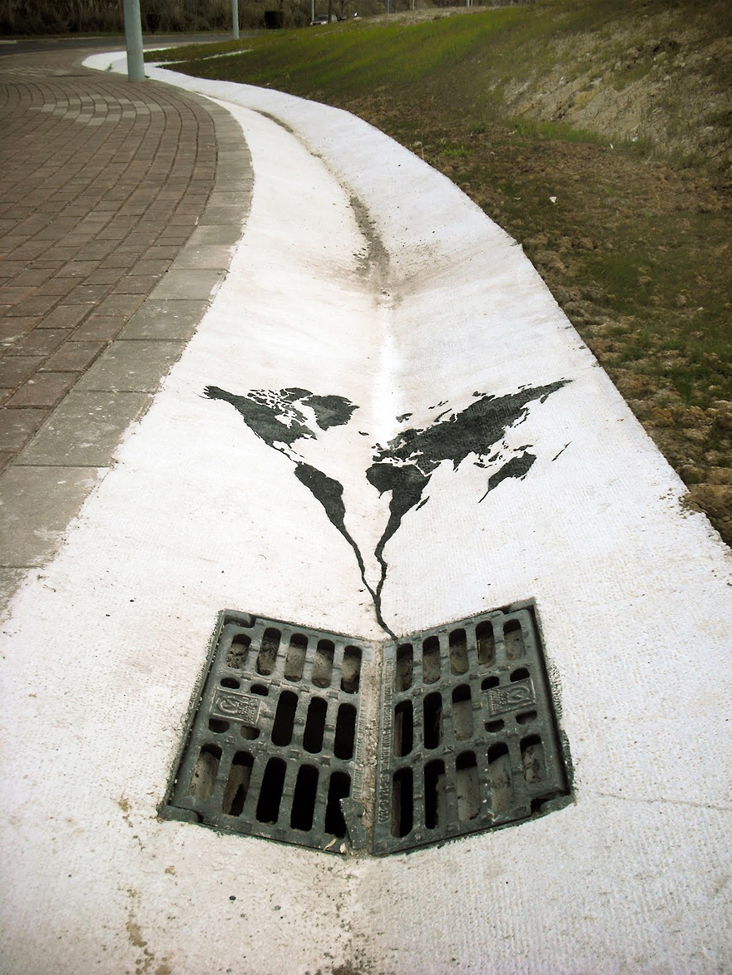
Graffiti vs Street-art
Incorporates environment
Humor and social commentary
May include volume, 3D
Self promotion
Goes over the environment

Slide 6
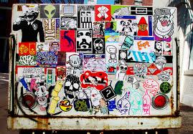
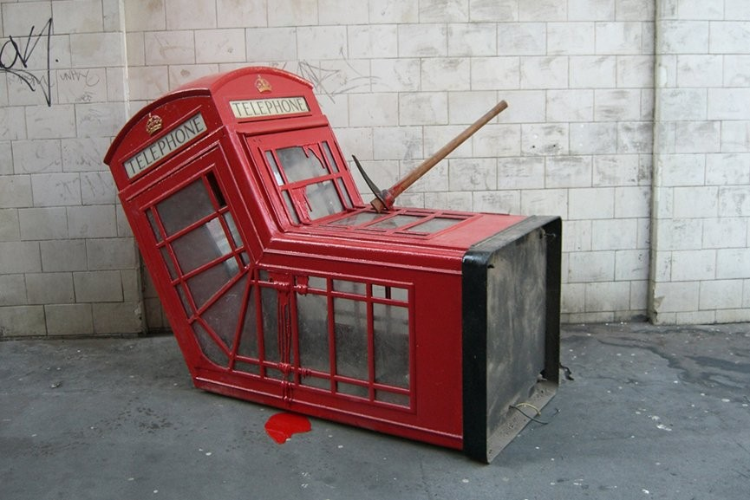
Different ways of doing street art
Stickers
Sculptures

Slide 7
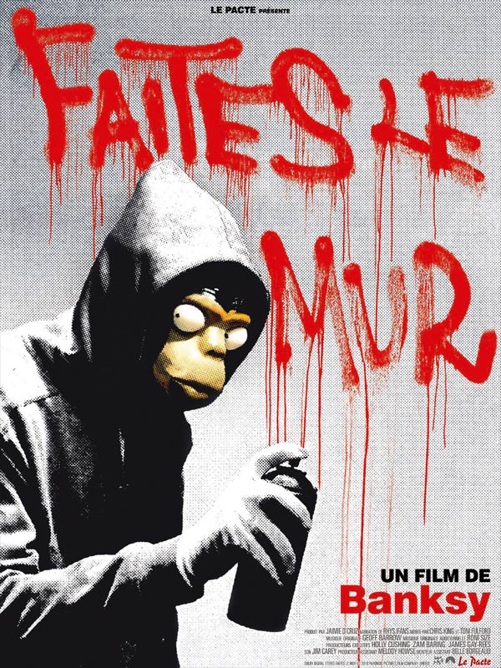
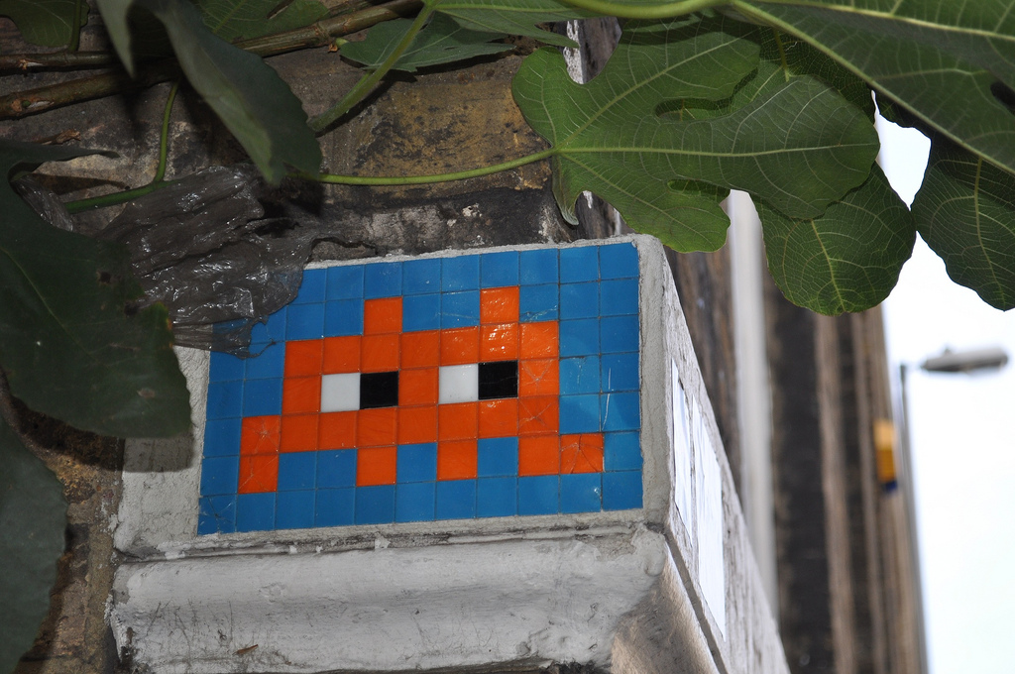
Famous Street-artistes
Banksy
Shepard Fairy
Invader
Mr. Brainwash
Keith Haring

Slide 8
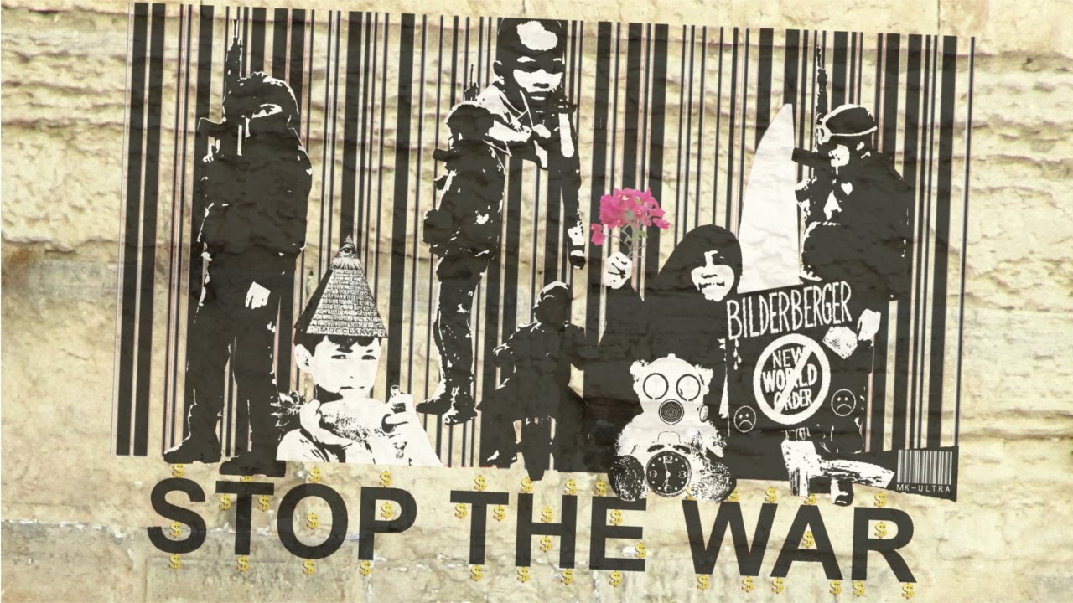
Different political ideas of Street-art
Illegal
A freedom of expression
Gives smiles to passers-by
A form of engaged art

Slide 9
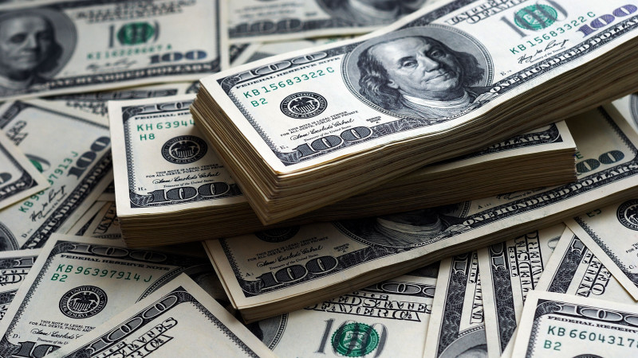
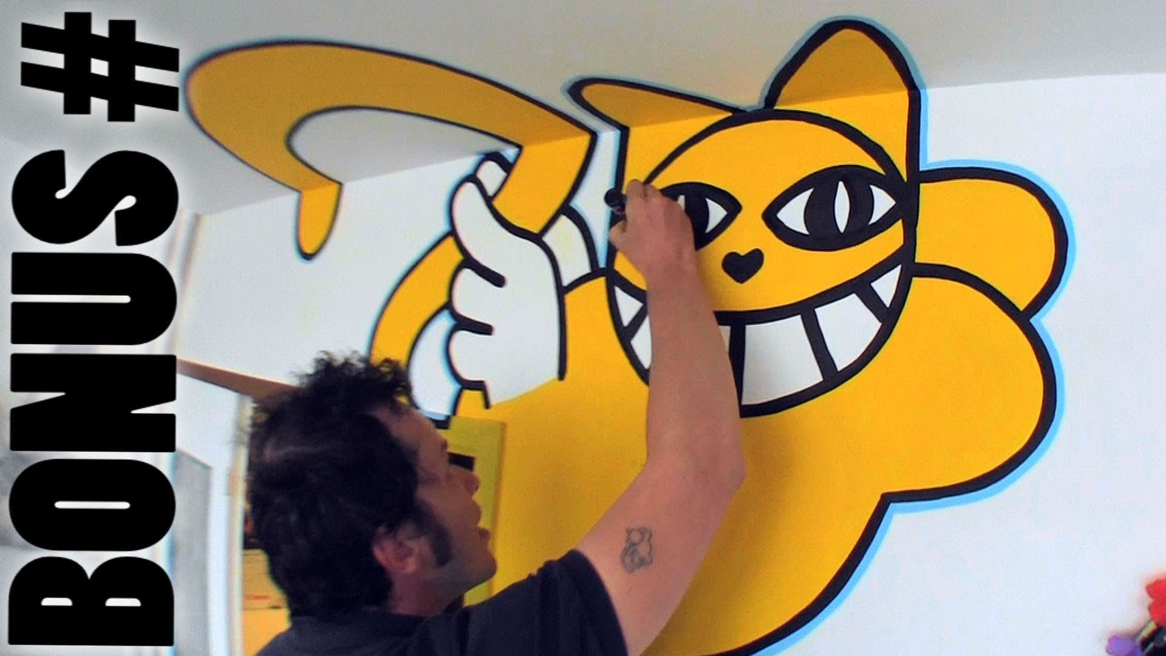
A danger for all Street-artist
Azyle → 180 000 euros
Mr Chat → 300 000 euros

Slide 10
Thanks for listening Any questions ?

