Slide 1
ECTTP: Variables And Operators
Valentijn Muijrers
https://github.com/vmuijrers/ECTTP

Slide 2
Course Overview
Week One: Course overview
Week Two: Variables ←
Week Three: Operators
Week Four: Conditions
Week Five: Loops
Week Six: Functions
Week Seven:
Week Eight: (Files, Exceptions, IO)
First Test!
Week Eleven: Lists
Week Twelve: Classes and Objects
Week Thirteen:
Week Fourteen:
Second Test!

Slide 3

Our Super Powers so far…
Variables! (Int, String, Boolean and Float)
They can have any name!
And you can give them values with the ‘=‘ operator
string_mySuperPowerVariable = “Awesome!”

Slide 4

Constants
Constants are fixed values which are always the same. 10 is always equal to 10.
Numeric constants are all of the numbers.
String constants can also be created if you use single quote marks
print(‘hello world’)
print 122
Constants can be assigned to variables

Slide 5
Variables
Variables can change over time. The order matters!
x = 10
x = 12
print(x) <<< this prints 12! Because variable has taken on a new value (the old one is overwritten)
Make sure to use logical variable names.
If some variable denotes a timer, call it int_myTimer.
If some variable denotes lives left, call it int_lives.

Slide 6
The Good, The Bad and the Variable
Variables must start with a letter or underscore _
Must consist of letters and numbers and underscores
Are case sensitive
Good: spam eggs spam23 _speed
Bad: 23spam #sign var.12
Different: spam Spam SPAM

Slide 7
Reserved Words
Do not use these for variable names! Python already uses these!
And del for is raise
Assert elif from lambda return
Break else global not try
Class except if or while
Continue exec import pass yield
Def finally in print

Slide 8
Quiz time!
What are the variables here?
What are the constants?
What is the reserved word python is using?
int_myVariable = 2
int_myOtherVariable = 3
int_myVariable = int_myVariable + int_myOtherVariable
print( int_myVariable)

Slide 9

Expressions
Whenever you have an assignment and another operator on the right, you have an expression that must be solved before it is assigned to the variable on the left
#this is an expression
x = x + y

Slide 10

Mathematical operators
Math is fun! (or weird)
#The ‘/’ operator is used for division, but….
x = 8 / 3
print (x) << this prints 2
If you divide any whole numbers
Together and get a remainder,
Python gives you a whole number and truncates the decimal.

Slide 11
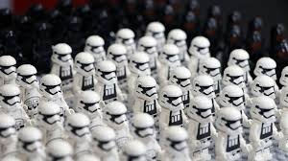
Mathematical operators
#use a float instead!
x = 8.0 / 3
print (x) <<< 2.666666
#Another operator is multiply!
x = 5 * 8
#Another operator is subtract
x = 10 -12

Slide 12
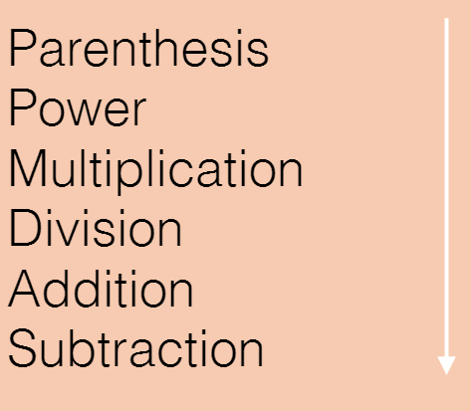
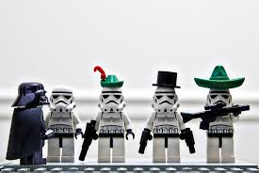
Please Excuse My Dear Aunt Sally
Python Evaluates just like algebra
x = 5 * 7 / 2 - 3
#first eval 5*7 = 35
#second 35 /2 which truncates
#to 17
# third 17-3
print(x) <<< 14

Slide 13
Another Example
#what does x print
X = 5 / 2 * 4 + 3
Print(x) <<< What is x ?
#And now?
X = 5/ 2 * (4+3)
Print(x)
Notes:
X prints 3 > 2*4 = 8..... 5/8 = 0.....0 +3 = 3
X prints 0 > 4+3 = 7......2*7=14..... 5/14 = 0 (because of integer division)

Slide 14
Types matter
Remember the Data types! (String float int Boolean)
Python knows what type a variable is
Python auto types variables but what type the variable is under the hood still matters
#What happens?
x = “cat” + 4
print(x) << TypeError: unsupported operand type(s) for +: ‘int’ and ‘str’

Slide 15
What’s your typo?
How do you know what type a variable is in Python if it auto casts?
Use the type-function!
x = 10
Print( type(x) ) <<< <type ‘int’ >

Slide 16

Type Casting
What if you have a string and need an int?
Use the int() function!
x = “10”
print(type(x) )
<type ‘str’>
x = int ( x )
print (type( x ))
<type ‘ int’ >
If you need a string use str( x ) and float ( x ) for a float!

Slide 17
String overloaded operators
You can add and multiply strings together
x = “hi” * 3
print(x) <<< “hihihi”
x = “hello” + “ world”
print(x) <<< “hello world”

Slide 18
Comments
Use ‘#’ to put notes in your code
They do not affect the code
They help you remind how your code works
#This is a comment!
‘’’
This is a multicomment!
‘’’

Slide 19
Back to Processing!
Let’s organize our code a little bit in Processing!
Use the setup() function to initialize your variables
Use the draw() function to update every frame
Use a tab or indent to create code belonging to their function
def setup():
size(1000,1000)
background(0)
def draw():
ellipse(100,100,100,100)

Slide 20

Global Variable
Use the ‘global’ word before a variable so that it is accessible in every function
def setup():
global x
x = 10
def draw():
global x
x = x + 1
print ( x )

Slide 21
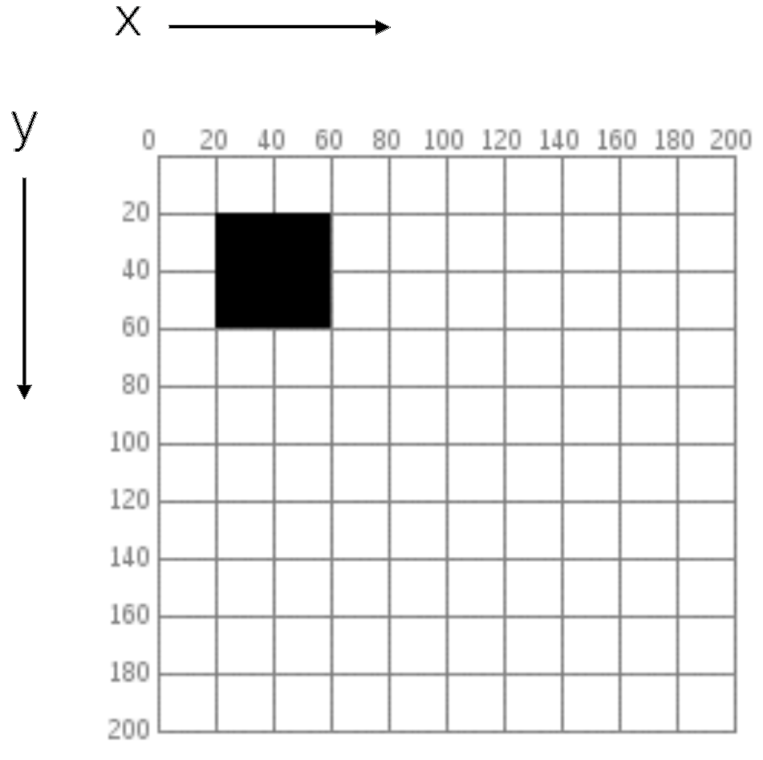
The Origin
Your grid is in the upper left corner and start with 0,0
Use the ‘width’ and ‘height’ variable to access the size of your screen directly

Slide 22
Second lab is online
https://github.com/vmuijrers/ECTTP/blob/master/Labs/Lab_2.md
#For examples/tutorials and references!
py.processing.org
#For more practice with python!
codecademy.com

