Slide 1
ECTTP: Conditions
Valentijn Muijrers
https://github.com/vmuijrers/ECTTP

Slide 2
Course Overview
Week One: Course overview
Week Two: Variables
Week Three: Conditions ←
Week Four: Loops
Week Five: Functions
Week Six:
Week Seven:
Week Eight: (Files, Exceptions, IO)
First Test!
Week Eleven: Lists
Week Twelve: Classes and Objects
Week Thirteen:
Week Fourteen:
Second Test!

Slide 3

Our Super Powers so far…
Variables! (Int, String, Boolean and Float)
They can have any name!
And you can give them values with the ‘=‘ operator
string_mySuperPowerVariable = “Awesome!”

Slide 4
...More Super Powers!
Operators!
Variables can be changed and manipulated with operators! (+, -, *, /)
Always be sure the input values are of the same type!
int_myInteger = 3 + 5 <<< 8
int_myInteger = 3 + “Kipje” <<< Error!
There are exceptions:
string_myString = “Kipje” * 3 <<< “KipjeKipjeKipje”

Slide 5
Boolean Expressions
Boolean types only have two values: True or False
boolean_myBoolean = True #Set the variable to True
If ( boolean_myBoolean == True ):#This is an if-statement
#Do something here
Boolean expressions ask a question and produce a yes or no result we use to control how a program flows

Slide 6
Comparison Operators
Boolean Expressions use comparison operators to evaluate if something is true or false, yes or no
Some examples of comparison operators are:
== (compares two values, True if the values are equal)
> (compares two values, True if the left side is larger)
< (compares two values, True if the left side is smaller)
>= (compares two values, True if the left side is equal or larger)
<= (compares two values, True if the left side is equal or smaller)
!= (compares two values, True if the values are not equal)
Comparison operators look at variables but do not change variables

Slide 7
Conditional Statements
The Comparison operators can be use to check conditional statements
This can be used to change the behavior of the program accordingly
An example is the if-statement:
if ( <Condition> ):
#If the condition is True then this code executes
else:
#If the condition is False then this code executes

Slide 8
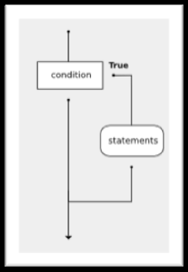
Example
x = 10
if ( x == 10):
x = x + 1
#because x is 10 the operator == resolves to True and the code will be executed
y = “Hello”
If ( y == “hello” ):
y = “CAPS”
# This code does not get executed because “Hello” is not equal to “hello”

Slide 9

Indentation
Indentation matters in Python.
If you have a statement that
ends in a : you can add lines
of code underneath it tabbed
in with one tab and those lines
of code are grouped within the
scope of that condition
When you un-indent you leave
this scope and are back
outside the conditional block

Slide 10
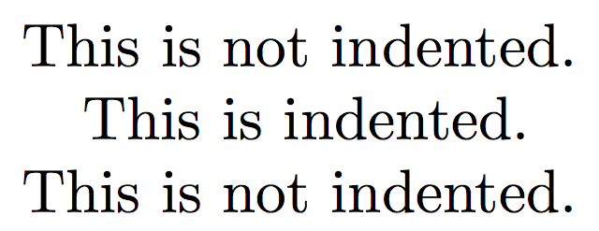
Indentation Example
x = 5
y = 7
if x == 5 or y == 6:
x = 10
y = 10
print (“This is indented!”)
print(“This is not indented”)

Slide 11
Scope
The Scope determines the life-time of a variable in memory
y = 10
if ( y == 10 ):
x = “I am alive!”
#The indent creates a scope, at the end of the scope, the variable x will die
print x
#this will give an error in most languages because the variable is no longer in memory (in processing this will still work, but it is bad practise!)

Slide 12
Logical Operators
It is possible to chain multiple conditions together using Logical Operators
The following are defined:
AND #is True if both the condition on the right is True and the condition on the left is True, otherwise False
OR # is True if either left or right or both are True, otherwise False
NOT #Flips the value to the opposite, so True becomes False, False becomes True

Slide 13
Example AND
#The And operator
x = 6
y = “Kaasje”
if x == 6 and y == “Kaasje”:
print "both conditions are true"
#Both sides of the and-operator are True, so this statement is executed

Slide 14
Example OR
#The Or operator
x = 6
y = “Kaasje!!!”
if x == 6 or y == “Kaasje”:
print "one condition is true“
#One of the sides of the operator is True, so this statement will be executed
#Note that only if BOTH left and right side are False, the OR-operator will resolve to False

Slide 15
Example NOT
x = False
if not x:
y = 5
#The NOT operator flips the value of x, so that the condition becomes True and the if- statement is executed
#sometimes you will see ‘!’ instead of not

Slide 16
Order of Execution
Python will always evaluate the arithmetic operators first (** is highest, then multiplication/division, then addition/subtraction). Next comes the relational operators.
Finally, the logical operators are done last.
Level Category Operators:
8 parentheses (,)
7(high) exponent **
6 multiplication *,/,//,%
5 addition +,-
4 relational ==,!=,<=,>=,>,<
3 logical not
2 logical and
1(low) logical or

Slide 17
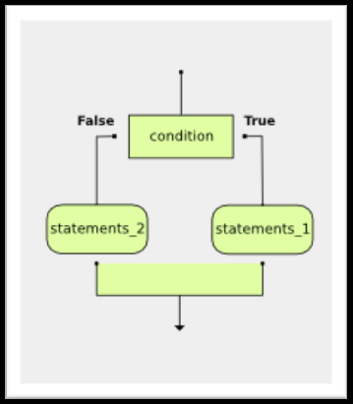
What if...else
If-statements can have second parts!
x = 11
if x == 10:
STATEMENTS_1
else:
STATEMENTS_2
if statement one is true run the
first set of statements, else run
the statements in the second
block

Slide 18

If-ception
You can nest if-statements inside each other:
if x < y:
print("x is less than y")
else:
if x > y:
print("x is greater
than y")
else:
print("x and y must
be equal")

Slide 19
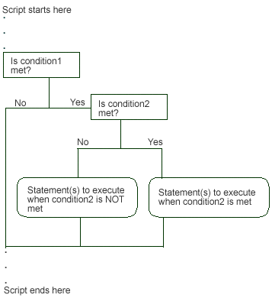
Flow
So with if-statements, you can make choices in your program, it determines the Flow of the program

Slide 20
Chained Conditional
Python provides an alternative way to write nested selection such as the one shown in the previous section. This is sometimes referred to as a chained conditional
if x < y:
print("x is less than y")
elif x > y:
print("x greater than than y")
elif x != y:
print("x is not equal to y")
else:
print("x and y are equal")
#The elif can be used multiple times to create a long chain of conditionals

Slide 21
Codecademy
Codecademy is a great way to learn how to program! It has instructions and small exercises to become a pro coder!
Now let’s practise!
https://www.codecademy.com/learn/python

Slide 22
CodingBat
Now let’s practise some more:
http://codingbat.com/python

Slide 23
Third lab is online
https://github.com/vmuijrers/ECTTP/blob/master/Labs/Lab_3.md
#For examples/tutorials and references!
py.processing.org
#For more practise with python!
codecademy.com

