Slide 1
Lacuna Malaria Detection via YOLO CNN
Tea en Wors:
Lukas Anthonissen: u21434345
Robert Officer: u20431122
Daniël van Zyl: u21446459

Slide 2
Project Description
Brief overview: multiclass object detection and classification model to identify and classify malaria parasites and blood cells.
The training and testing datasets were collected from the ZINDI website
Importance: Aid in quick, accurate malaria diagnosis, especially in resource-limited settings.

Slide 3
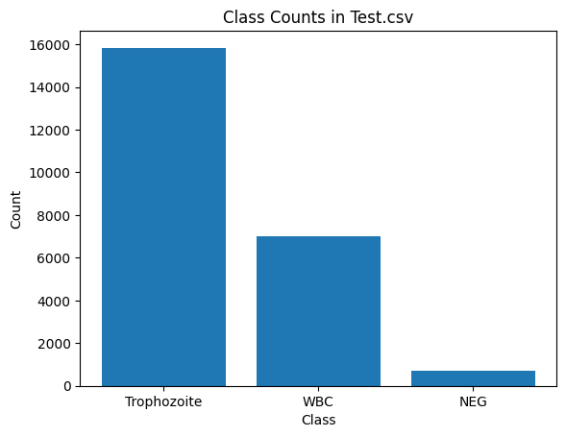
EDA
Performed EDA on training data to determine obvious patterns or skewness of data
Found massive skewness to Trophozoite class
Increase of NEG classes needed
Class counts in Train.csv

Slide 4
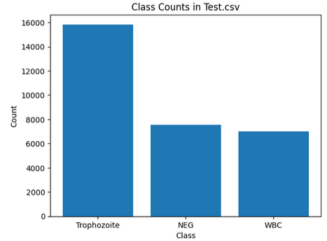
Data pre-processing
Cleaning: address any inconsistencies, potentially remove corrupted images.
Patch removal if height or width is found to be 0
Augmentation of dataset: increase data diversity to avoid overfitting given the small dataset size.
Change to image size - reduced to 1024
Increased number of NEG classes by duplicating pre-existing NEG images
Normalised image coordinates
8:2 split in training and validation data
Technologies:
Scikit Learn (train-test split)
Pillow (image augmentation)
YOLO (fixing image sizes)
Kaggle
GPU accelerator: GPU T4 x2
Class counts in Train.csv

Slide 5
YOLO (You Only Look Once)
Pretrained object detection and image segmentation model (a CNN).
Trained to detect a wide range of objects from cats to bicycles, but of course not blood cells.
Transfer learning was utilised to specialize this model to detect and classify blood cells in a microscopic image of a blood smear to be either infected (Trophozoite) or not infected (White Blood Cell).
We used Ultralytics’s YOLO11m model in Python, running in a Kaggle notebook.

Slide 6
Parameter optimisation
Tested Optimisers:
RMSProp
Adam
SGD
Tested models:
YOLOv8n
YOLOv8m
YOLO11m
YOLO11n
Tested initial learning rates:
[0.2, 0.1, 0.01]

Slide 7
Final model parameters
YOLO model utilised
YOLO11m
Architecture:
Activation function (Layers 1 -> n - 1): ReLu
Activation function (Layer n): Linear activation function
Hyper-parameters
Batch size: 8
Patience: 5
Epochs: 30
Optimiser: SGD

Slide 8
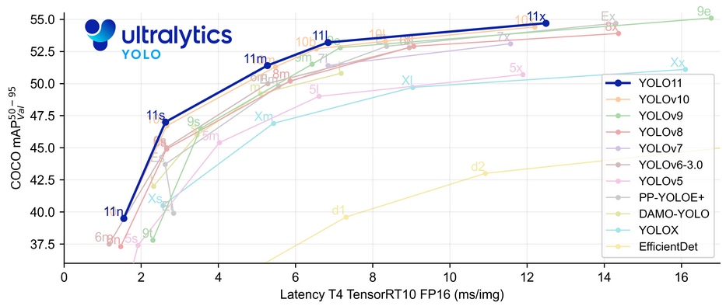
Regularisation & Compression
EDA indicated that Trophozoite is the majority class by far. To combat overfitting we performed:
Image augmentation
Coordinate Normalisation
Image duplication
This added more NEG images.
Used a medium size model: YOLO11m
Perfect balance of accuracy and speed
Utilised Cosine learning rate scheduler
Adjusts learning rate using curve of cosine function
Improves convergence

Slide 9
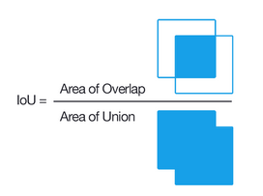
Evaluation
Cell detection metrics:
Mean Average Precision @ Intersection over Union(IoU) threshold: 0.5
Optimizer:
Standard Gradient Descent
Cell classification metrics:
Precision
Recall
F1-Score

Slide 10
Live Demo

Slide 11
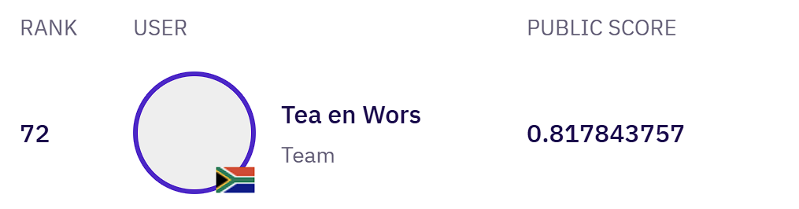
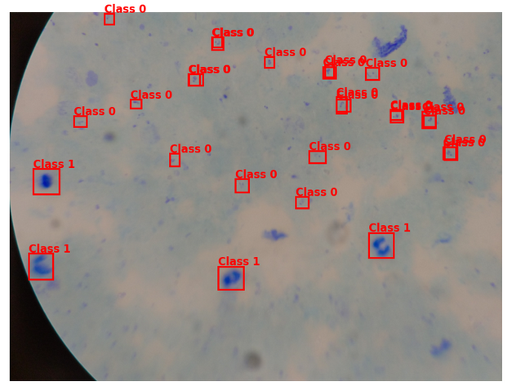
Results
Training sets results:
Precision: 0.8
Recall: 0.8382
mAP50: 0.8607
Training time: 4.123 hours
Final YOLO model structure: 303 layers
Final model storage size: 38.6MB
Best Zindi score: 0.8178

Slide 12
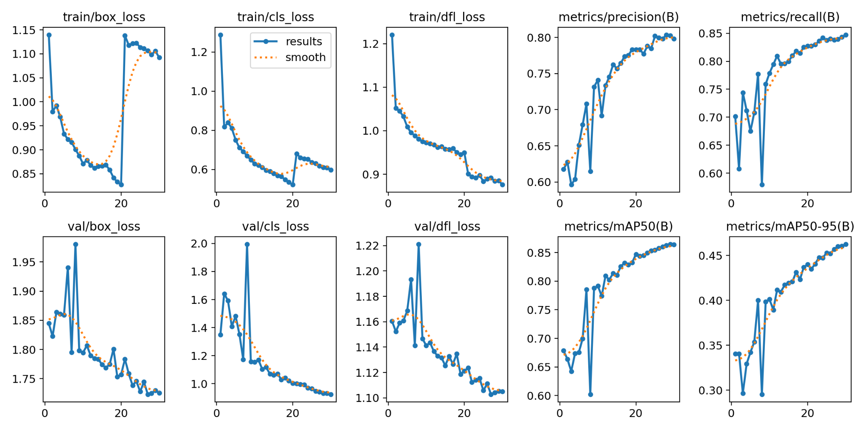
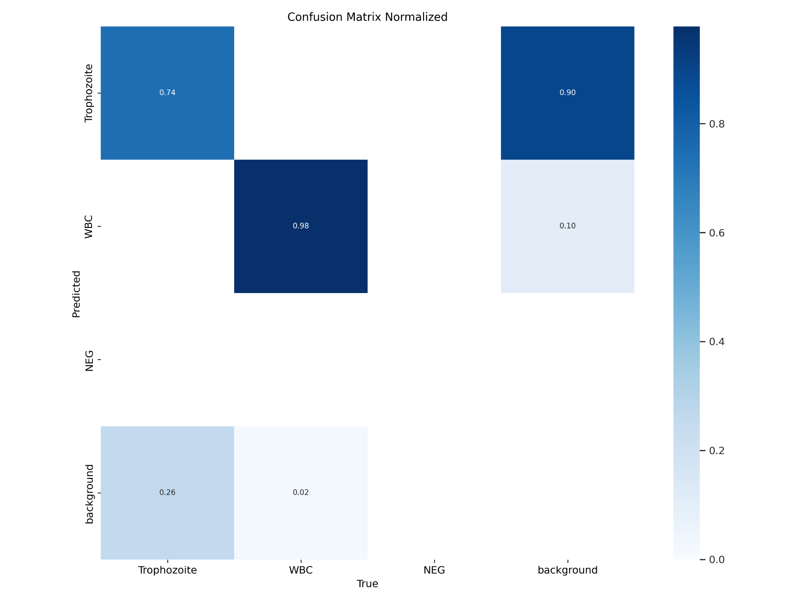
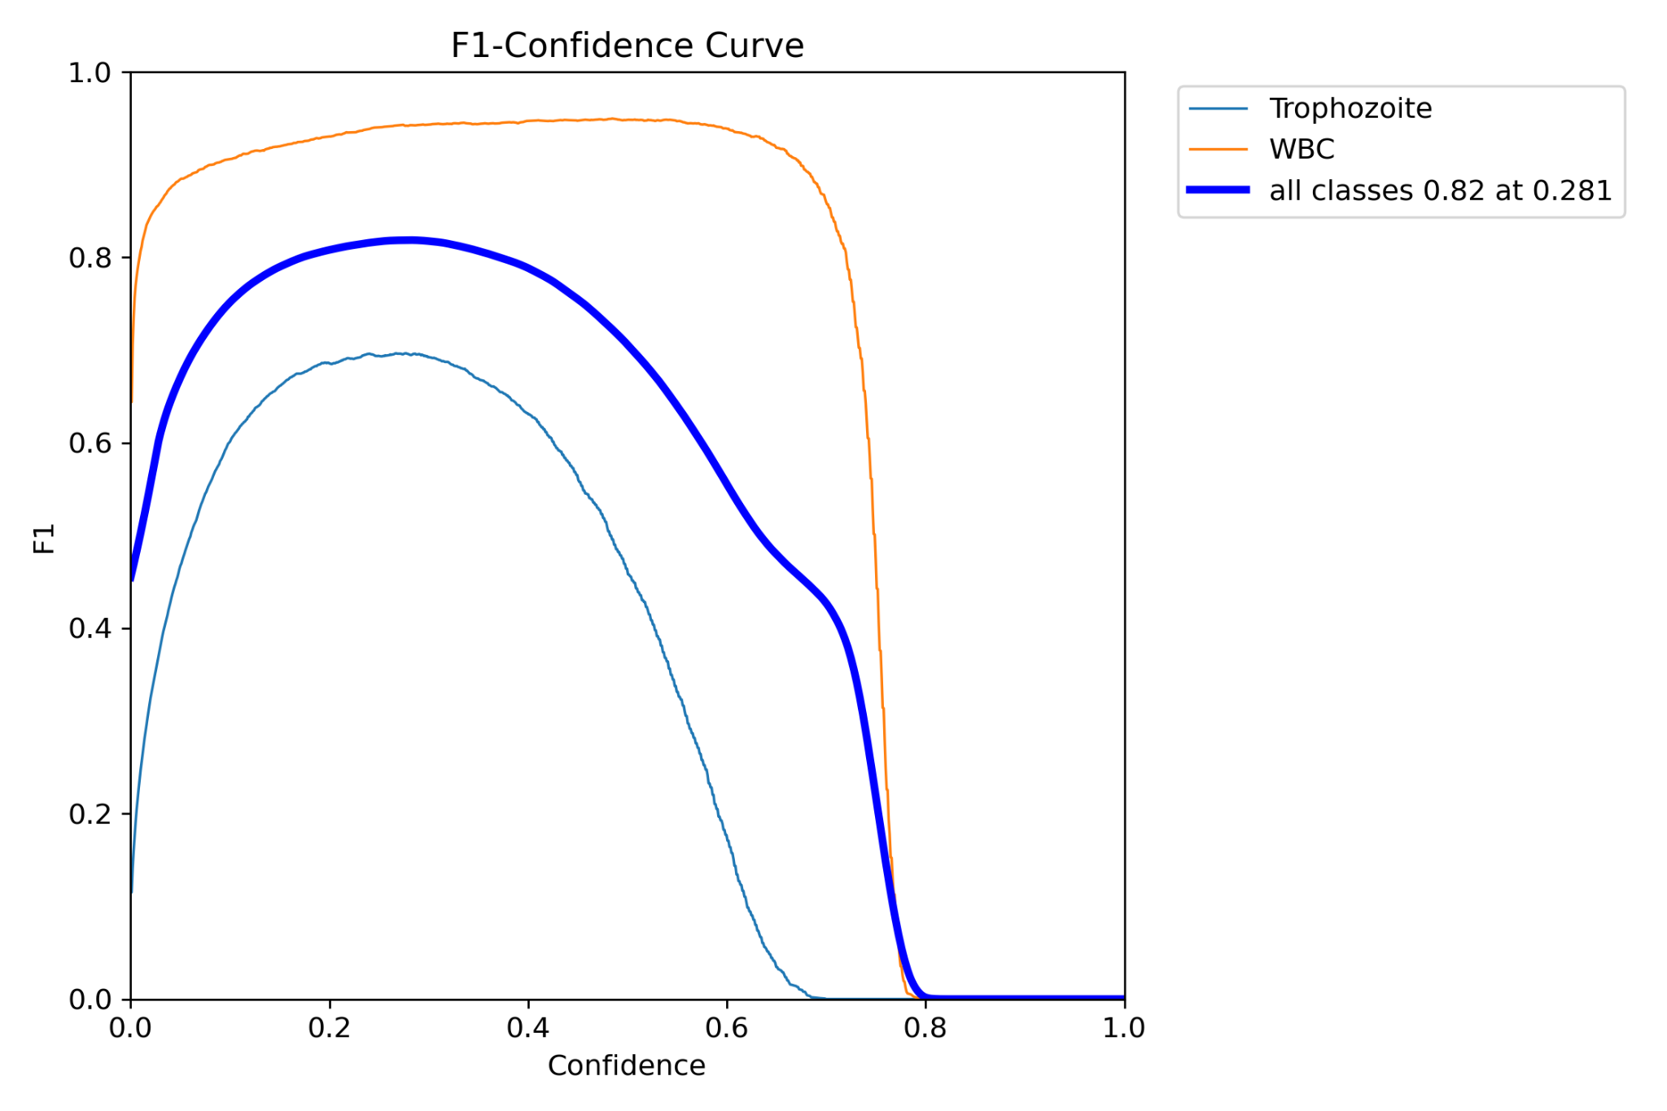
Training

Slide 13
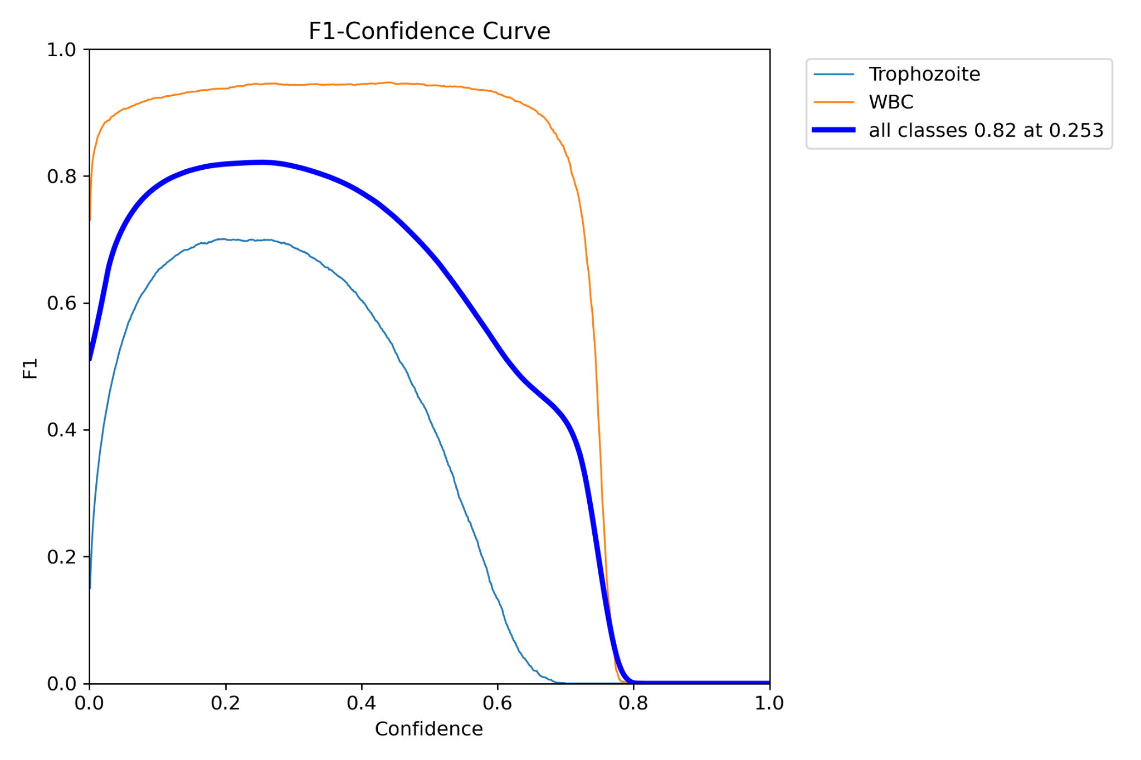
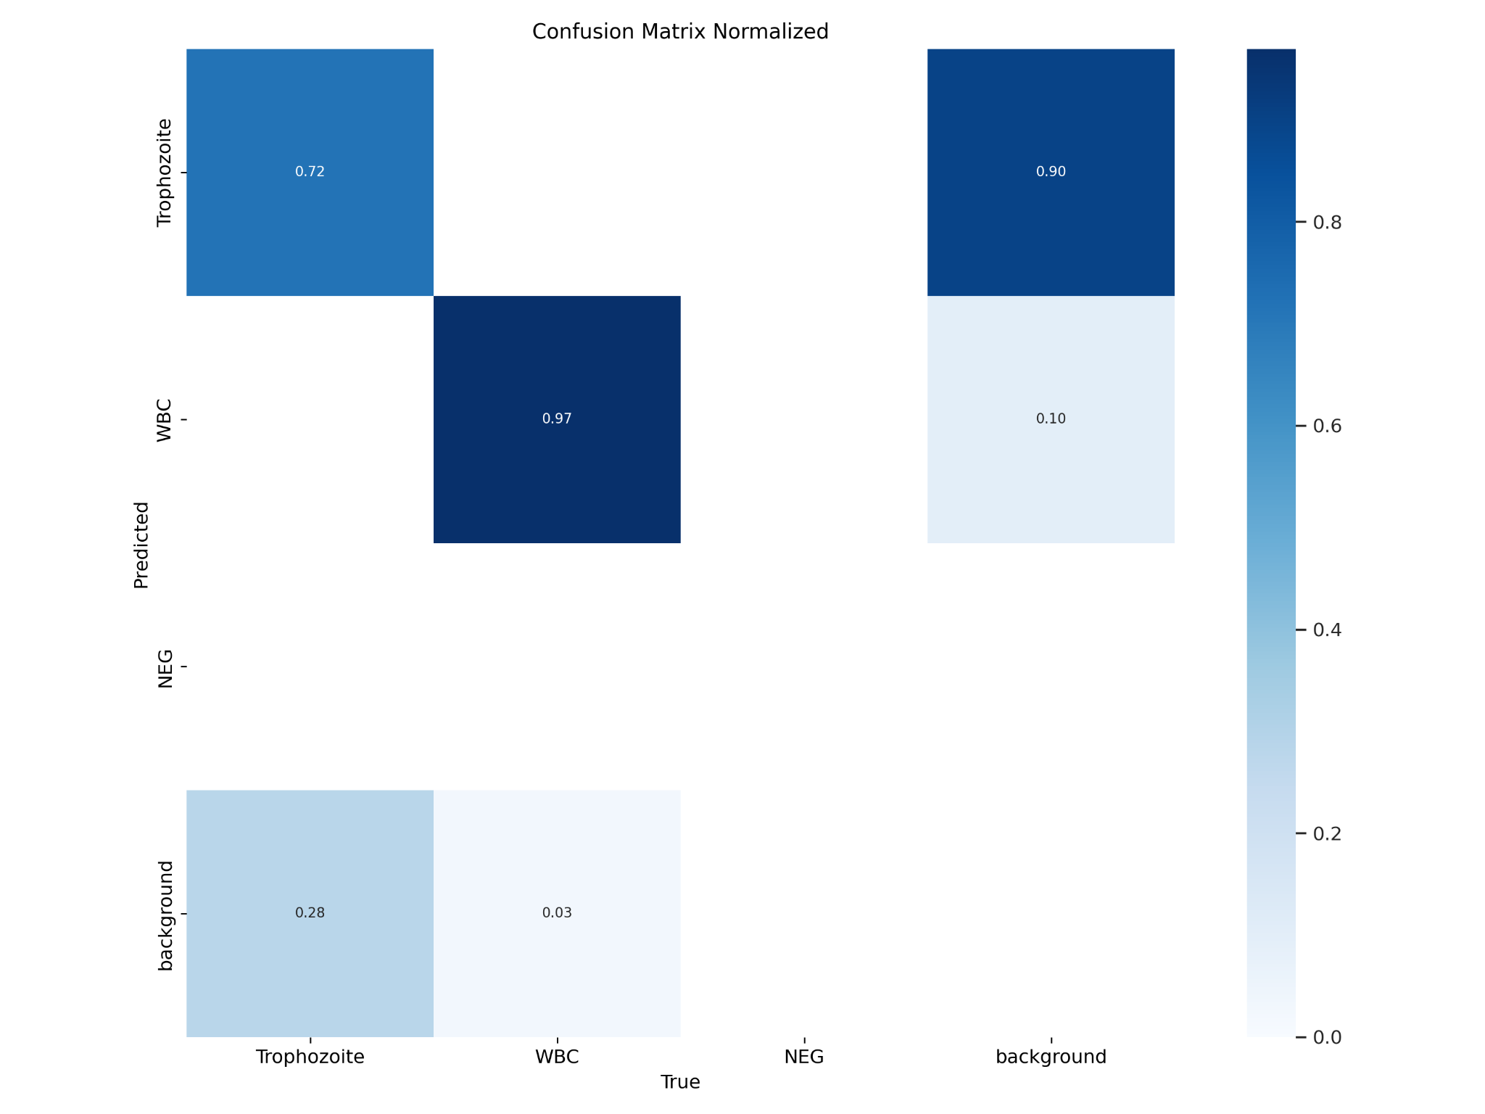
Testing metrics

Slide 14
Experiments
CNN for classifying blood cells
Extract the bounding boxes of a cell
Feed into the CNN
Return a binary class
Replace incorrect class
Val Accuracy = 0.98
Val Loss = 0.0873
Adding this step to the pipeline did result in a lower score than before. We are unsure what exactly causes this change, but assume it has to do with the inaccurate prediction of the bounding box, leading to split cells etc which can lower the accuracy of the model.

Slide 15
Conclusion
What was difficult?
Hardware limitations
Runtime of the models (made it difficult to debug and improve the model within the timeframe)
Limited GPU time given by Kaggle
What did we learn?
The inner workings of CNNs for object detection
The power of CNNs to solve image processing problems
Intecresies of building a pipeline to solve a complex task

