Slide 1

React
A Guide to Typescript integration:
How to start cleaning up and typing your JavaScript
This Photo by Unknown Author is licensed under CC BY-SA

Slide 2

Getting Started with the Create React App
Run inside the location you would like to create a project
yarn create react-app my-app --typescript
yarn add typescript @types/node @types/react @types/react-dom @types/jest
yarn
yarn add antd
Run inside your new my-app folder
This Photo by Unknown Author is licensed under CC BY-SA

Slide 3
Interfaces
An interface is a programing tool that tells us how to interact with a module or component.
Increases productivity when it coordinates with the IDE
Increases clarity of code
Makes you go through the steps of architecting a solution rather than ad-hoc throwing things into props.

Slide 4



TypeScript Component
Define props interface
1
Define state Interface
2
Pass interfaces int Component
3

Slide 5

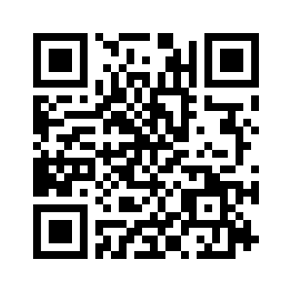
Find the code and presentation at:
https://github.com/Rob-Page/typescript_basic

