Slide 1

Green Pace
Security Policy Presentation
Developer: Robert Bogart

Slide 2

OVERVIEW: DEFENSE IN DEPTH
To kick off the security policy, let's break down why it's a big deal. Cyber threats are getting sneakier and more dangerous, so just having a security policy isn't a nice-to-have anymore—it's a must. This policy is our shield, defending our data, systems, and network from nasty cyber attacks like ransomware, phishing, and other tricks hackers use. It spells out the rules and steps everyone at Green Pace needs to follow to keep our defenses tight and strong.

Slide 3
THREATS MATRIX
Likely Data Type – When data types are improperly handled, it can lead to undefined behavior, making our system vulnerable. Properly declaring variables helps avoid this. | Priority SQL Injection – SQL injection is a critical threat where attackers can manipulate queries to gain unauthorized access. We need to ensure user inputs and queries are handled correctly to prevent this.
Low priority Data Value – Incorrect data values can cause unexpected behaviors, particularly in calculations. It’s not the biggest threat but still something to keep an eye on. | Unlikely Code Documentation – Poor documentation might not seem like a big deal, but clear and concise documentation is essential for maintainability and readability of the code. While the risk is low, it's still important to address.
We’ll use automation to regularly scan our codebase for these vulnerabilities, catching issues before they become bigger problems. Automated tools will help us maintain consistency across our code and prevent human error from introducing security gaps.

Slide 4
10 PRINCIPLES
Validate Input Data – Data Type, Data Value, String Correctness, SQL Injection
Heed Compiler Warnings – Proper Error Handling and Recovery, Memory Protection, Assertions, Exceptions.
Architect and Design for Security Policies – Resource Management, Memory Protection, Proper Error Handling and Recovery
Keep It Simple – Code Documentation, Resource Management, Memory Protection.
Default Deny – Proper Error Handling and Recovery, Resource Management, Memory Protection
Adhere to the Principles of Least Privilege – Resource Management, Proper Error Handling and Recovery, Memory Protection
Sanitize Data Sent to Other Systems – Data Type, Data Value, SQL Injection, String Correctness.
Practice Defense in Depth – Memory Protection, Proper Error Handling and Recovery, Resource Management
Use Effective Quality Assurance Techniques – Assertions, Exceptions, Code Documentation, Proper Error Handling and Recovery
Adopt a Secure Coding Standard – Code Documentation, Resource Management, Proper Error Handling and Recovery

Slide 5
CODING STANDARDS
Memory Protection
Proper Error Handling
SQL Injection
Data Type
Resource Management
String Correctness
Data Value
Assertions
Exceptions
Assertions
The system of prioritization is based on the potential impact of each coding standard on the overall security and stability of our code. We start with Memory Protection and Error Handling because they're directly tied to preventing serious vulnerabilities like crashes and unauthorized access. SQL Injection is prioritized next because of its high risk in compromising data. From there, we focus on standards like Data Type and Resource Management, which prevent errors and inefficiencies that could lead to bigger problems. Finally, String Correctness, Data Value, Assertions, Exceptions, and Code Documentation are ranked lower but are still essential for ensuring that our code is both secure and maintainable in the long run.

Slide 6
ENCRYPTION POLICIES
When it comes to encryption, we've got it covered on all fronts to make sure data stays locked down.
Encryption at Rest is about protecting the data that's stored on disks or any storage media. Even if someone gets their hands on the physical hardware, they won't be able to read the data without the encryption keys. It's like having a lock on your storage room; without the key, whatever's inside stays hidden.
Encryption in Flight is all about securing data while it's moving across the network. Whether it's emails, file transfers, or API calls, this encryption makes sure that if anyone tries to snoop or intercept the data, all they'll see is gibberish. This is crucial because, during transmission, data is more exposed and easier to hijack.
Then there's Encryption in Use, which is the next level. It's about encrypting data even while it's being processed in memory. This means that even if someone tries to access the data while it's actively being used, they won't be able to read it. It's like having an extra layer of security while you're working on sensitive information, keeping it protected even in the most vulnerable state.
Each of these encryption policies makes sure that no matter where your data is—whether it’s stored, moving, or being used—it's safe from prying eyes.

Slide 7
TRIPLE-A POLICIES
When it comes to keeping our systems secure, we've got a few key policies in place. Authentication makes sure that anyone trying to access our resources is who they say they are, by verifying their identity. Authorization kicks in next, ensuring that once someone is authenticated, they only have access to the stuff they're supposed to. Finally, Accounting keeps track of everything that happens, recording activities so we can review them later to spot any funny business or potential security issues. Together, these policies make sure that access is secure and that we can hold people accountable for their actions.

Slide 8
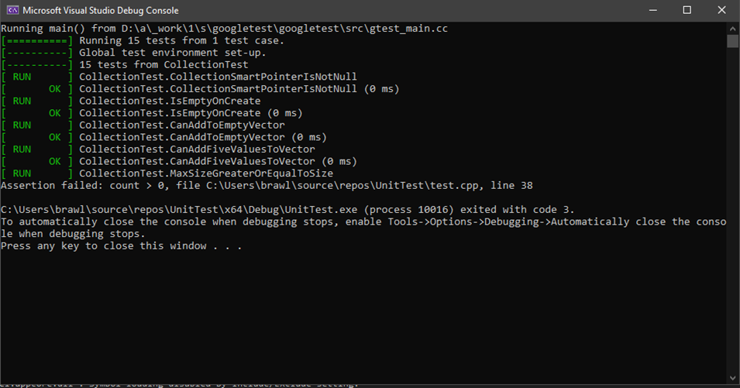
Unit Testing
During the module where we did unit testing, most tests ran correctly.
One test checked if a collection started off empty, and it passed with flying colors.
Another test made sure we could add something to an empty vector, and that one worked just fine too.

Slide 9


Slide 10
TOOLS
Automation will be used for the enforcement of and compliance to the standards defined in this policy. Green Pace already has a well-established DevOps process and infrastructure. Define guidance on where and how to modify the existing DevOps process to automate enforcement of the standards in this policy. Use the DevSecOps diagram and provide an explanation using that diagram as context To integrate automation for enforcing and ensuring compliance with our coding standards, we can embed security checks throughout our DevSecOps pipeline. In the Assess and Plan phase, automated tools can monitor threats and regulatory changes, prioritizing updates. During Design, static analysis tools can enforce best practices in real-time. In the Build phase, CI/CD pipelines can include security checks, catching vulnerabilities early. For Verify and Test, automated security and compliance testing ensures secure behavior. Transition and Health Check use automated scripts for consistent security settings and routine penetration tests. In Production, monitoring tools provide real-time alerts for anomalies. Automated response systems quickly mitigate issues by blocking attacks or rolling back services. Finally, Maintain and Stabilize with regular automated assessments ensures ongoing compliance and stability. This approach integrates security seamlessly into our existing DevOps process, enhancing our security posture.

Slide 11
RISKS AND BENEFITS
We’ve got a few problems on our hands. First, our coding standards are solid, but if we don’t act now to integrate them into our process, we risk leaving the door open to security vulnerabilities like SQL injections or memory leaks. Our encryption policies are great, but without enforcing them consistently across all levels, there’s a chance data could be exposed, especially when it’s most vulnerable during processing. The strategy we’ve laid out is solid but lacks in making sure that everyone is on the same page and that the tools we’re using are properly configured to catch all issues early. If we wait to act, these gaps could lead to significant risks, like data breaches or service downtime.
The big benefit of acting now is that we’ll be ahead of the game, catching issues before they become major problems. This means fewer headaches down the road and a stronger security posture overall. The downside? Rushing into this could mean missing some critical steps, like properly training the team or ensuring our tools are fully integrated and tested. To make this strategy foolproof, we should take immediate steps to automate security checks, make sure everyone understands the standards, and regularly review our processes to catch any weak spots. The biggest risk is becoming complacent and thinking the strategy is set in stone—constant vigilance is key to staying secure.

Slide 12
RECOMMENDATIONS
One big gap in our current policies is the lack of detail on how to actually integrate automation into our existing processes. We talk about using tools to enforce standards, but we don’t get specific about which tools or how exactly they fit into our workflow. This leaves a lot of room for things to fall through the cracks, especially if people aren’t sure what to use or how to set it up. Another gap is in how we handle the ongoing training and awareness for the team. We’ve got solid policies, but if everyone isn’t on the same page or doesn’t understand the “why” behind them, we’re risking mistakes or even non-compliance. Moving forward, we need to tighten up by specifying the tools we’ll use for automation and making sure everyone is trained and aware of the policies. We should also keep an eye on how these tools and practices evolve so we can adapt quickly if something changes or if a new threat emerges.
Real World Example: Equifax, a major credit reporting agency, experienced one of the largest data breaches in history because they failed to adopt some of the key standards we’ve been talking about. They didn’t promptly apply a security patch to a known vulnerability in their software, leaving them exposed for months. Hackers exploited this gap and accessed sensitive personal information of about 147 million people. If Equifax had a standard practice for routine updates and patch management, this vulnerability could have been patched quickly, preventing the breach. Additionally, if they had continuous security testing and secure code review in place, they might have caught the issue before it became a problem. Also, stronger access control policies could have minimized the damage by restricting how much data the hackers could access even if they got in. This real-world example shows just how crucial it is to adopt these standards to avoid catastrophic security failures.

Slide 13
CONCLUSIONS
To keep things running smoothly and avoid future issues, we should adopt a few key standards. First, continuous security testing should be a must—automated tools should regularly scan our code for vulnerabilities, not just during development but even after deployment. We should also standardize secure code review practices so that every piece of code gets a second set of eyes before it goes live, making it less likely that bugs or security holes slip through. Another important standard is routine updates and patch management; setting up a system to automatically check for and apply security patches will keep us protected against new threats. Lastly, access control policies need to be standardized, ensuring that everyone only has access to what they really need, which minimizes the risk of insider threats or accidental data exposure. These standards will help us stay ahead of potential problems and keep our system secure in the long run.

Slide 14
REFERENCES
Josh Fruhlinger Feb 12, 2020 “Equifax data breach FAQ: What happened, who was affected, what was the impact?” https://www.csoonline.com/article/567833/equifax-data-breach-faq-what-happened-who-was-affected-what-was-the-impact.html

