Slide 1
Restaurant Investment
Analysis by Robert Hosack

Slide 2
Which neighborhood is best for an Investor?
Deciding where to setup a restaurant is a large financial commitment and can be very risky if not executed properly
This analysis will help discover where a greater probability of success can be achieved

Slide 3

The Data
Scraped from Wikipedia
https://en.wikipedia.org/wiki/List_of_postal_codes_of_Canada:_M
Venue information will be acquired utilizing Foursquare API

Slide 4
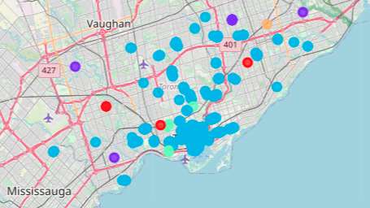
K-Means Cluster
Restaurant Venues within Toronto utilizing the K-Means cluster analysis

Slide 5
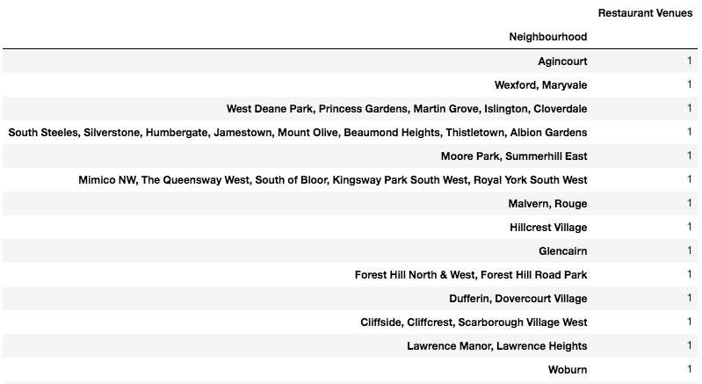
Restaurant Venues per Neighborhood
Example of the isolated restaurants

Slide 6

Restaurant Venues per Neighborhood cont’d
These neighborhoods have the most competition

Slide 7
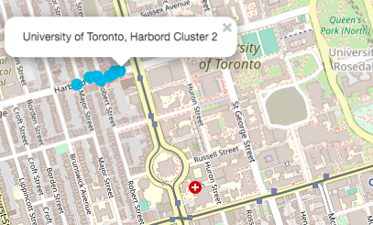
Neighborhood Recommendations
1: University of Toronto
Close proximity to the college
Higher priced menu items may exclude a large portion of the customers in the area.

Slide 8
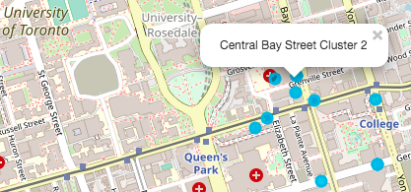
Neighborhood Recommendations
2: Central Bay Street
Walking distance to Queens Park (South) and a local hospital
A short drive to the University of Toronto

Slide 9
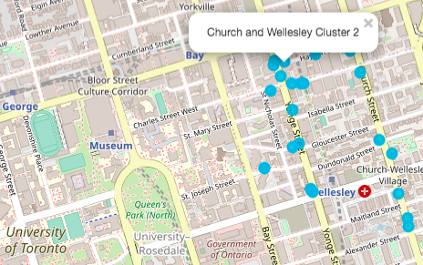
Neighborhood Recommendations
3: Church and Wellesley
Walking distance to Queens Park (North)
More competition- however the type of restaurant would be especially important for this location

Slide 10
Conclusion
These sections of Toronto still show an opportunity to capitalize on the restaurant market share.
University of Toronto
Central Bay Street
Church and Wellesley
While this analysis was not intended to select which type of restaurant to open/invest in, we do suggest additional analyses if the investor has not decided this factor yet.

