Slide 1

Center for Innovation in Jewish Education
DFRobot DFR1154
AI Camera
Quick Start & Assembly Guide
Firmware v3.1.4 | Arduino IDE 2.x | OpenAI Integration
Includes: Hardware Setup • Arduino IDE Config • Code Upload • Web Interface Guide • Process Flow

Slide 2
What You Need — Parts & Prerequisites
REQUIRED
OPTIONAL (Recommended)
DFR1154
AI Camera Module (ESP32-S3 + OV3660 + Mic + Speaker)
○ AI Camera Tripod / Mount Kit
○ Arduino UNO (for Serial Automation)
Arduino IDE 2.x
Download from arduino.cc/en/software
○ Mini Breadboard + jumper wires
○ MicroSD Card (up to 16GB) — for file storage
USB-A to USB-C cable
For power and code upload to the board
○ Small speaker with MX1.25-2P connector
OpenAI Account
API key required — platform.openai.com
Code Library Required
WiFi Network
2.4GHz network with SSID and password
ArduinoJson by Benoit Blanchon Version 7.42 or newer required Install via: Arduino IDE > Tools > Manage Libraries
Computer
Windows, macOS, or Linux with USB port
CIJE | DFR1154 AI Camera Quick Start Guide
2 / 12

Slide 3
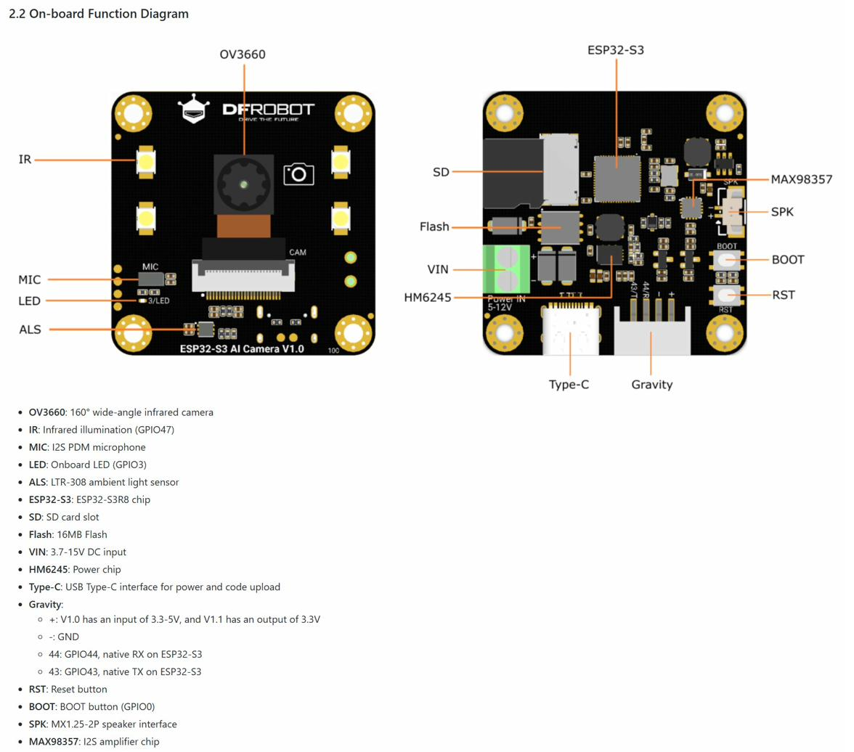
Hardware Overview — DFR1154 Board Features
OV3660 Camera
160° wide-angle, infrared capable
PDM Microphone
GPIO 38/39, I2S interface
MAX98357A Speaker
I2S amplifier, GPIO 45/46/42
IR Illumination
GPIO 47, for low-light imaging
ALS Sensor
LTR-308 ambient light (GPIO 8/9)
SD Card Slot
Up to 16GB, SPI interface
Type-C USB
Power input + code upload port
Gravity Connector
GPIO 43(TX)/44(RX) for Arduino
CIJE | DFR1154 AI Camera Quick Start Guide
3 / 12

Slide 4
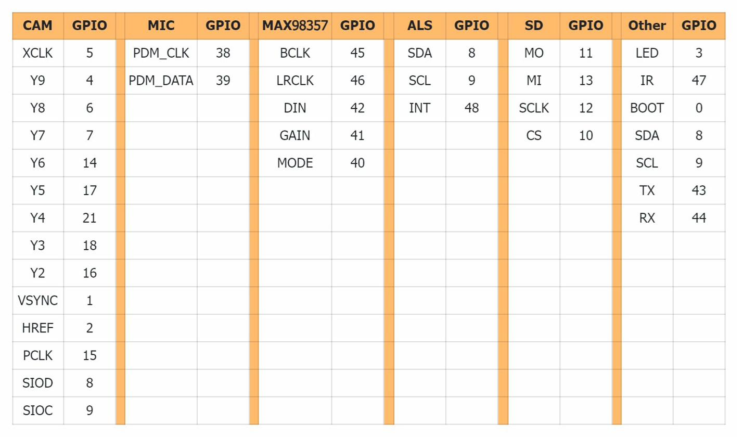
GPIO Pin Reference Table
Tip: Camera (SIOD=8, SIOC=9) shares I2C with ALS sensor. PDM mic (GPIO 38/39) shares I2S_NUM_0 with camera DMA — real-time audio+video simultaneously is not supported.
CIJE | DFR1154 AI Camera Quick Start Guide
4 / 12

Slide 5
Step 1 — Arduino IDE Setup
Configure Arduino IDE 2.x before uploading firmware to the DFR1154:
A. Board Manager Setup
B. Board Configuration (Tools Menu)
1
Open Arduino IDE > File > Preferences
Board: ESP32S3 Dev Module
USB CDC On Boot: Enabled
2
Add Board URL:
arduino.esp8266.com/stable/package_esp8266com_index.json
(also add Espressif ESP32 URL)
Flash Size: 16MB (128Mb)
Partition Scheme: 16M Flash (3MB APP/9.9MB FATFS)
3
Tools > Board Manager > Search "ESP32" > Install esp32 by Espressif Systems
PSRAM: OPI PSRAM
Timeout fix (if install fails):
Edit: ~/.arduinoIDE/arduino-cli.yaml
Add: network:
connection_timeout: 600s
C. Install Required Library
Tools > Manage Libraries > Search:
"ArduinoJson" by Benoit Blanchon
Install version 7.42 or newer
CIJE | DFR1154 AI Camera Quick Start Guide
5 / 12

Slide 6
Step 2 — Code Configuration
Open the firmware .ino file in Arduino IDE and configure these settings before uploading:
v3.x First-Run Setup Wizard (Recommended — No Code Editing Required)
1. Upload firmware as-is → 2. Power on — camera broadcasts WiFi: "AI-Camera-Setup" → 3. Connect phone/laptop to that network → 4. Browser opens config portal → Enter your WiFi & OpenAI API key
Alternative: Hardcode Credentials in .ino File
const char* ssid = "YourWiFiSSID"; // ~line 46 const char* password = "YourWiFiPassword"; // ~line 47 const char* OPENAI_API_KEY = "sk-proj-xxxxxxxxxxxxxxxxxxxx"; // Your OpenAI key // Save file > Verify (checkmark) > Upload (arrow) to DFR1154
CIJE | DFR1154 AI Camera Quick Start Guide
6 / 12

Slide 7
Step 3 — Upload Firmware & First Boot
Upload to DFR1154
Serial Monitor Output
====================================
ESP32-S3 OpenAI Interface v3.1.4
====================================
SD Card OK
Camera OK
PDM Microphone OK
Speaker OK
Connecting to WiFi...
WiFi connected
IP: 192.168.0.181
====================================
API Key status: Configured
Initialized counters: Images:0 Audio:0
1
Connect DFR1154 to computer via USB-A to USB-C cable
2
In Arduino IDE: Tools > Port > Select the COM port for your camera
3
Click the Upload button (right arrow) in Arduino IDE
4
Wait for compilation and upload to complete (~2-3 minutes)
Open the Web Interface
5
Open Tools > Serial Monitor, set baud to 115200
1. Note the IP address from Serial Monitor 2. Open a browser on the SAME WiFi network 3. Type the IP in the address bar: http://192.168.0.XXX
6
Watch for the IP address to appear in the serial output
CIJE | DFR1154 AI Camera Quick Start Guide
7 / 12

Slide 8
Web Interface — Layout & Controls Overview
LEFT PANEL — Camera & Controls
RIGHT PANEL — Audio & Files
Pairing Workflow Banner Yellow bar shows current step in the image/audio/analysis workflow
Audio Playback Bar HTML5 player — plays back recorded WAV audio files with controls
Stop Stream / Start Stream Green button — toggles live camera video feed on/off
Record Button Red — starts/stops PDM mic recording (saves as REC_N.wav on SD)
Capture Button Purple — takes a still photo and saves to SD card
Speaker Button Controls MAX98357A speaker for TTS playback
Review Button Shows/previews the most recently captured image
Image for Export Selected image to pair with audio prompt for OpenAI analysis
LIVE Indicator Green dot — shows camera stream is active and broadcasting
Audio for Export Selected audio file to send as Whisper transcription prompt
Camera Preview Area Live MJPEG stream from the OV3660 wide-angle camera
Image/Audio Files (Resources) Lists all files on SD card; Save to PC or Add to Export
CIJE | DFR1154 AI Camera Quick Start Guide
8 / 12

Slide 9
Web Interface — Analysis Controls & Results
Send to OpenAI
Replay TTS
Export Package
Sends the export image(s) + audio prompt to GPT-4 Vision and Whisper. Results appear in the analysis text box and are spoken via TTS speaker.
Re-plays the most recent text-to-speech audio response through the MAX98357A speaker without re-calling the OpenAI API.
Downloads a ZIP file to your PC containing the image(s), audio prompt, and OpenAI response text from the analysis session.
OpenAI Analysis Results Box
The large text area below the video panel displays the GPT-4 Vision response after analysis. Results are automatically spoken through the speaker using OpenAI TTS. The response is also saved to the SD card in /analysis/[timestamp]/ folder for archiving.
Example prompt result: "I can see a circuit board with an ESP32-S3 microcontroller. The OV3660 camera module is visible in the upper left..."
CIJE | DFR1154 AI Camera Quick Start Guide
9 / 12

Slide 10
Usage Process Flow — Step by Step
Standard workflow for capturing, analyzing, and archiving with the DFR1154 AI Camera:
1
2
3
4
5
Start
Stream
Capture
Image
Record
Audio Prompt
Add to
Export
Send to
OpenAI
Click 'Start Stream' — camera begins live MJPEG feed
▶
Frame your subject, click 'Capture' to save to SD card
▶
Click 'Record', speak your question/prompt, click 'Stop'
▶
Select image + audio from Resources, click 'Add to Export'
▶
Click 'Send to OpenAI' — analysis result spoken via speaker
After Analysis — Optional Steps:
▶ Replay TTS
⬇ Export Package
✕ Delete Files
↺ Reset & Repeat
Re-listen to AI response via speaker
Download ZIP with image + audio + response
Clean SD card files from Resources panel
Start new capture session with fresh prompts
CIJE | DFR1154 AI Camera Quick Start Guide
10 / 12

Slide 11
Optional: Arduino UNO Automation Agent
Connect an Arduino UNO to the DFR1154 via the Gravity Serial connector to create automated AI workflows:
Wiring: Arduino UNO ↔ DFR1154
Classroom Use Cases
Arduino UNO
DFR1154 Gravity
Automated sorting robot: Arduino moves objects, camera identifies and classifies them
Smart door: motion sensor triggers capture + AI description announcement
Science lab: photograph experiments at timed intervals, AI provides analysis each time
Inventory system: Arduino scans items, AI camera identifies and logs them
Interactive game: physical buttons trigger AI-powered responses to visual prompts
Environmental monitor: periodic capture + AI analysis of plant/weather conditions
Pin 2 (SoftSerial RX)
GPIO 43 (TX)
Pin 3 (SoftSerial TX)
GPIO 44 (RX)
GND
GND
3.3V or 5V
+ (power)
Serial API Commands
CAPTURE — Take a photo
ANALYZE — Send to OpenAI
SPEAK:text — Speak via TTS
STATUS — Get system state
CIJE | DFR1154 AI Camera Quick Start Guide
11 / 12

Slide 12
Troubleshooting & Quick Reference
⚠ Board not found / COM port missing
✔ Install CH340 or CP2102 USB driver. Try a different USB cable (some are charge-only). Press BOOT button while plugging in.
⚠ Upload fails: Brownout / timeout
✔ Set Flash Size: 16MB and Partition: 16M Flash (3MB APP/9.9MB FATFS) in Tools. Use a powered USB hub.
⚠ Camera stream not showing
✔ Ensure USB CDC on Boot is Enabled. Refresh browser. Camera and PDM mic share I2S — audio recording stops stream briefly.
⚠ OpenAI returns 401 / 403 error
✔ Check API key is correct and has billing enabled at platform.openai.com. Key must not have extra spaces.
⚠ TTS / speaker not working
✔ Check speaker wiring on SPK connector (MX1.25-2P). MAX98357A uses GPIO 45 (BCLK), 46 (LRCLK), 42 (DIN).
⚠ SD card not detected
✔ Reformat SD card as FAT32. Use a card 16GB or smaller. Re-seat the card. Check SD LED on board during boot.
DFRobot Wiki
Arduino IDE Download
OpenAI Platform
ESP32 Setup Tutorial
CIJE | DFR1154 AI Camera Quick Start Guide
12 / 12

